Slide 1
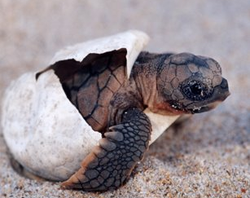
JOURNEY OF THE SEA TURTLE
Today’s lesson is about the journey of one loggerhead turtle. On her journey she encounters some dangers that are bother dangers in nature and dangers that are man made.

Slide 2
Learning intentions
Listening – students will listen to, and interpret, a story about a sea turtle
Reading – students will read along with the story Journey of the Sea Turtle
Writing – students will make predictions and write responses to provide a conclusion for the story
Speaking – students will participate in discussions
Social Studies– students will develop an awareness of the influence that humans have to the ocean environment
Today you will create pages for a class book. The page that you create will finish the story that you will listen to.

Slide 3
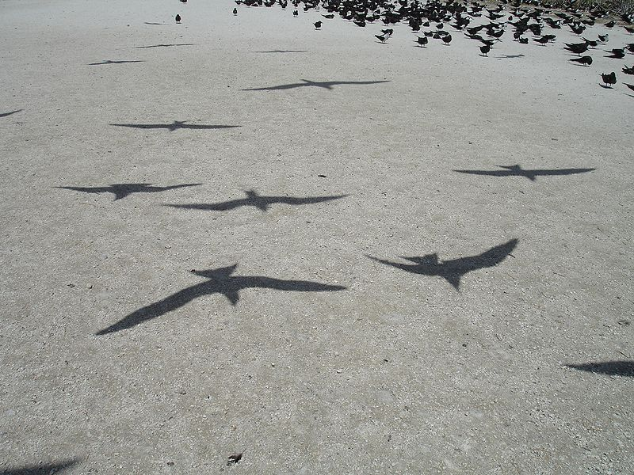
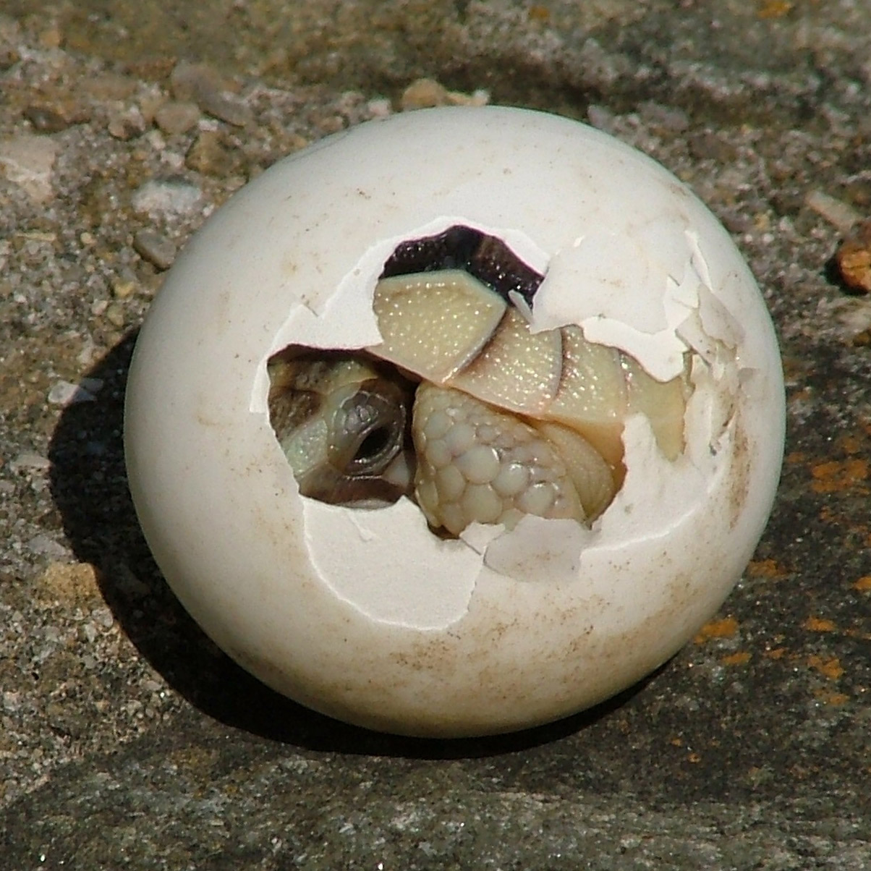
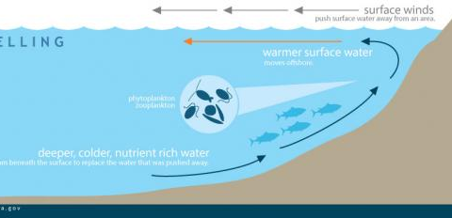
New vocabulary
Shadow birds - - birds that follow, or fly over the turtles casting a shadow
hatchling - a baby that has just been hatched
ancestors - the turtles that are mothers or fathers or grandparents
currents - the way in which the ocean moves
This Photo by Unknown author is licensed under CC BY-NC-ND.
This Photo by Unknown author is licensed under CC BY-SA.

Slide 4
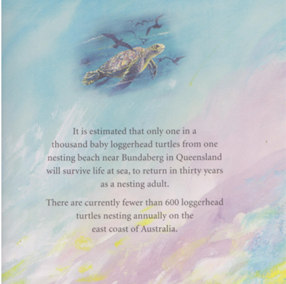

Slide 5
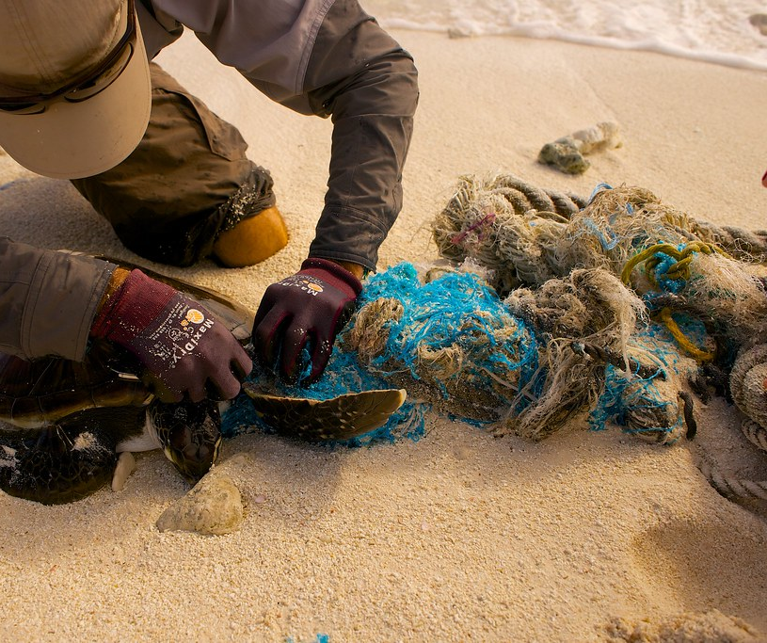
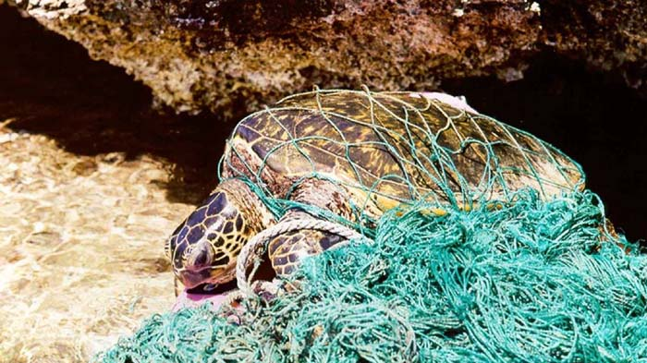
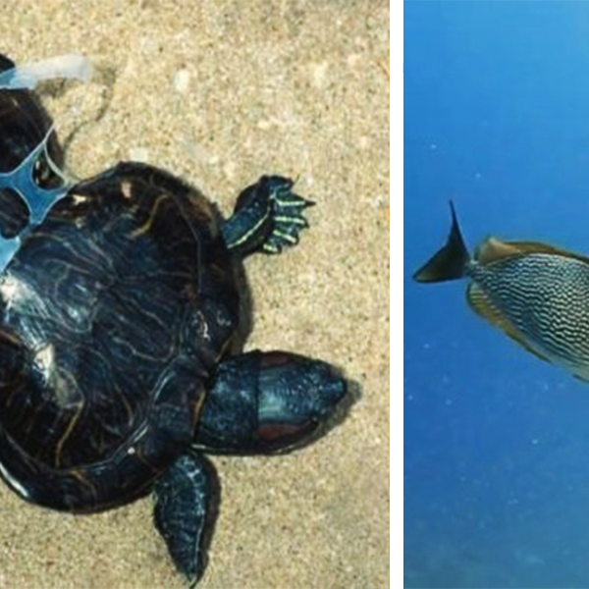
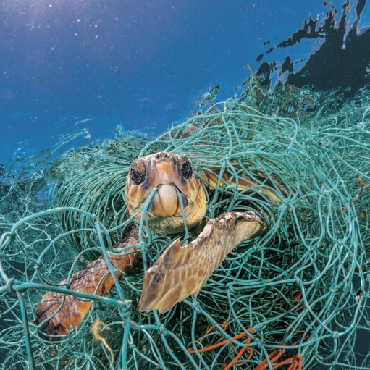
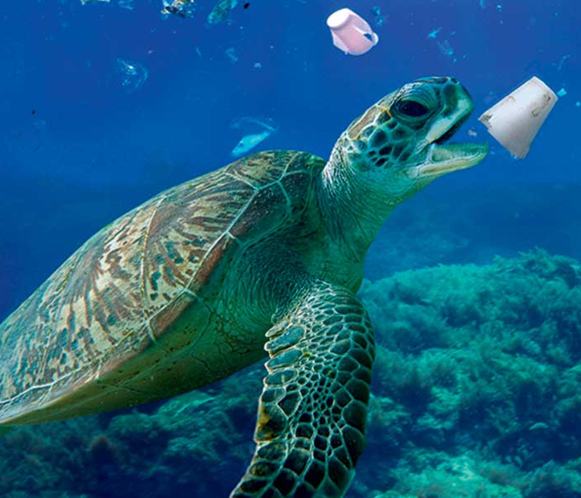
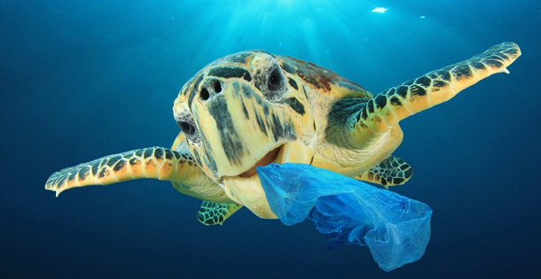
This Photo by Unknown author is licensed under CC BY-SA.
This Photo by Unknown author is licensed under CC BY.
This Photo by Unknown author is licensed under CC BY-SA-NC.
This Photo by Unknown author is licensed under CC BY.
This Photo by Unknown author is licensed under CC BY-ND.
This Photo by Unknown author is licensed under CC BY-NC-ND.

Slide 6
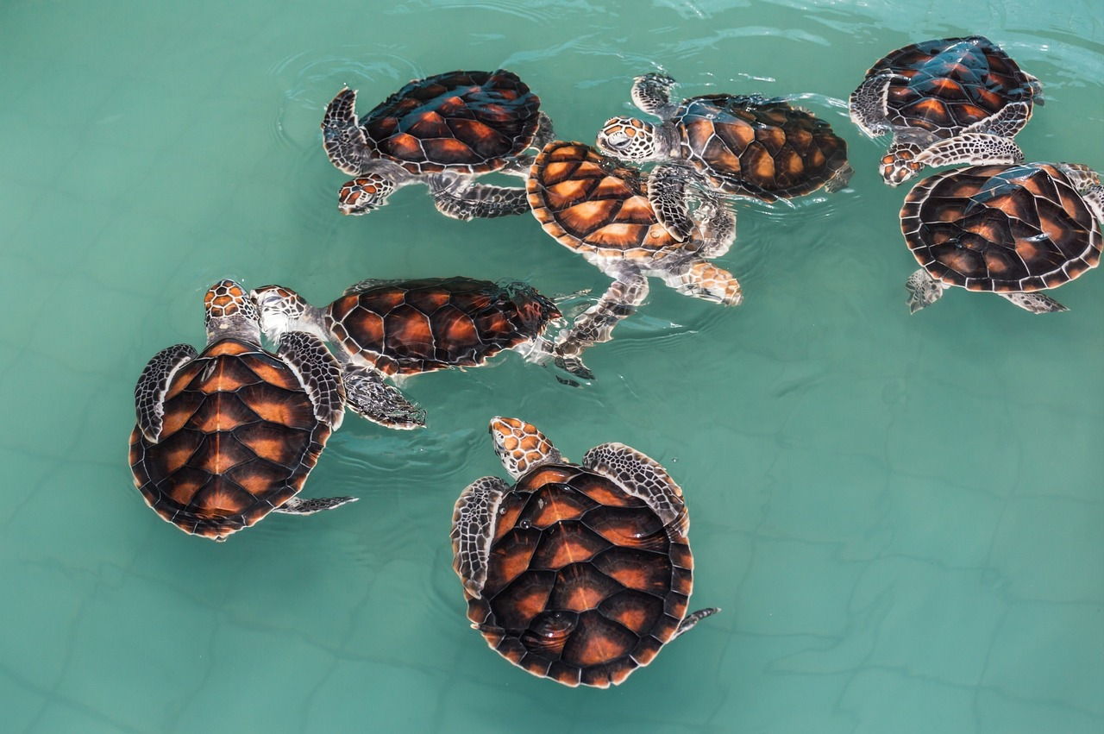
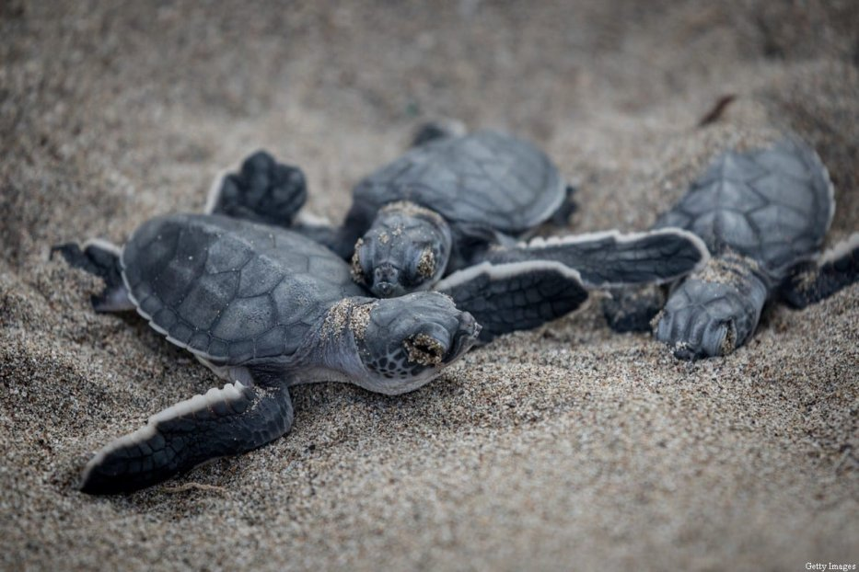
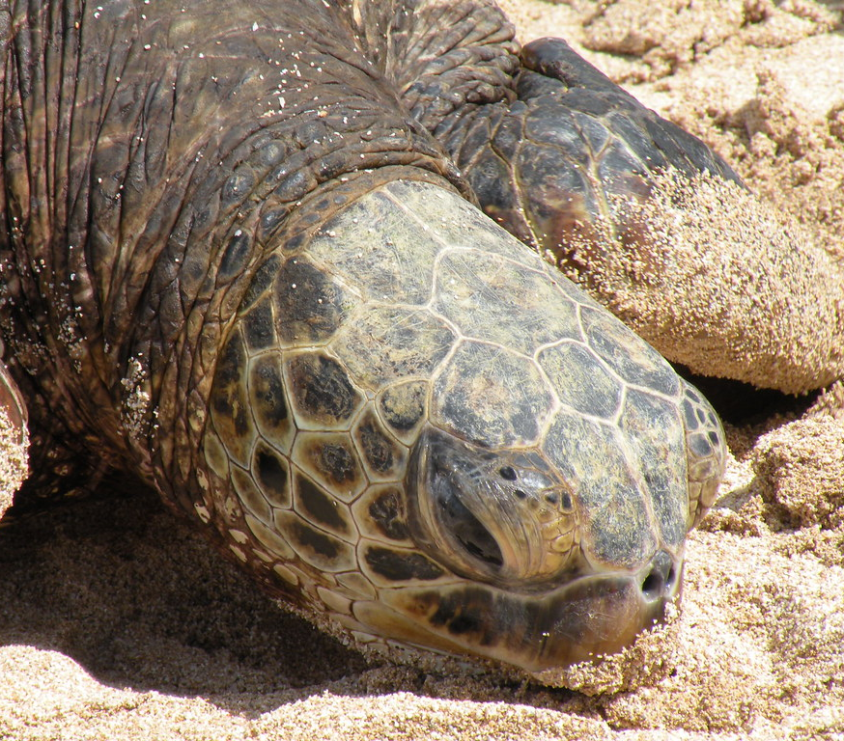
This Photo by Unknown author is licensed under CC BY-ND.
This Photo by Unknown author is licensed under CC BY-SA-NC.
This Photo by Unknown author is licensed under CC BY-NC-ND.

Slide 7
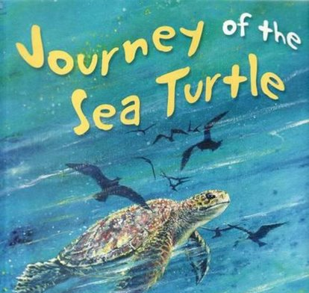

Slide 9
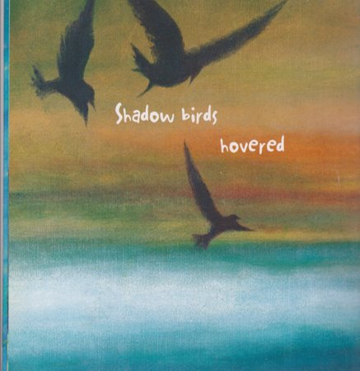

Slide 10
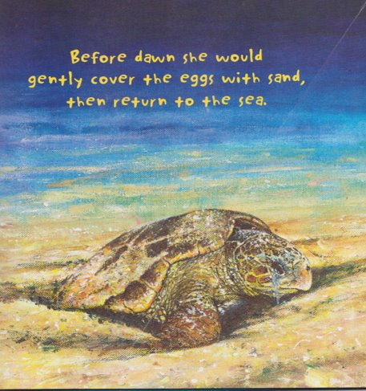

Slide 11
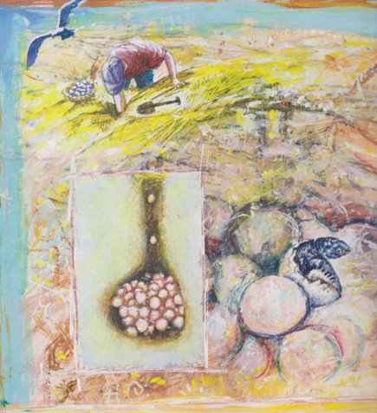

Slide 12
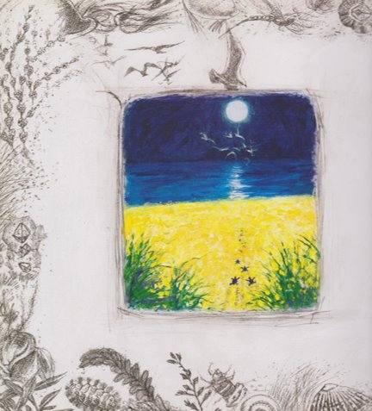

Slide 13
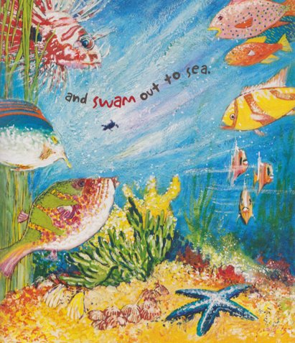

Slide 14
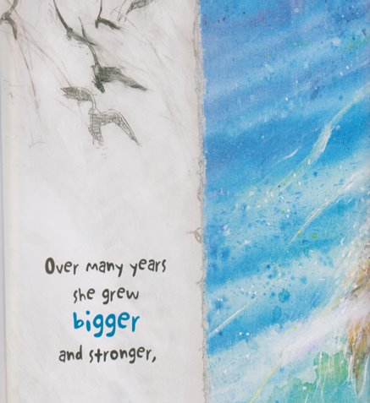

Slide 15
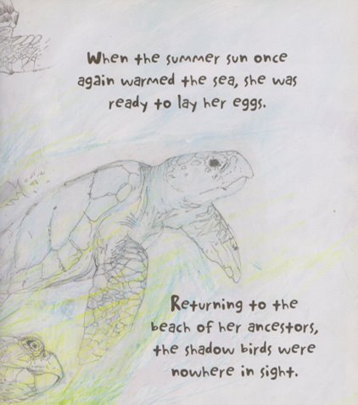

Slide 16
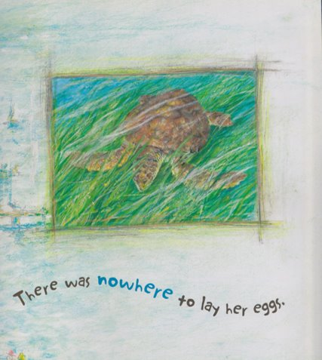

Slide 17
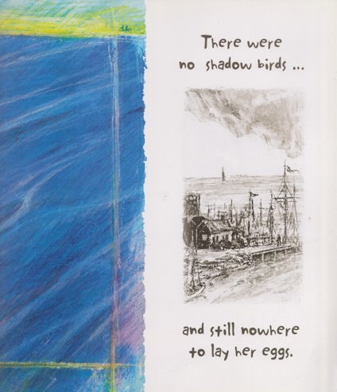

Slide 18
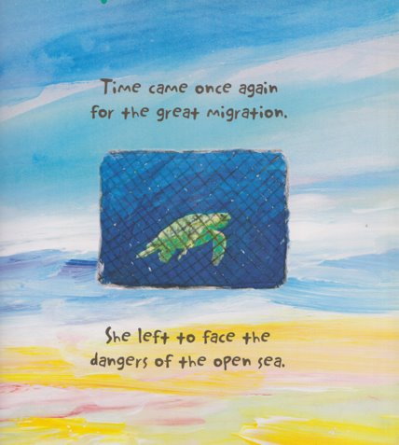

Slide 19
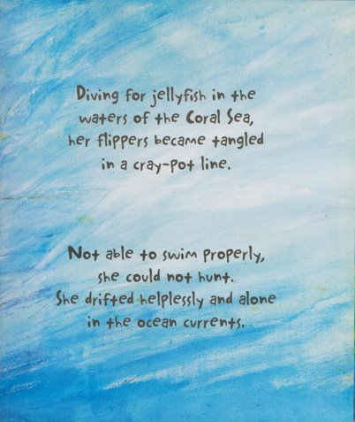

Slide 20
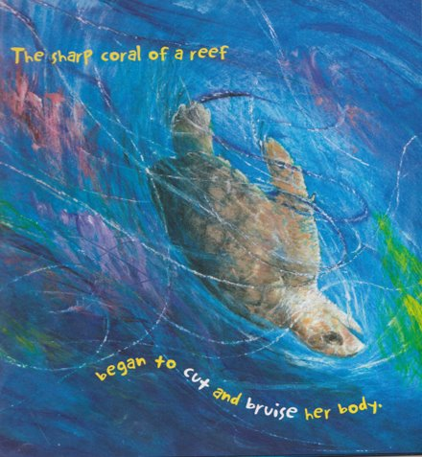

Slide 21
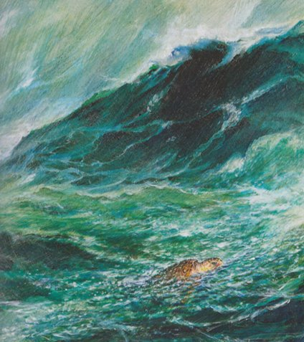

Slide 22
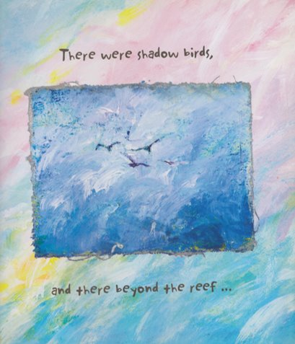

Slide 23
What do you think will happen next?​
What will be beyond the reef?

Slide 24
Worksheet
When the storm passed
She looked up to the sky
There were shadow birds , and there beyond the reef she could see …………………………………………………………………………………………………………………………………………………………………………………………………………….
Name:

