Slide 1
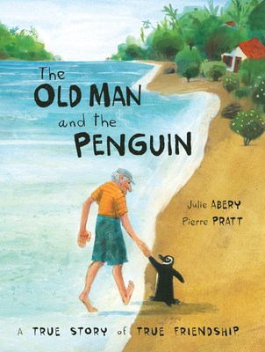
Dangers to wildlife The Old Man and the Penguin
Lesson 1
Notes:
Students will need a copy of the worksheet and writing and drawing materials.

Slide 2
Learning intentions
Listening - students will listen to a story written in poetry style
Speaking – students will participate in a discussion with a partner
Reading – students will present their work orally
Writing – students will devise a plan for maintaining a safe environment for birds
Science – Students will develop a better understanding of the environmental risks to habitat and livelihood that birds encounter– pollution, deforestation, chemicals, predators
Today you will work with a partner to develop a tool box of ideas that you could implement to ensure that your village/island is safe for birds.

Slide 3
NEW VOCABULARY
instinct - a response to a situation without giving thought
chemicals – something that cannot be broken down without changing it into something else eg. Water, oxygen, gold
predators – an animal that lives by killing and eating other animals
deforestation – clearing or cutting down of forests by humans
pollution – anything that makes the earth dirty or unhealthy

Slide 4
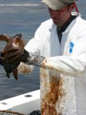
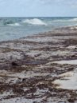
Pollution – oil spills

Slide 5
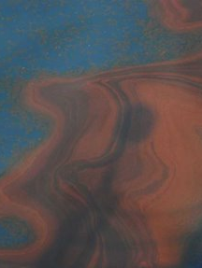
Pollution – putting chemicals into water ways

Slide 6
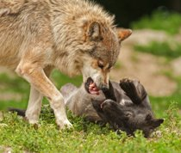
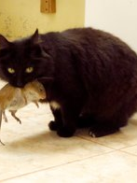
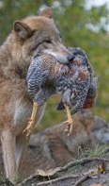
Predators

Slide 7
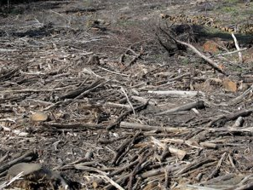
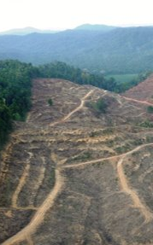
Deforestation

Slide 8
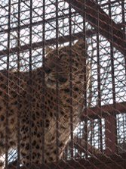
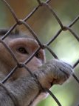
Taking wildlife as pets

Slide 9
https://www.youtube.com/watch?v=CYqsbjAr6vw

Slide 10
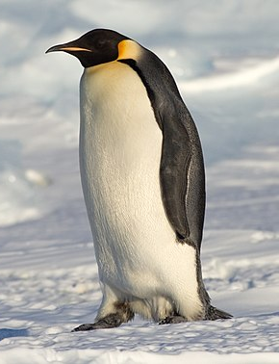
What happened to the penguin?
What did the old man do?
How did the old man look after the penguin?
This Photo by Unknown author is licensed under CC BY-SA.

Slide 11
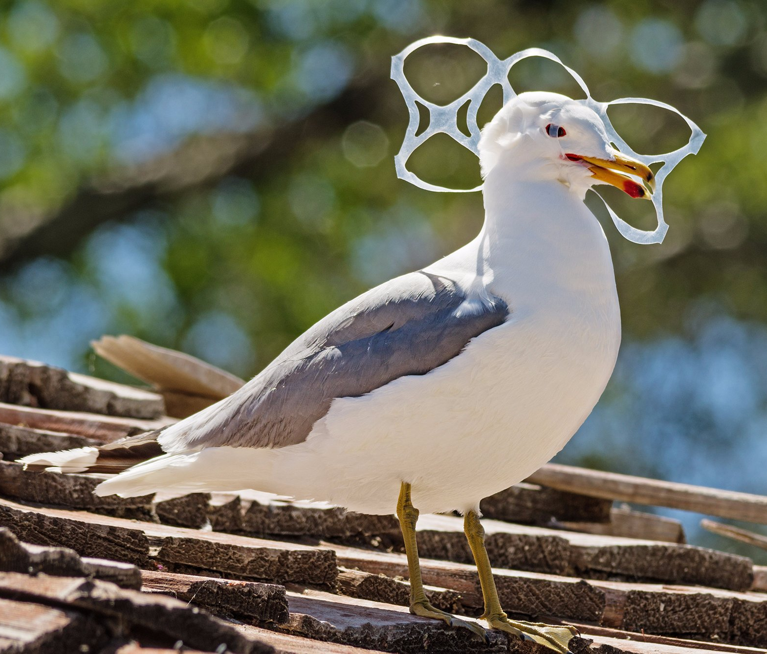
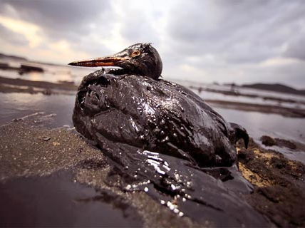
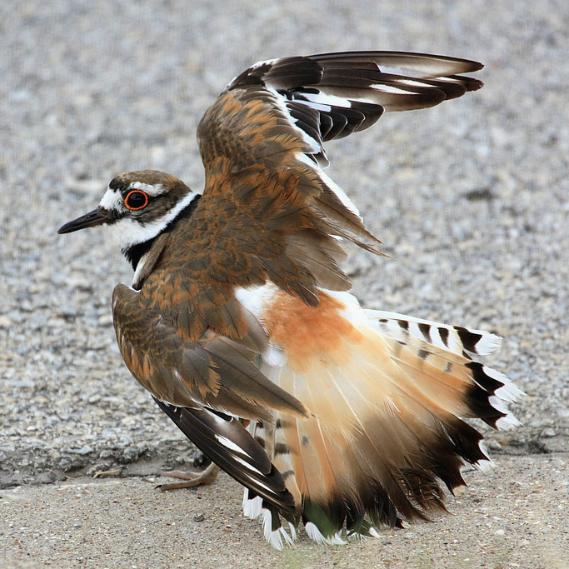
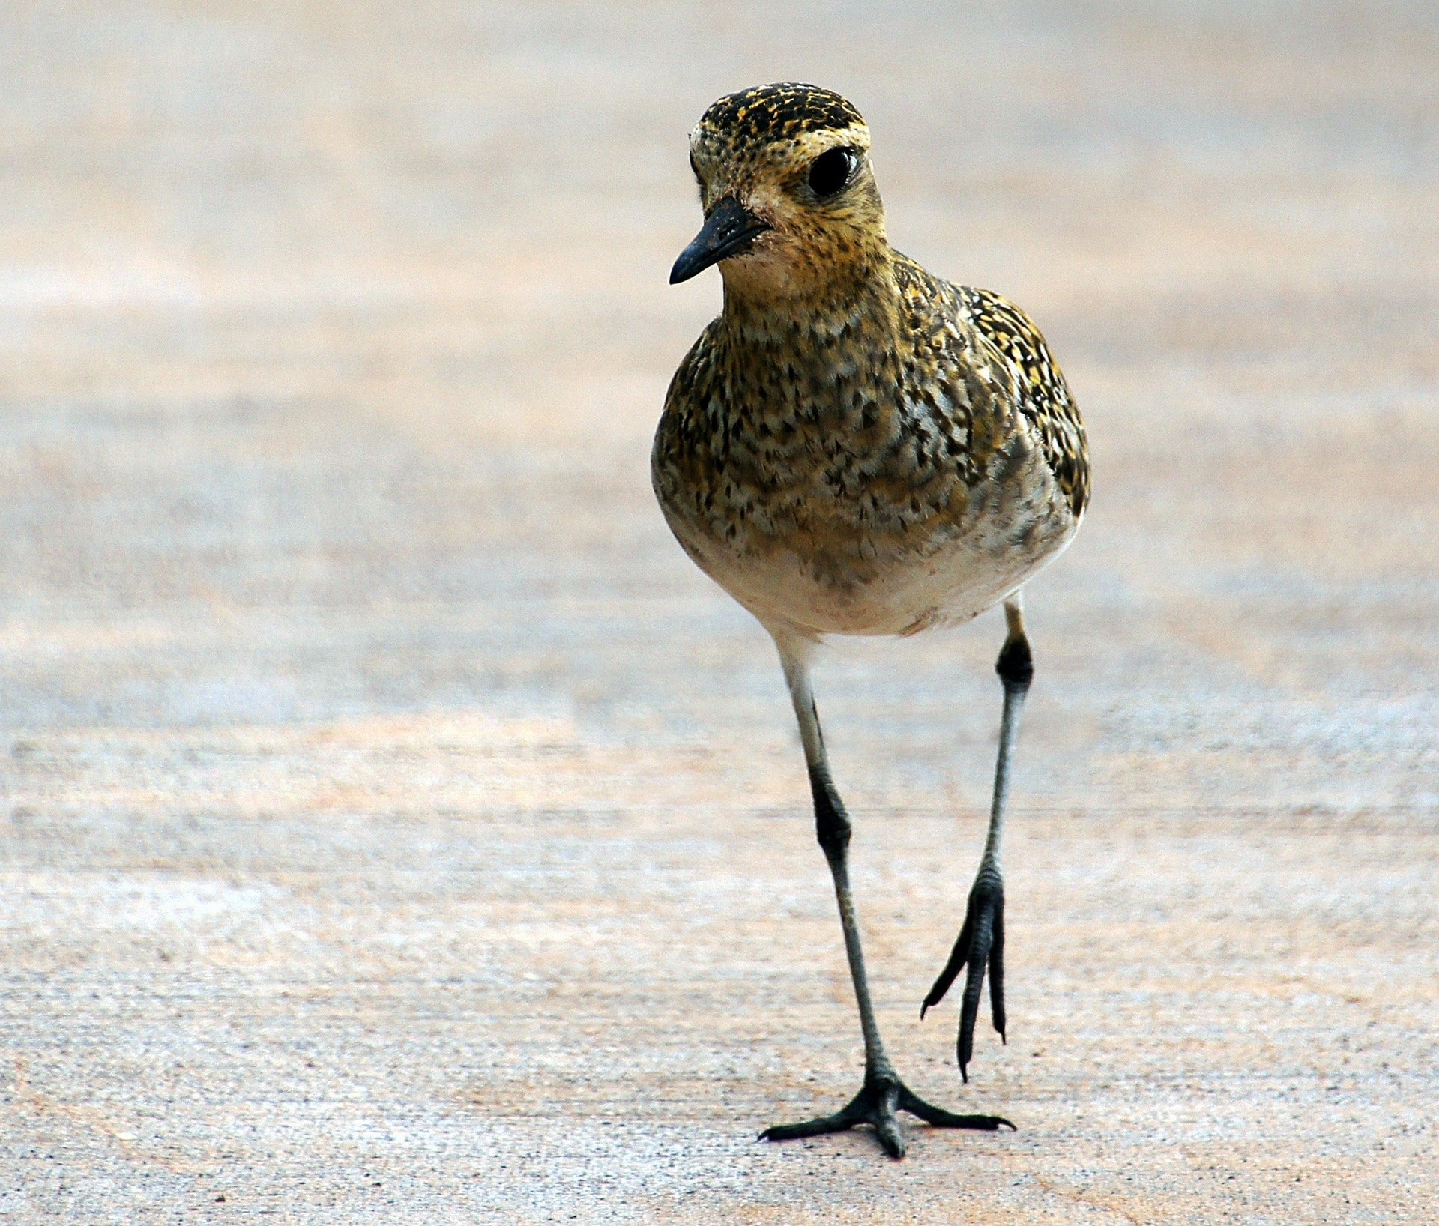
. What would you do if a bird was injured at, or near your home?
. Who could help you?
. What things would you need to use to help an injured bird?
This Photo by Unknown author is licensed under CC BY-SA.
This Photo by Unknown author is licensed under CC BY-NC.
This Photo by Unknown author is licensed under CC BY-NC-ND.

Slide 12
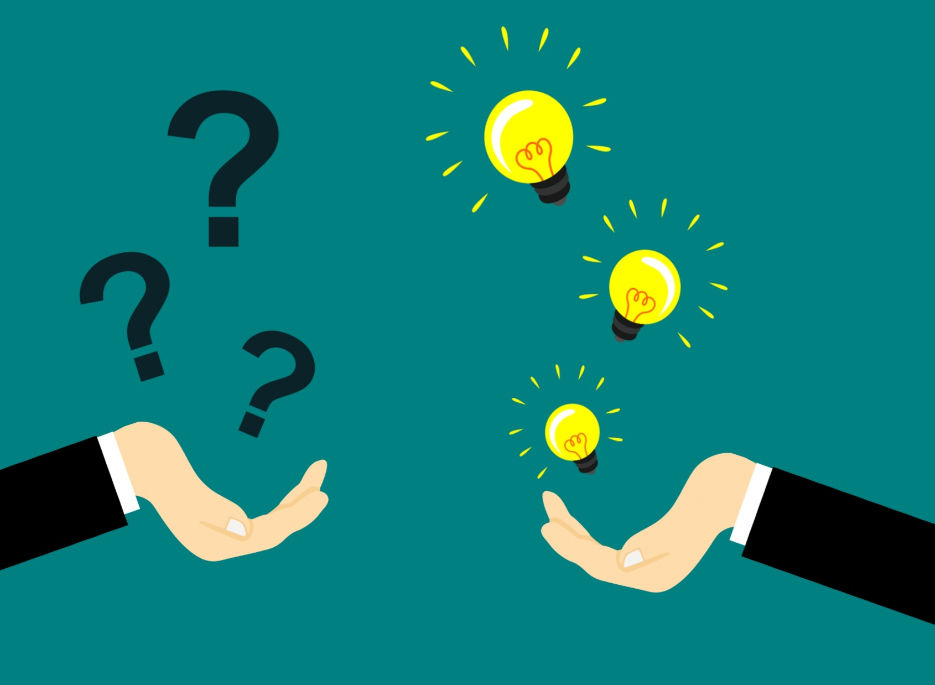
What can you do to care for an injured animal?

Slide 13
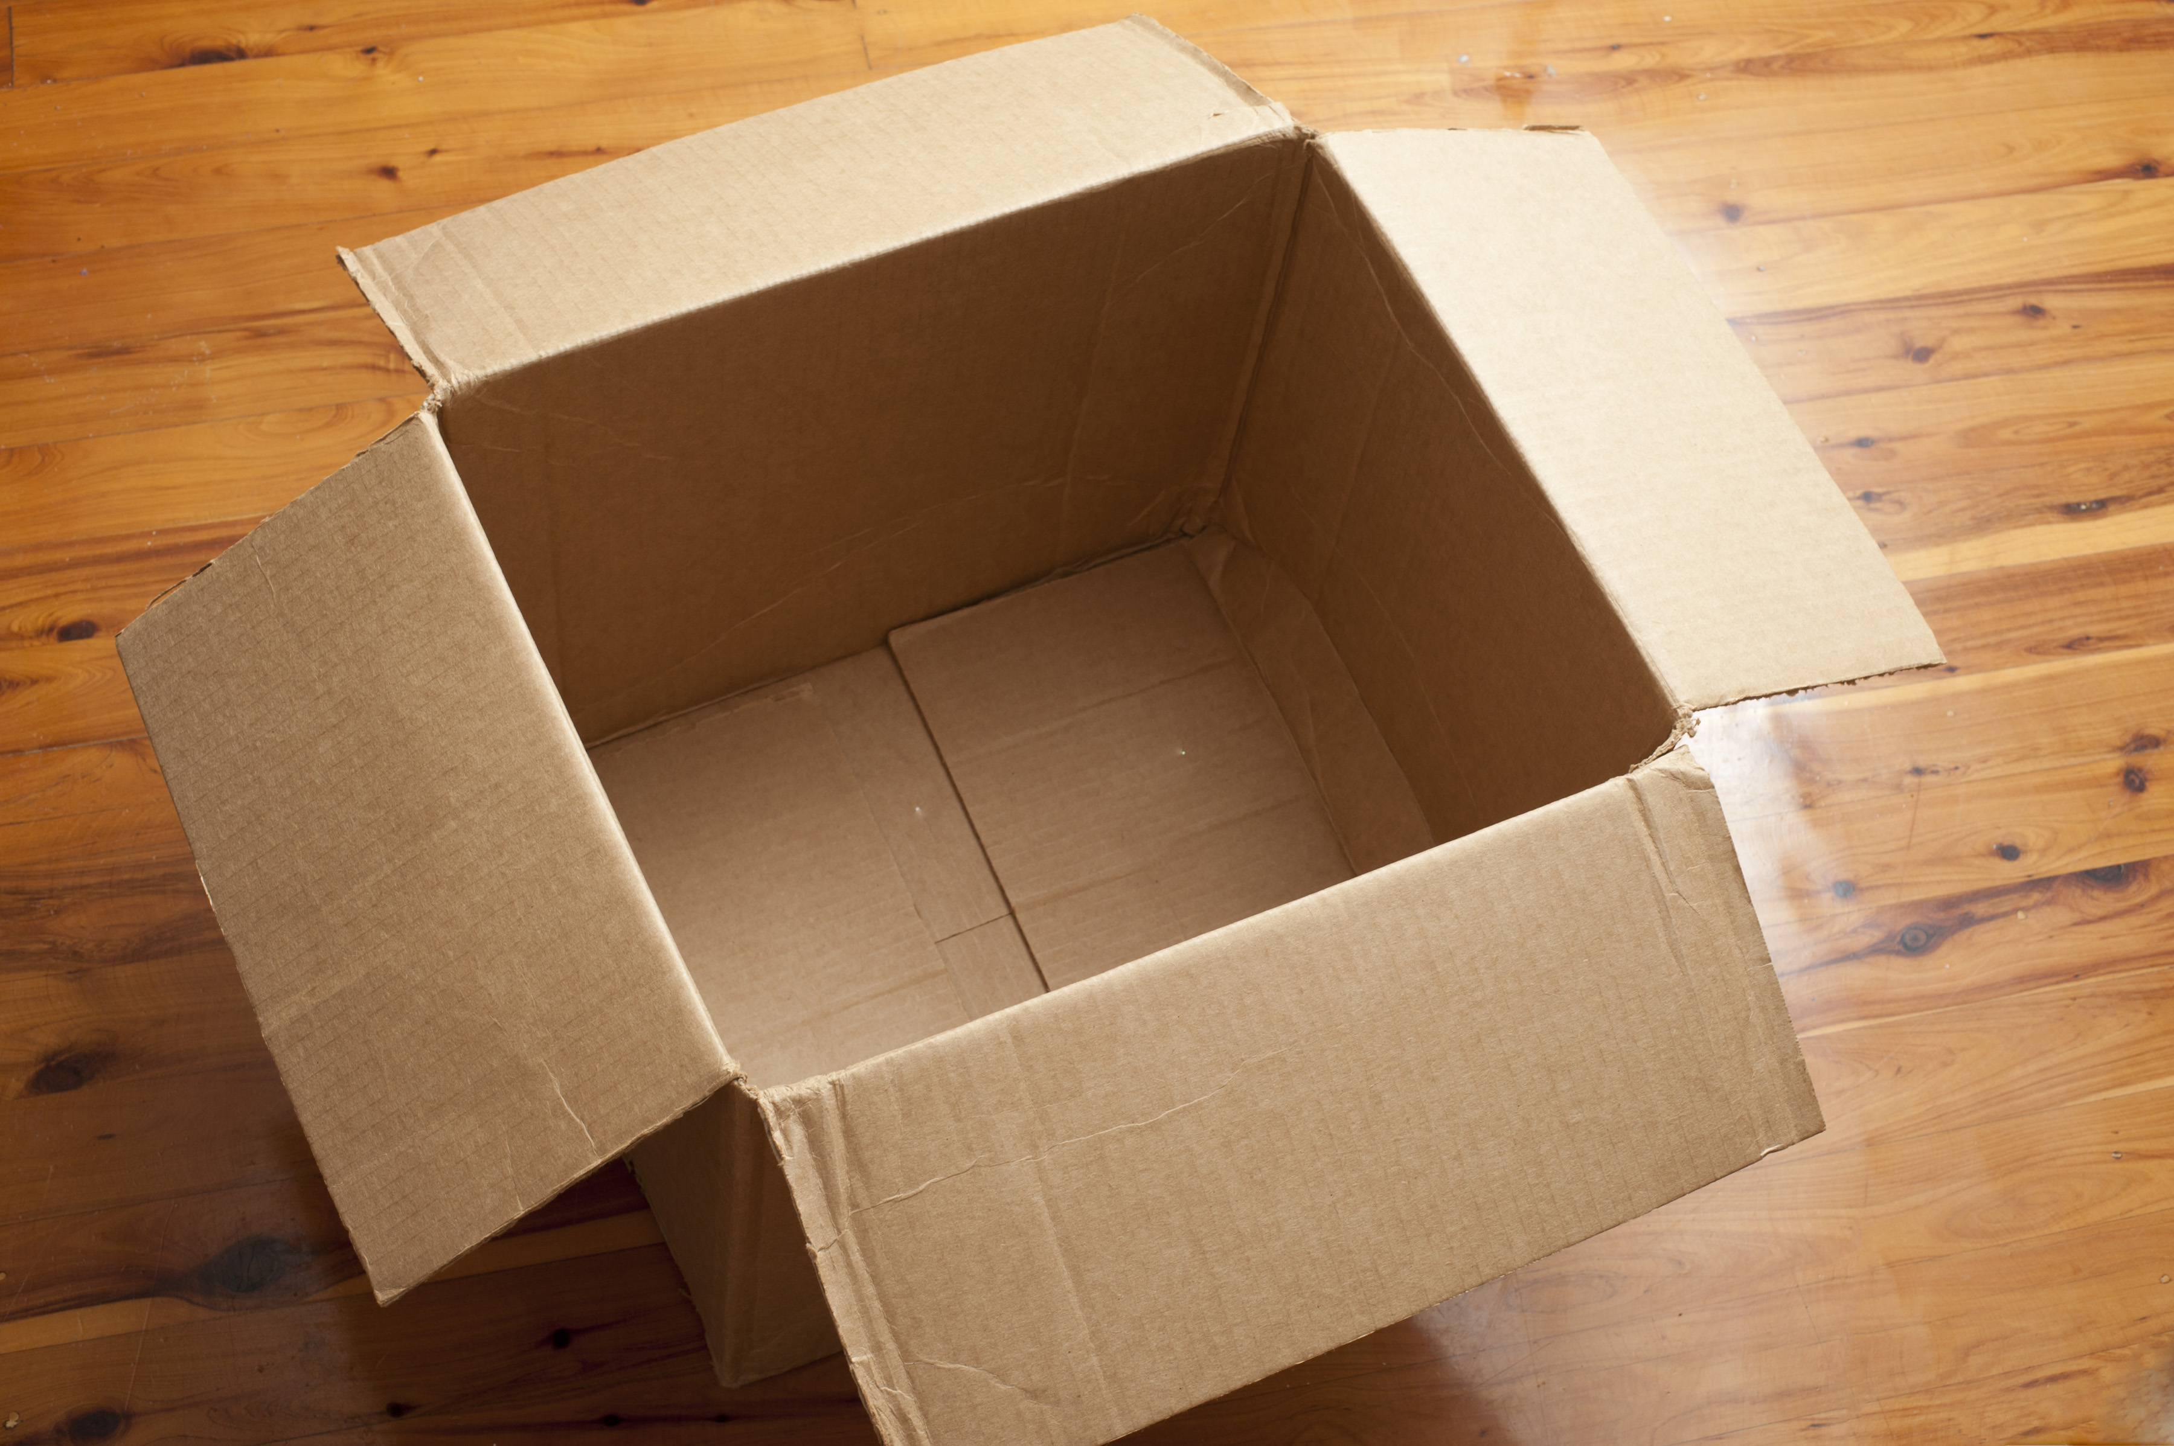
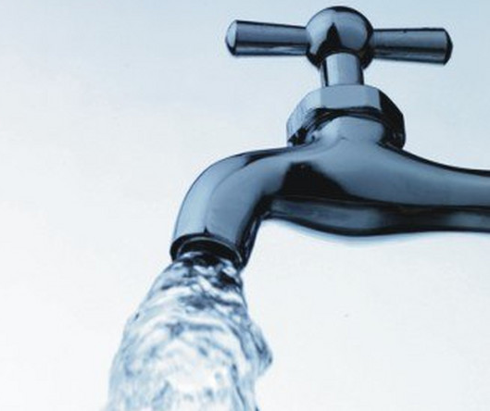
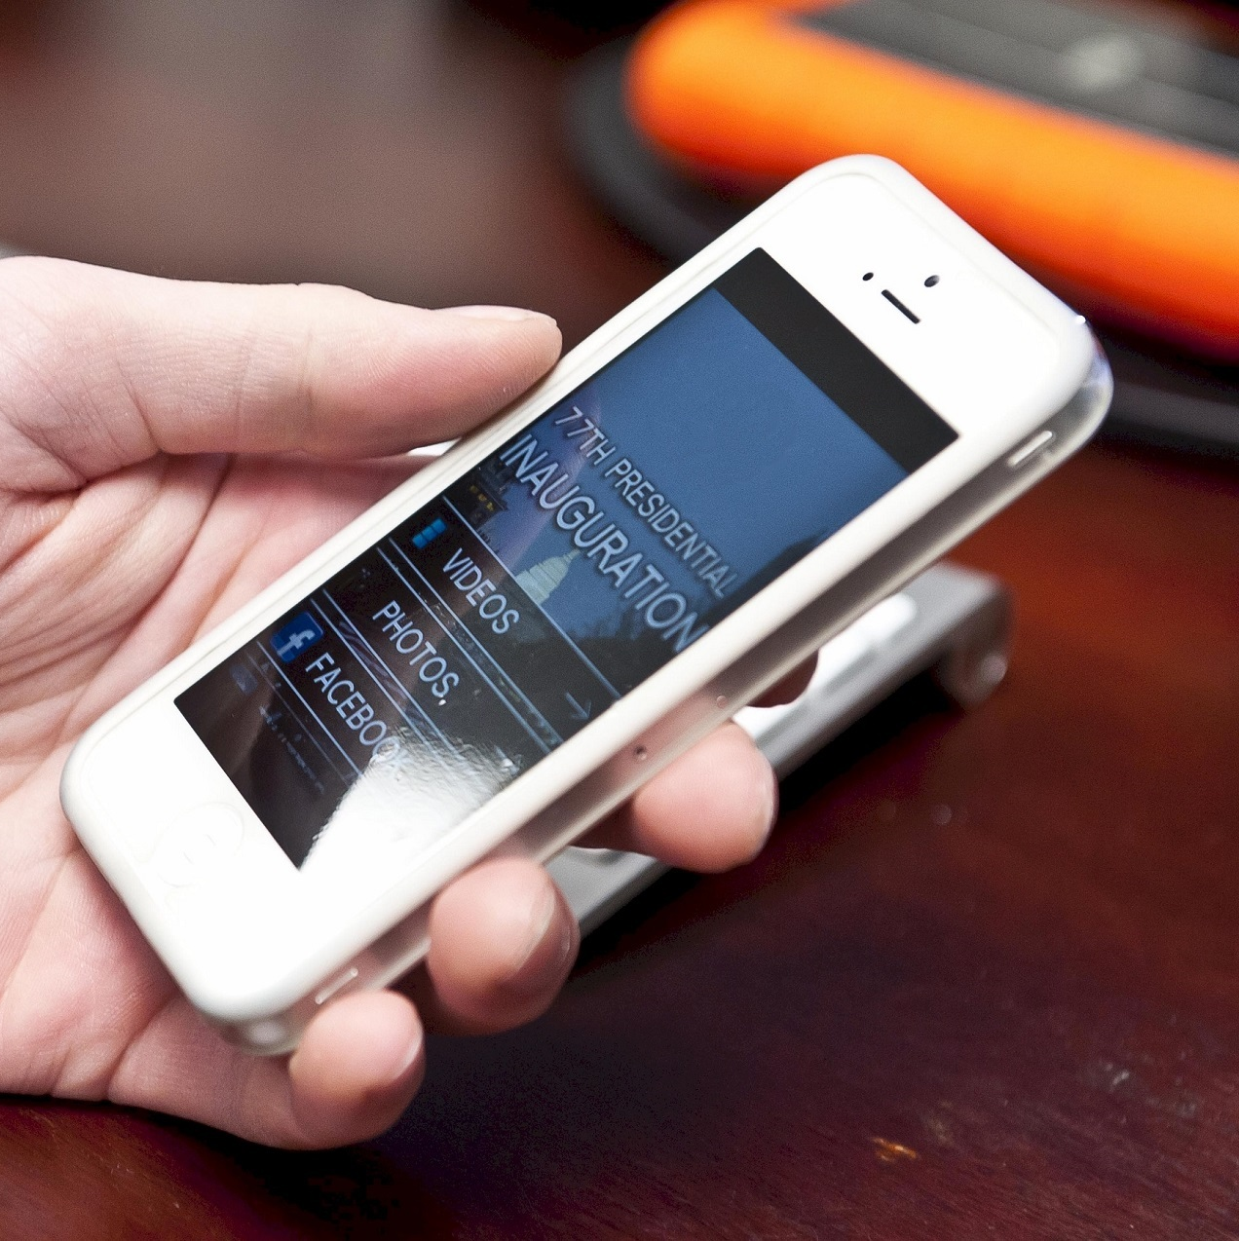
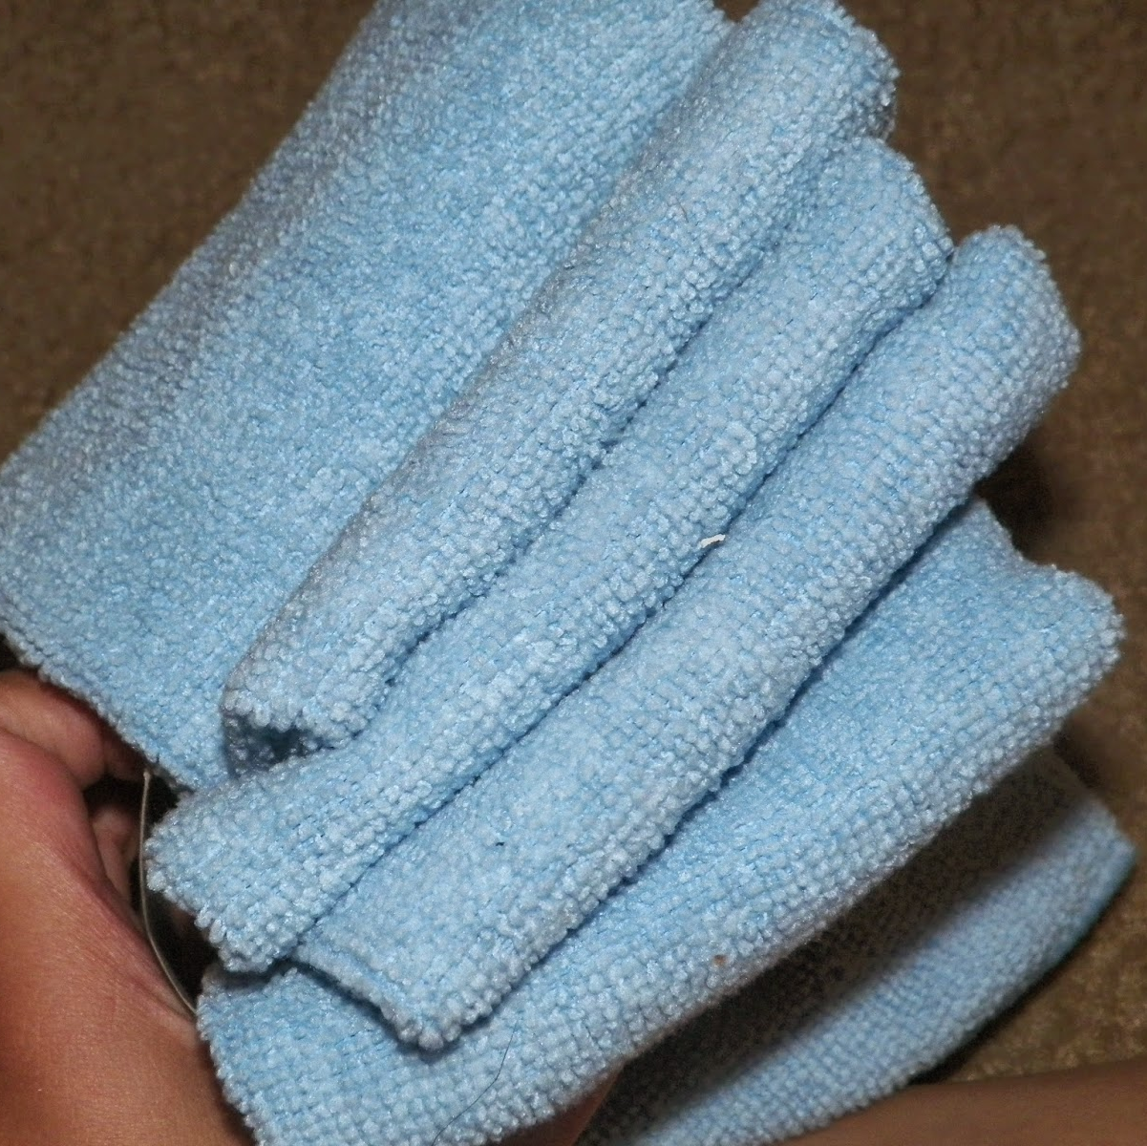
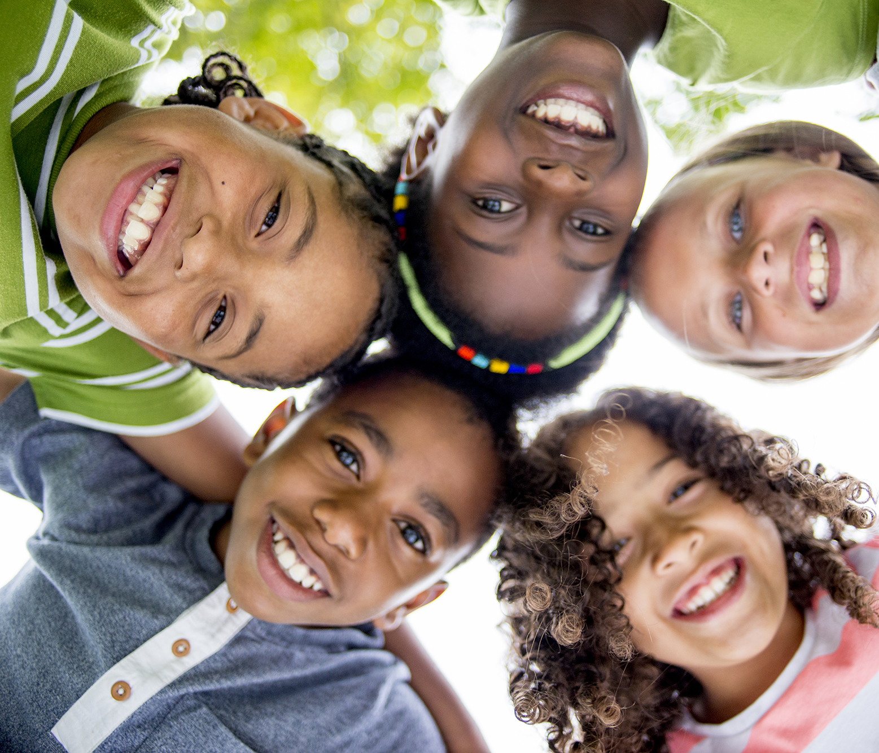
This Photo by Unknown author is licensed under CC BY-SA.
This Photo by Unknown author is licensed under CC BY.
This Photo by Unknown author is licensed under CC BY.
This Photo by Unknown author is licensed under CC BY.
This Photo by Unknown author is licensed under CC BY-SA-NC.

Slide 14
LESSON 1
In my tool box I will have:
1._______________2._______________
3._______________ 4._______________
The ________ will be used to _________________________ | The _________ will be used to _________________________
The _________ will be used to ________________________ | The _________ will be used to ________________________

Slide 15
This Photo by Unknown author is licensed under CC BY.

