Slide 1
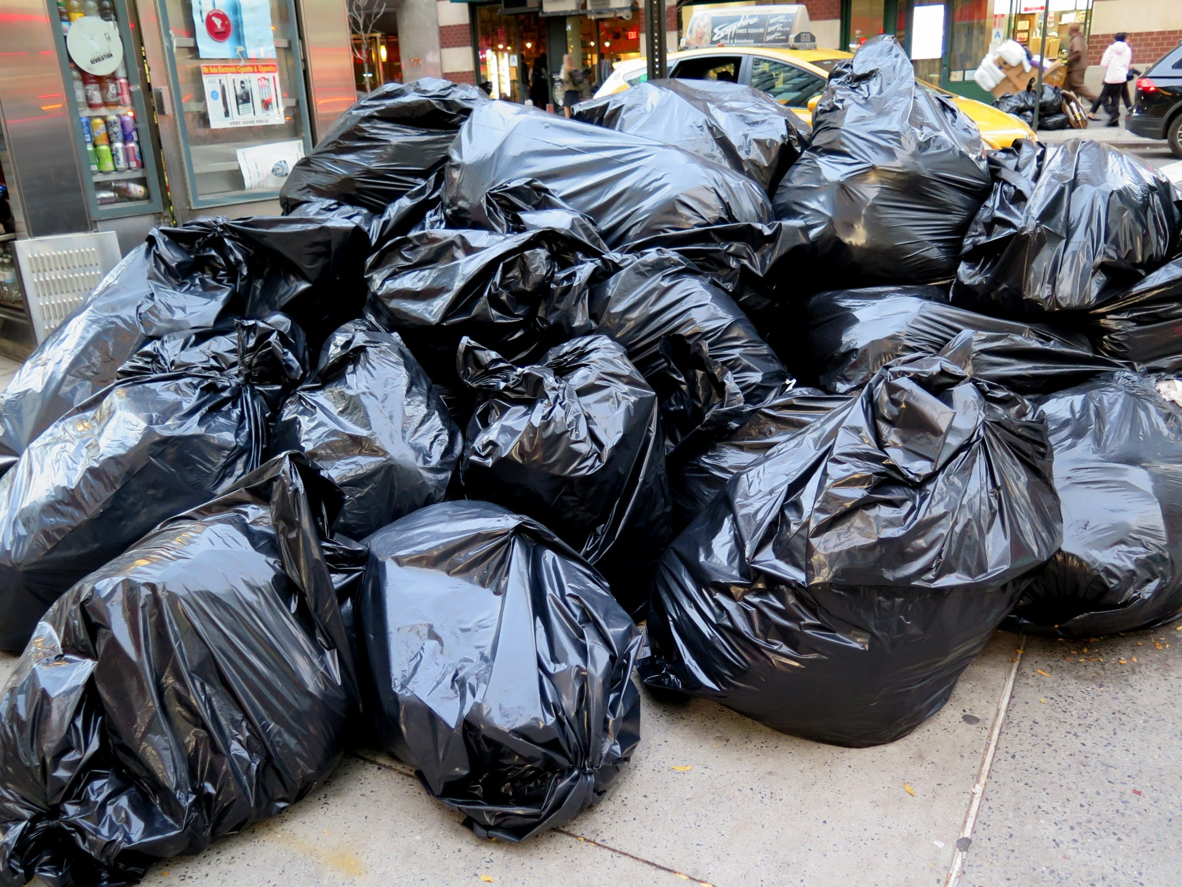
WHERE DOES YOUR GARBAGE GO?

Slide 2
Learning intentions
Language
Writing – students will write a series of responses to explain what happens to garbage
Speaking – students will participate in discussions
Social studies – students will understand the consequences of actions in regard to garbage
Science – students will develop an understanding of the management of garbage
Today you will document the journey that your garbage takes in your community

Slide 3
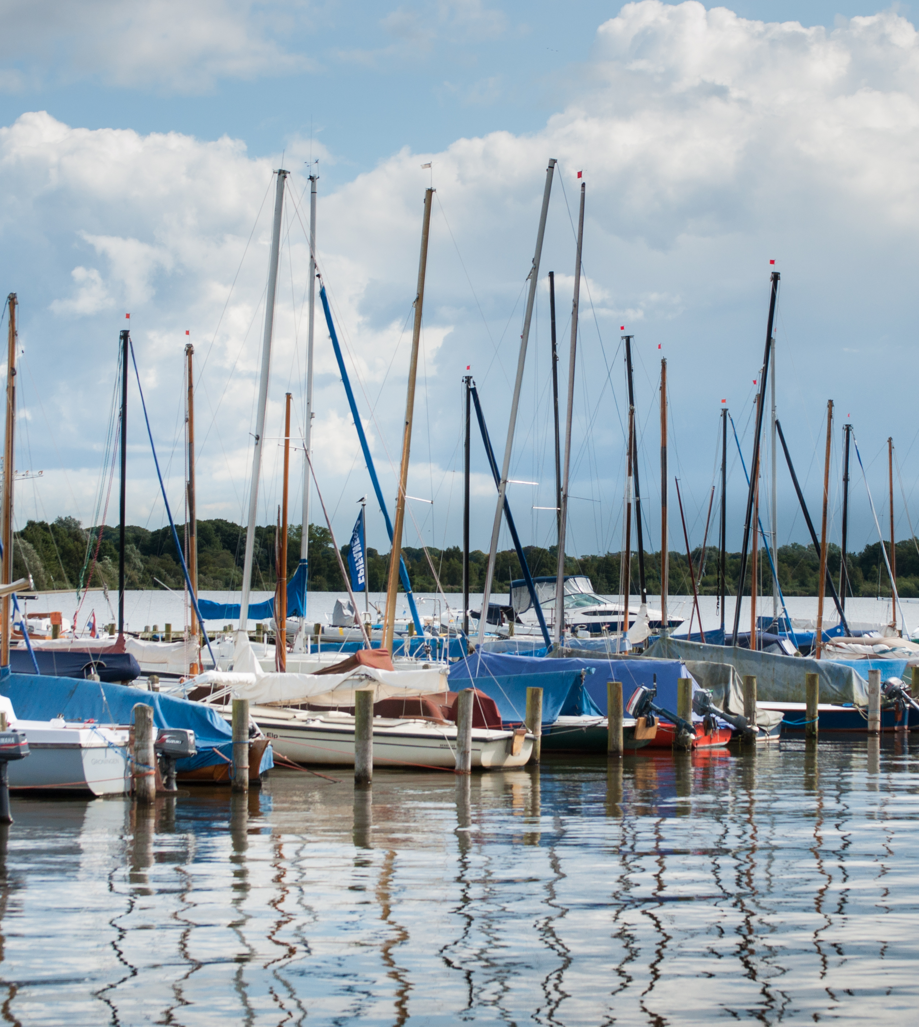
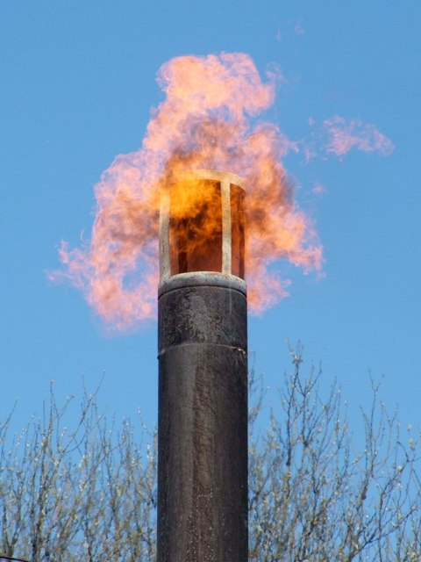
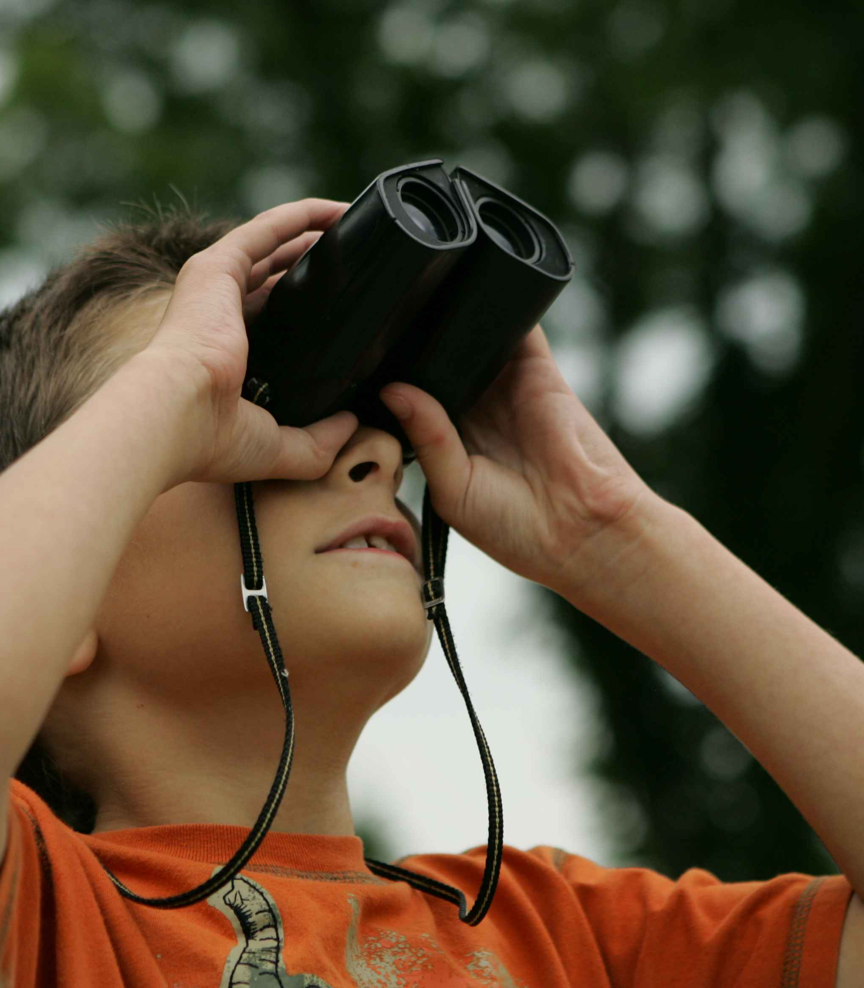
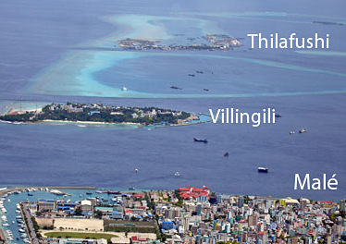
New vocabulary
Garbage barge – a flat boat that transports garbage
Tug boat – a small boat that is used to tow larger boats
Binoculars - a tool for people to use so that they can see long distances
Harbor - a safe place for boats to stay
Stink – a bad smell
Incinerator – an extremely hot fire
Landfill – a place where garbage is dumped to build up low-lying land or in the ocean
This Photo by Unknown author is licensed under CC BY.
This Photo by Unknown author is licensed under CC BY-SA.
This Photo by Unknown author is licensed under CC BY.

Slide 4
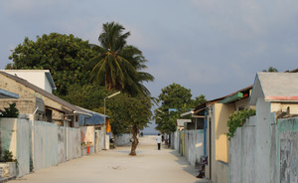
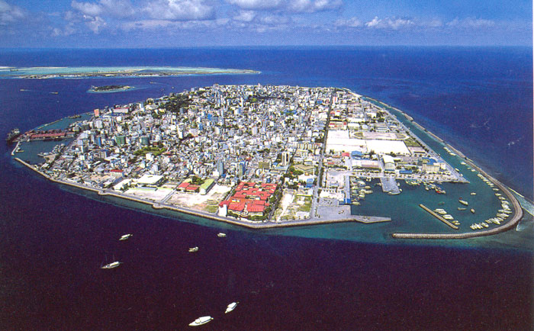
Where does all of the garbage go from these communities?
This Photo by Unknown author is licensed under CC BY-NC.
This Photo by Unknown author is licensed under CC BY-SA.
Notes:
Do you live in a village or a large city?

Slide 5
Where does this garbage go?
This Photo by Unknown author is licensed under CC BY-ND.

Slide 6
Where is this garbage barge going to?
This Photo by Unknown author is licensed under CC BY-SA-NC.

Slide 7
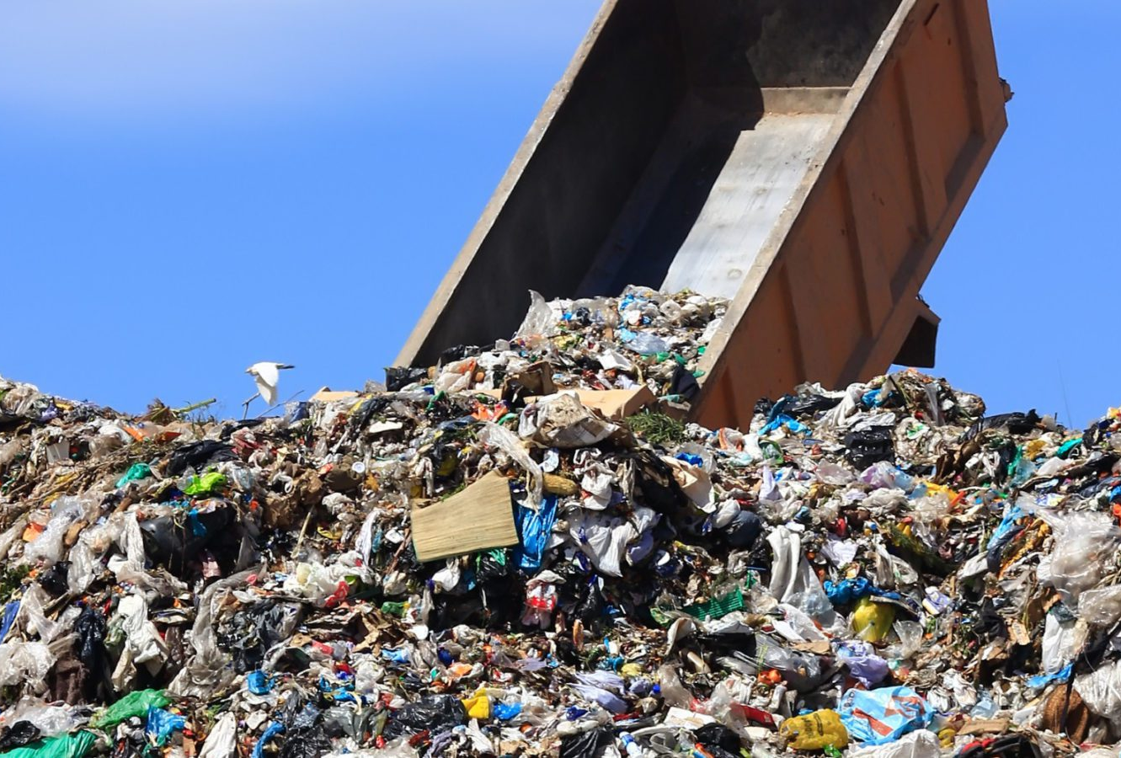
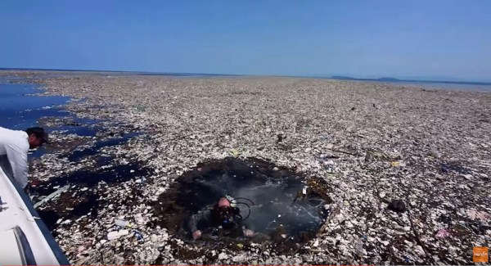
What happens to the garbage now?
This Photo by Unknown author is licensed under CC BY-ND.
This Photo by Unknown author is licensed under CC BY-NC.

Slide 8
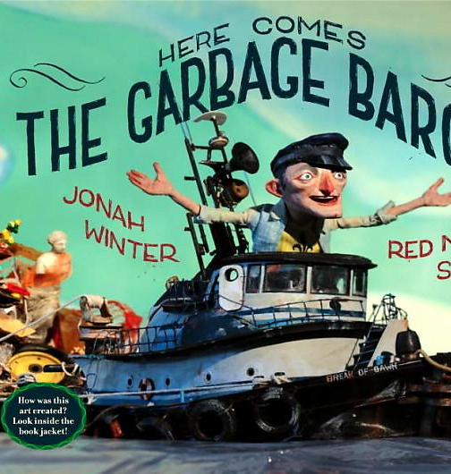
What is going to happen in this story?
https://www.youtube.com/watch?v=Xb3bXKAkeek

Slide 9
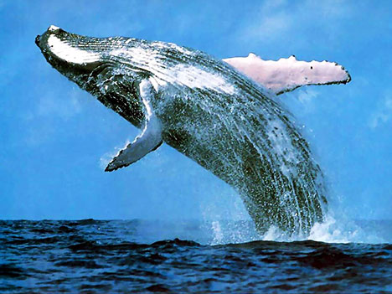
What does 3000 tons look like?
A blue whale can grow to be 30 metres long and weigh 150 tons. 20 Blue Whales would weigh approximatley 3000 tons!
This Photo by Unknown author is licensed under CC BY-SA-NC.

Slide 10
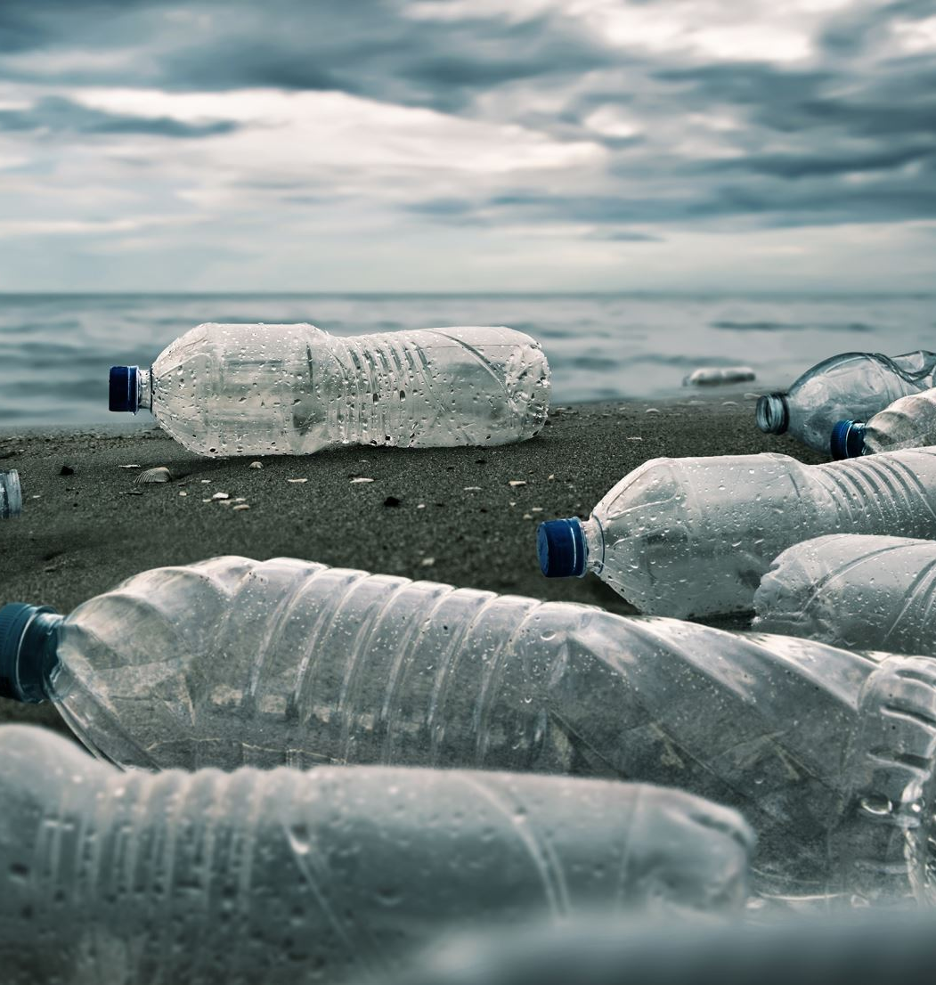
What happened in this story?
Why wouldn’t different communites take the garbage?
What happened to the garbage in the end?

Slide 11
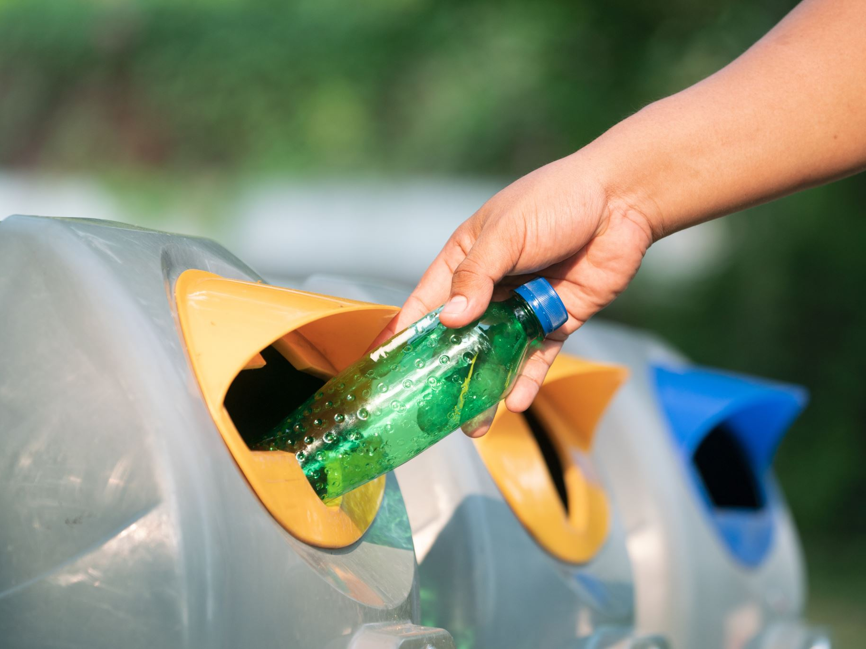
What is the message of the story
Don't
make
so
much
garbage

Slide 12
How would you feel if garbage was dumped beside your house?
What would you do?
This Photo by Unknown author is licensed under CC BY-NC.

Slide 13
THE GARBAGE JOURNEY.
WHERE DOES YOUR GARBAGE GO?
WHAT HAPPENS TO IT IN THE END? Write and illustrate your responses
1. First ________________________________________________________________
2. Then________________________________________________________________
3. Then_________________________________________________________________
4. Finally__________________________________________________________________

