Slide 1
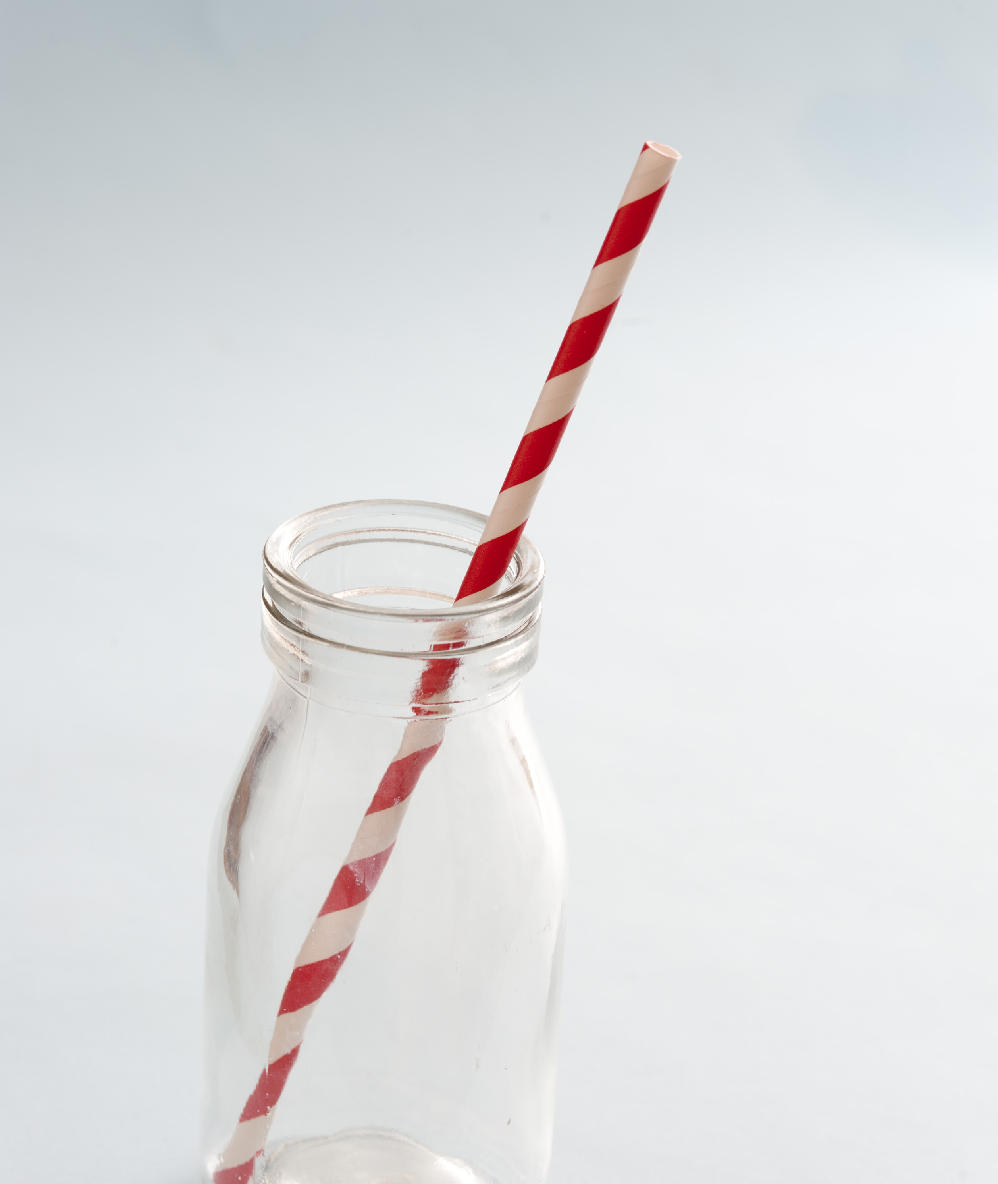
The Last Straw Lesson 2
This Photo by Unknown author is licensed under CC BY.

Slide 2
This lesson is about:
Our impact on the environment
Meaning of ‘the last straw’.
When you become really upset about something and think that you can't do anything more.
BUT
you can decide to do something to make a change and make things better.
This Photo by Unknown author is licensed under CC BY-SA-NC.

Slide 3
Learning intentions
Listening – students will listen to a story
Speaking – students will participate in discussions
Writing – students will write a list
Environmental awareness – students will develop an awareness of plastic items in their environment
Social studies – students will develop an understanding that their actions can have an impact on their environment
Today you will write a letter to someone in your family or village. You will explain to them how you feel about your environment and suggest how you can go about making your environment a better, cleaner and healthier place for you all to live in.

Slide 4
New vocabulary
Extraction – taking something our of something
Production – the process of something being made
Emissions – something that has been released into the atmosphere
Green house gases – gases in the earth's atmosphere that trap heat
Bioplastics – a biodegradable material that is made from a renewable source eg corn, sugarcane

Slide 5
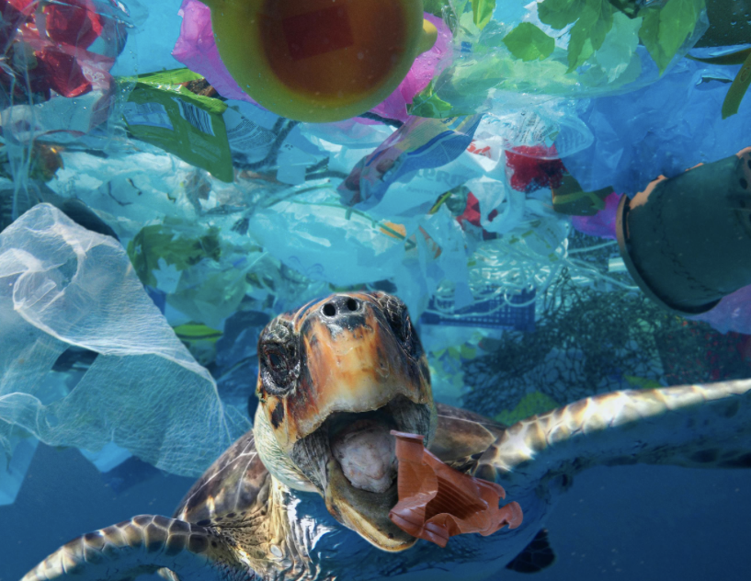
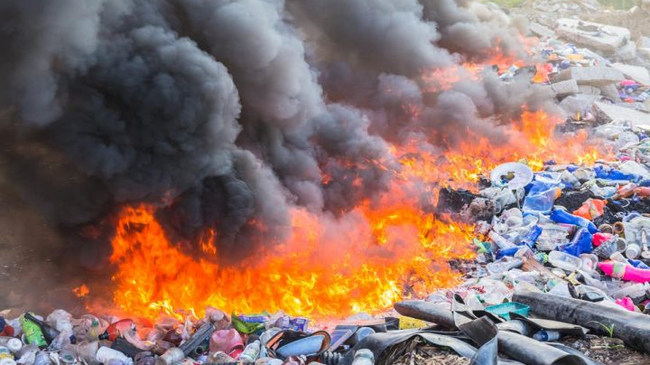
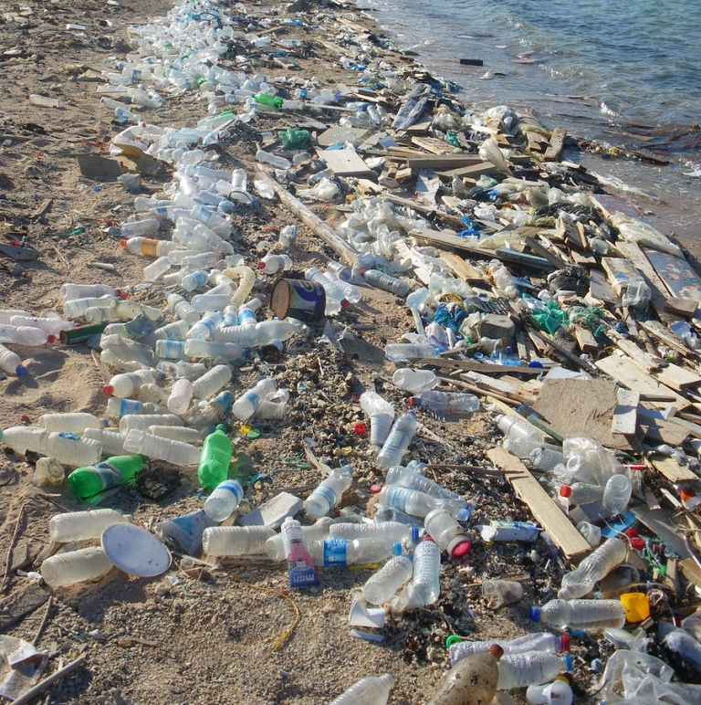
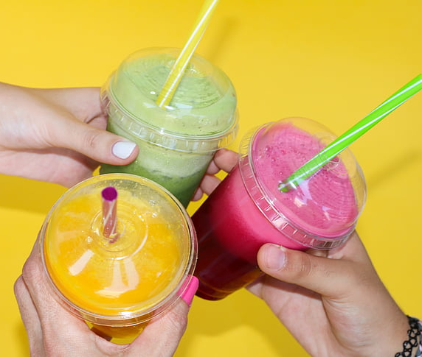
How do these pictures make you feel?
This Photo by Unknown author is licensed under CC BY.
This Photo by Unknown author is licensed under CC BY.
This Photo by Unknown author is licensed under CC BY-NC-ND.

Slide 6
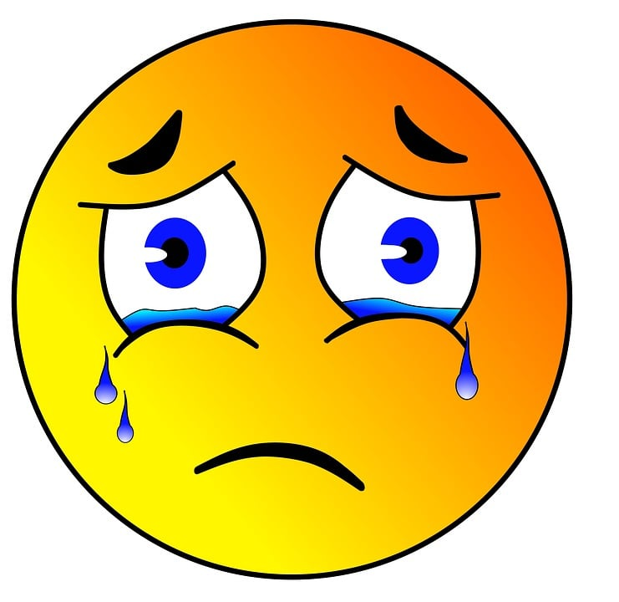
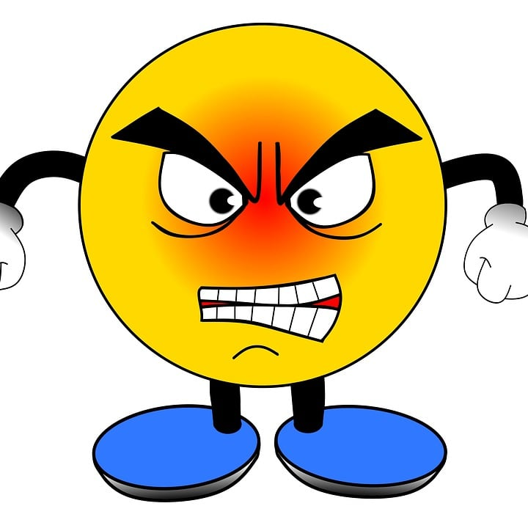
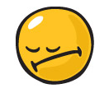
They make me feel
This Photo by Unknown author is licensed under CC BY-SA.

Slide 7
What do you know about plastic bags, plastic bottles and plastic straws?
Milo Cress, was 9 years old when he founded BeStrawFree.org said:​
‘When I first started this project, I thought that adults wouldn’t listen to what a kid has to say. But I found that being a kid can actually be an advantage. People are willing to listen to your ideas. And when you’ve gotten people to make a small change in their life, like using fewer plastic straws, or bags, or bottles, it makes them think about all the different ways they can make a change in their community.’
This Photo by Unknown author is licensed under CC BY-SA-NC.

Slide 8
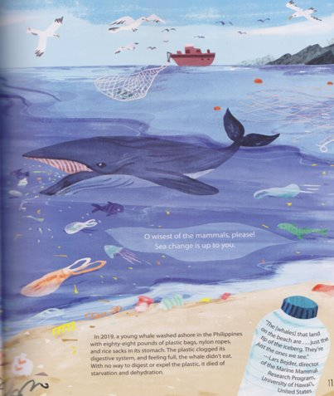

Slide 9
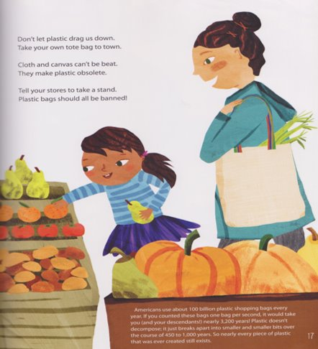

Slide 10
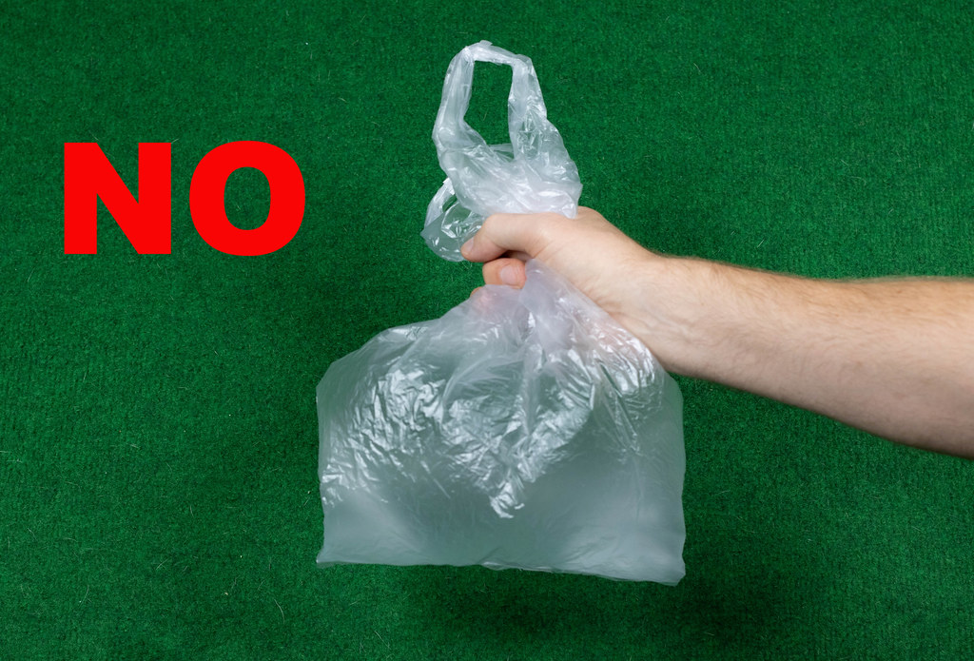
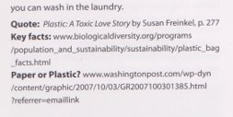
This Photo by Unknown author is licensed under CC BY.

Slide 11
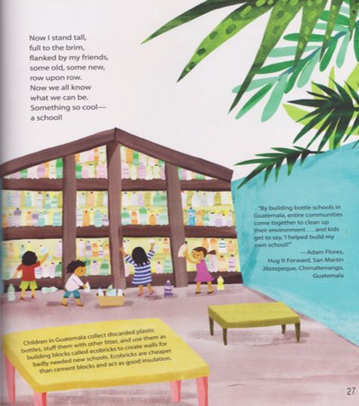

Slide 12
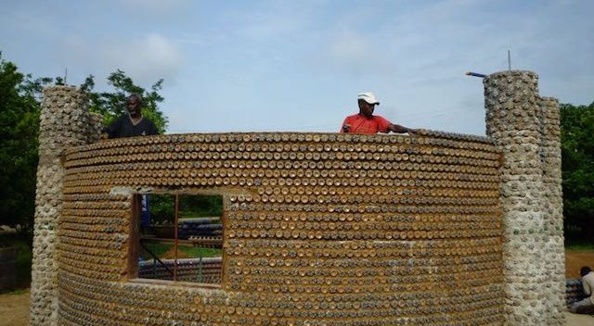
What can a bottle be?
Ecobricks are the brainchild of environmentalist Susanna Heisse. Schools built from bottles clean up villages and spread self reliance and pride as the whole community gets involved. The idea has now spread to the Philippines and South Africa
www.hugitforward.org
This Photo by Unknown author is licensed under CC BY.

Slide 13
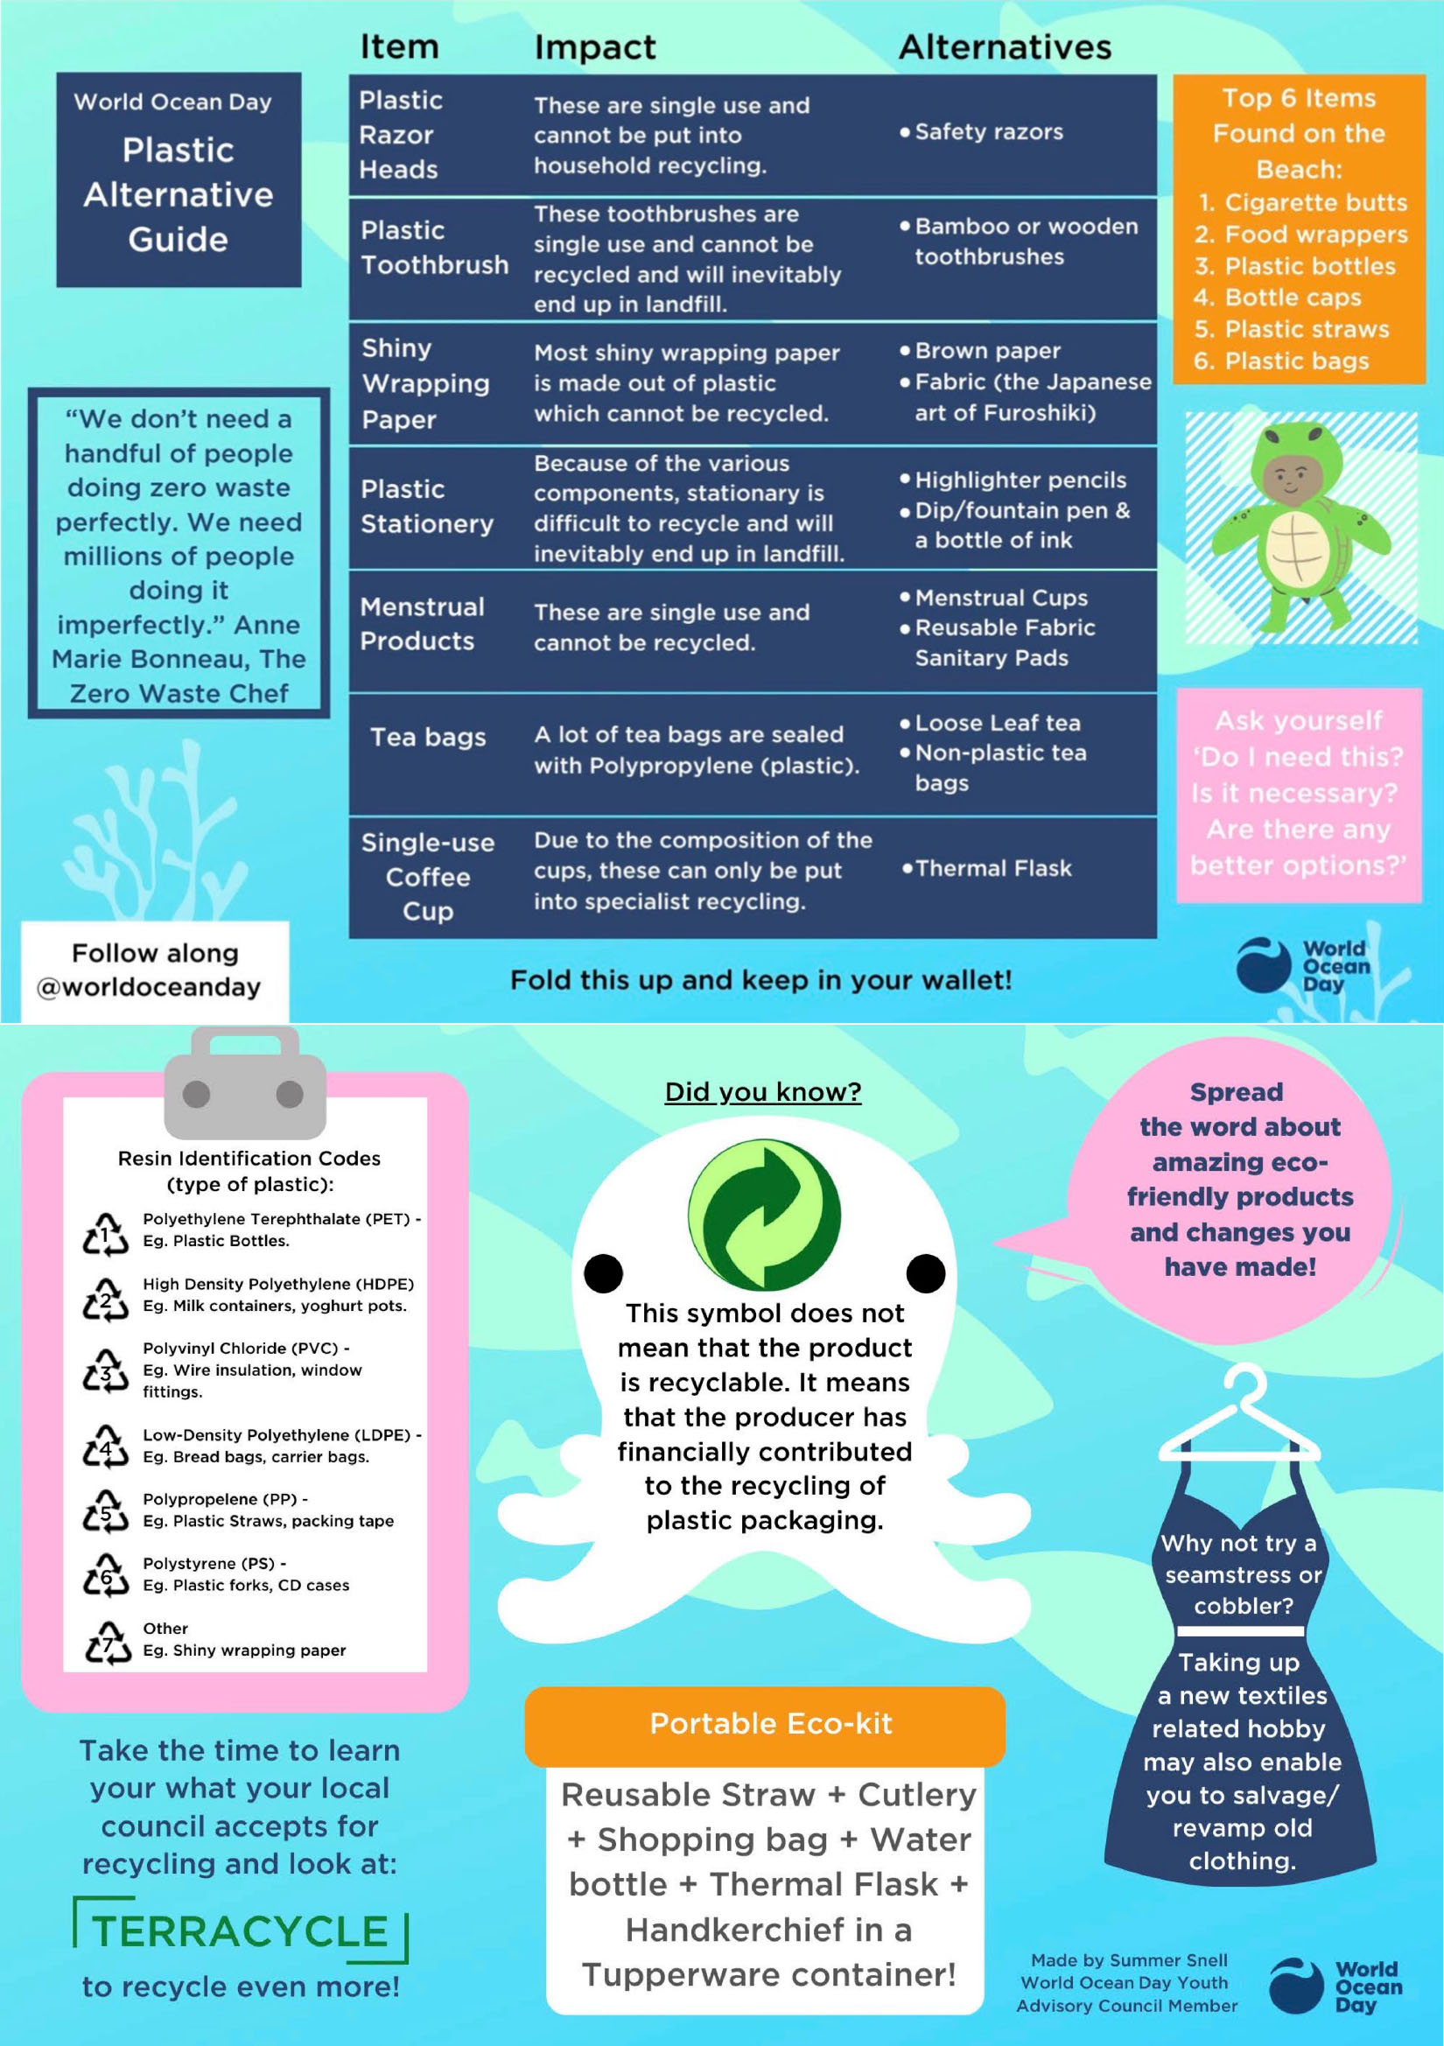
Here are some suggestions to get you started. I wonder if you’re doing some of these things already.
Remember what Milo Cress said ‘people are willing to listen to our ideas. It makes them think about all the different ways they can make a change in their community.”

Slide 14
THE LAST STRAW
Dear ……………,
I am writing this letter because I feel ………………………………………………………....................
I feel …………. because ………………………………………………………………………………….................
I think that we can make things better by …………………………………………………..................
…………………………………………………………………………………………………………………...................
This will make me feel …………………………………………………………………………….....................
This is what makes me feel ….... | This is what will make me feel ….....

