Slide 1
Dangers to wildlife lesson 2

Slide 2
Learning intentions
Listening - Students will listen to a story written in poetry style
Speaking – Students will engage in discussions with a partner
Writing – Students will use note taking as a tool to record information
Science - Students will develop a better understanding of the environmental risks to habitat and livelihood that birds encounter– pollution, deforestation, chemicals, predators
Art – Students will create a poster that will educate their community about safe environments for birds
Today you will work with a partner to create a poster.

Slide 3
New vocabulary
instinct - a response to a situation without giving thought
chemicals – something that cannot be broken down without changing it into something else eg. Water, oxygen, gold
predators – an animal that lives by killing and eating other animals
deforestation – clearing or cutting down of forests by humans
pollution – anything that makes the earth dirty or unhealthy

Slide 4
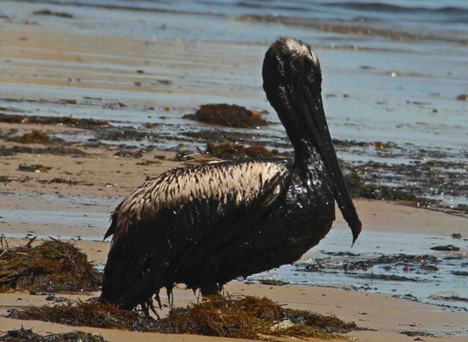
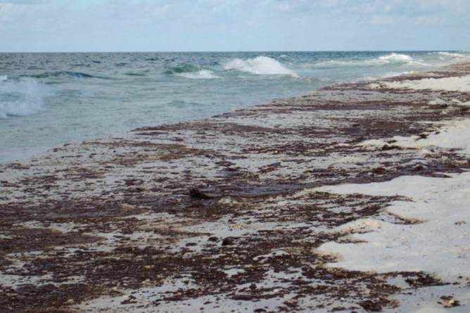
Pollution – oil spills
This Photo by Unknown author is licensed under CC BY.
This Photo by Unknown author is licensed under CC BY-ND.
This Photo by Unknown author is licensed under CC BY-ND.

Slide 5
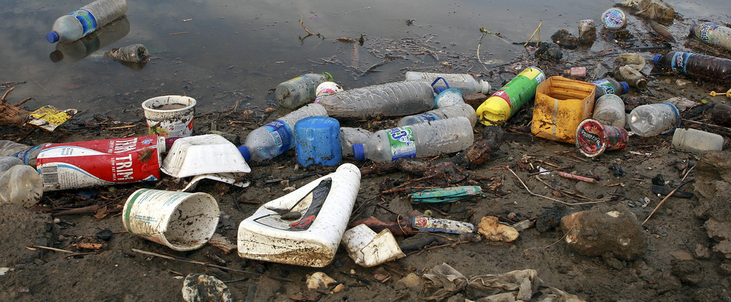
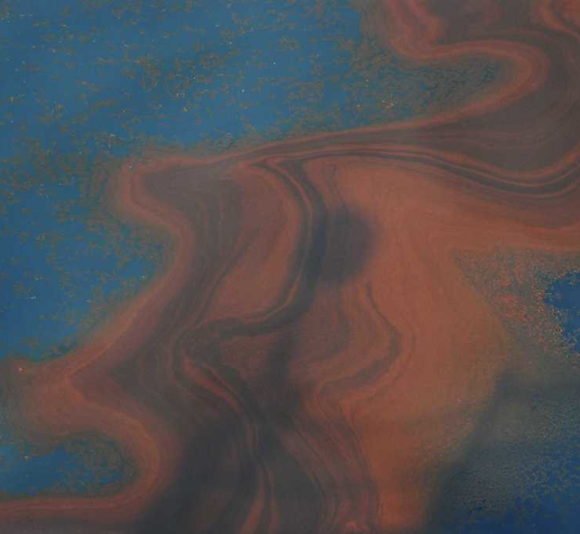
Pollution – putting chemicals into waterways
This Photo by Unknown author is licensed under CC BY-NC-ND.
This Photo by Unknown author is licensed under CC BY-NC-ND.
This Photo by Unknown author is licensed under CC BY-SA-NC.

Slide 6
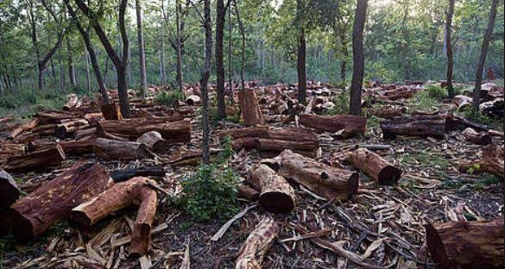
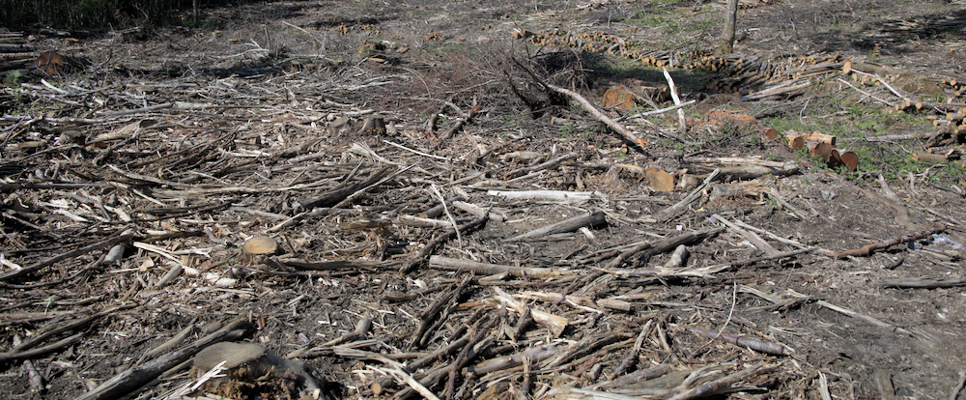
Deforestation
This Photo by Unknown author is licensed under CC BY-NC-ND.
This Photo by Unknown author is licensed under CC BY-NC-ND.
This Photo by Unknown author is licensed under CC BY-ND.

Slide 7
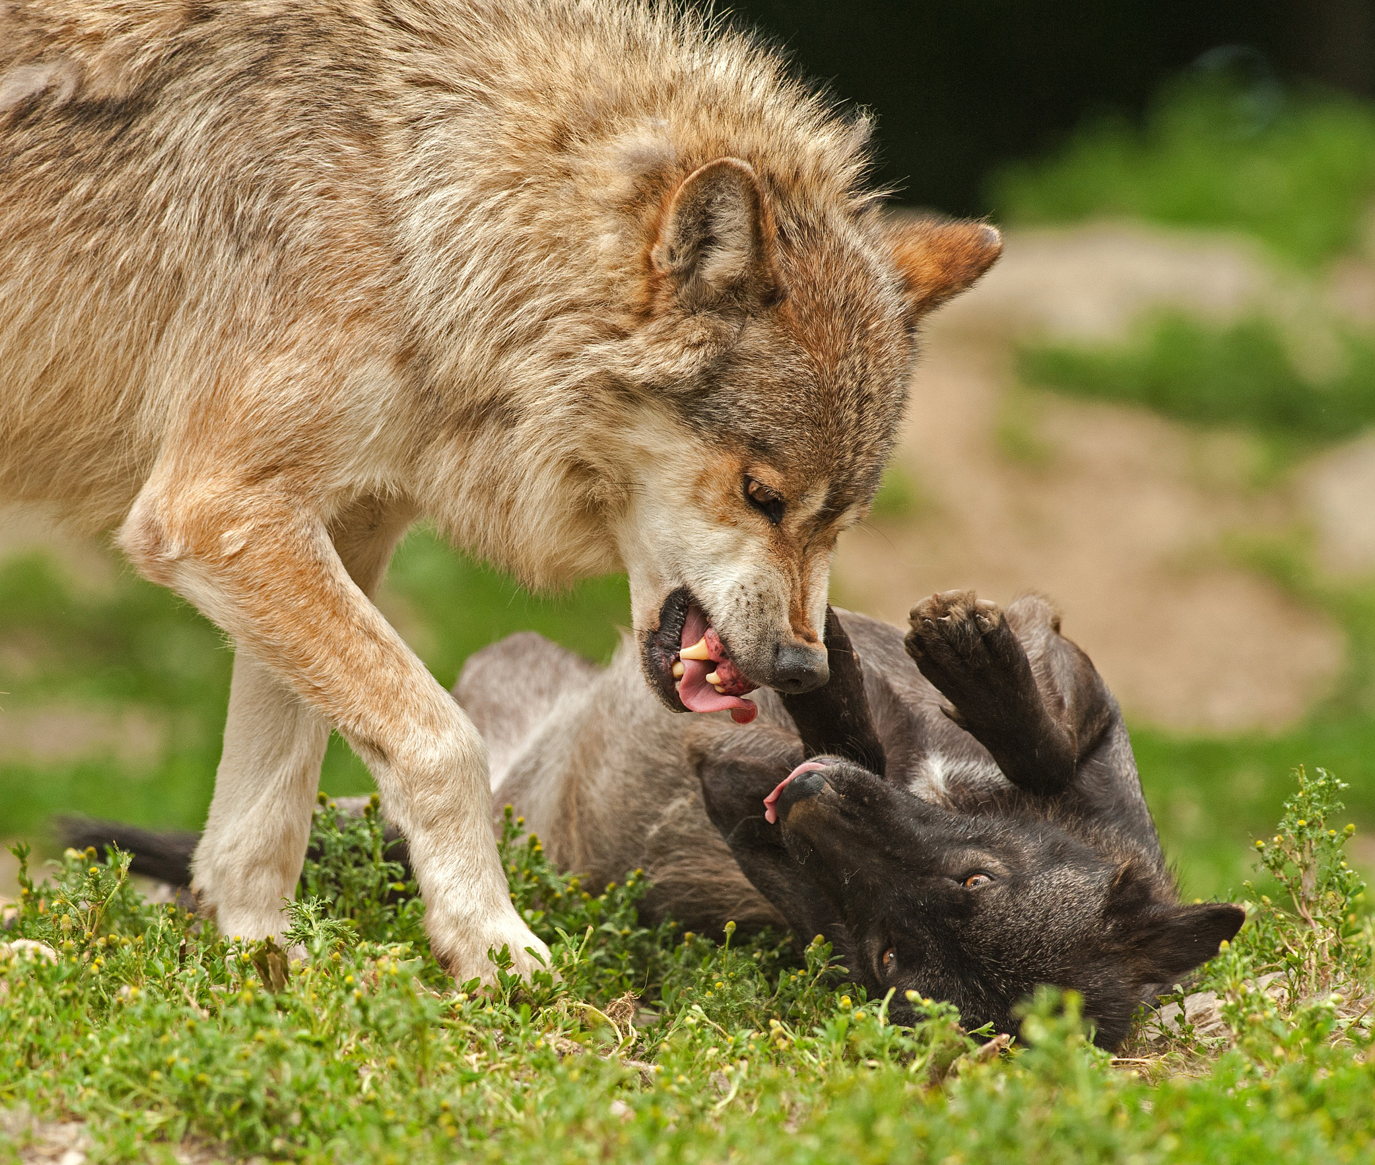
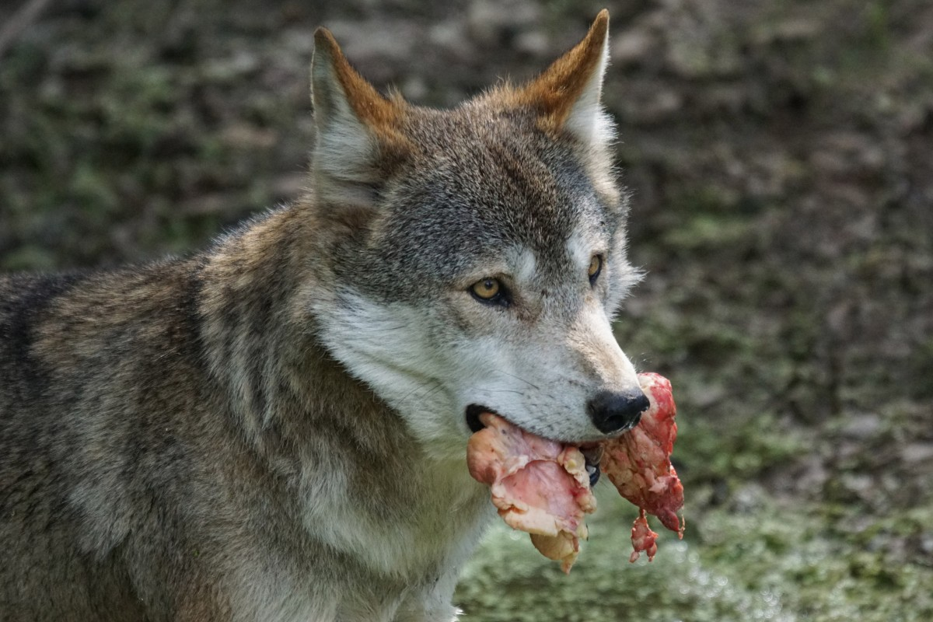
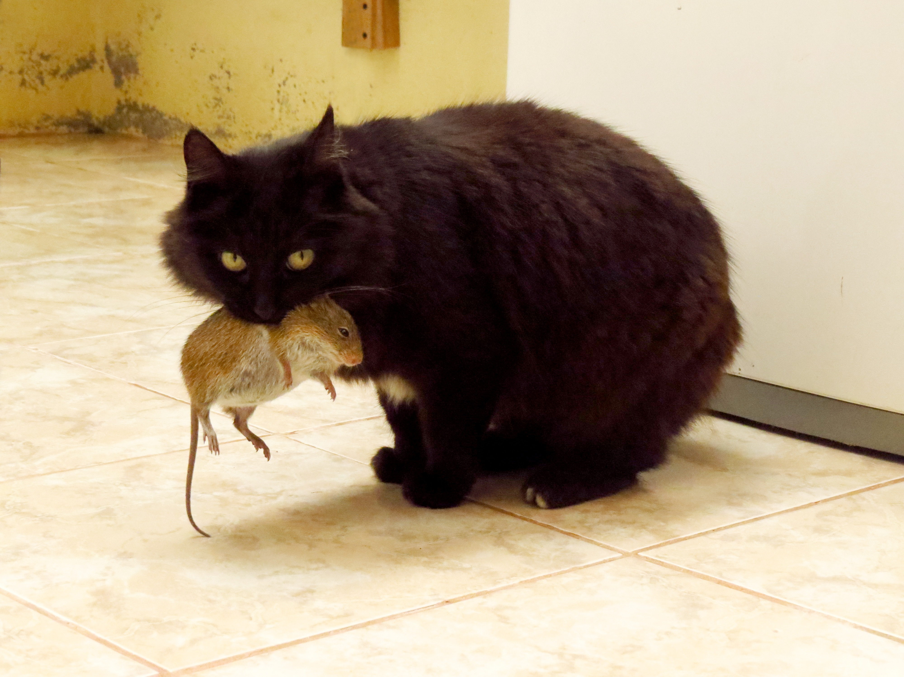
Predators

Slide 8
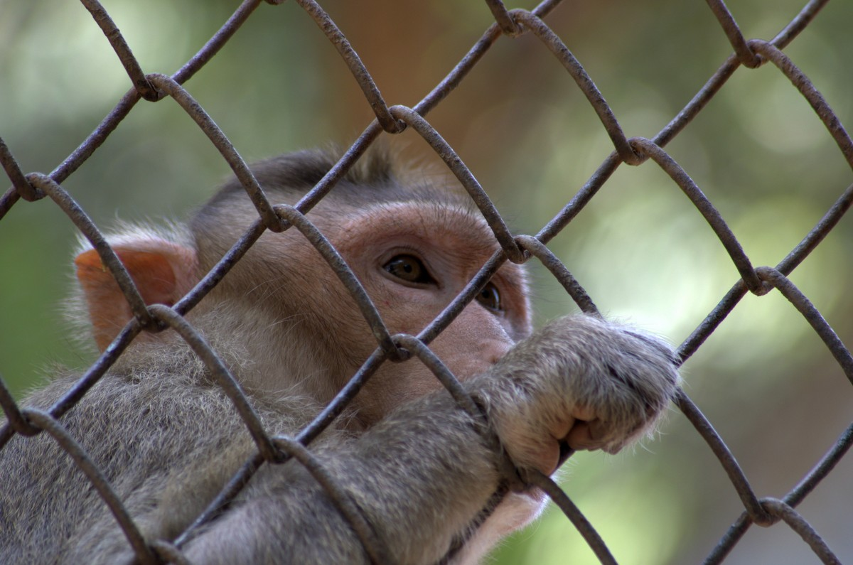
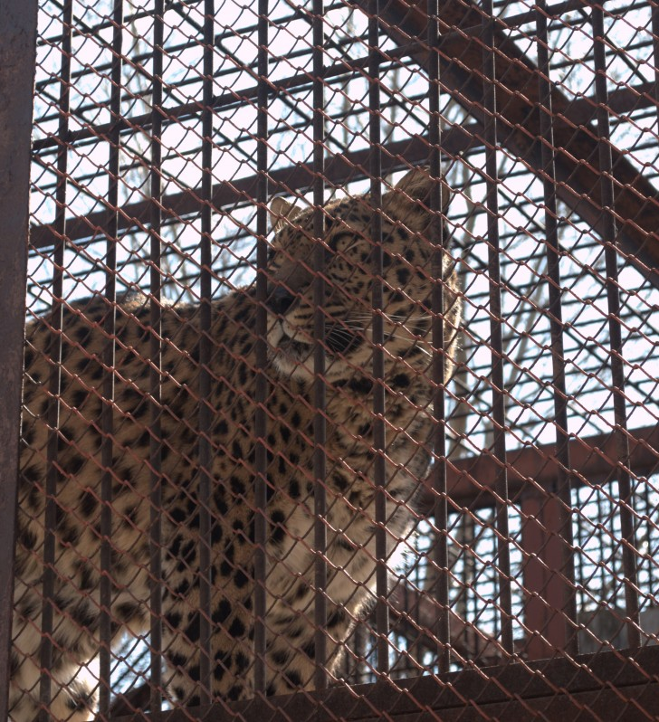
Taking wildlife for pets

Slide 9
https://www.youtube.com/watch?v=CYqsbjAr6vw​

Slide 10
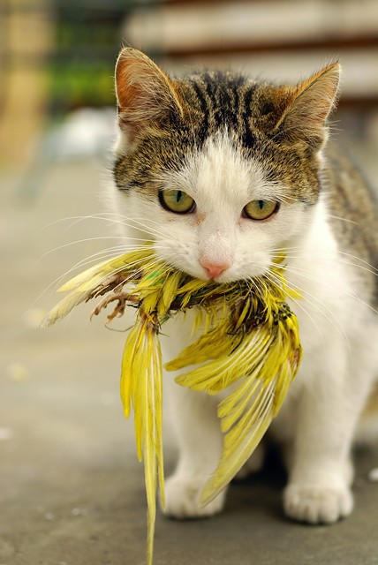
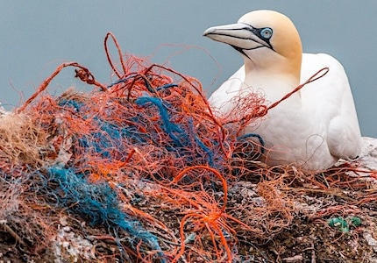
What is wrong in these images
This Photo by Unknown author is licensed under CC BY-NC-ND.
This Photo by Unknown author is licensed under CC BY-ND.
This Photo by Unknown author is licensed under CC BY-SA.

Slide 11
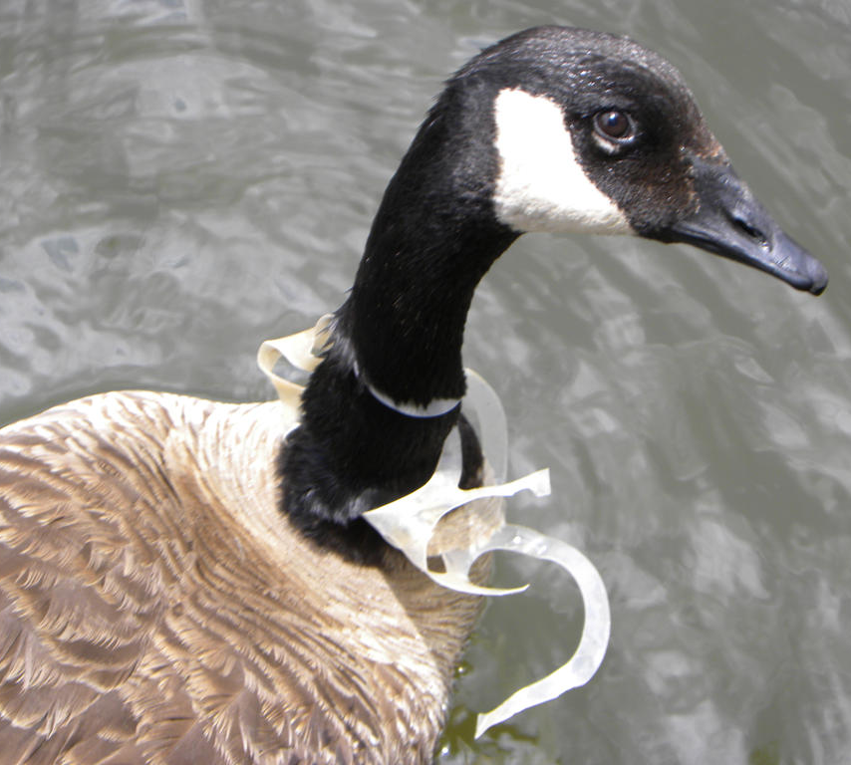
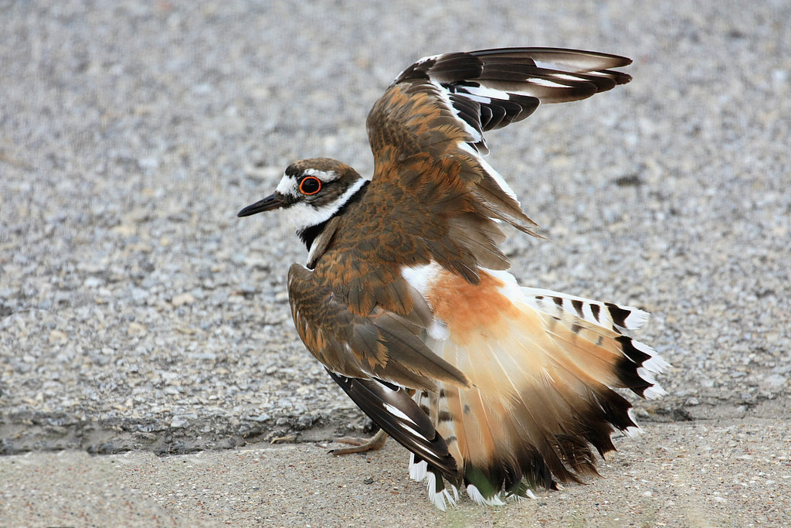
What dangers could a bird encounter in your village or on your island?
This Photo by Unknown author is licensed under CC BY-NC-ND.
This Photo by Unknown author is licensed under CC BY-NC.
This Photo by Unknown author is licensed under CC BY-SA.

Slide 12
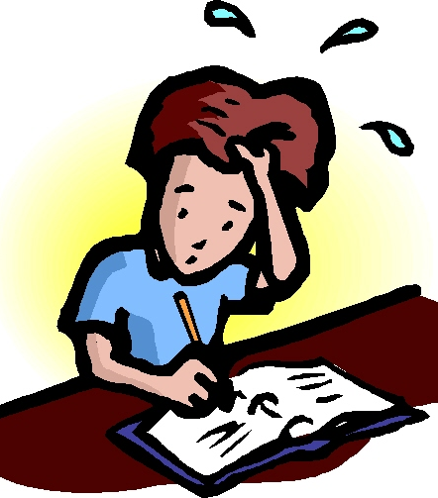
With a partner discuss some of the dangers that a bird might encounter in your village or on your island.
Make some notes of your ideas
This Photo by Unknown author is licensed under CC BY-SA-NC.

Slide 13
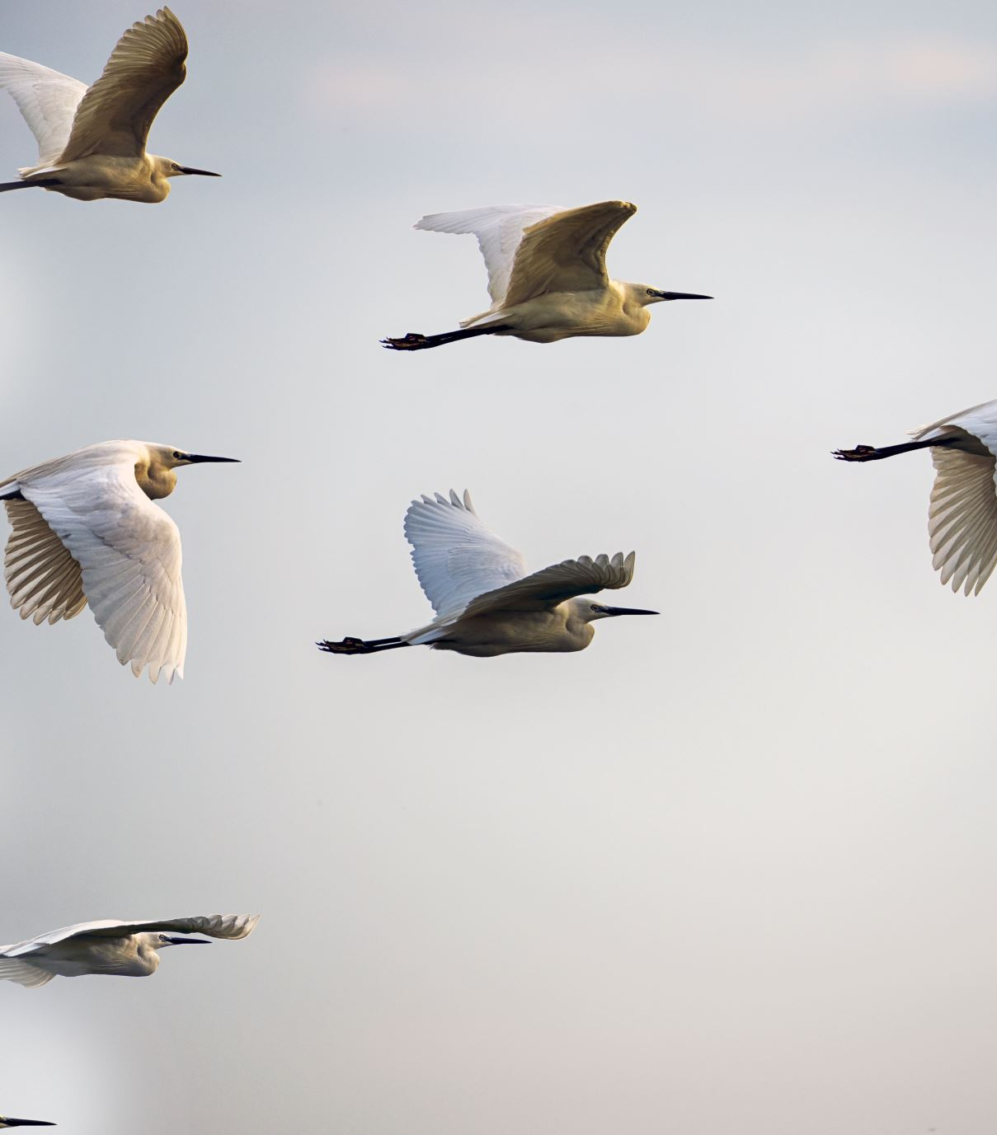
With a partner discuss how your village or island can become a safe place for birds to live. Add more notes.

Slide 14
With your partner and using your ideas, create a poster to display at your school or in your community.

Slide 15
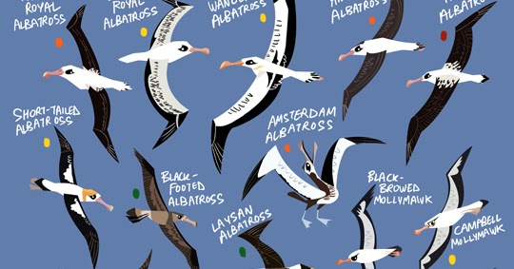
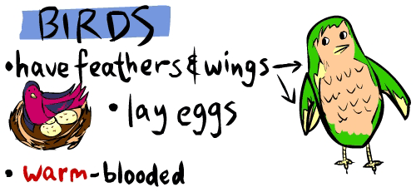
In your poster include
This Photo by Unknown author is licensed under CC BY-NC-ND.
A clear message
An interesting design
And attract attention
This Photo by Unknown author is licensed under CC BY.

