Slide 1
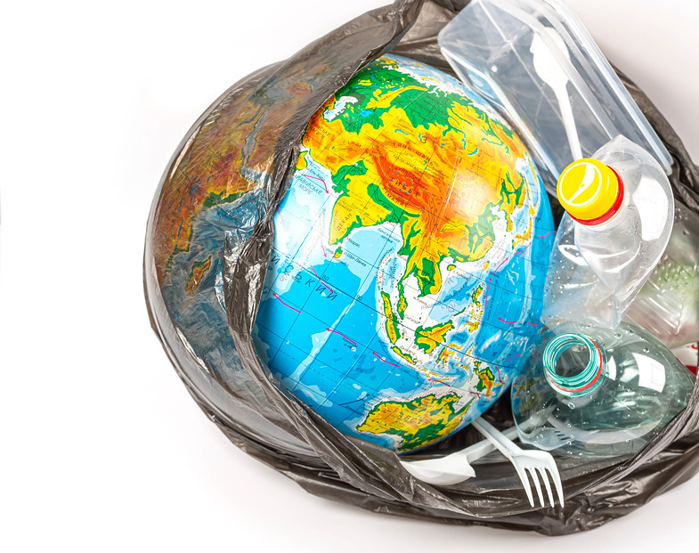
A planet full of plastic
This Photo by Unknown author is licensed under CC BY.

Slide 2
Learning intentions
Literacy
Listening – Students will listen to the story 'A Planet Full of Plastic' by Neal Layton
Writing – Students will conduct an audit of plastic in their classroom, in their home, in their community
Speaking – Students will participate in discussions
Science – Students will identify different uses of plastics, frequency of use, ability to be recycled
Today you will conduct an audit. You will identify objects that are made from plastic in your classroom, in your home and in your community

Slide 3
New vocabulary
Biodegradable – something that can be decomposed (broken down) by bacteria or other living things and thus avoid creating pollution
Micro plastic – small plastic pieces that are less that 5mm long
circular current (ocean gyre)– an ocean current that acts like a whirlpool by going round and round. As it does it draws marine rubbish to its centre creating large ocean garbage patches

Slide 4
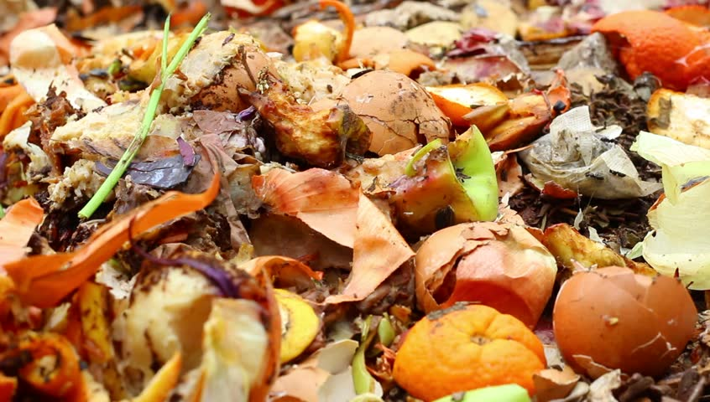
What things are biodegradable?

Slide 5
Which gyre is closest to the country in which you live?
This Photo by Unknown author is licensed under CC BY-SA-NC.

Slide 6
Where would you find micro plastic?
This Photo by Unknown author is licensed under CC BY-SA.

Slide 7
What is plastic?
This Photo by Unknown author is licensed under CC BY.

Slide 8
Types of plastics

Slide 9
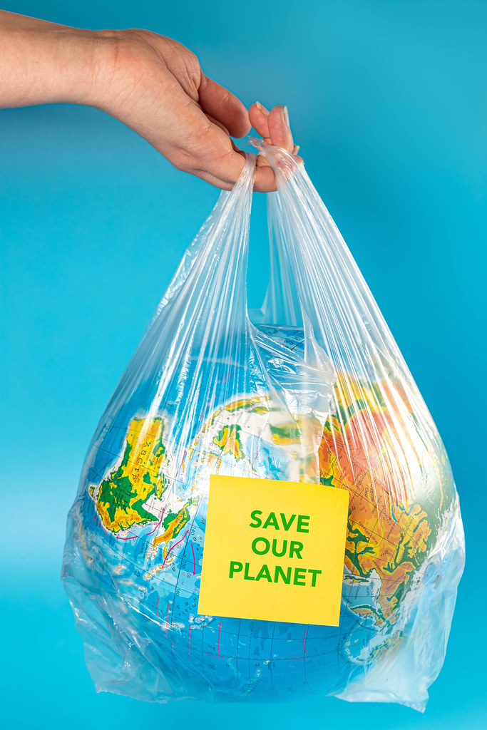
A Planet Full of Plastic by Neal Layton
https://www.youtube.com/watch?v=mFJ8beW9ZCI
This Photo by Unknown author is licensed under CC BY.

Slide 10
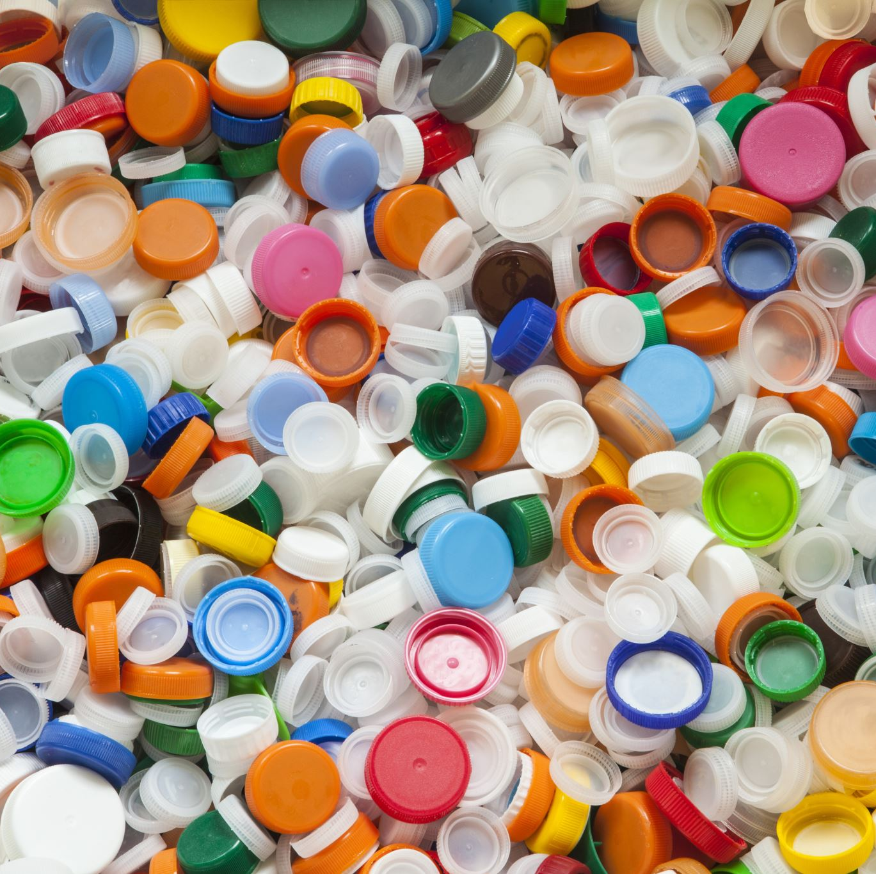
QUESTIONS FOR DISCUSSION
Why was plastic 'fantastic'?
What was the problem with plastic?
What problems do we have with plastics now?

Slide 11
Plastic audit – in my classroom
Things that are used once | Things that are used many times | Things that are recycled

Slide 12
Plastic audit – in my home
Things that are used once | Things that are used many times | Things that are recycled

Slide 13
Plastic audit – in my community
Things that are used once | Things that are used many times | Things that are recycled

Slide 14
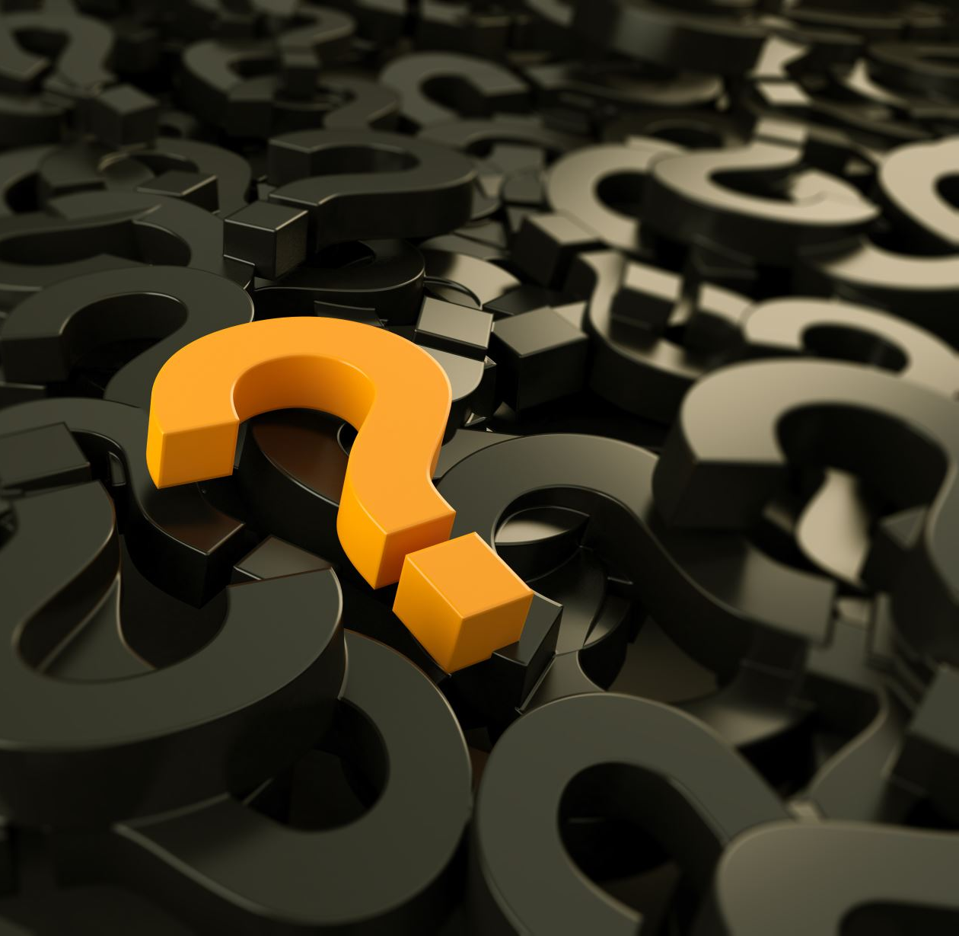
A FINAL QUESTION What are you going to do?

