Slide 1
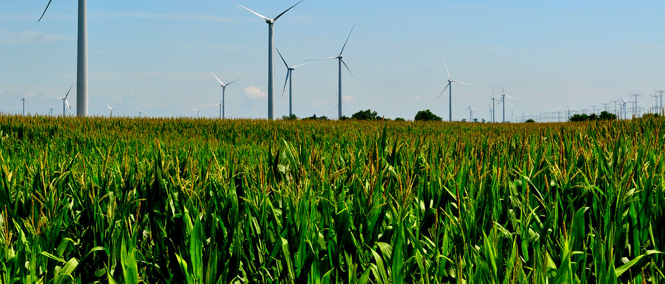
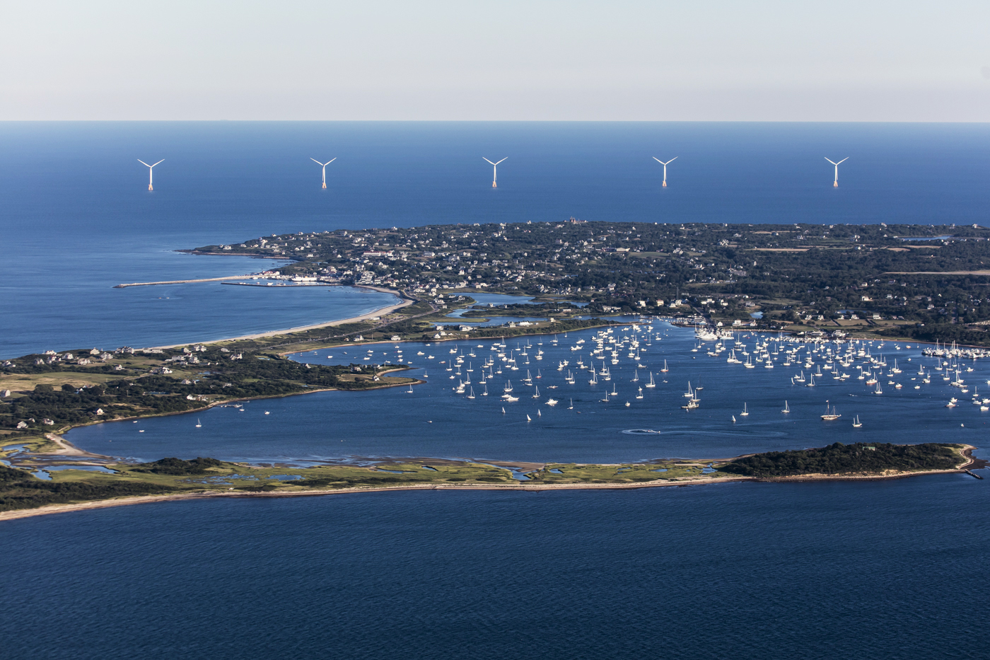
The Windy Farm by Doug MacLeod
This Photo by Unknown author is licensed under CC BY.
This Photo by Unknown author is licensed under CC BY-SA.

Slide 2
Learning intentions
Speaking – participate in discussions about renewable and non renewable forms of energy
Art and technology – students will make an origami windmill and use it to demonstrate how wind power is generated
Science – students will develop a understanding of the differences between renewable and non renewable forms of energy
- students will develop an understanding of how electricity is made
Social Studies – students will develop an understanding of the importance of communities (families) working together to find solutions
Today you will make an origami pinwheel (windmill )and you will use it to demonstrate how wind is a source of energy

Slide 3
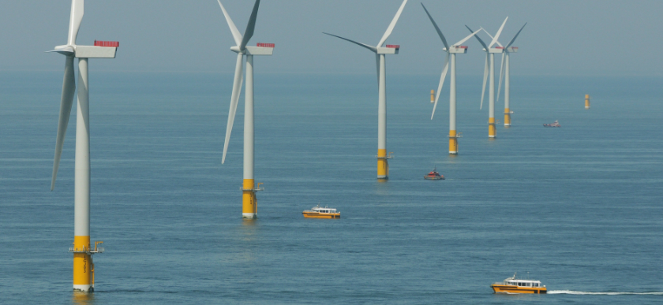
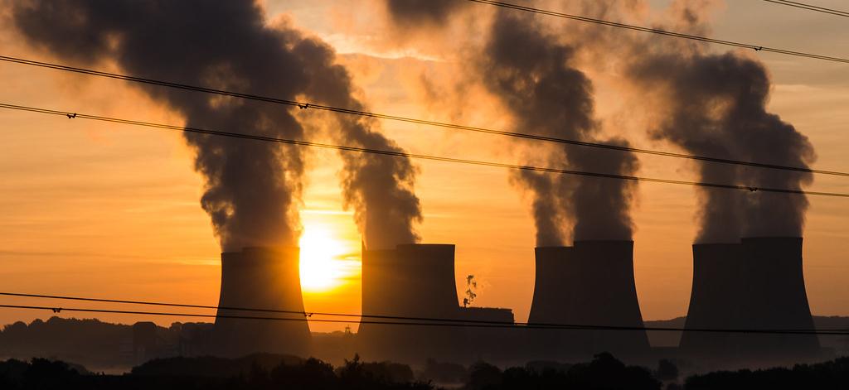
New vocabulary
Renewable energy – energy that is made from natural resources that do not run out eg. Wind power, solar power
Nonrenewable energy – energy that is made from resources that cannot be replaced once they have been used eg. Coal, gas
Wind power – energy (electricity) that is made by using wind
Generator - a machine that changes mechanical energy into electrical energy
Transformer – a machine that sends electric energy from one current circuit to another current circuit
This Photo by Unknown author is licensed under CC BY-ND.
This Photo by Unknown author is licensed under CC BY-SA.

Slide 4
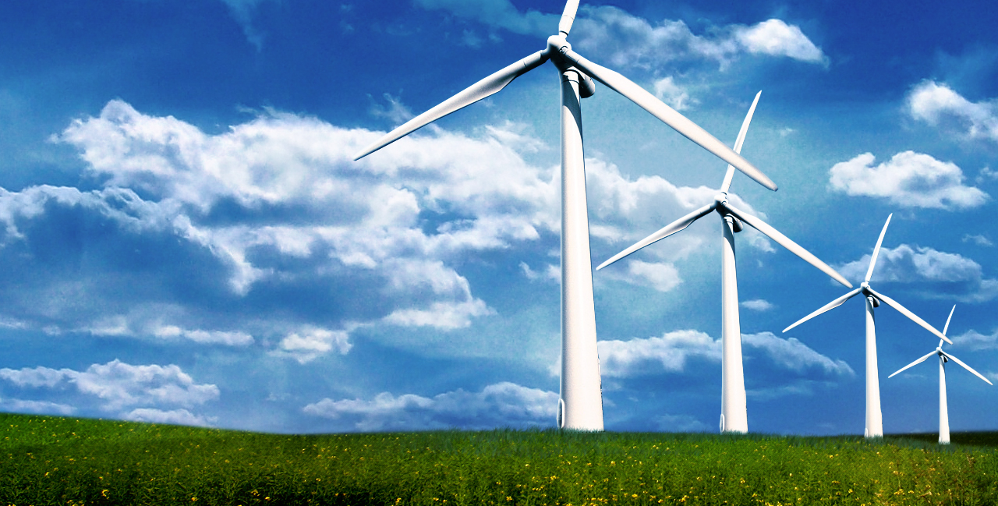
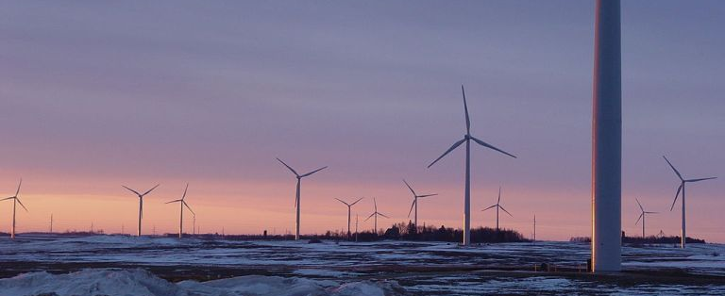
How does wind power work?
This Photo by Unknown author is licensed under CC BY-NC-ND.
This Photo by Unknown author is licensed under CC BY-ND.

Slide 5
This Photo by Unknown author is licensed under CC BY.

Slide 6
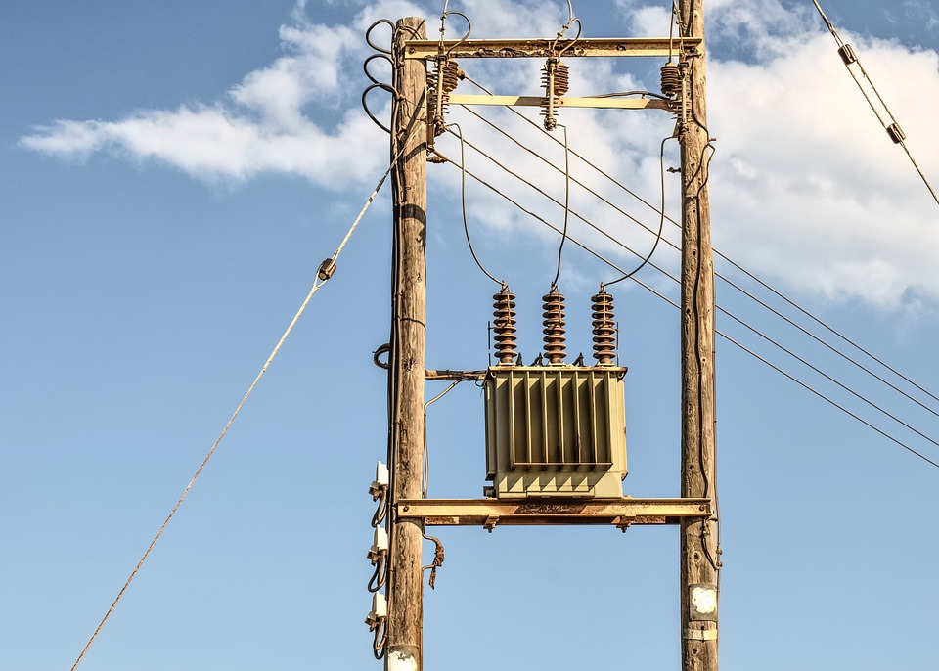
Here are examples of a portable generator and a transformer on a power pole

Slide 7
What do you think that this story going is to be about?
It is quite a funny story. I hope that you enjoy it.
https://www.youtube.com/watch?v=n38VNIva53g

Slide 8
What were some of the challenges that the family had? What were some of the solutions that the family came up with?
This Photo by Unknown author is licensed under CC BY-ND.

Slide 9
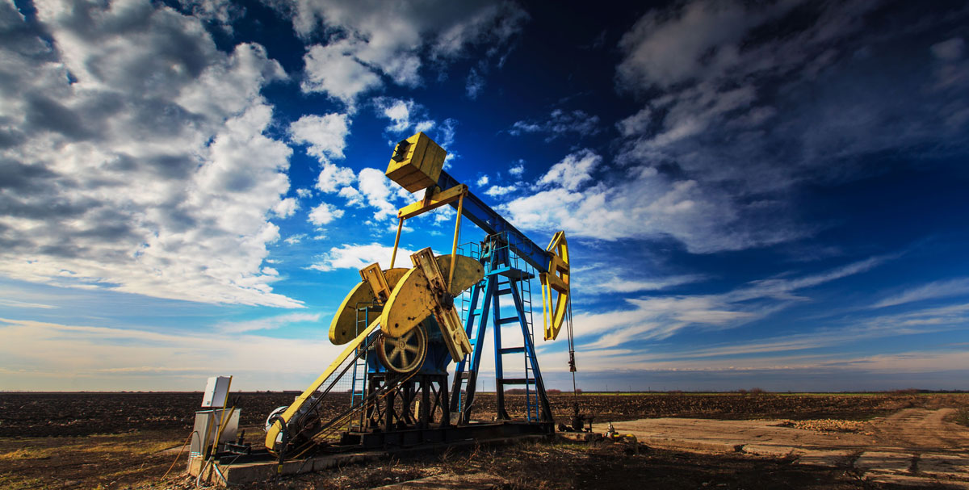
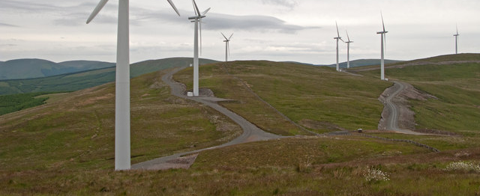
What happened to the oil supply, and why? What were the benefits of the electricity that was generated from wind power?
This Photo by Unknown author is licensed under CC BY-SA.
This Photo by Unknown author is licensed under CC BY.

Slide 10
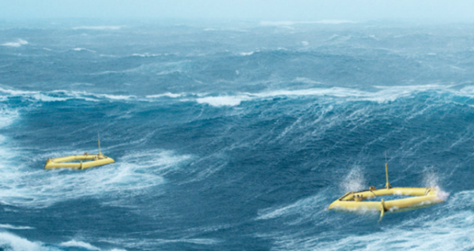
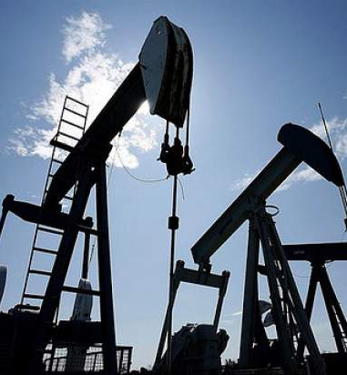
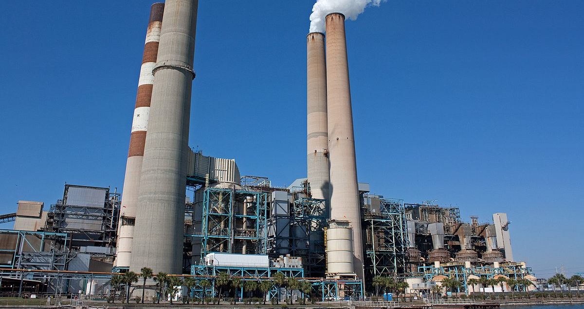
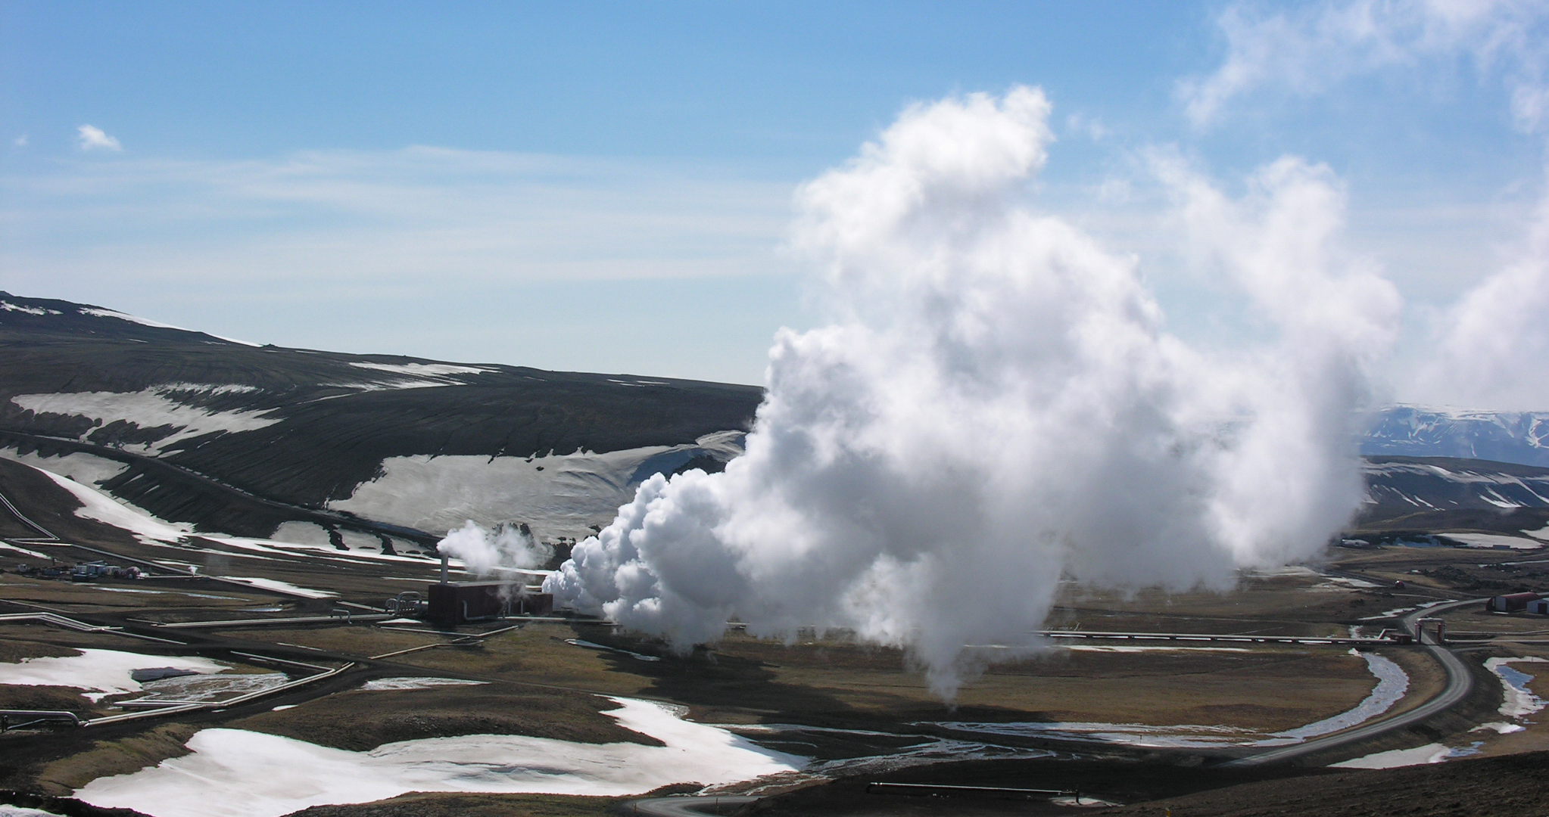
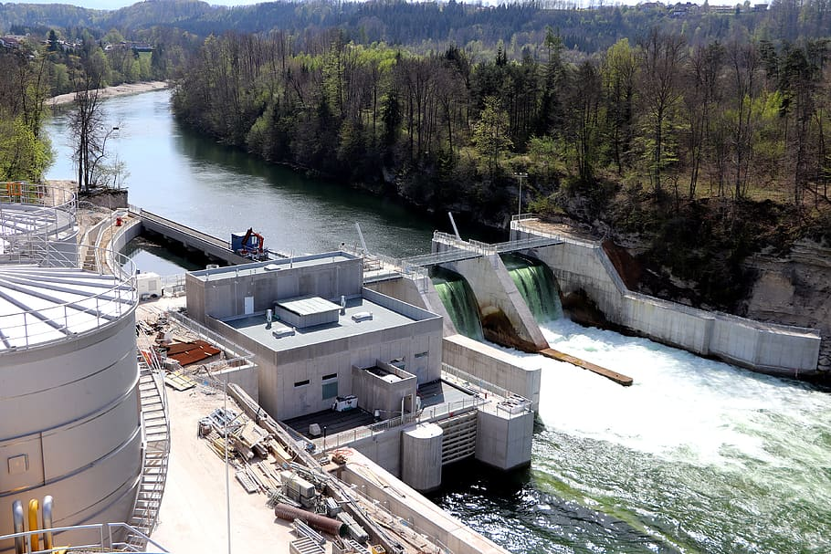
Where does your electricity come from and what is it made from? Can you identify these power sources? Which ones are renewable and which ones are nonrenewable?
This Photo by Unknown author is licensed under CC BY-SA-NC.
This Photo by Unknown author is licensed under CC BY-SA.
This Photo by Unknown author is licensed under CC BY-SA.
This Photo by Unknown author is licensed under CC BY.
This Photo by Unknown author is licensed under CC BY-SA.
This Photo by Unknown author is licensed under CC BY-ND.

Slide 11
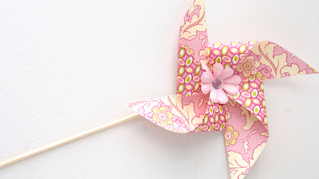
How to make an origami pinwheel (windmill)
https://www.youtube.com/watch?v=-NNb-TD9Utw
https://origami.me/pinwheel/
This Photo by Unknown author is licensed under CC BY-NC-ND.

Slide 12
Take your pinwheel outside How can you can get your pinwheel to move? You may have to move the pinwheel into different positions
This Photo by Unknown author is licensed under CC BY-ND.

