Slide 1
One Plastic Bag
This Photo by Unknown author is licensed under CC BY-NC-ND.

Slide 2
Learning outcomes
Listening - Students will listen to a story about Isatou Cessay
Writing - Students will write a plan for use of plastic bags
Speaking – Students will participate in discussions and report their findings
Science – Students will learn about the impact of plastic bags on domestic animals (goats), the effects of burning plastic on living things, and mosquitoes and plastic bags.
Social studies– Students will learn about the process of recycling/repurposing an item and turning it into a commodity for sale to generate income to improve living standards
Geography – Students will learn about where Gambia, Africa is
Today you will be thinking of an idea to upcycle or reuse plastic bags. To do this you will use a mind map.

Slide 3
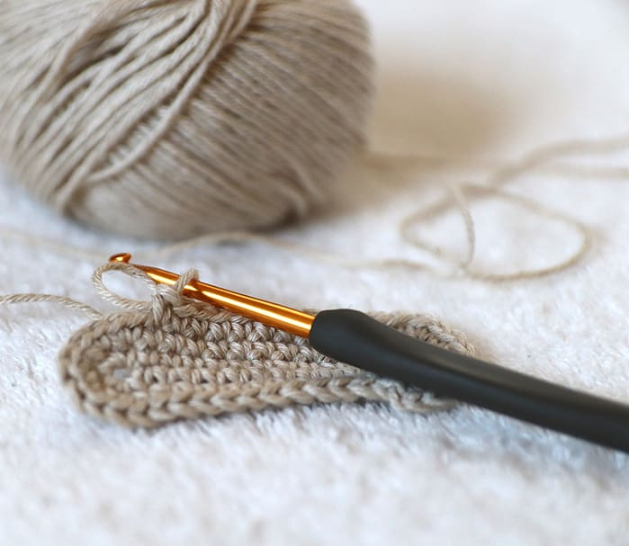
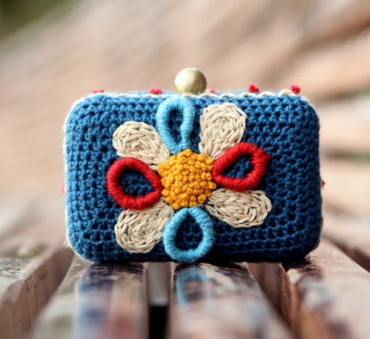
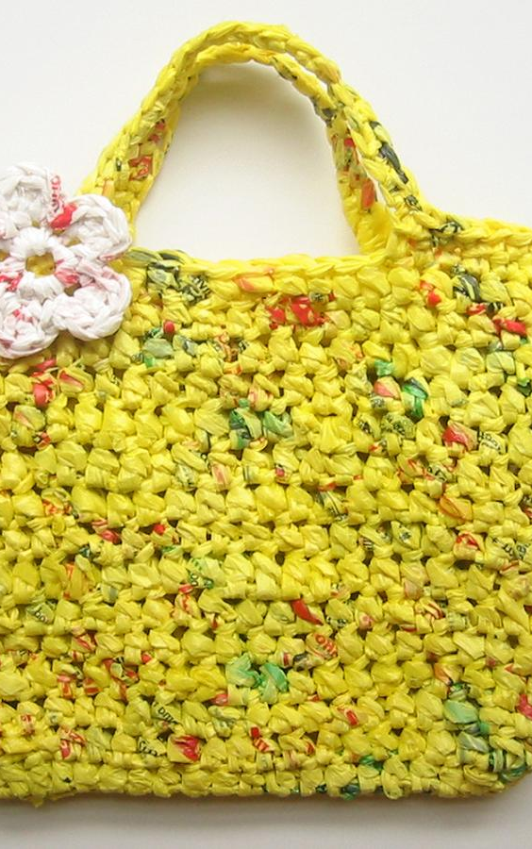
New vocabulary
Upcycle – to make something into a product of higher quality
Recycle – making waste products into something else
Reuse – use something more than once
Tamarind tree – an evergreen tree that produces pod like fruit
Tote – a type of handbag
Forage – to search for something
Crochet – a handcraft in which a material is made into a textured fabric using a hooked needle
Clutch – a small handbag
This Photo by Unknown author is licensed under CC BY-NC-ND.
This Photo by Unknown author is licensed under CC BY-SA-NC.
This Photo by Unknown author is licensed under CC BY.

Slide 4
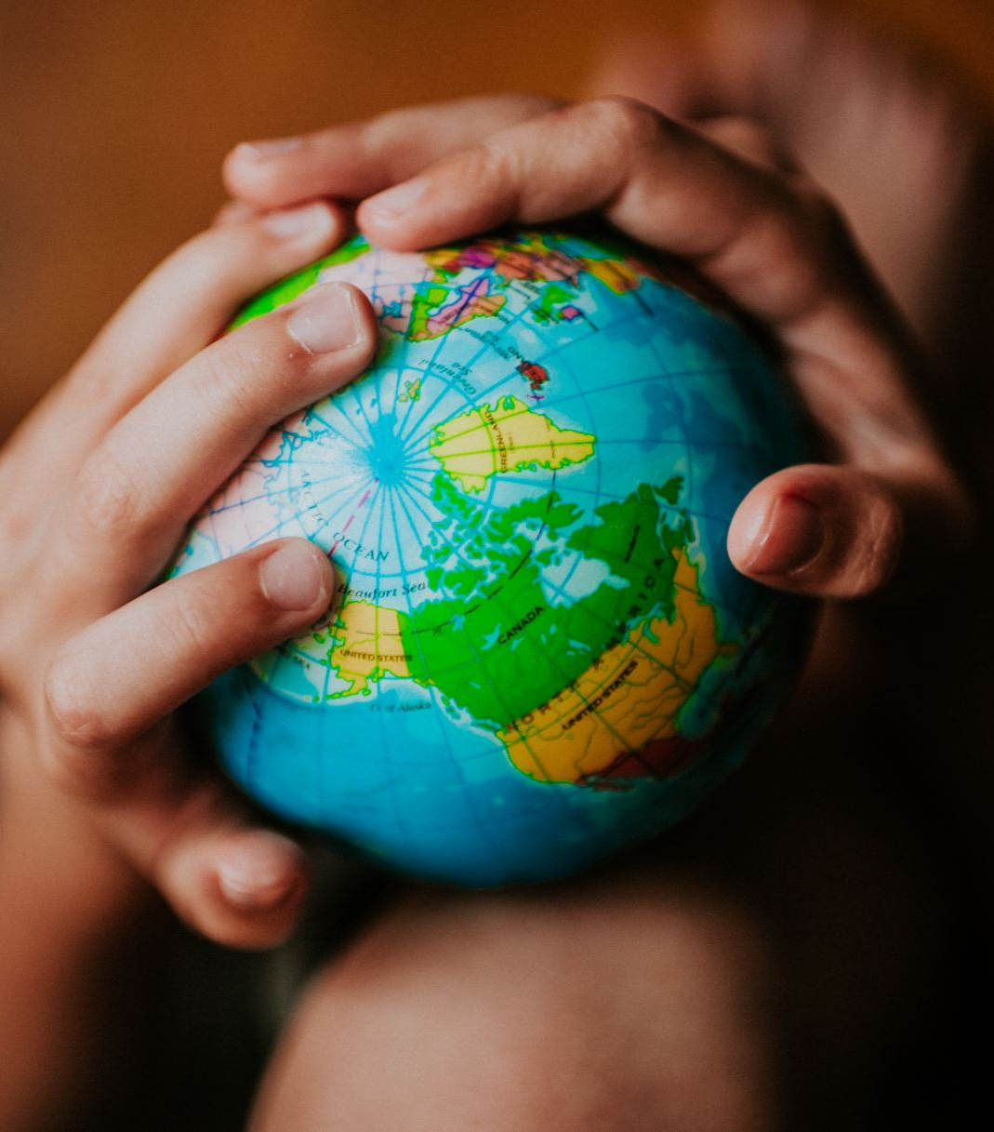
The story that you will listen to today is a true story written by Miranda Paul and illustrated by Elizabeth Zunon. It is about one person, Isatoe Cessay, and how she demonstrates that one persons' actions really can make a difference on our world.

Slide 5
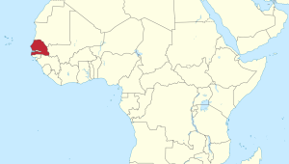
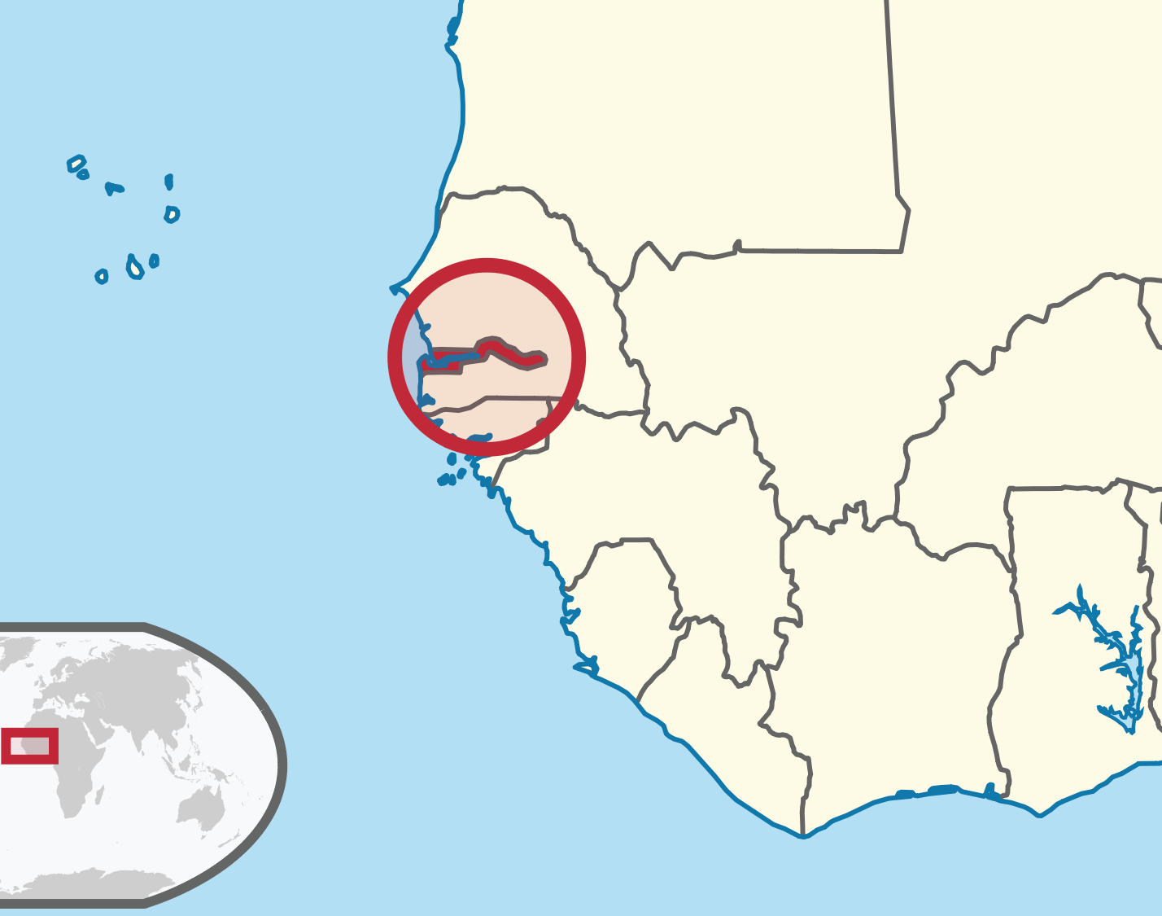
Where is Gambia?
This Photo by Unknown author is licensed under CC BY-NC-ND.
This Photo by Unknown author is licensed under CC BY.

Slide 6
https://www.youtube.com/watch?v=Ah2zjHDCobk&t=59s
This Photo by Unknown author is licensed under CC BY-SA.

Slide 7
What happened to the goats?
What happens when plastic is burned?
What does Isatoe do to solve the problem?
Why are mosquitoes harmful?

Slide 8
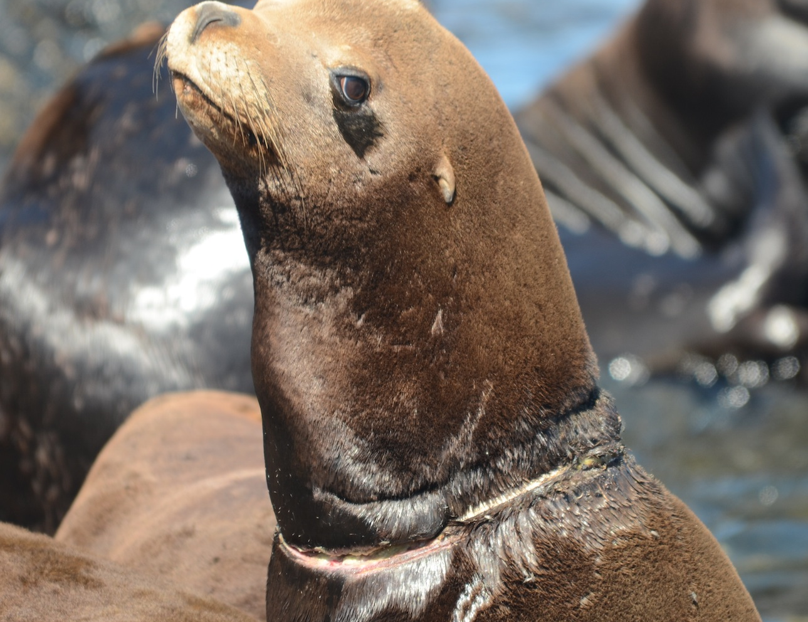
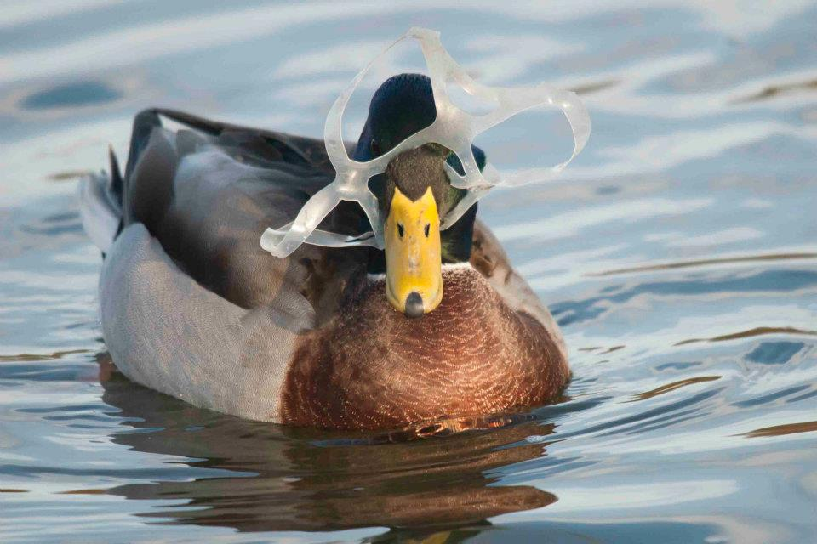
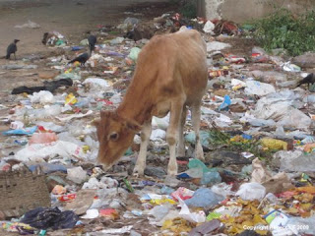
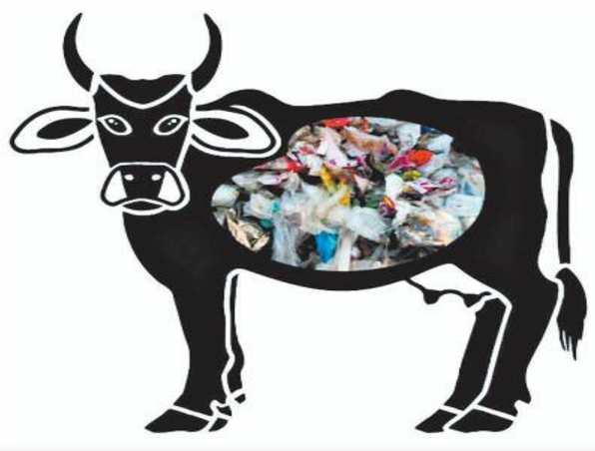
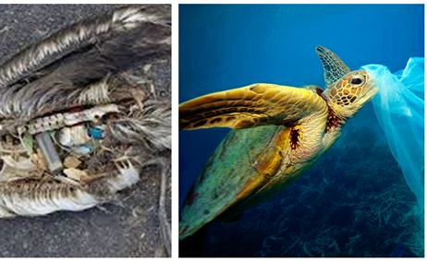
How are animals affected by plastic bags where you live?
This Photo by Unknown author is licensed under CC BY.
This Photo by Unknown author is licensed under CC BY.
This Photo by Unknown author is licensed under CC BY-NC-ND.
This Photo by Unknown author is licensed under CC BY-NC-ND.

Slide 9
What happens to plastic bags where you live?
This Photo by Unknown author is licensed under CC BY.

Slide 10
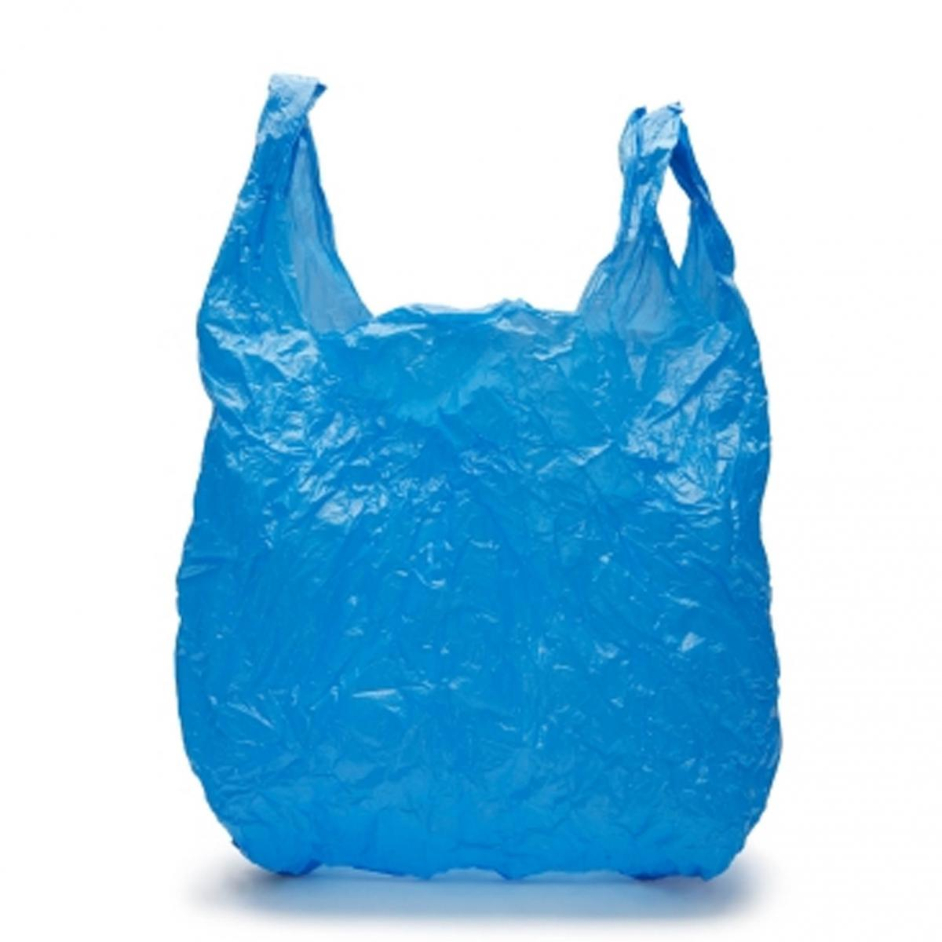
What do you use plastic bags for?
Have a chat with a partner and see how many uses you have for plastic bags?
This Photo by Unknown author is licensed under CC BY-SA.

Slide 11
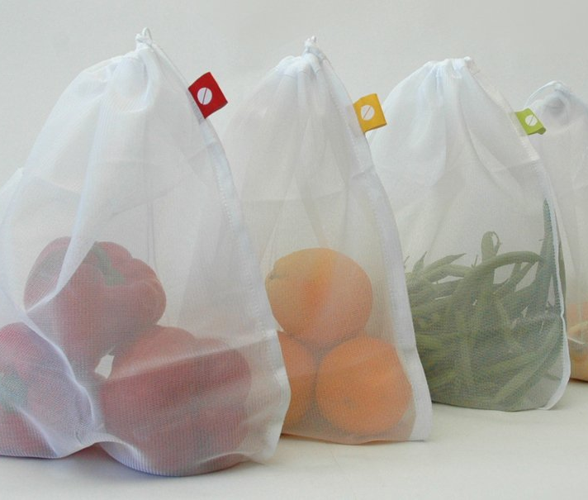
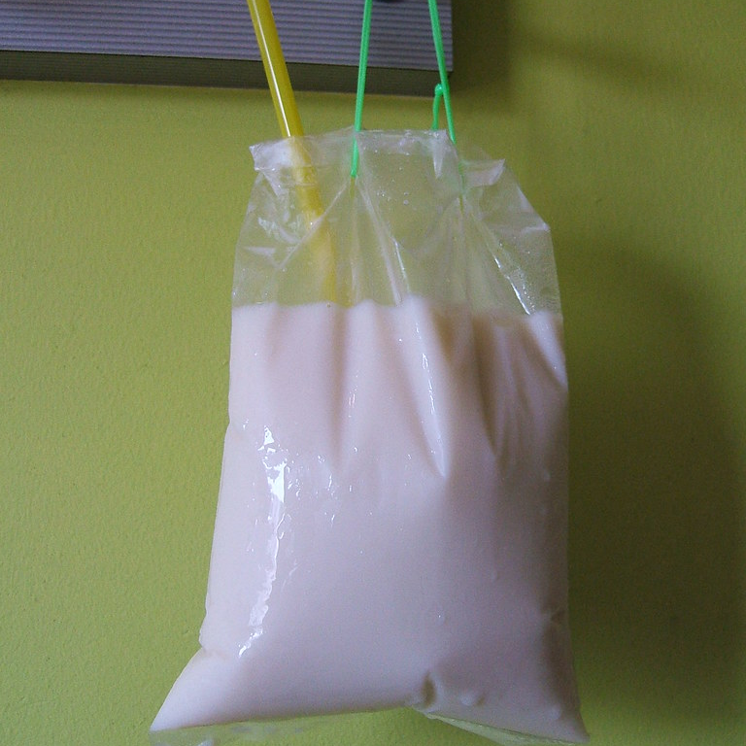
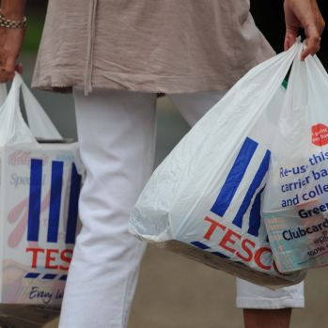
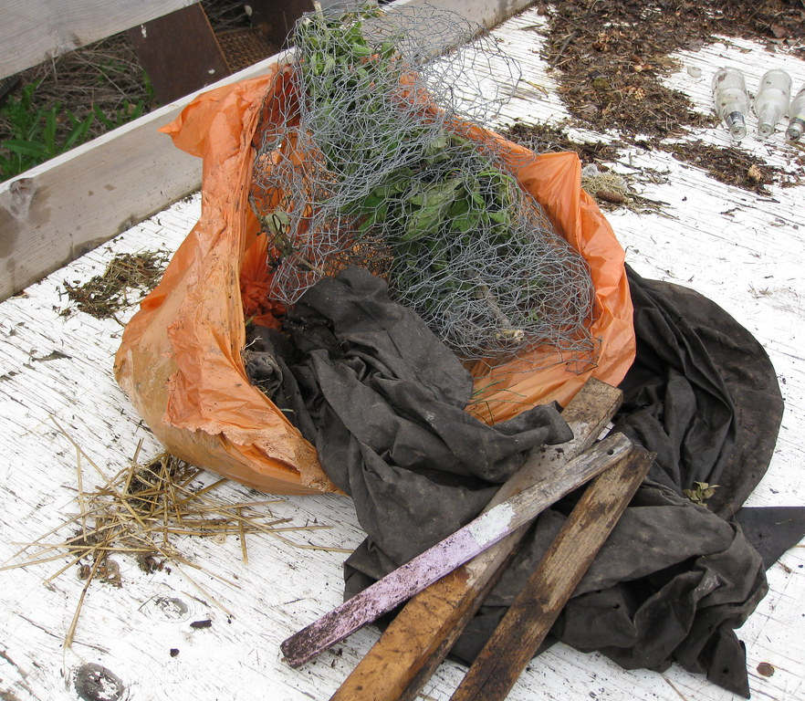
This Photo by Unknown author is licensed under CC BY-SA.
This Photo by Unknown author is licensed under CC BY-NC-ND.
This Photo by Unknown author is licensed under CC BY-NC-ND.
This Photo by Unknown author is licensed under CC BY.

Slide 12
How could you upcycle plastic bags? How could you recycle plastic bags How could you reuse plastic bags?

Slide 13
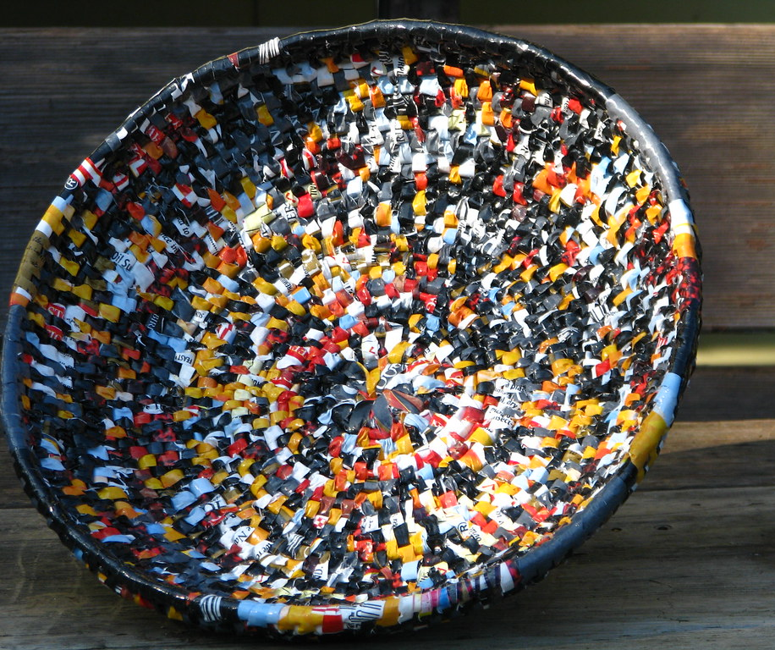
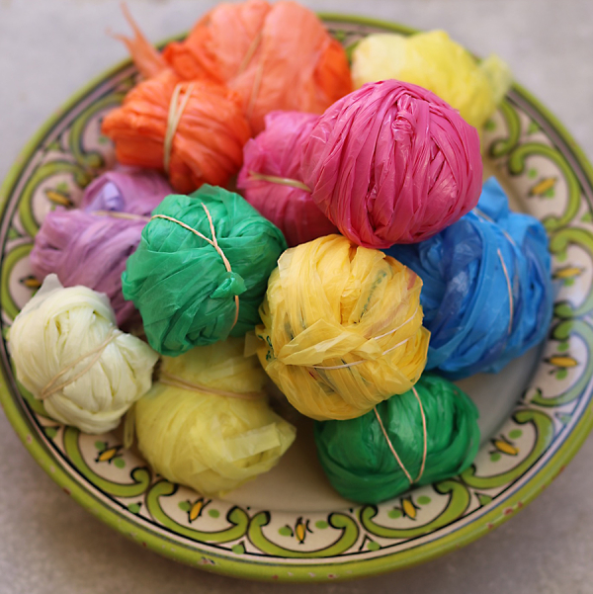
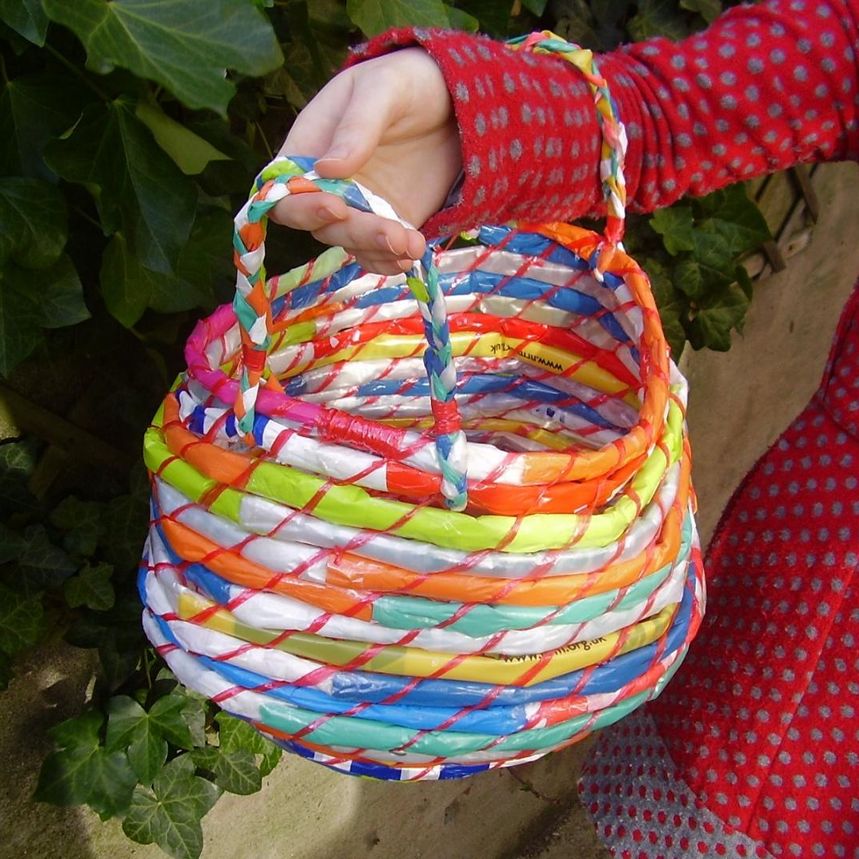
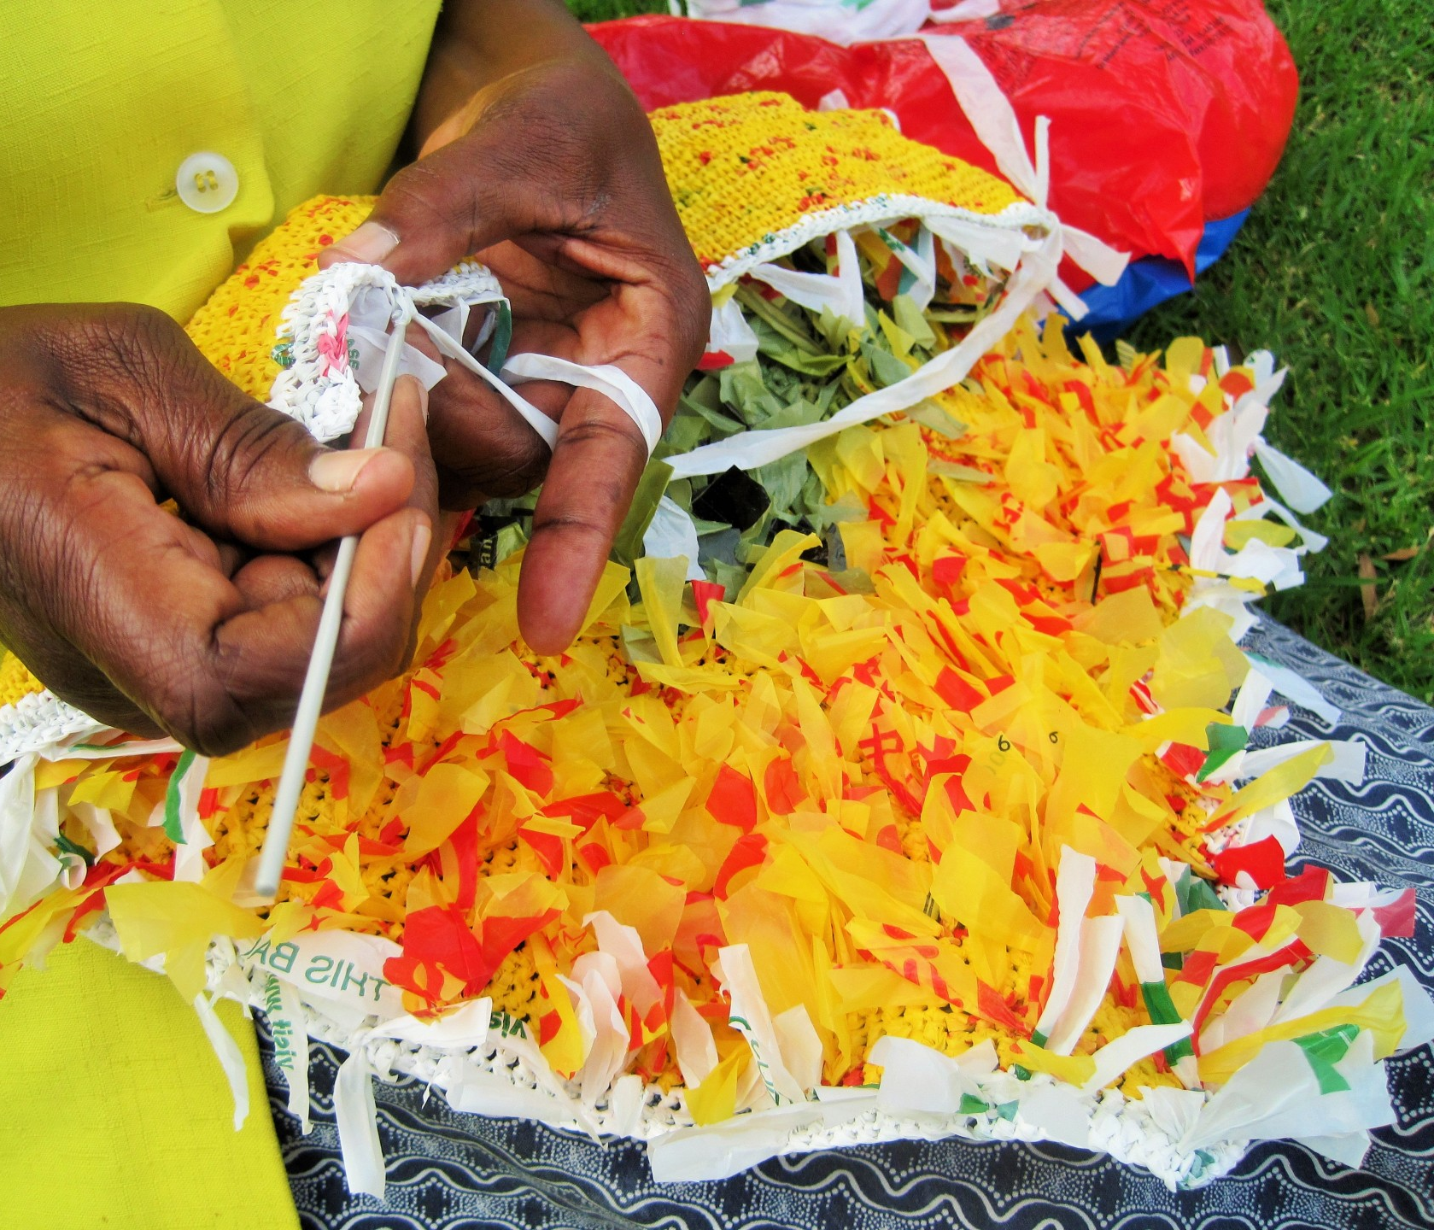
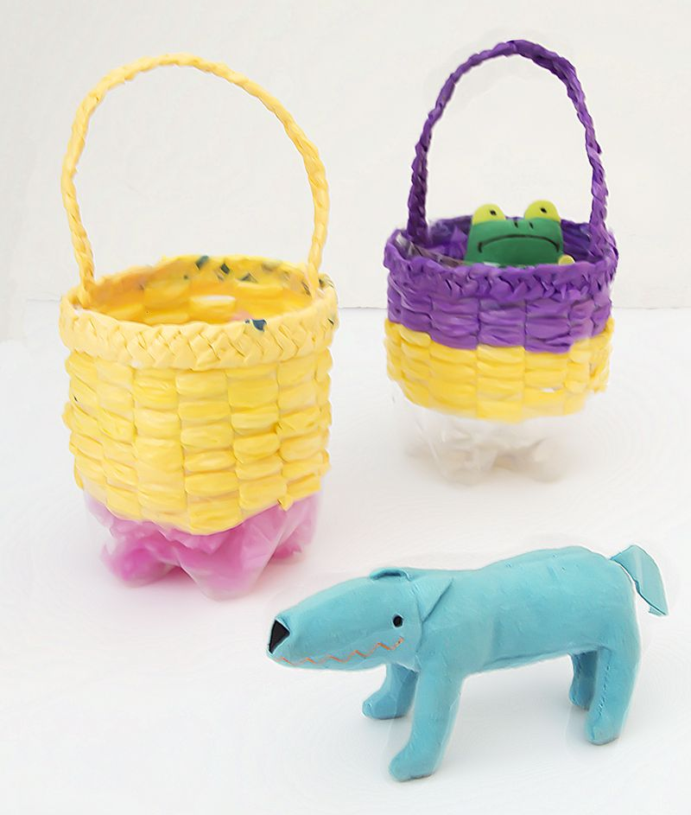
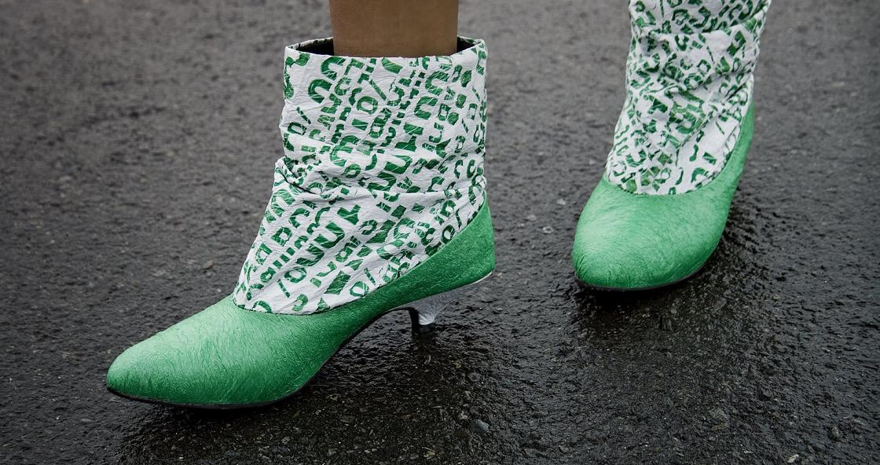
Here are some ideas to get you started.
This Photo by Unknown author is licensed under CC BY-NC.
This Photo by Unknown author is licensed under CC BY-NC.
This Photo by Unknown author is licensed under CC BY-NC.
This Photo by Unknown author is licensed under CC BY-SA-NC.
This Photo by Unknown author is licensed under CC BY-SA-NC.

Slide 14
Your task today is to come up with an idea to upcycle or recycle or reuse plastic bags.
Think about something that you could do that would:
1. upcycle plastic bags for something useful and durable in your community
2. reduce the use of plastic bags in your community
3. recycle plastic bags
4 reuse plastic bags
Consider how your action could have a positive impact on your community.
Make sure that your action is something that you can do.

Slide 15
Make a plan – some ideas to get you started
What is your idea?
What do you need to make your idea happen?
Do you need to learn a new skill?
Collecting resources (this might include people to help you)
Getting started
Sharing your product or outcome

Slide 16
Why is this idea important?
What do I need?
Your idea
When can I do this?
Who can help me?
How and who will use this?
What will the outcome of this be?
Any new skills that I may need to learn.

Slide 17
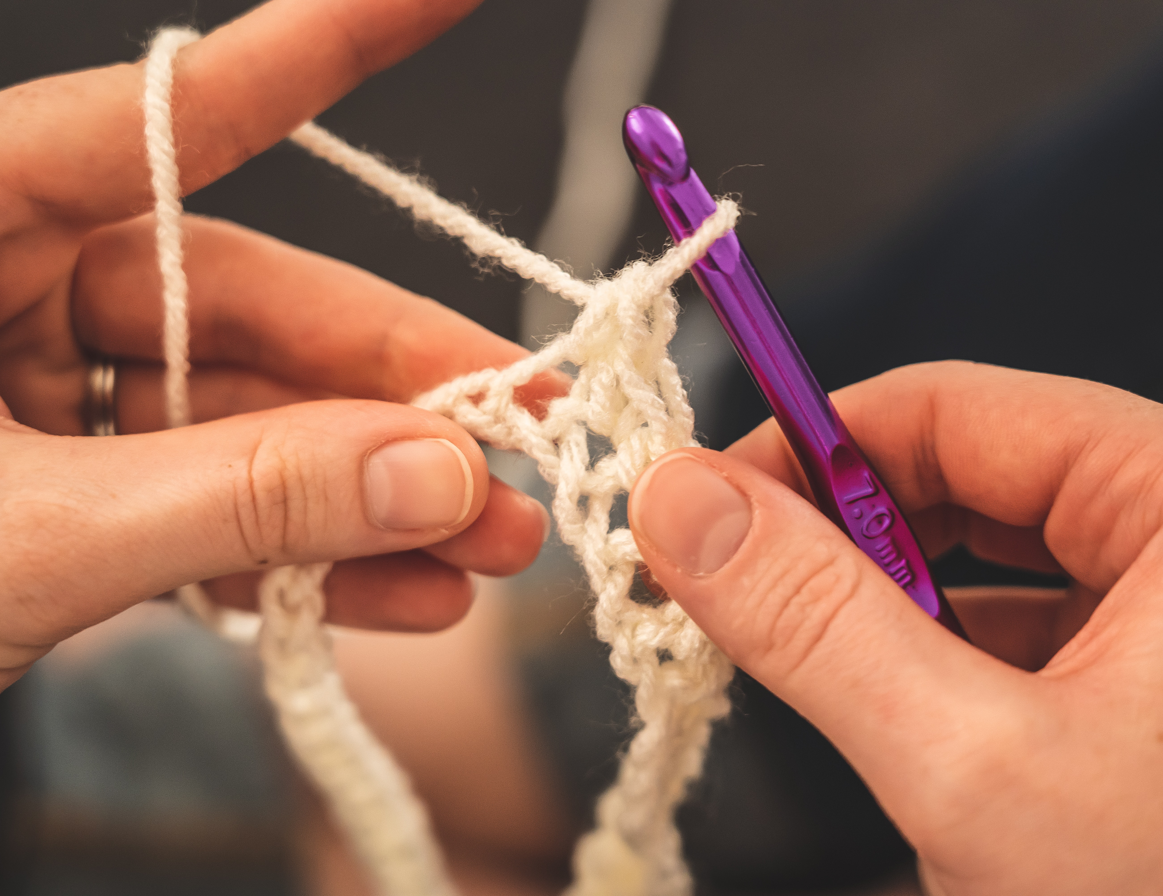
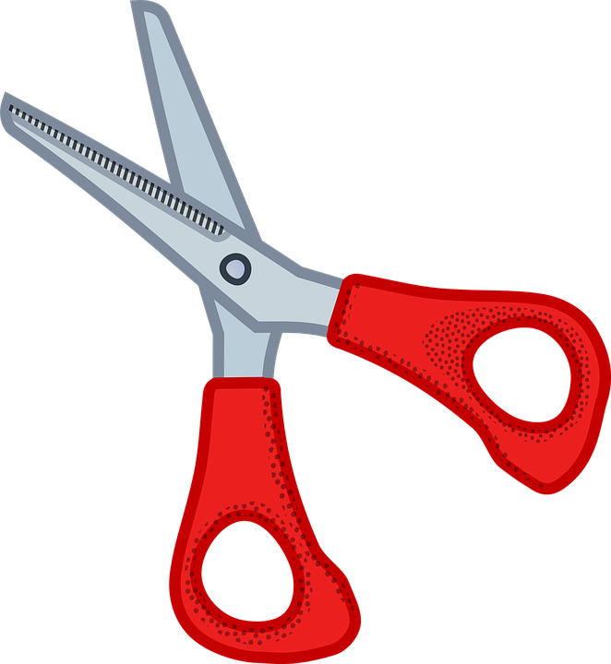
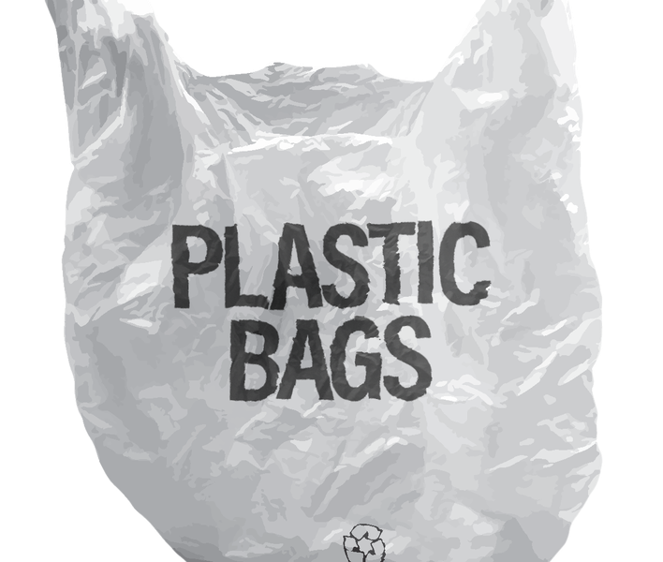
Isatoe Cessay demonstrating how to recycle plastic bags.
https://www.youtube.com/watch?v=1zZw7yrI22M
If you want to try this you will need:
A clean, reuseable plastic bag
A pair of scissors
A crochet hook
This Photo by Unknown author is licensed under CC BY-NC.

