Slide 1
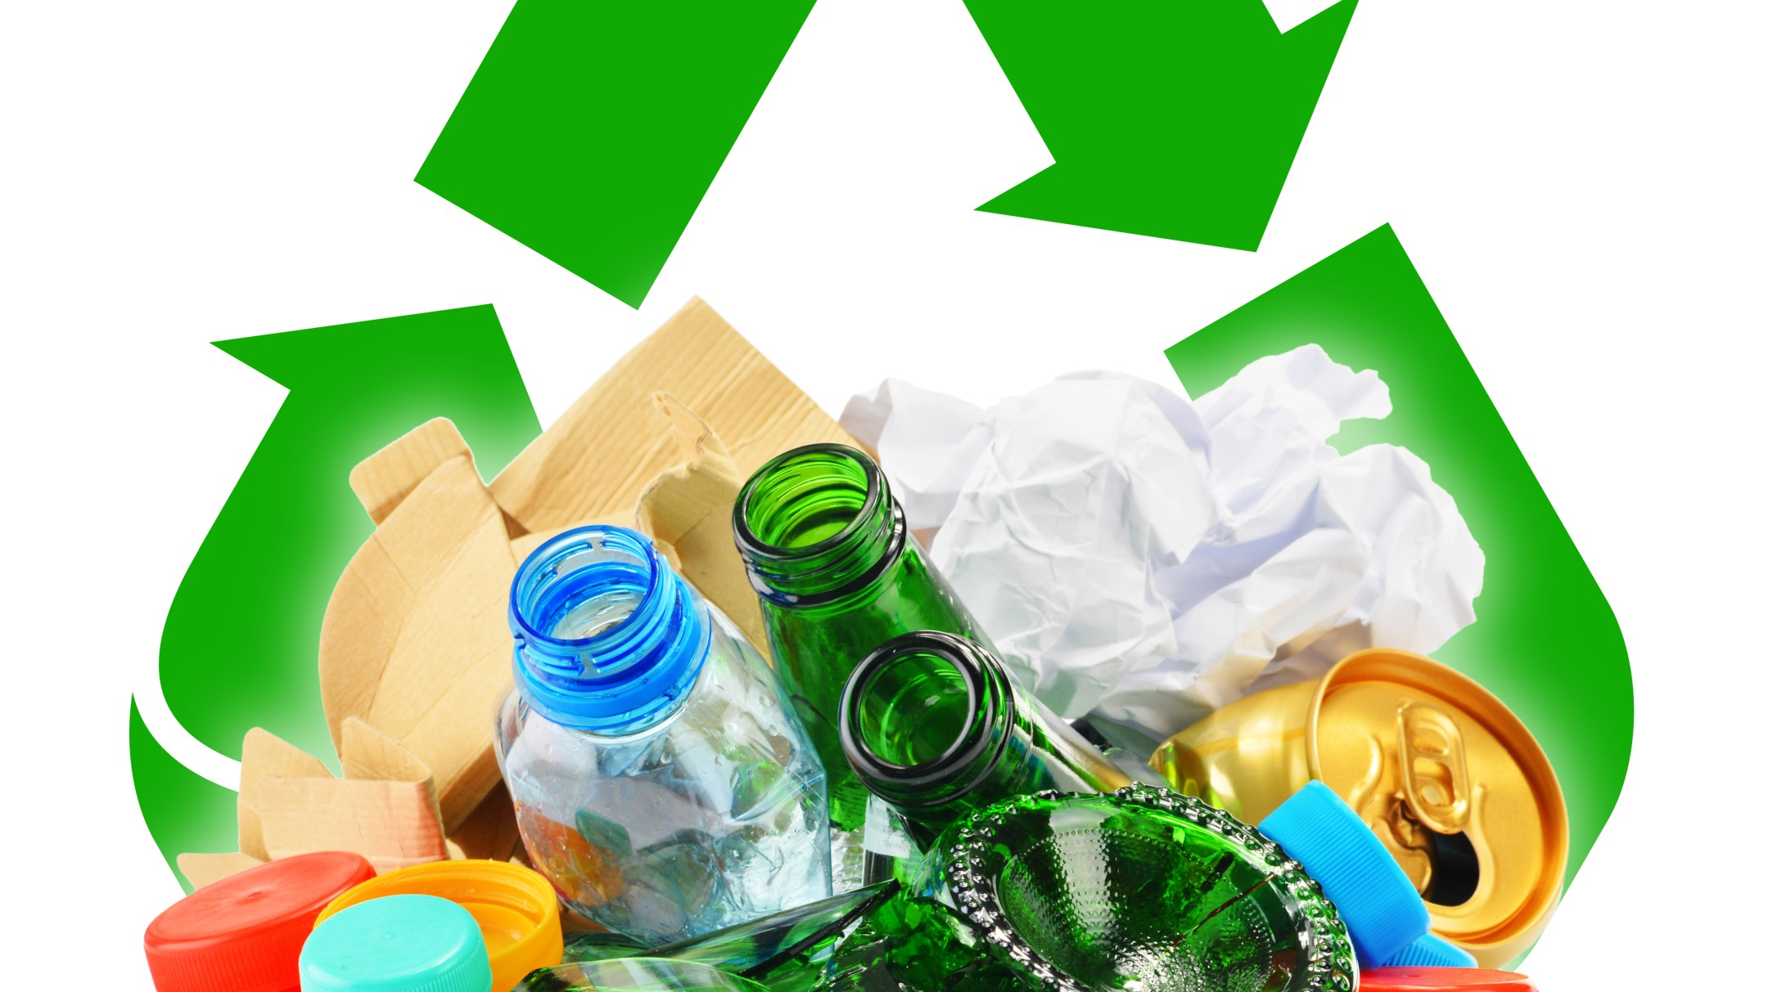
RECYCLING/REUSING/ UPCYCLING
This Photo by Unknown author is licensed under CC BY-SA.

Slide 2
Learning intentions
Listening – students will listen to a story
Speaking – students will participate in discussions
Writing – students will label a design
Art and design – students will design and construct a toy using recycled, reused and repurposed items
Technology – students will develop an understanding between elements to create motion and force
Today you will design a toy using recycled, reused and repurposed items

Slide 3
New vocabulary
Recycling – making a use for something that may have been thrown away
Reusing – to use again in a different way
Upcycling – reuse something to make it into something better
Fed-up – annoyed. Especially with something that has happened for a long time
Fiori tree – an African tree that loses it leaves each year

Slide 4
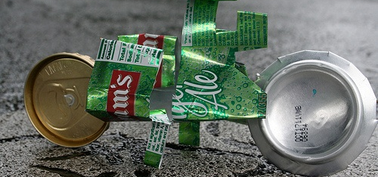
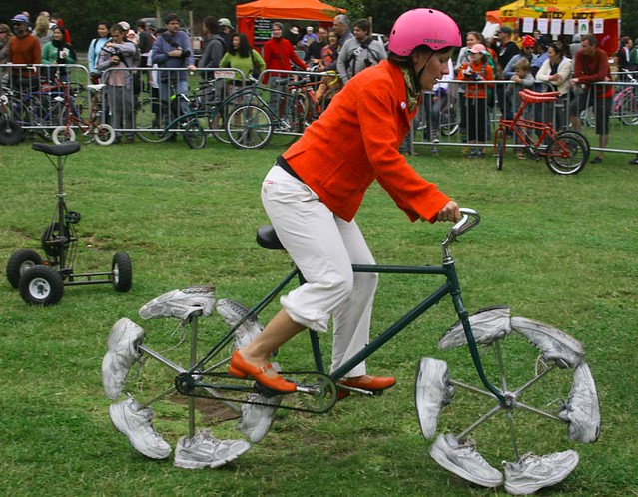
THE PATCHWORK BIKE by Maxine Clarke Illustrated by Van T Rudd
https://storyboxlibrary-com-au.eu1.proxy.openathens.net/stories/the-patchwork-bike
This Photo by Unknown author is licensed under CC BY.
This Photo by Unknown author is licensed under CC BY.

Slide 5
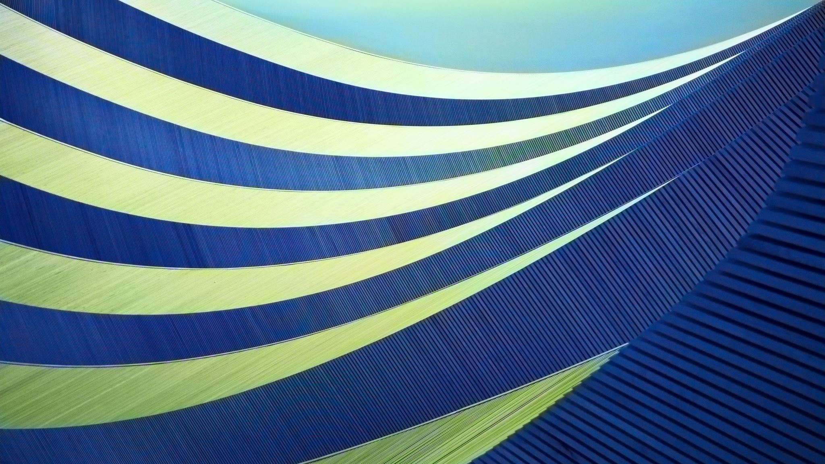
What did the children use to make their bicycle out of?
Can you remember 3 of the things that they used?

Slide 6
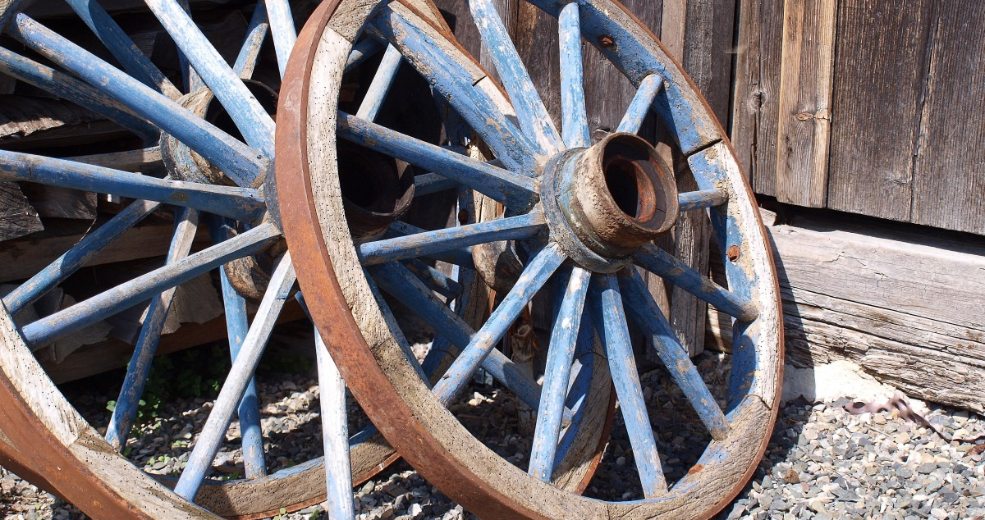
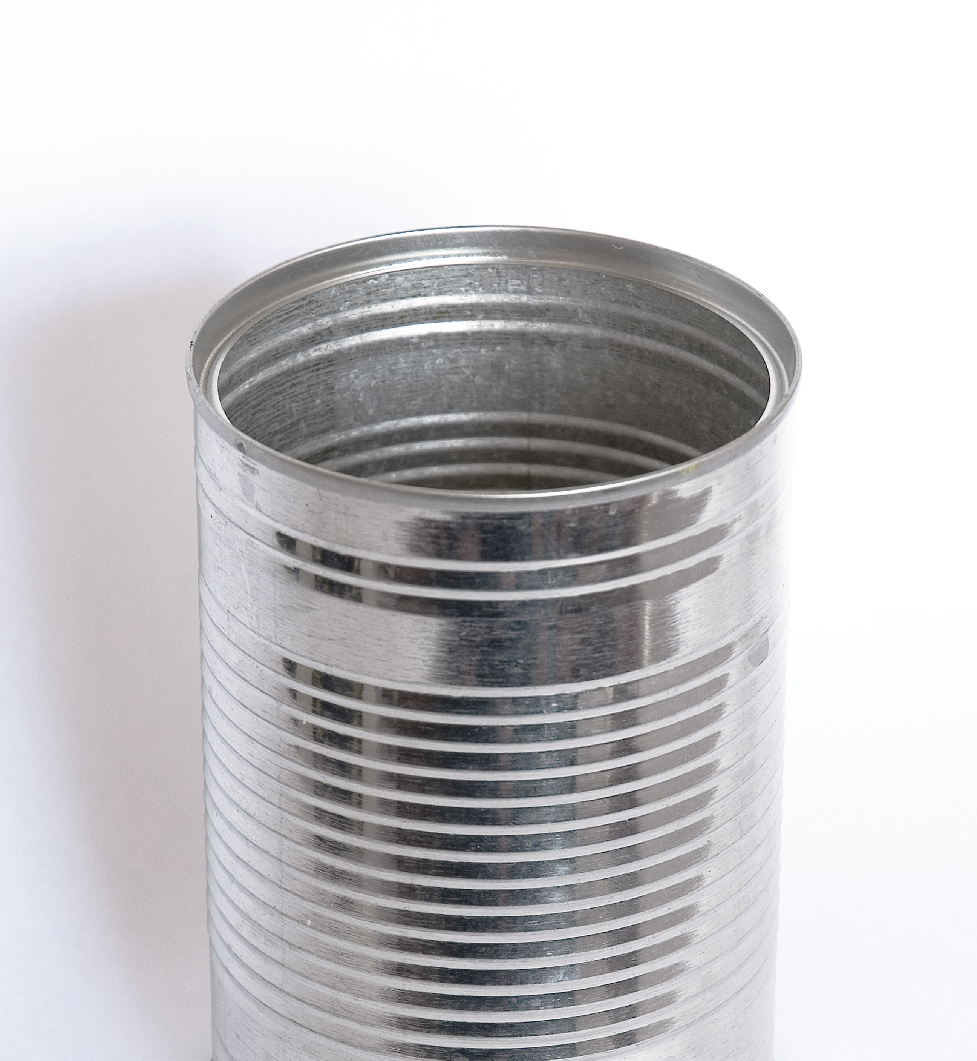
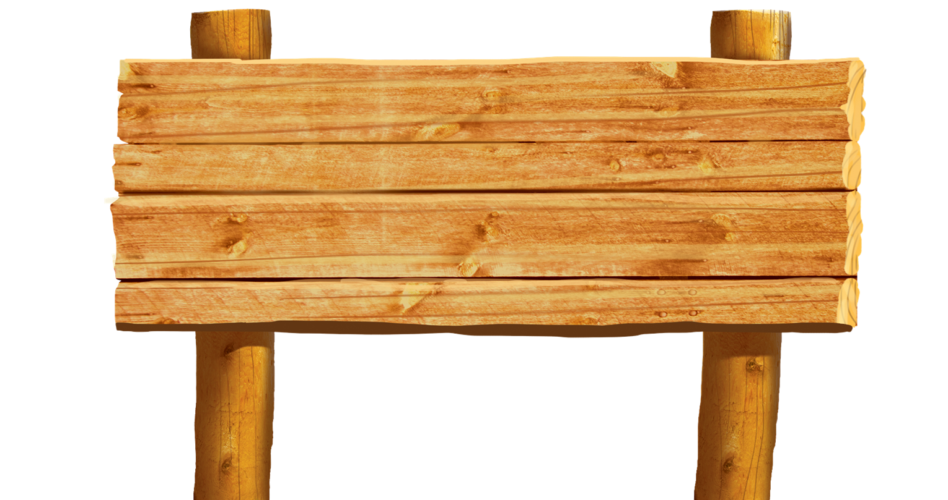
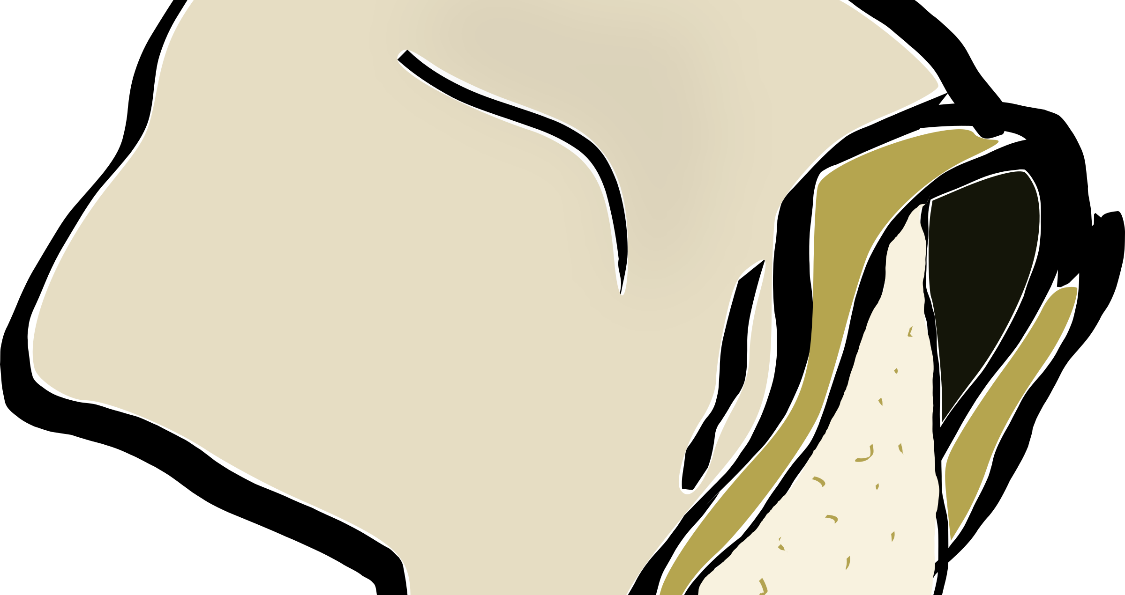
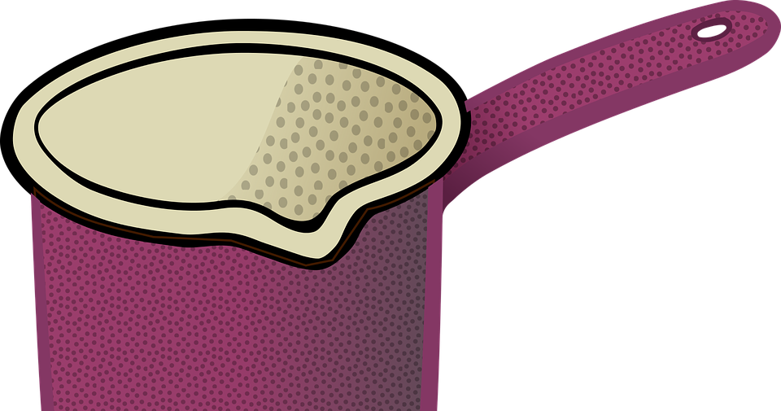
This Photo by Unknown author is licensed under CC BY-NC.
This Photo by Unknown author is licensed under CC BY-SA.
This Photo by Unknown author is licensed under CC BY.

Slide 7
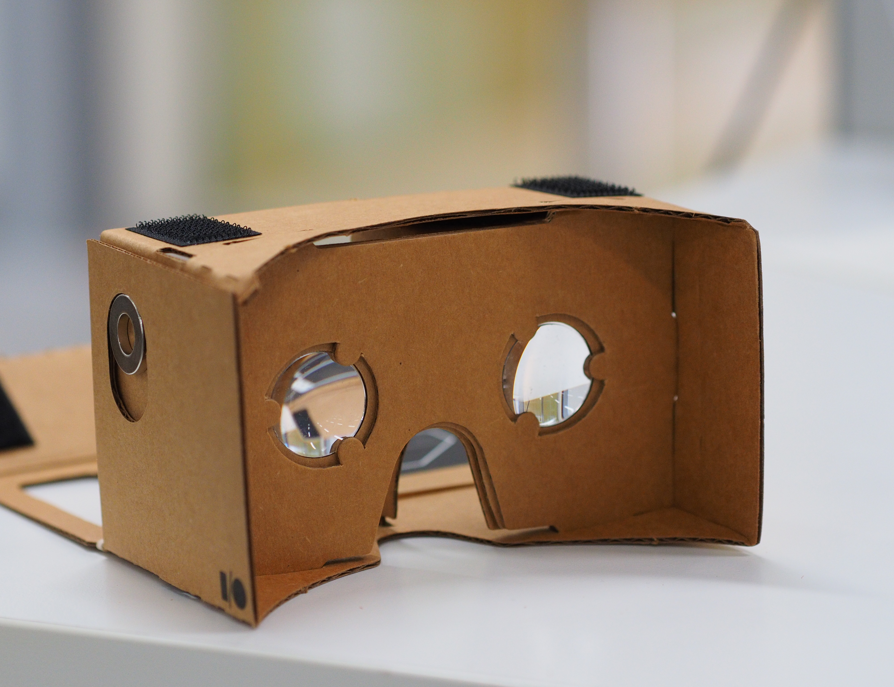
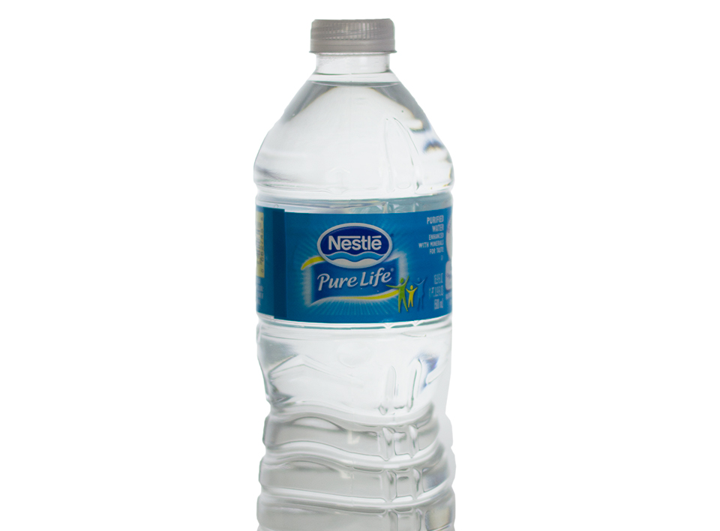
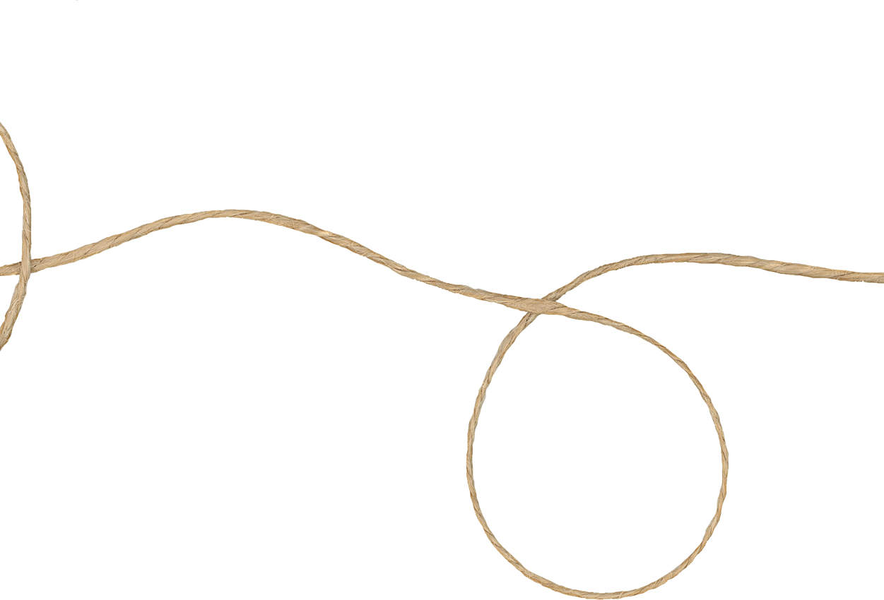
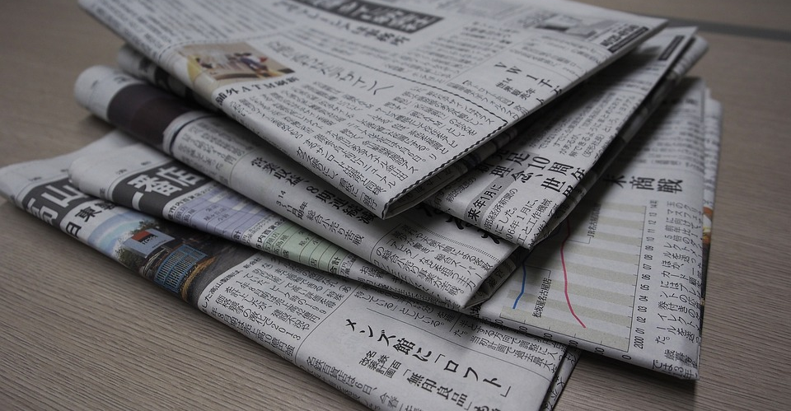
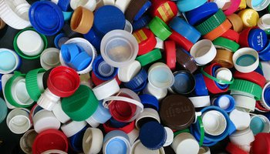
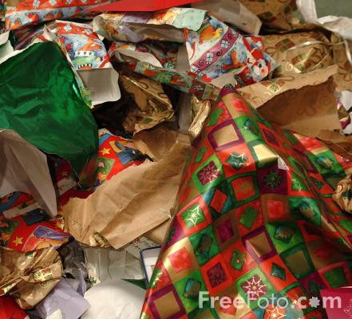
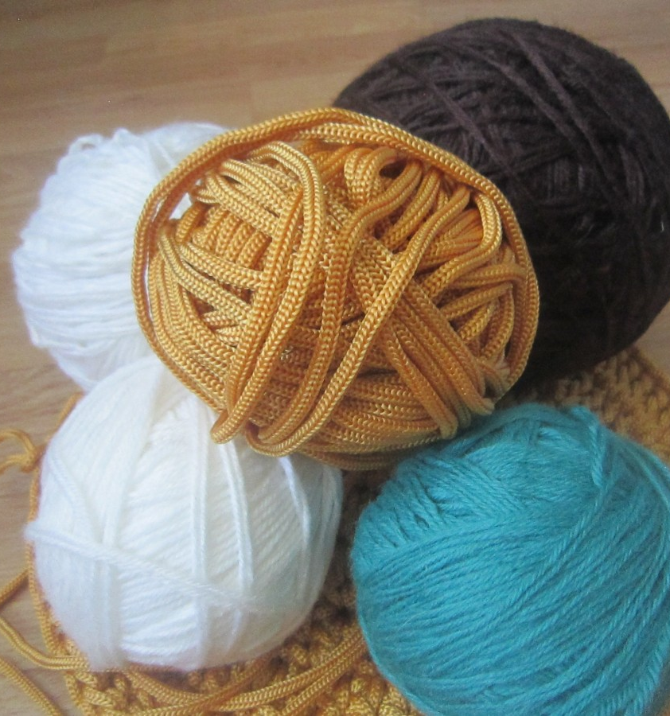
Let's see what you can come up with.
You are going to draw a picture of a toy that you can make by recycing, reusing and repurposing materials that you can easily find.
This Photo by Unknown author is licensed under CC BY-NC.
This Photo by Unknown author is licensed under CC BY-NC-ND.
This Photo by Unknown author is licensed under CC BY-SA-NC.
This Photo by Unknown author is licensed under CC BY-NC.
This Photo by Unknown author is licensed under CC BY-SA.

Slide 8
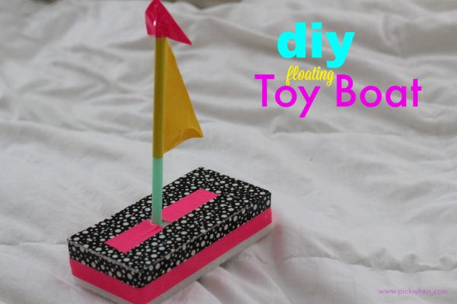
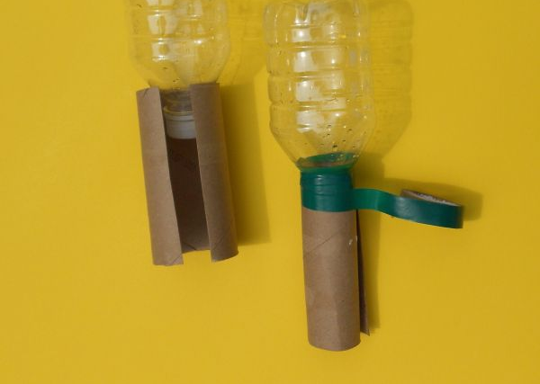
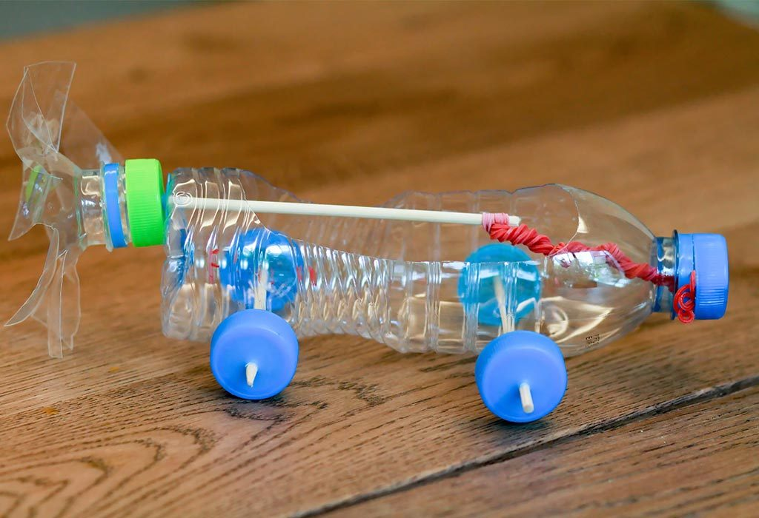
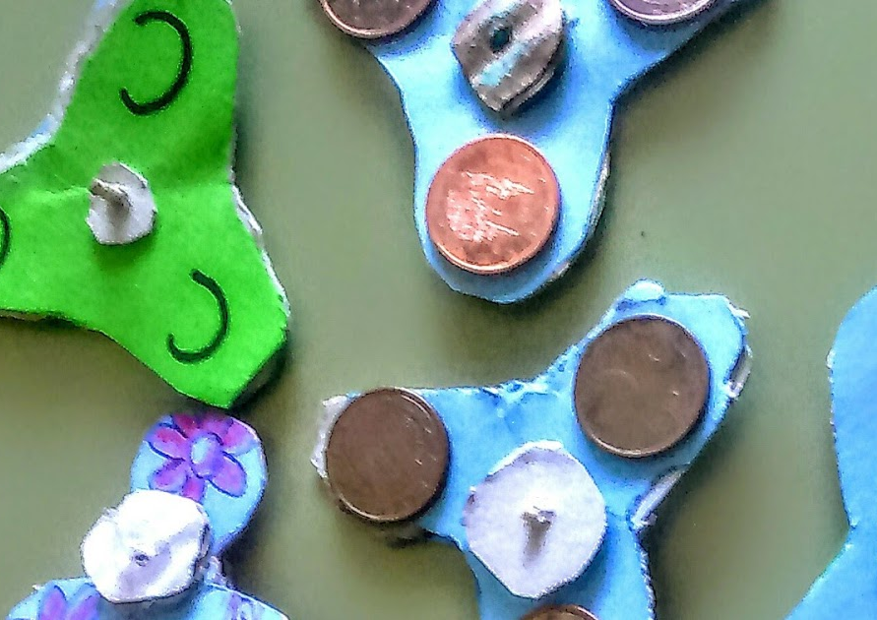
Some children don't have toys that are bought in shops. They need to make toys from materials that they find in and around their homes.
Have a look around the room that you are in now? Are there any things that you could use to make a toy?
What things do you have that could be made into a toy?
What could you make a toy out of?
This Photo by Unknown author is licensed under CC BY-NC-ND.
This Photo by Unknown author is licensed under CC BY-NC-ND.
This Photo by Unknown author is licensed under CC BY-SA.
This Photo by Unknown author is licensed under CC BY.

Slide 9
Think of a toy
Think of what you can make it from
Draw a picture of what you are thinking
Label the pieces of the toy
Label what you
are using to make
the toy
straw
Plastic bottle
Plastic bottle tops

Slide 10
A TOY MADE OF RECYCLED, REPURPOSED, REUSED, UPCYCLED MATERIALS
I am going to make a …....................................................
It will be made out of….....................................................
….......................................................................................
It will look like this

Slide 11
Further resources and ideas for lessons
https://www.lamontbooks.com.au/media/96132/the-patchwork-bike-teachers-notes-from-publisher.pdf

