Slide 1
Human made dangers in animal habitats

Slide 2
Learning intentions Lesson 1
Listening: students will listen to a story
Writing: students will write a retell of a story putting the retell into the context of the environment in which they live.
Speaking: students will engage in discussion and present their work
Science: students will explore dangers that animals encounter that are made by humans
Today students will listen to a story and write a retell of the story about animals in the Maldives. In doing so they will learn about some man-made hazards that animals encounter.

Slide 3
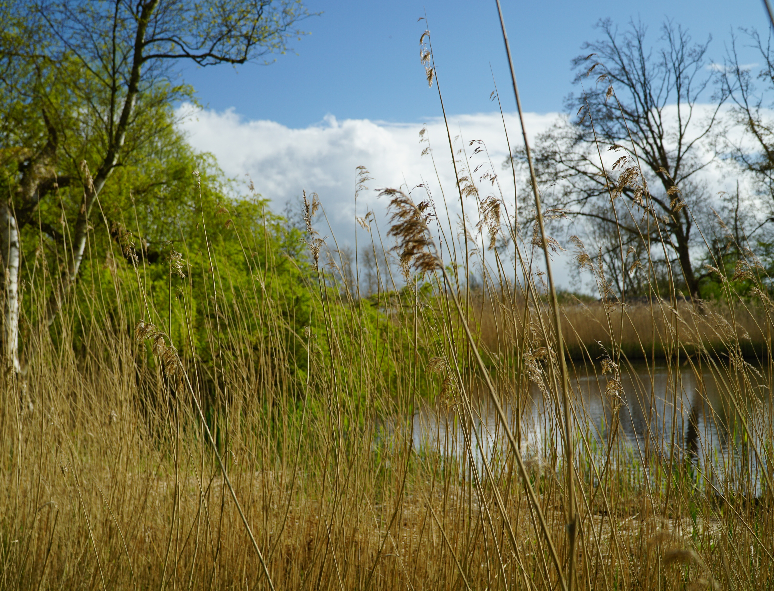
New vocabulary
habitat – a place where things live
hazards – dangers or risks

Slide 4
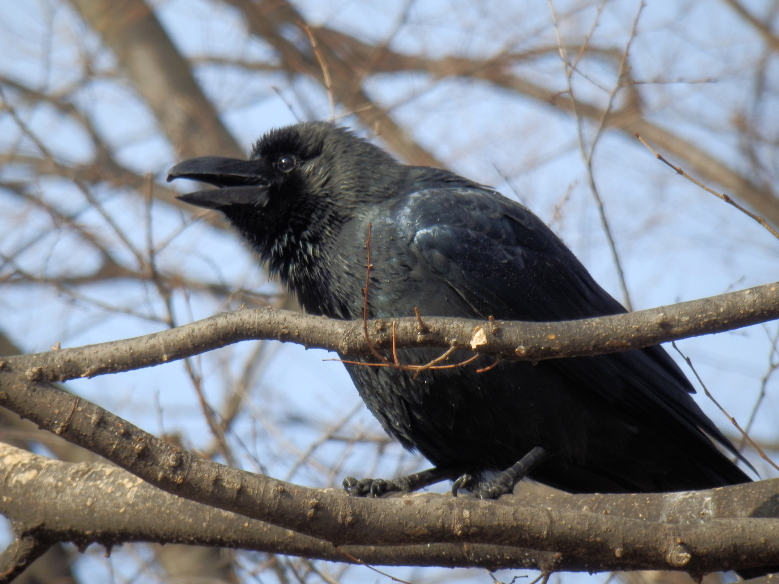
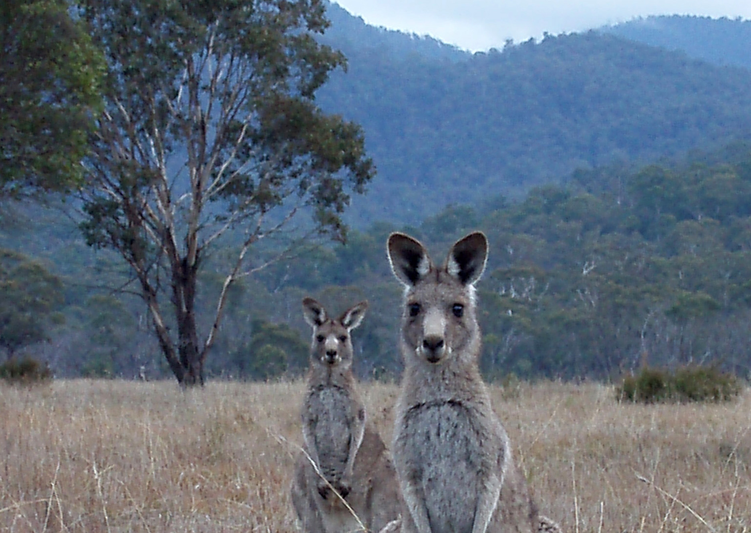
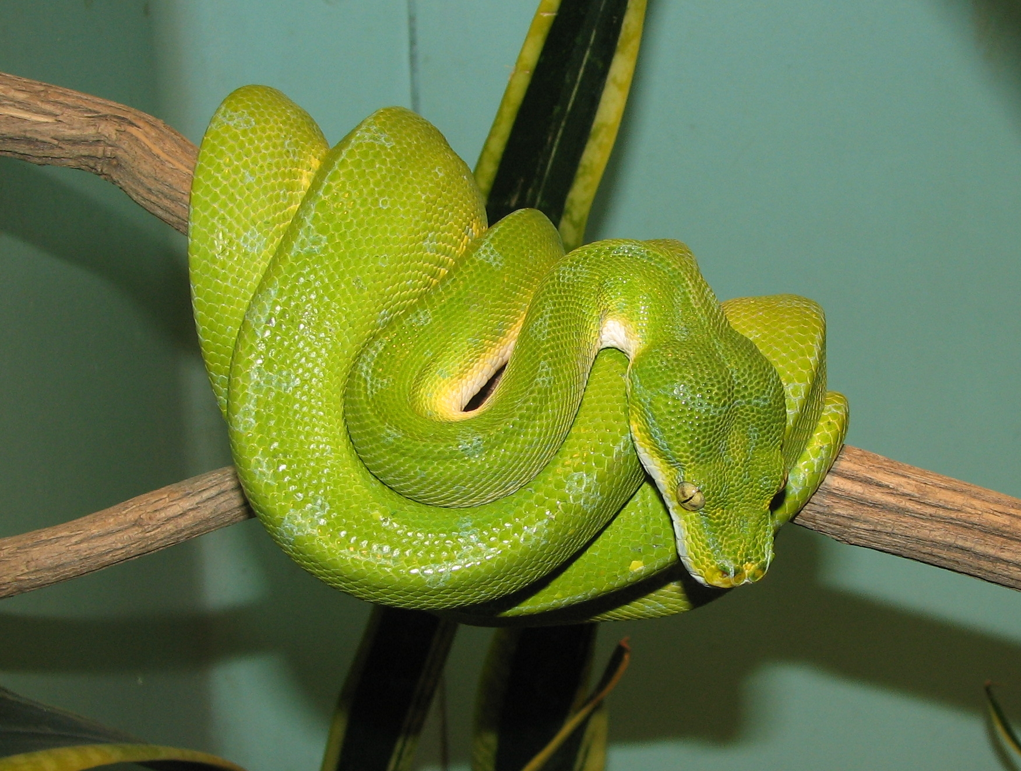
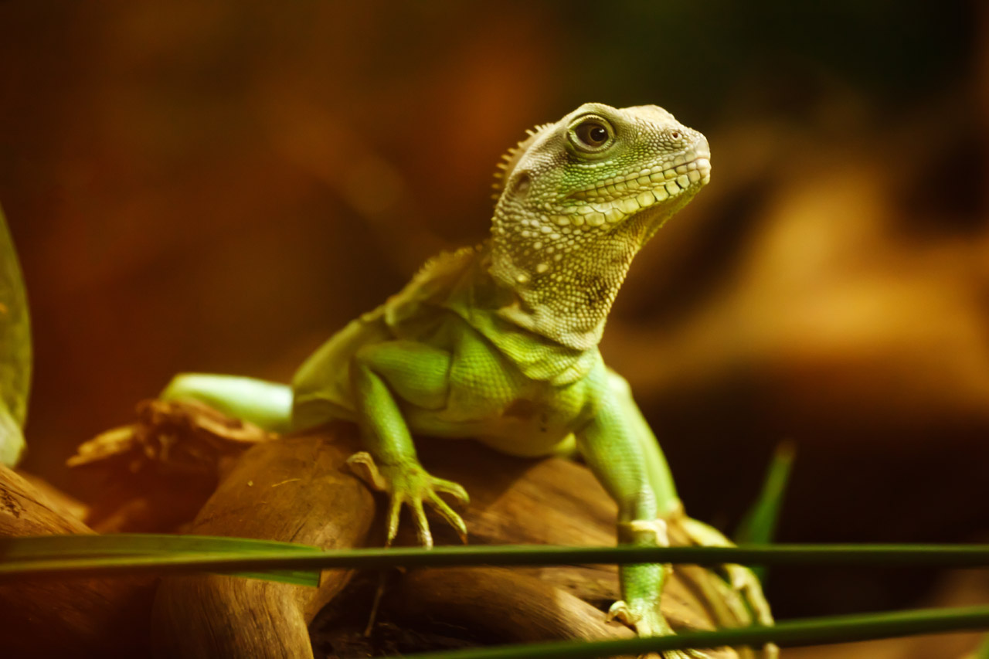
The story that you are going to listen to today is about 4 animals and things that happen to them in their habitat.
The characters are:
Benny Bungarra
Olive Python
Kathy Kangaroo
Colin Crow
This Photo by Unknown author is licensed under CC BY-SA.
This Photo by Unknown author is licensed under CC BY.

Slide 5
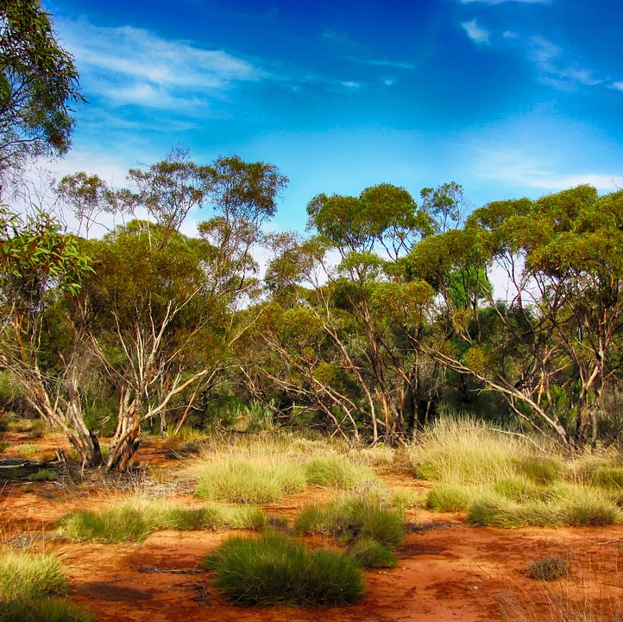
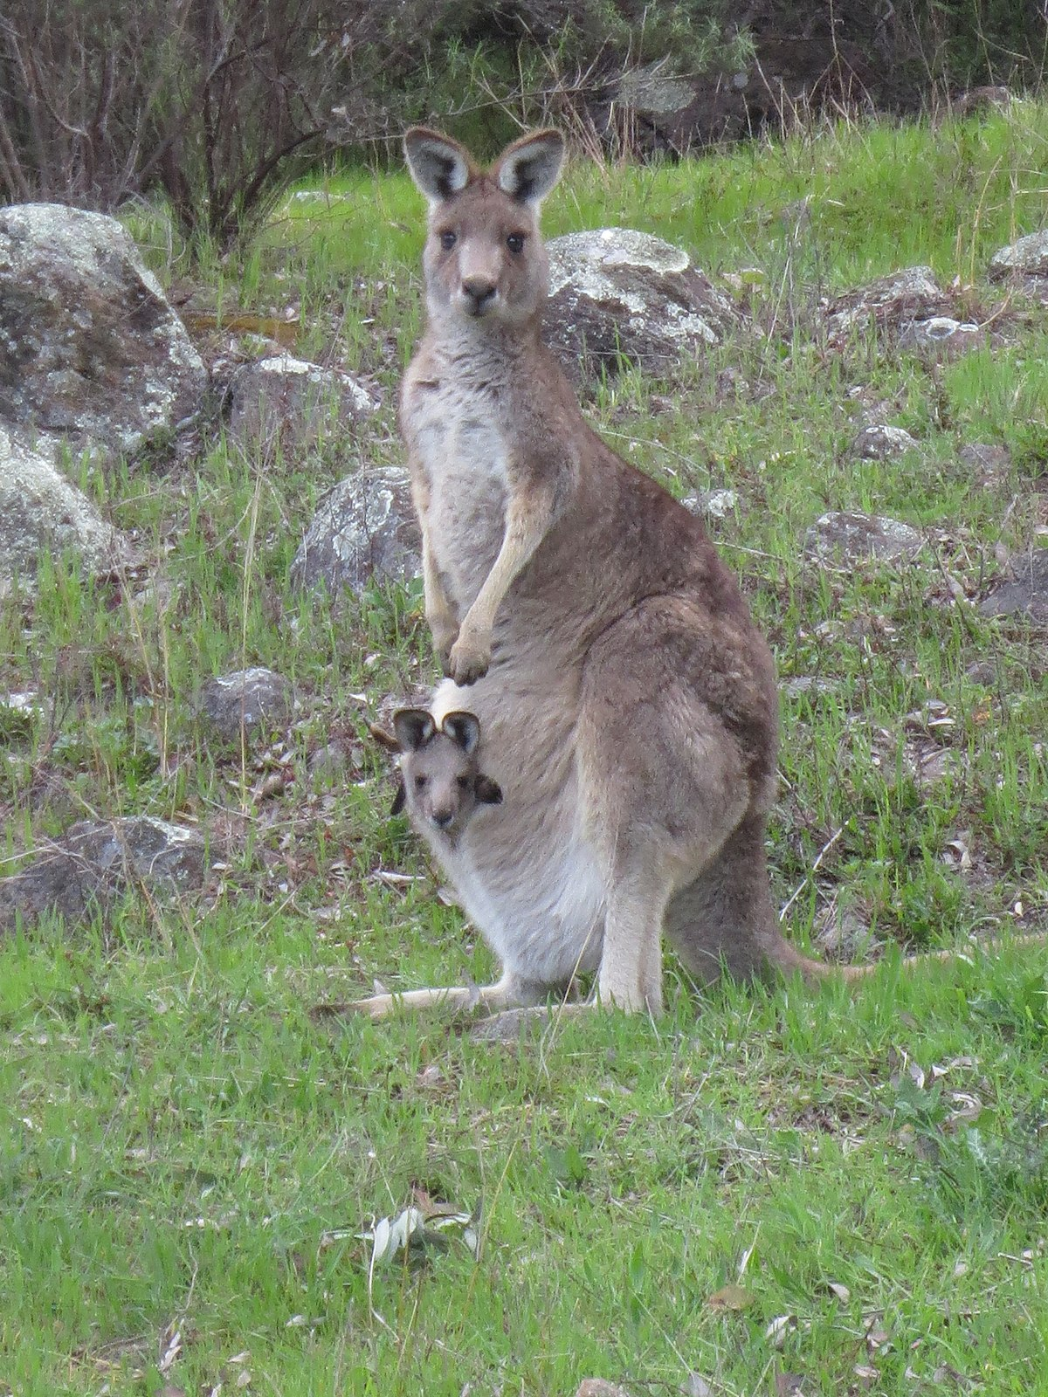
BENNY BUNGARRA'S BIG BUSH CLEAN UP by Sally Morgan
https://www.youtube.com/watch?v=Hy8KAqoiBgo.
What do you think is going to happen in this story?
Make some predictions
This Photo by Unknown author is licensed under CC BY-SA.

Slide 6
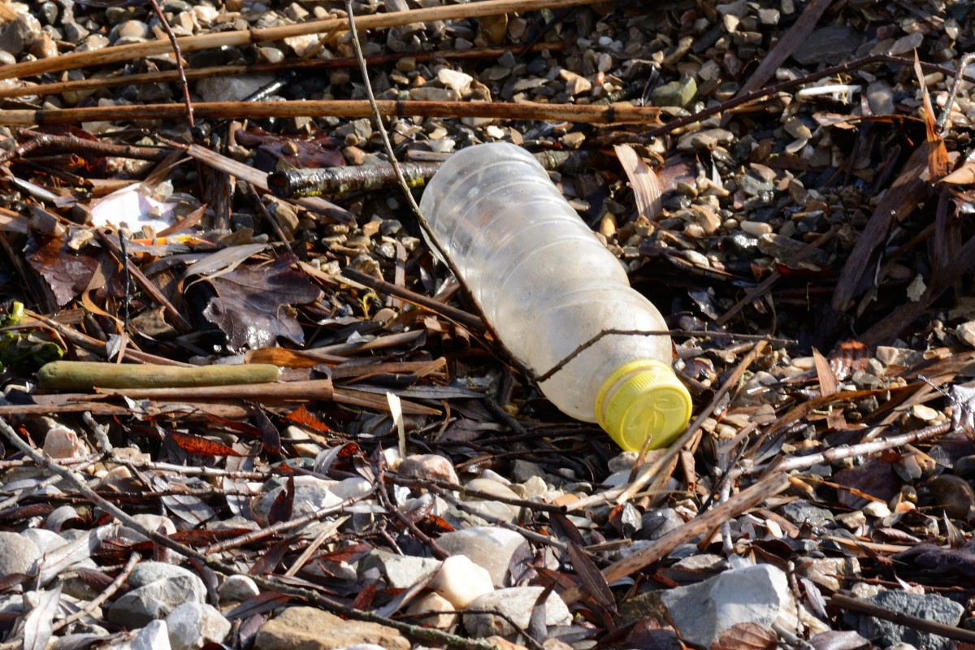
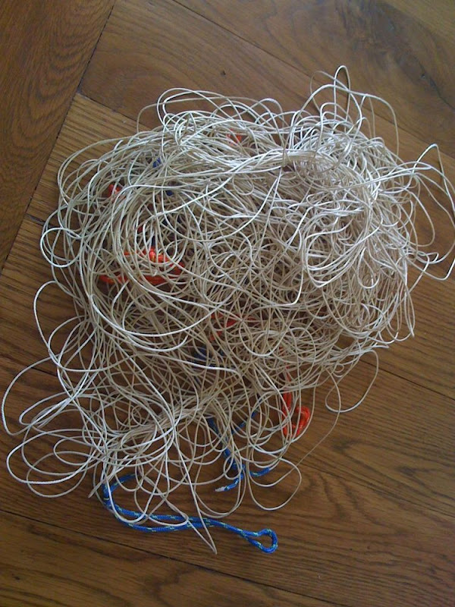
How did these things affect the animals in the story?
Benny Bungarra
Olive Python
Kathy Kangaroo
Colin Crow
This Photo by Unknown author is licensed under CC BY-NC-ND.

Slide 7
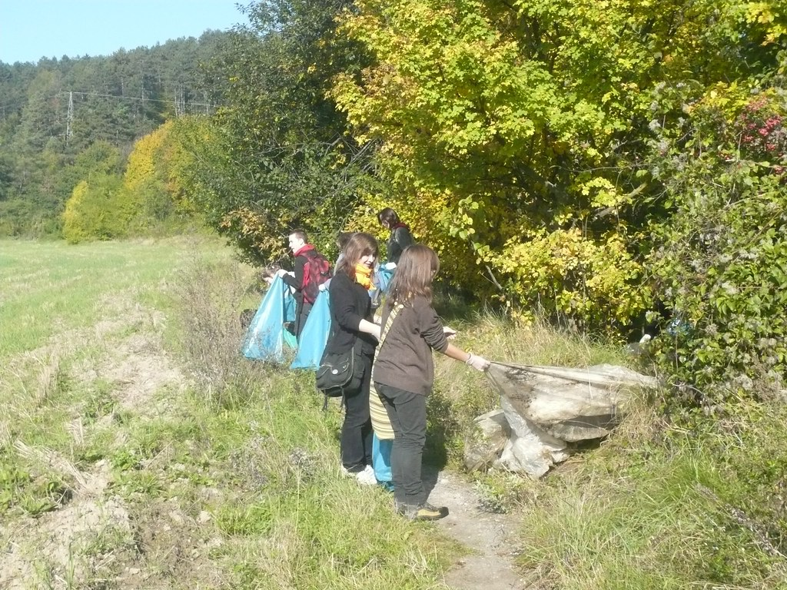
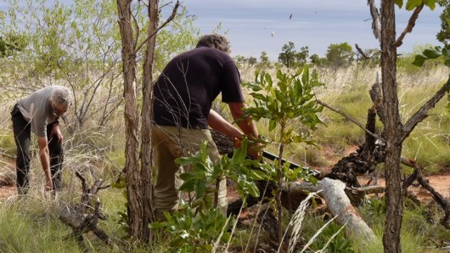
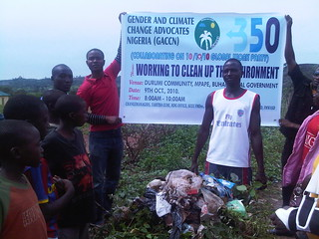

Slide 8
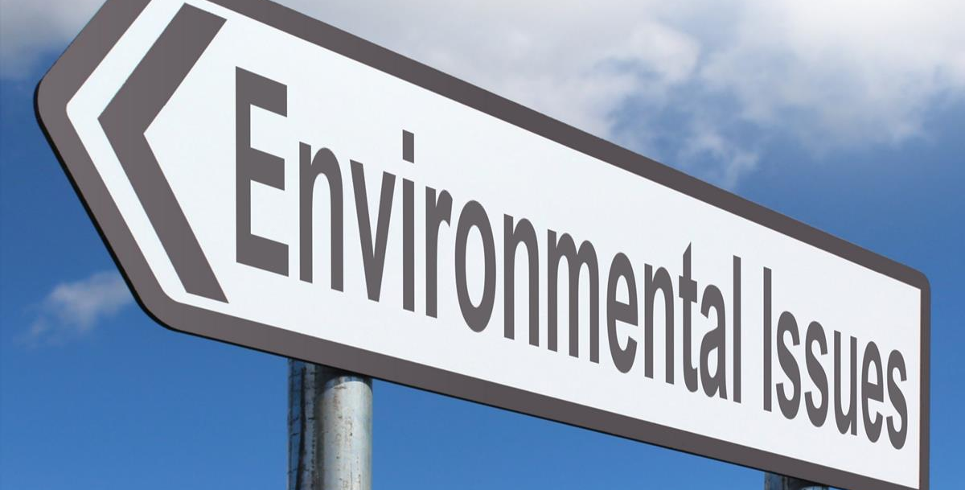
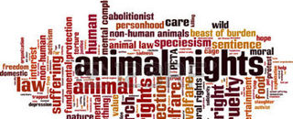
How could the situations and solutions, in the story, be similar or dissimiliar to your community?
What are some dangerous situations that animals could find themselves in in your community?
What could be the solutions?
This Photo by Unknown author is licensed under CC BY-SA.

Slide 9
What is a retell? A retell is when you rewrite or retell a story in your own words.
Adapt the story that you have heard today.
Choose 4 animals from your local environment
Give your animals (characters) names
Give your story a title
Write a retell of the story using your chosen animals and including situations that they could confront in their habitat
Provide a solution, or solutions to the dangers that the animals encounter.

Slide 10
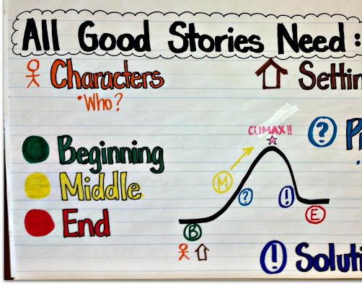
Elements to include in your retell
Title
Characters
Setting – where does this happen
Sequence of events
Solutions to challenges encountered by your characters
Conclusion
This Photo by Unknown author is licensed under CC BY-ND.

Slide 11
Quick check list of what you need to do
What are your animals?
What are their names?
What is your title?
What happens?
What are the solutions?

Slide 12
Worksheet
Creature: Whale
Name: Willie
Problem: whale gets tangled in fishing netting
Solution: Carefully drive a boat to get close to the whale. Use a long hook on the end of a rope to throw to the whale where the hook will attach to the net. Gently pull the net free from the whale.
Sketch of my solution

