Slide 1
Human made dangers in animal habitats

Slide 2
Learning intentions Lesson 2
Listening: students will listen to a story
Writing: students will write a short puppet play.
Speaking: students will engage in discussions students will present their work
Science: students will explore dangers that animals encounter that are made by humans
The Arts: students will create puppets for the characters that will be in their puppet show.

Slide 3
Lesson 2
PART 1
Revisit the retell that you wrote in lesson 1
Adapt your retell (from lesson 1) to enable you, and a group of your friends, to enact the story in the form of a puppet show
PART 2
Create a puppet for each of your characters .
PART 3
Present your puppet show to an audience outside of your classroom

Slide 4
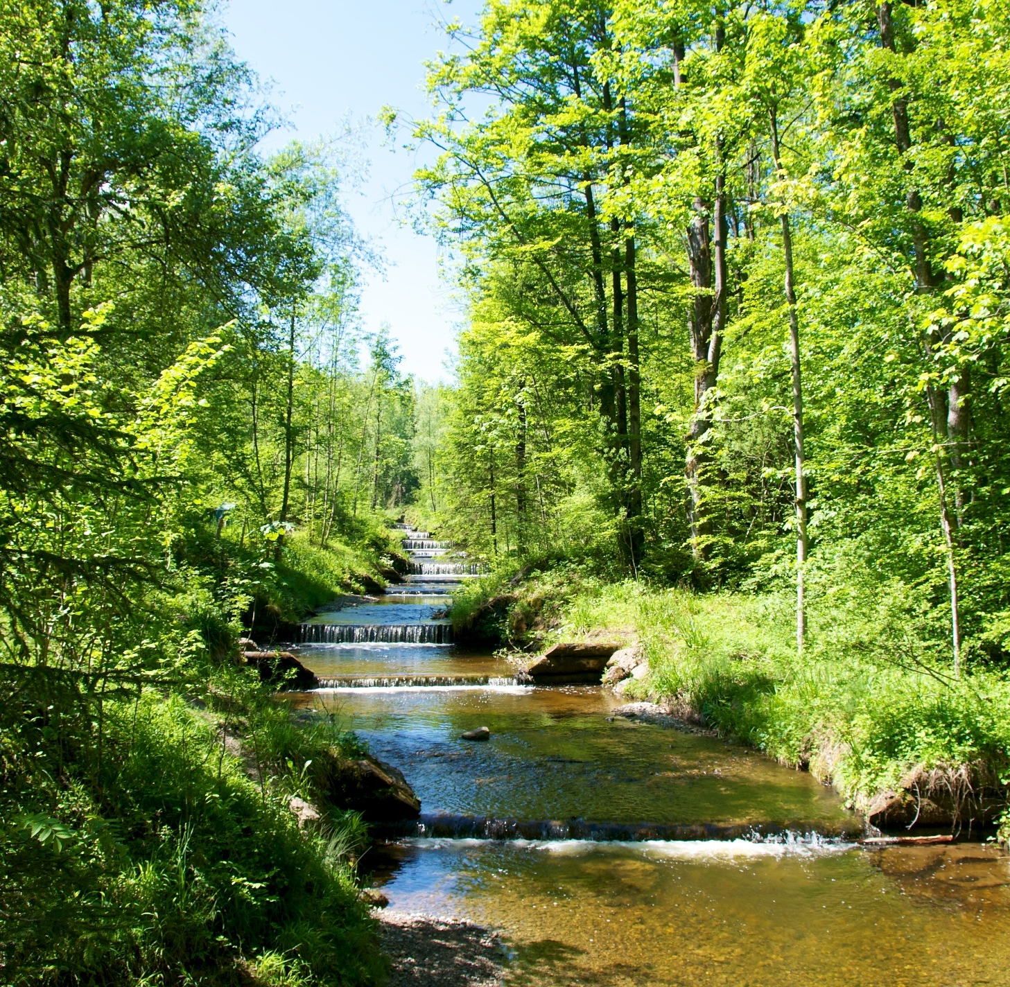
New vocabulary
Habitat – places where things live
Hazards – dangers or risks

Slide 5
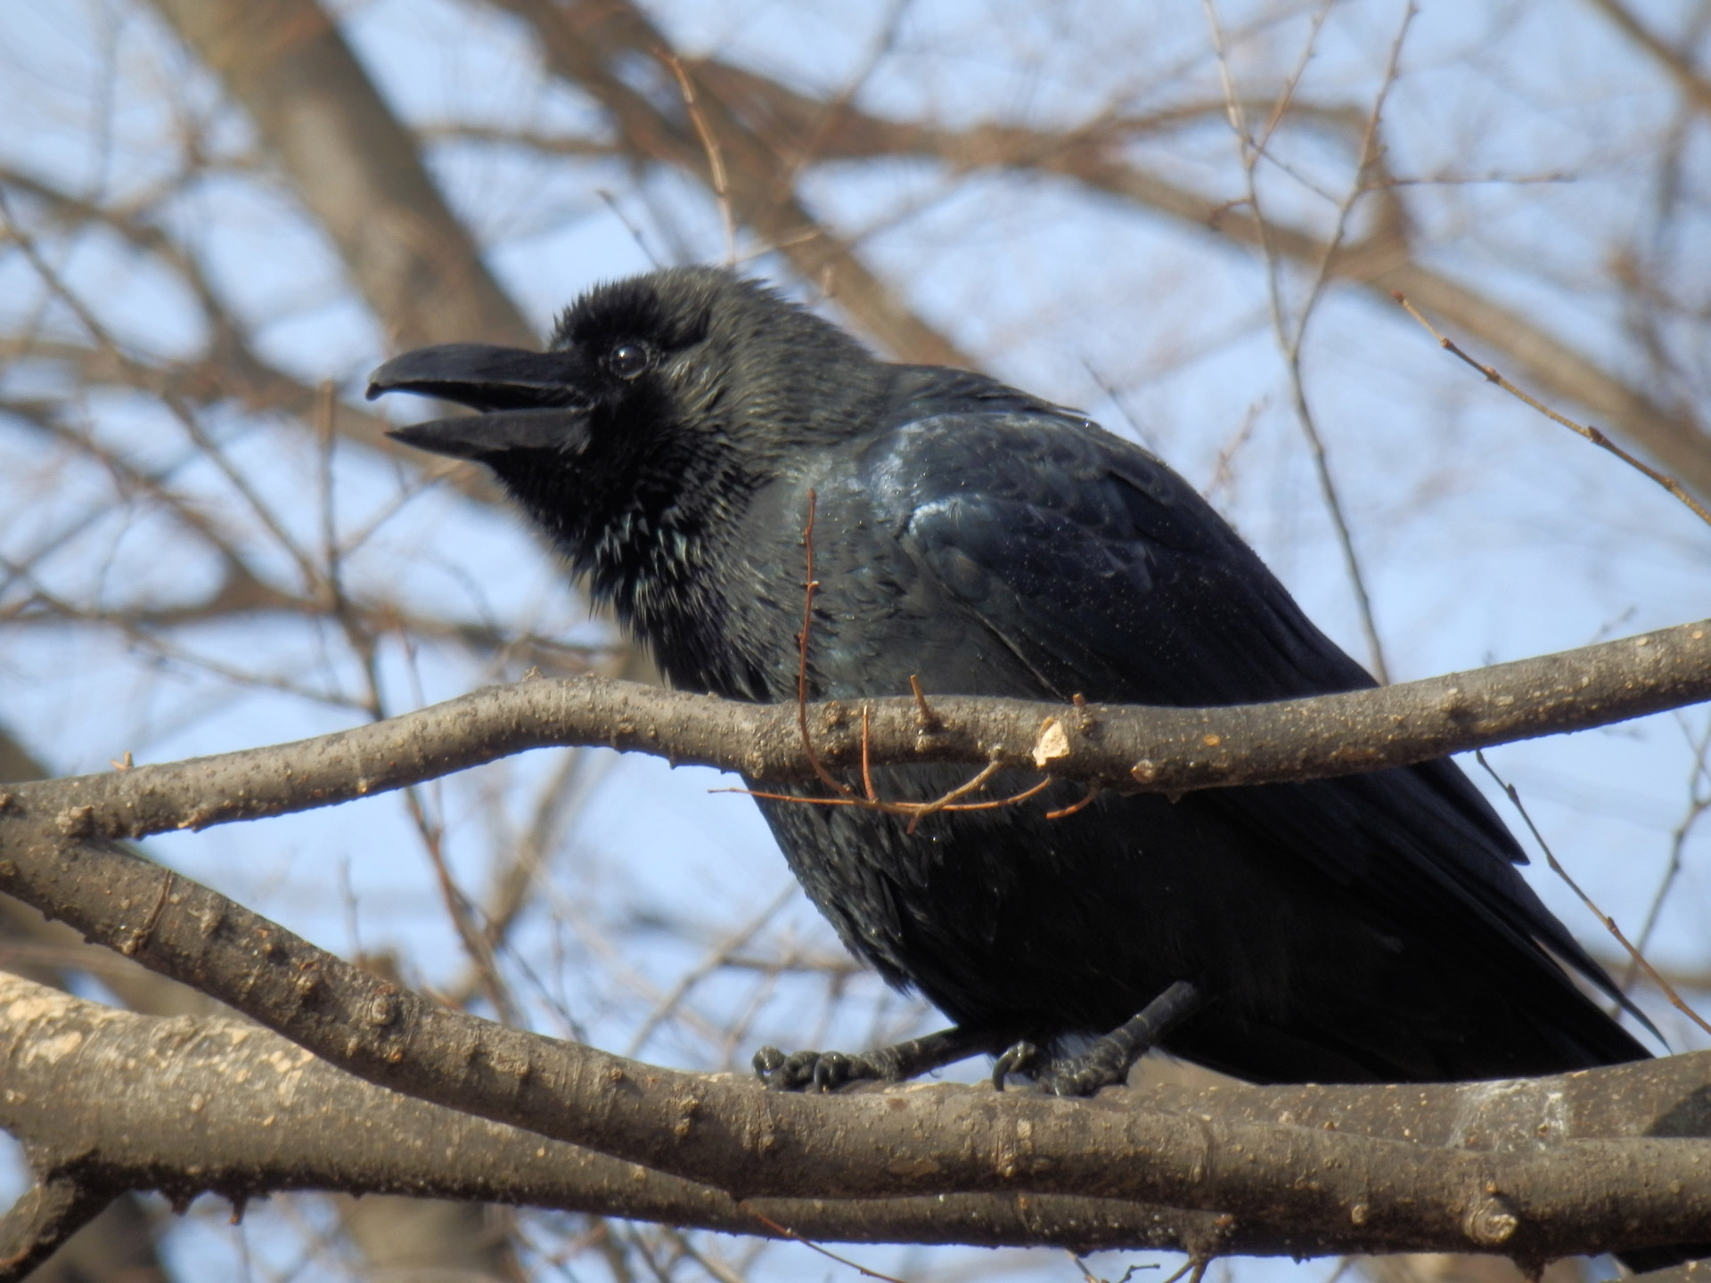
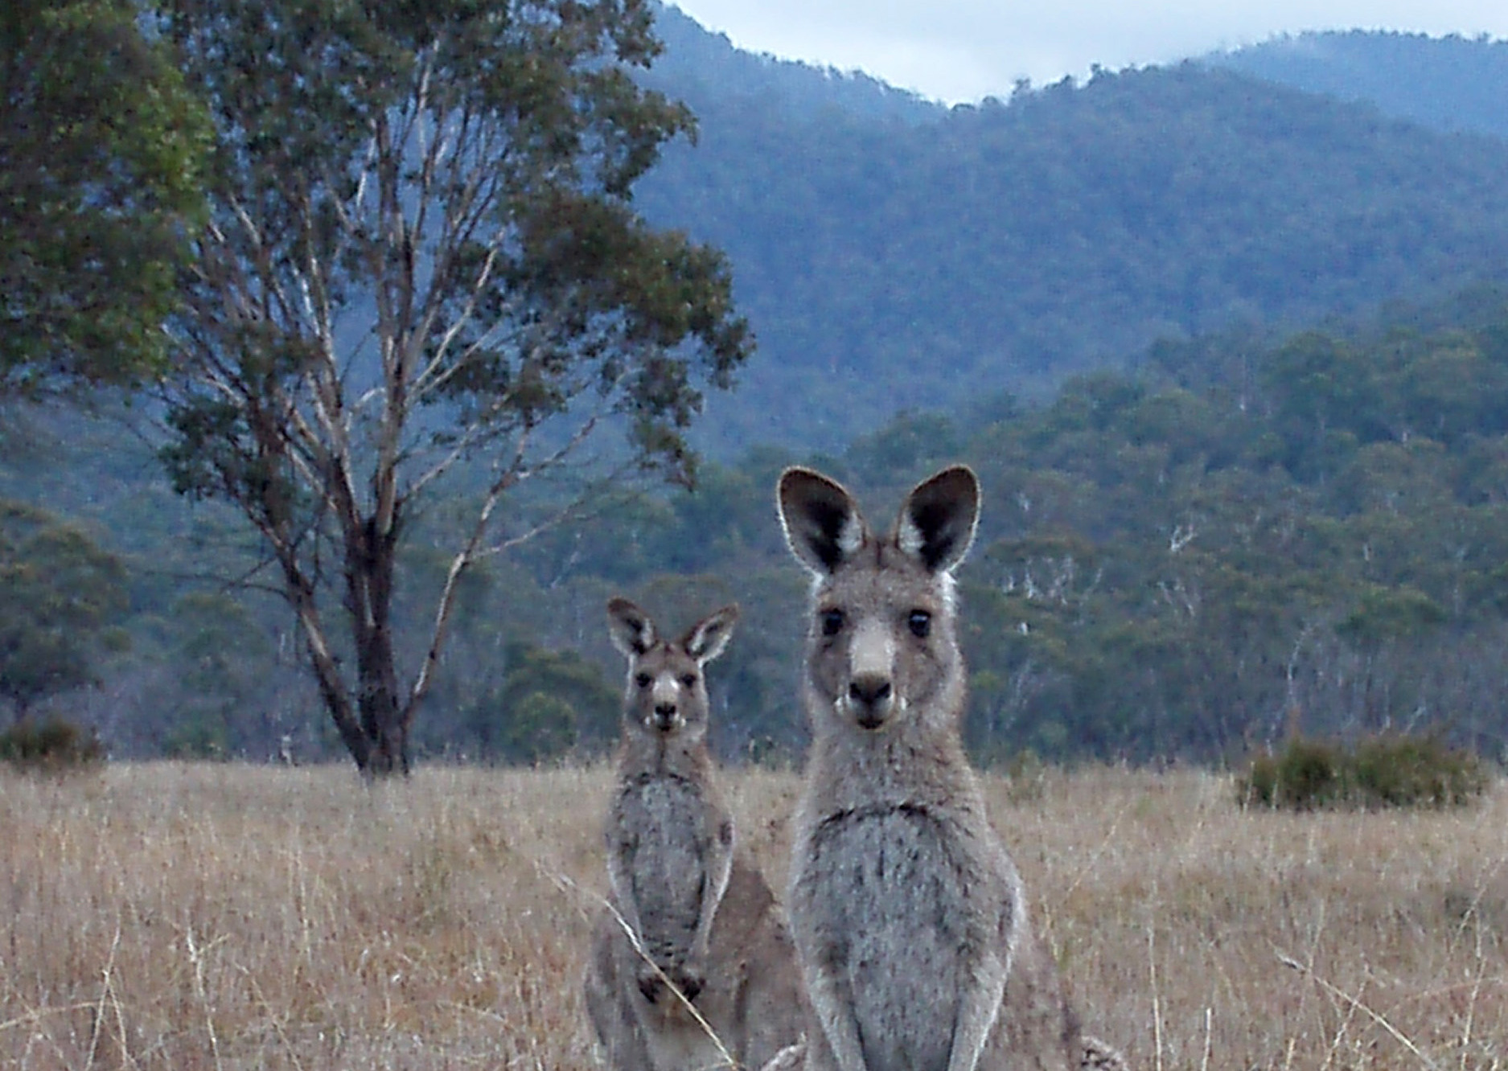
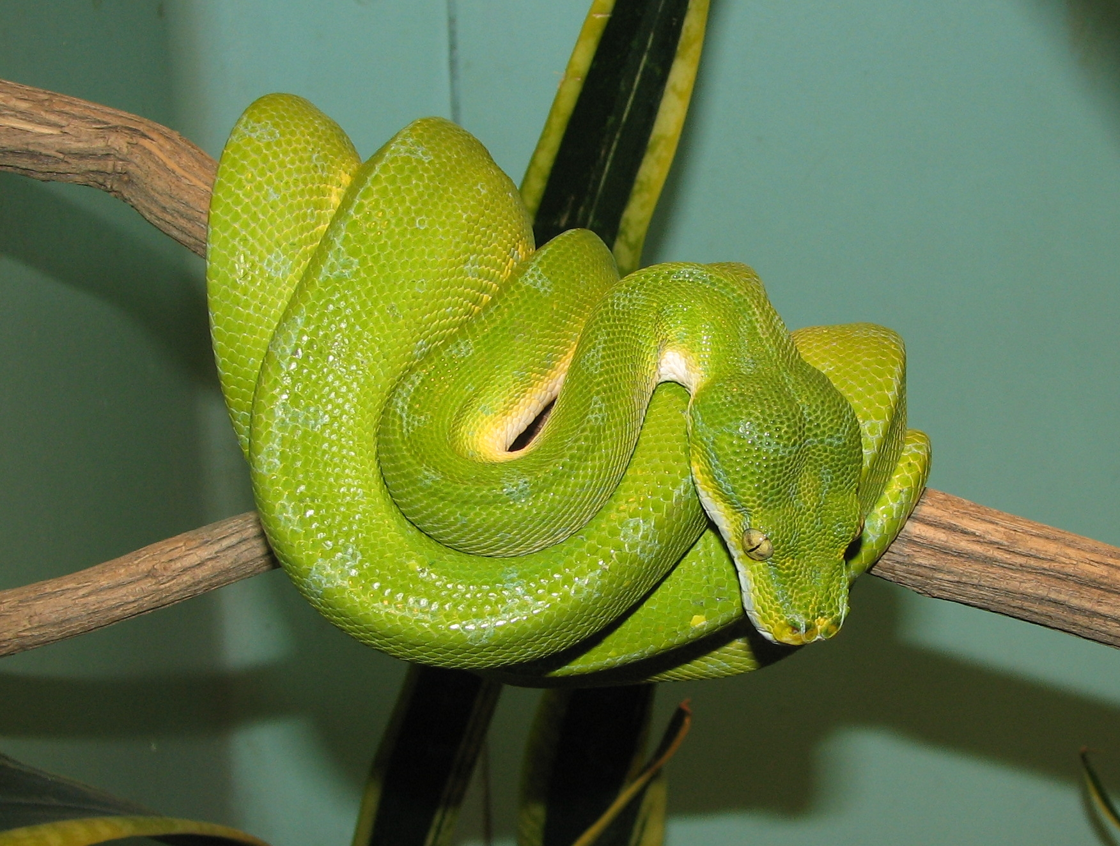
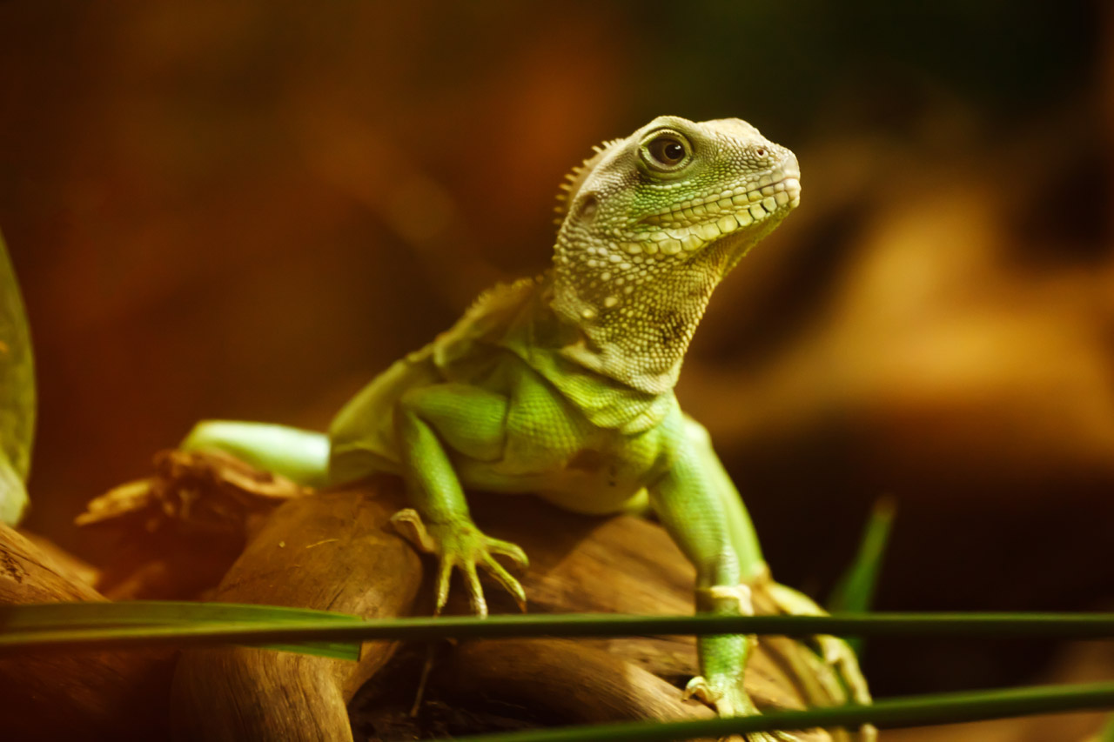
The story that you are going to listen to today is about 4 animals and things that happen to them in their habitat.
The characters are:
Benny Bungarra
Olive Python
Kathy Kangaroo
Colin Crow
This Photo by Unknown author is licensed under CC BY-SA.
This Photo by Unknown author is licensed under CC BY.

Slide 6
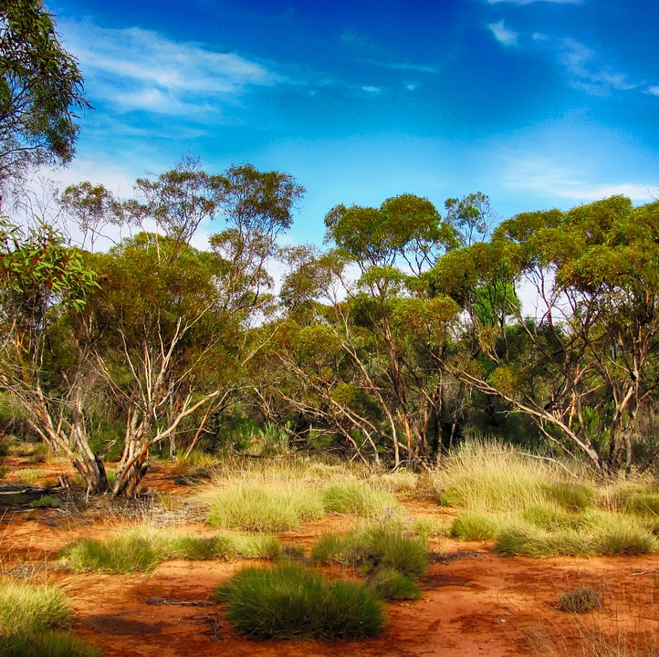
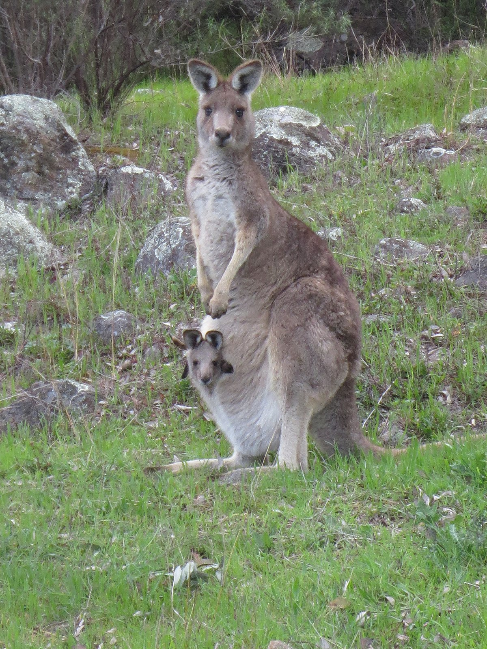
BENNY BUNGARRA'S BIG BUSH CLEAN UP by Sally Morgan
https://www.youtube.com/watch?v=Hy8KAqoiBgo
What happened in the story?
This Photo by Unknown author is licensed under CC BY-SA.

Slide 7
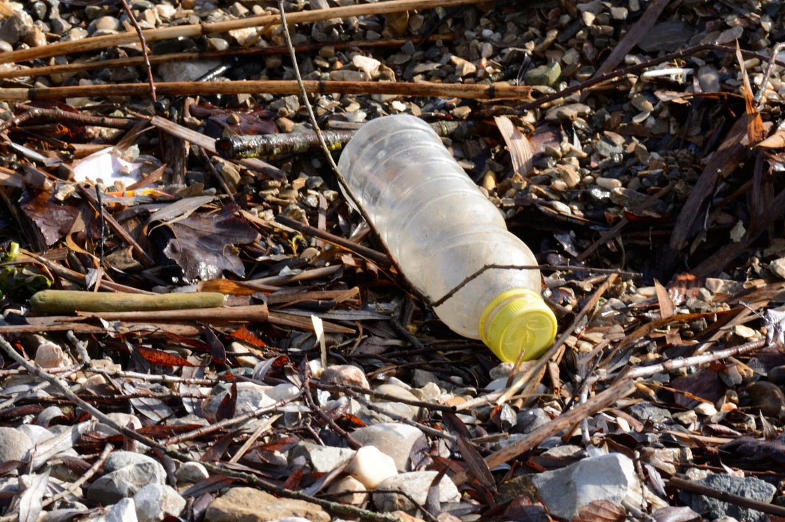
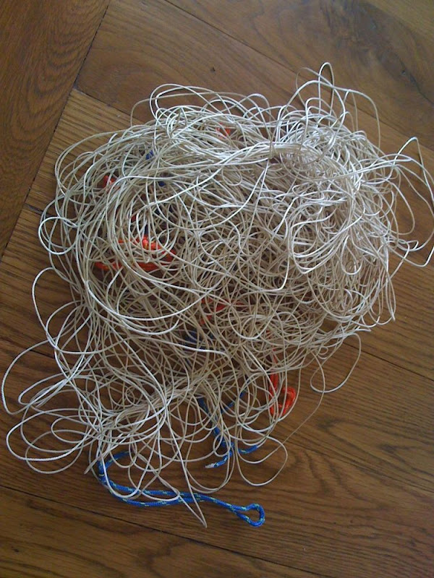
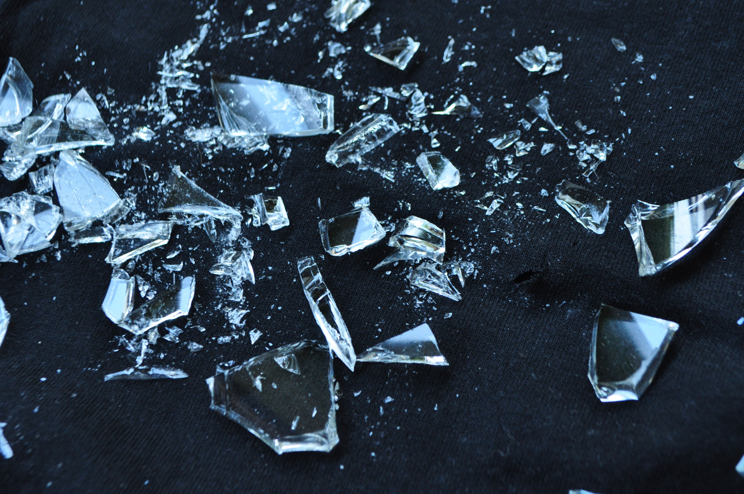
How did these things affect the animals in the story?
This Photo by Unknown author is licensed under CC BY-NC-ND.

Slide 8
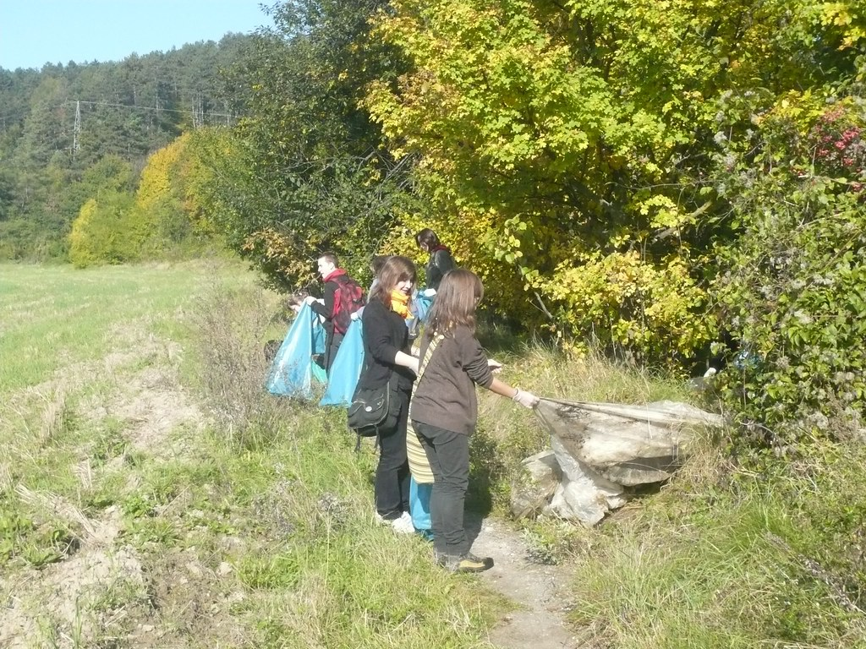
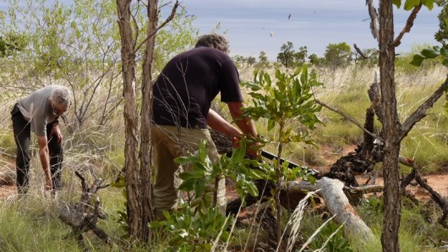
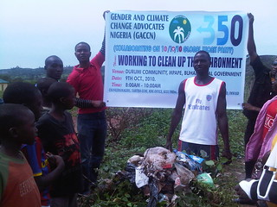

Slide 9
Which animals did you write about in your retell?
What were some of the dangers that the animals encountered in your retell?
What solutions did you suggest?
This Photo by Unknown author is licensed under CC BY-SA.

Slide 10
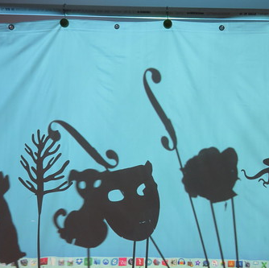
PART 1
Adapt your retell into a puppet play that you will perform
Write your puppet play using direct speech
This Photo by Unknown author is licensed under CC BY-SA.

Slide 11
Here is an example
Helpful Harry: Oh no! What happened to you Brown Beetle?
Brown Beetle: I was digging a hole in the garden under the carrots and I stood on a piece of glass. My foot really hurts. Can you help me please.
Helpful Harry: Sit down and put your foot up on this rock.........
I think that I can get the glass out.... Hold still..... Got it!
Brown Beetle: Of, thank you. That feels better already.
Helpful Harry: You need to be careful when you go digging. The humans are careless aren't they? Look there's more glass over there!

Slide 12
Worksheet
Puppet play script
A conversation between two characters
TITLE: ___________________________________________________________
Character 1 ...name …..
_____________________________________________________________________________________________
_____________________________________________________________________________________________
Character 2:… name ...
_____________________________________________________________________________________________
Character 1: ….
_____________________________________________________________________________________________
Character 2: ….
Character 1:…..
Character 2: ….
Illustrate what is happening in this scene

Slide 13
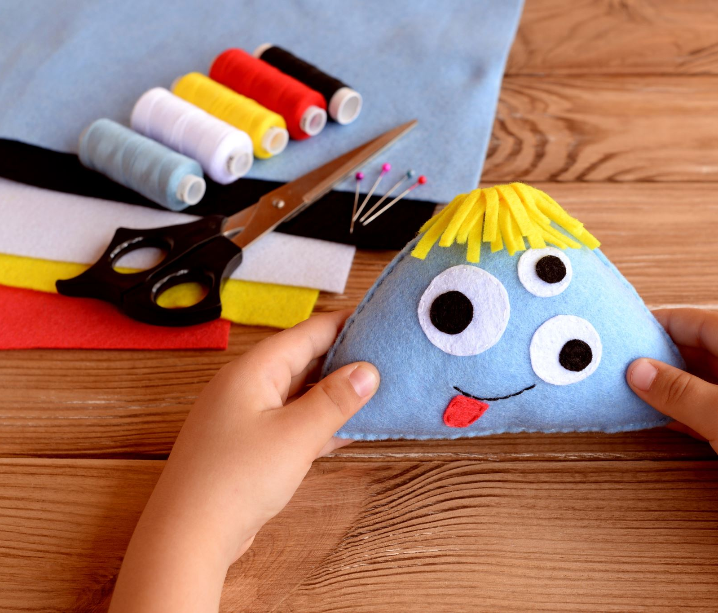
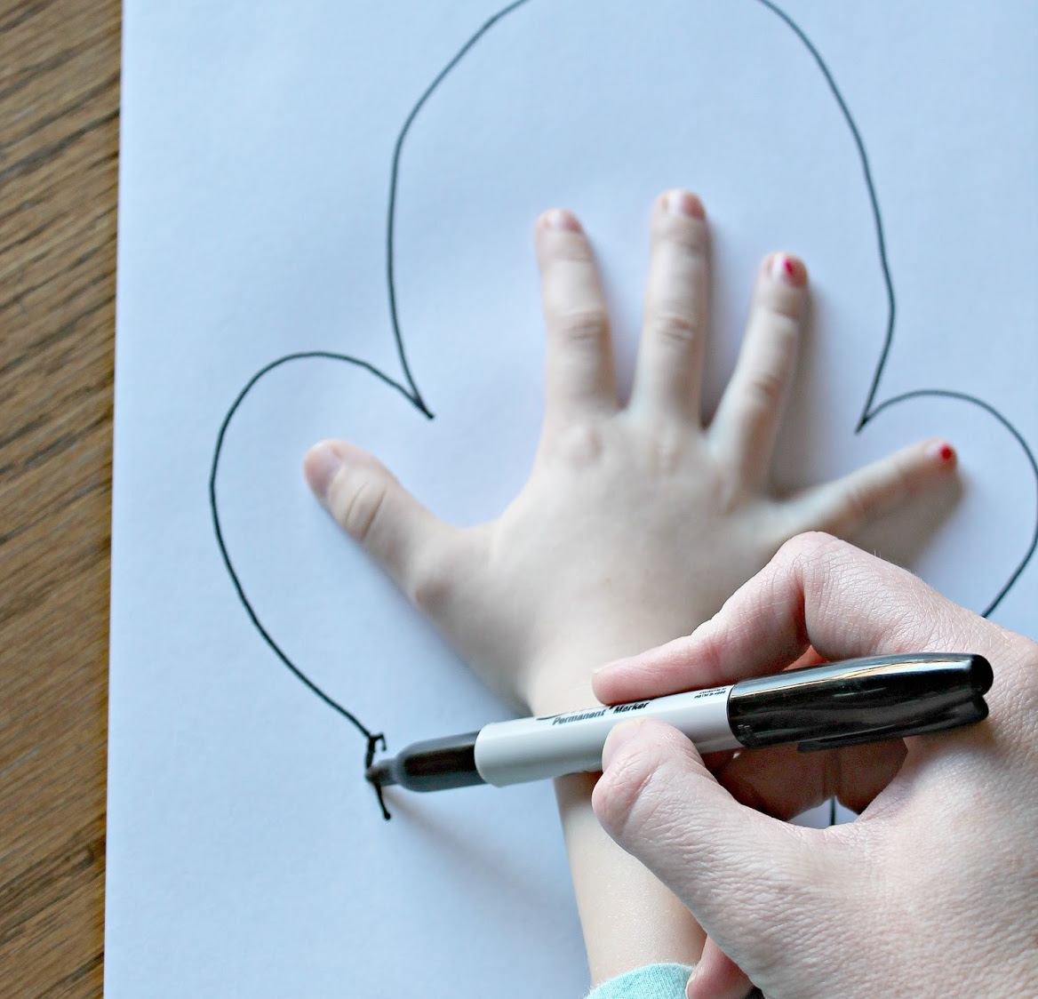
PART 2
Illustrate what your puppets might look like
Make a list of the materials (use recycled materials)that you might need to make your puppets
Create your puppets
Collect any props that you may need e.g. plastic bottle, fishing line
This Photo by Unknown author is licensed under CC BY-SA.

Slide 14
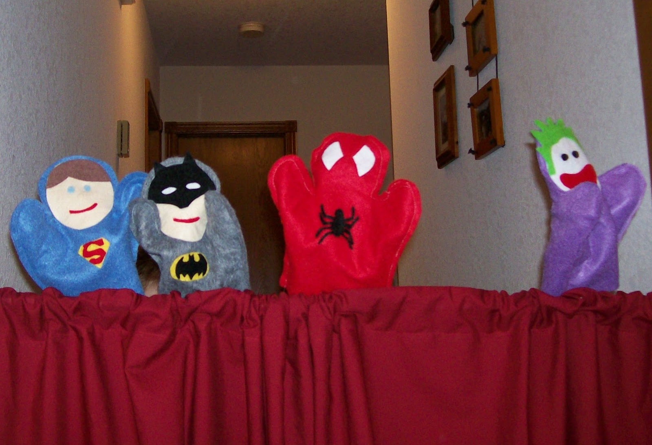
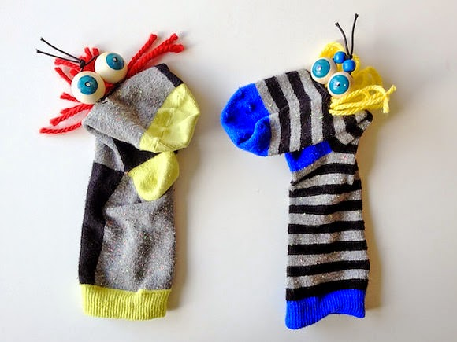
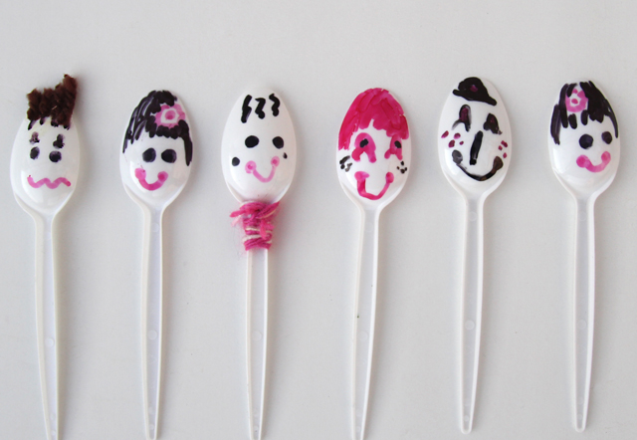
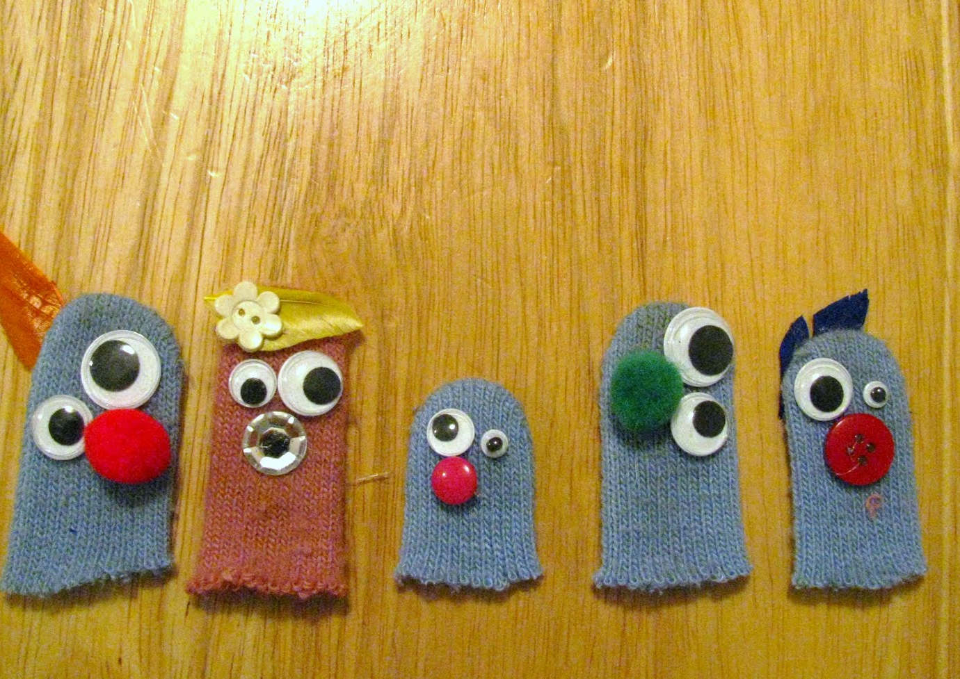
Here are some ideas to get you started with designing and making your puppets.
You might need to have some props eg plastic bottle, fishing line, plastic bag. These props will depend on the perils that your characters encounter.
This Photo by Unknown author is licensed under CC BY-SA-NC.
This Photo by Unknown author is licensed under CC BY.
This Photo by Unknown author is licensed under CC BY-NC.
This Photo by Unknown author is licensed under CC BY-NC.

Slide 15
Worksheet
Illustrate. This is what my character will look like:
This is what I will need to make my character:
-
-
Illustrate. This is what my character will look like:
This is what I will need to make my character:
-
-
-
-

Slide 16
PART 3
Enjoy sharing your puppet show with members of your school community.
This Photo by Unknown author is licensed under CC BY-NC.

