Slide 1
THE CURIOUS GARDEN by Peter Brown

Slide 2
Learning intentions
Listening – students will listen to a story
Writing – students will complete sentences
Reading – students will read their sentences to an audience Speaking - students will engage in discussions and the presentations of their work
Science – students will develop an understanding of how plants can grow in different environments - students will develop an understanding of the process of photosynthesis
- students will develop an understanding of what they can do to develop a garden

Slide 3
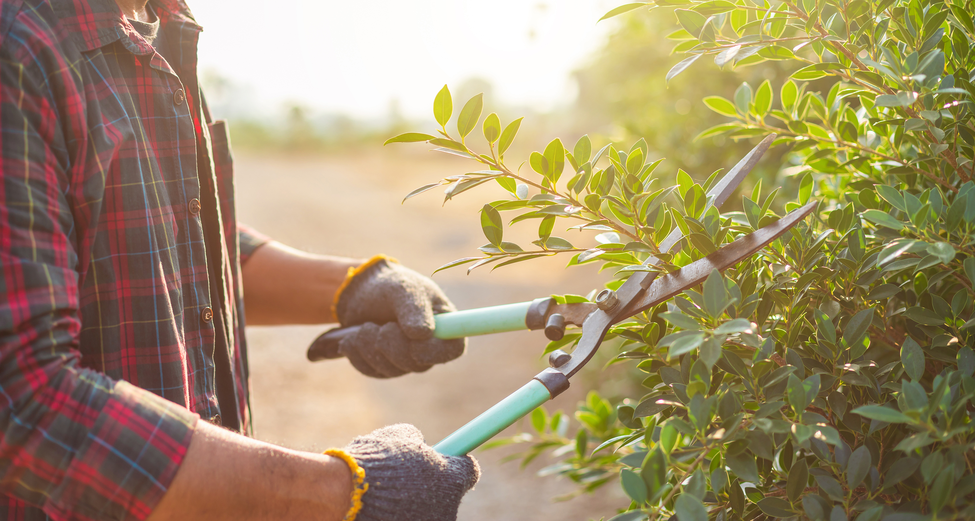
NEW VOCABULARY
Curious – eager to know or learn something
Railway – where trains go
Pruning – cutting plants to help them grow better
Weeds – unwanted plants
Sustainability - to maintain things over time
Carbon dioxide – a gas that we breathe out and plants breathe in
Oxygen – a gas that we breathe in and plants breathe out

Slide 4
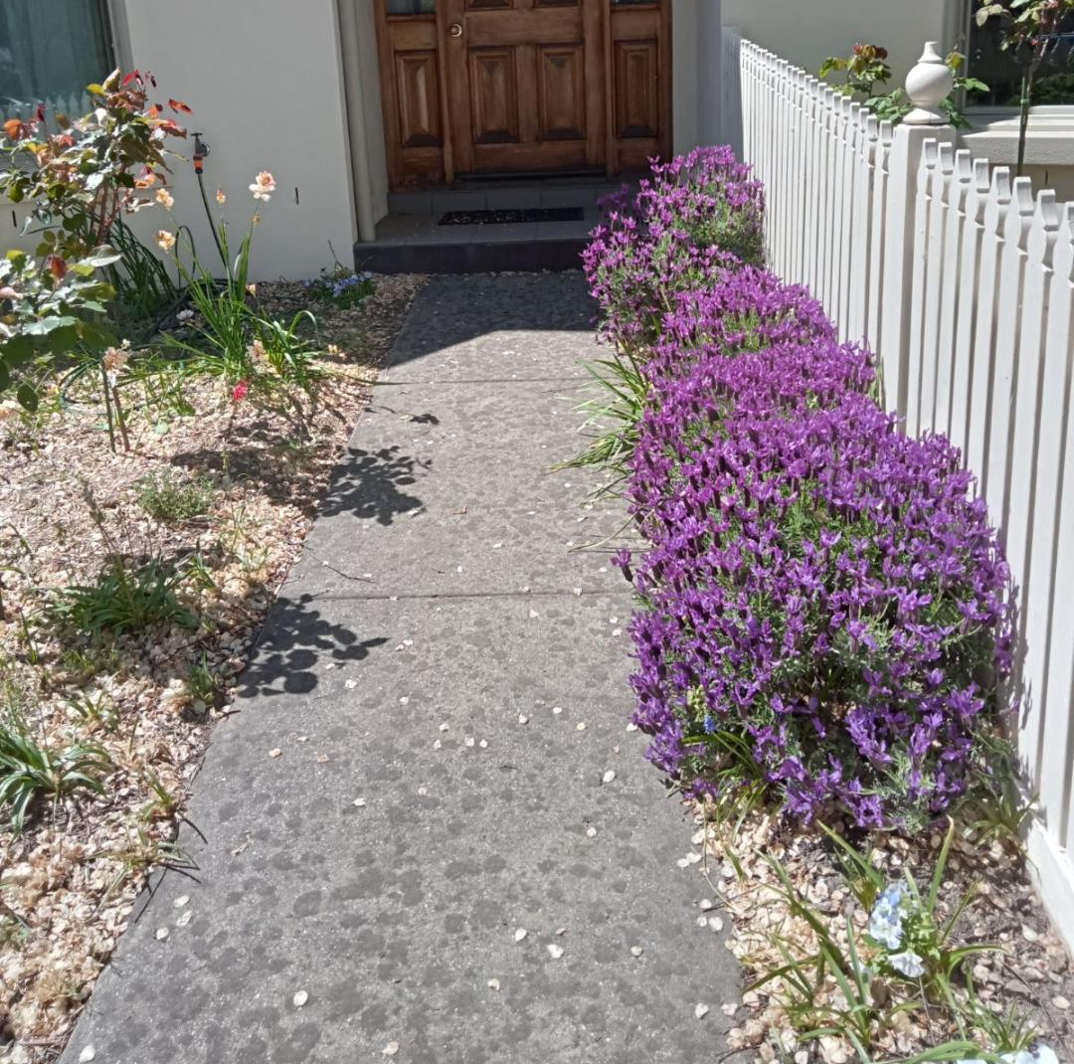
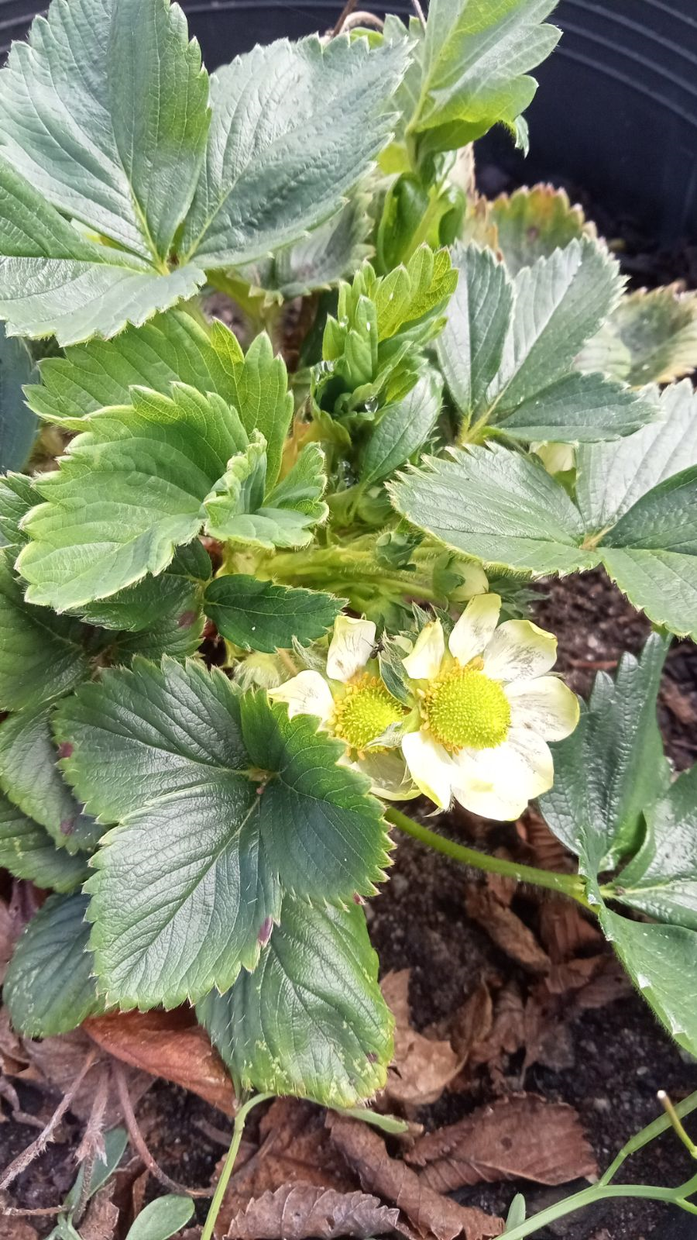
In my garden I like to grow some flowers and lots of fruit and vegetables.

Slide 5
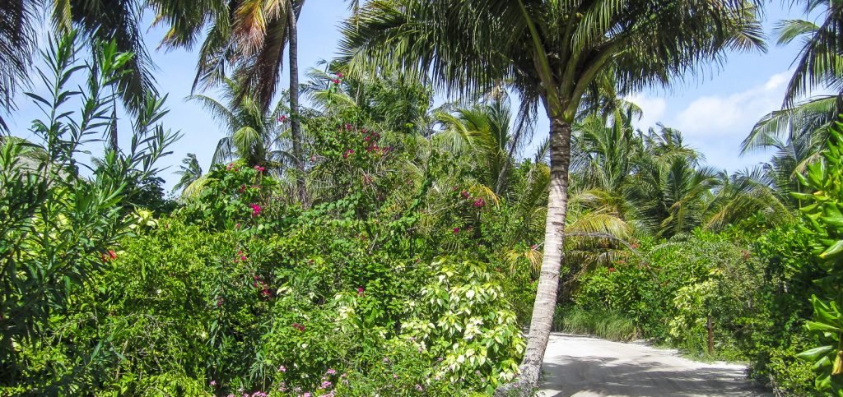
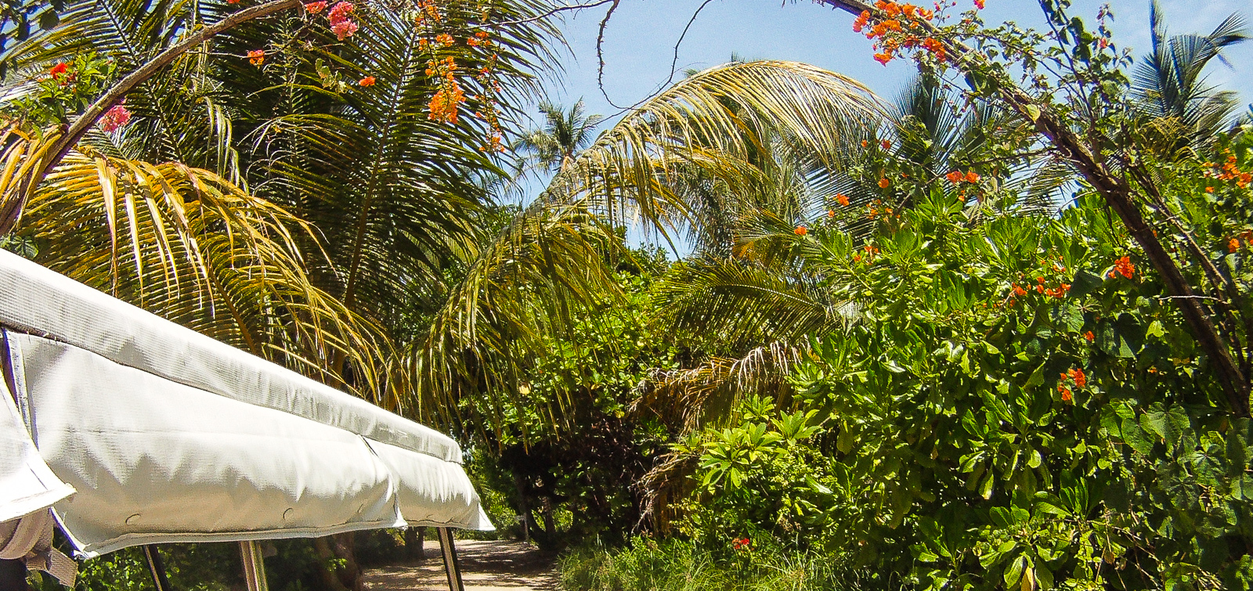
Do you have a garden? What is planted in your garden?

Slide 6
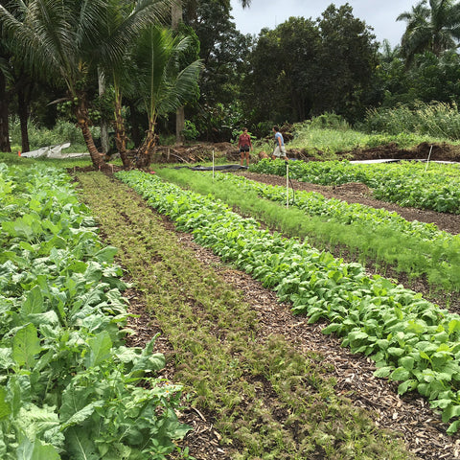
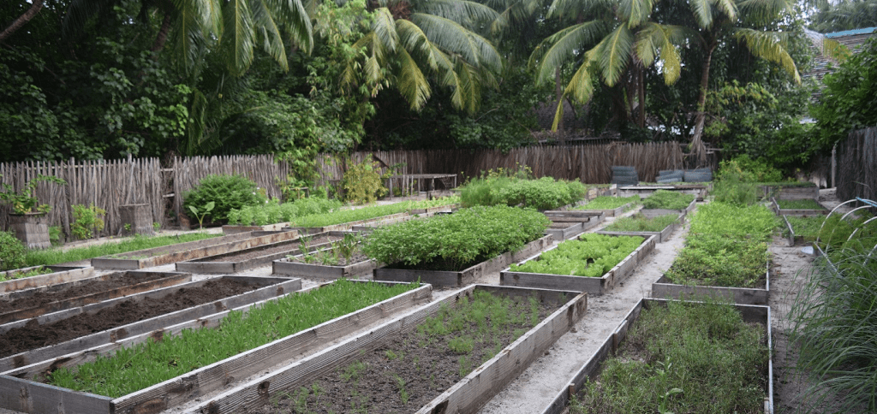
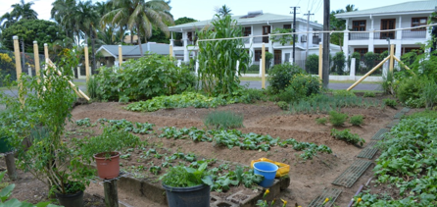
Community gardens

Slide 7
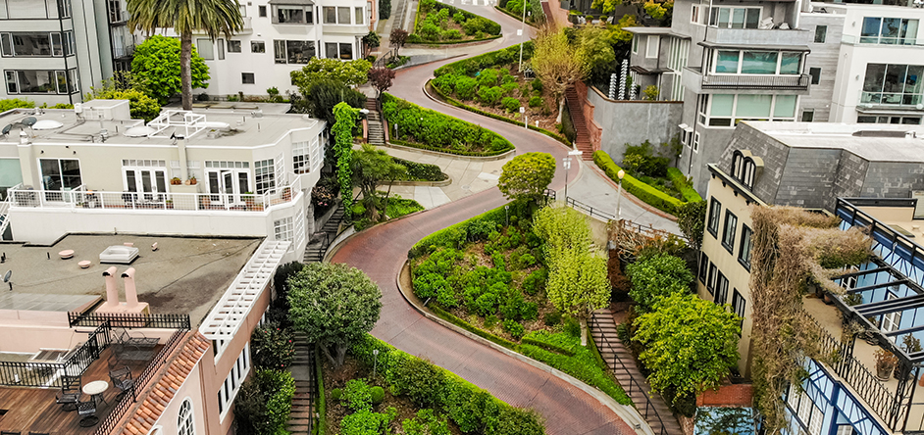
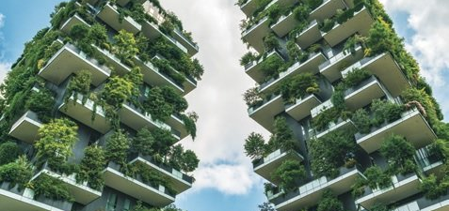
What do you notice about these images?
Why is the bottom image so different?

Slide 8
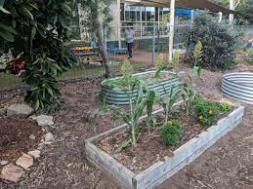
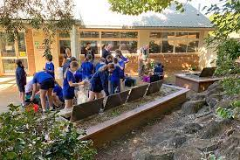
Gardens and the environment
How do gardens help the environment?
Notes:
https://www.vsgp.org.au/about-2/the-importance-of-school-gardens/

Slide 9
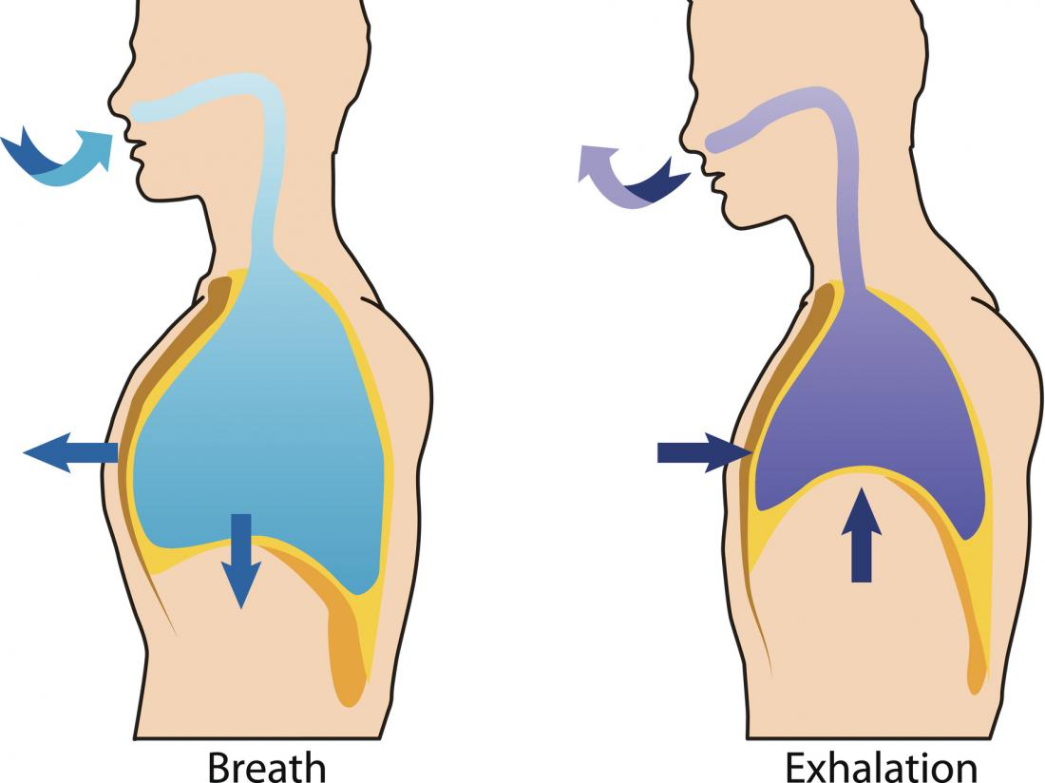
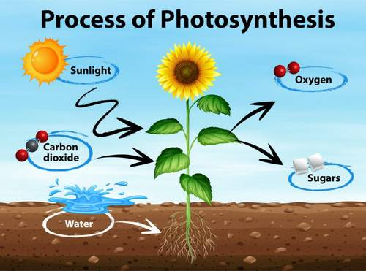
Plants clean the air for us
We breathe in oxygen
We breathe out carbon dioxide
Plants breathe in carbon dioxide
Plants breathe out oxygen

Slide 10
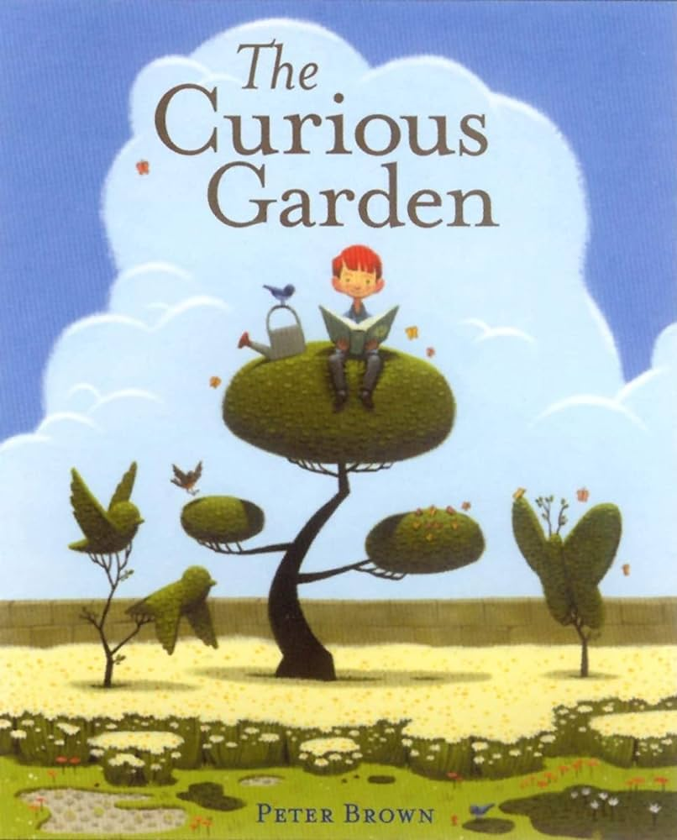
Notes:
https://youtu.be/A7HFcOBNIIs

Slide 11
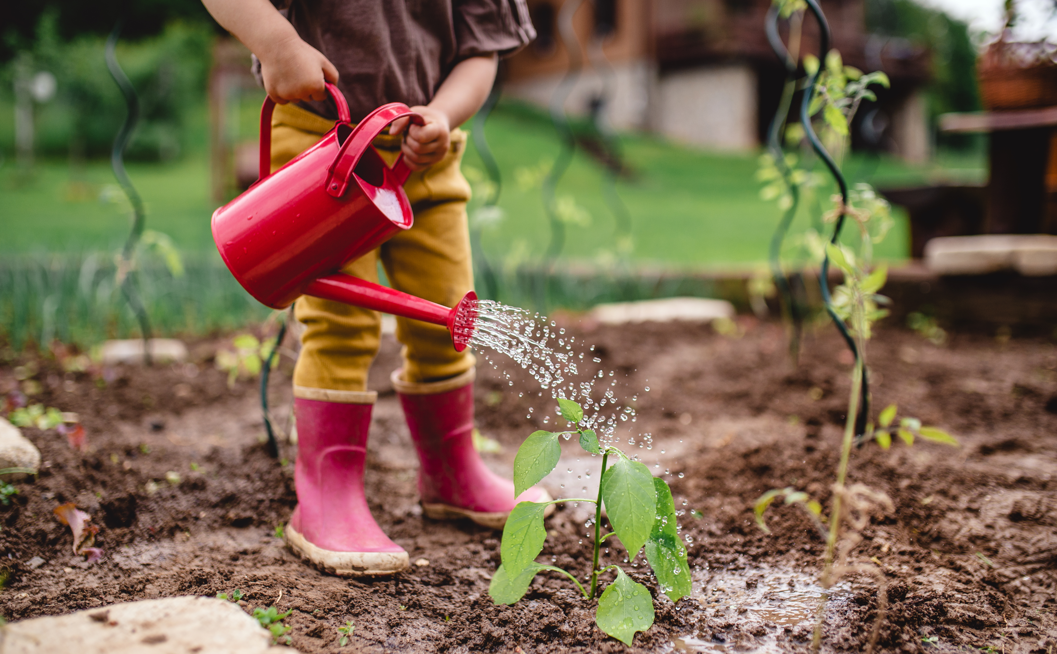
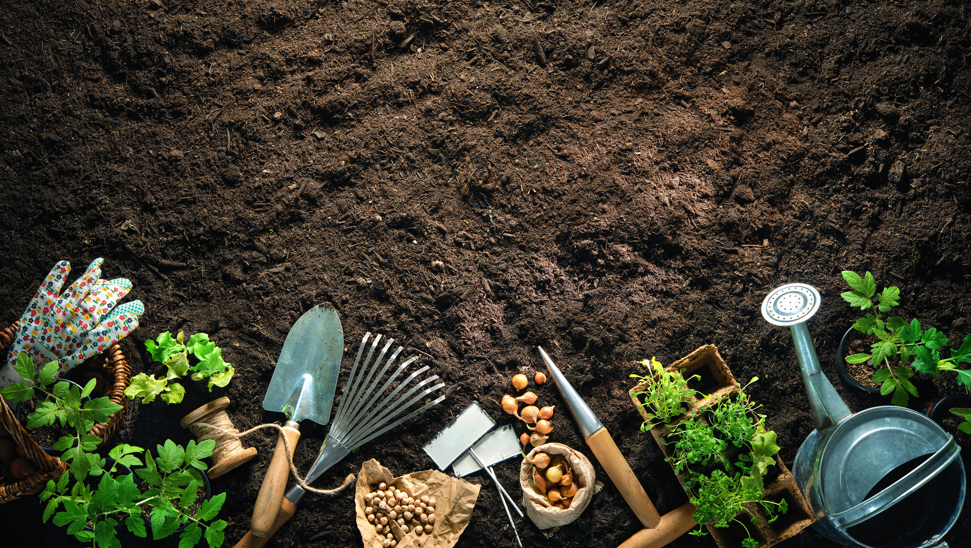
What do plants need to help them grow to be strong and healthy?

Slide 12
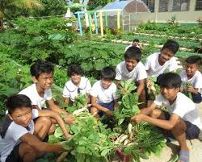
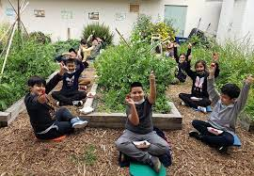
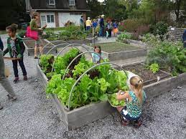
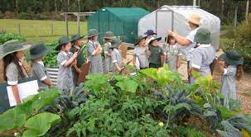
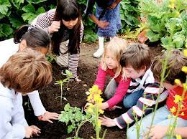
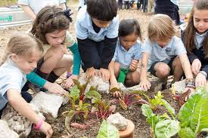

Slide 13
WOULD IT BE POSSIBLE FOR YOU TO HAVE A SHARED GARDEN AT YOUR SCHOOL?
Challenges
Solutions
Benefits

Slide 14
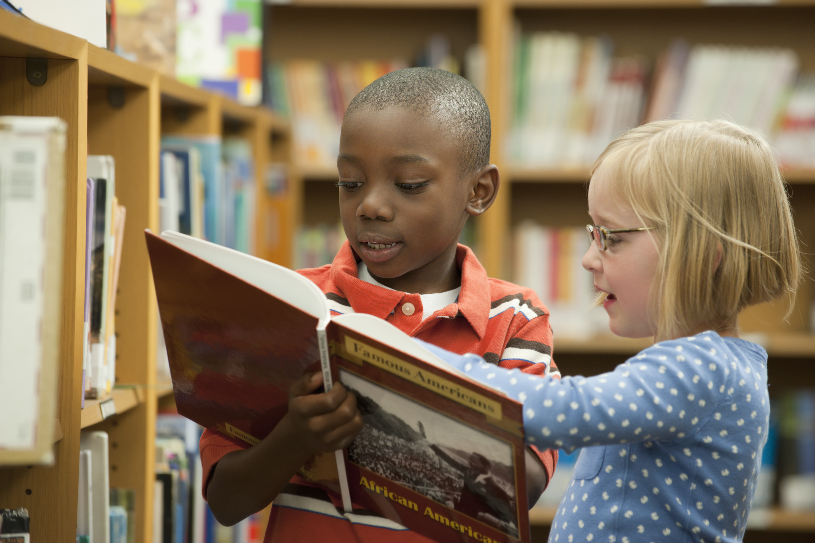
You are going to work with a partner. You will discuss and write about challenges, solutions and benefits associated with establishing a school garden at your school. You will complete a worksheet together.

Slide 15
Our school garden
Challenges
1.
2.
Solutions
1.
2.
Benefits
1.
2.

