Slide 1
Today's story is about the forest in the ocean that is made of seaweed
THE HIDDEN FOREST by Jeannie Baker

Slide 2
Learning intentions
Students will:
Listening – listen to a story
Speaking – participate in discussions
Writing – write a response to the text in the form of an acrostic poem
Science
Develop an understanding of the importance of kelp to our world
Develop an understanding and awareness of how kelp can be used

Slide 3
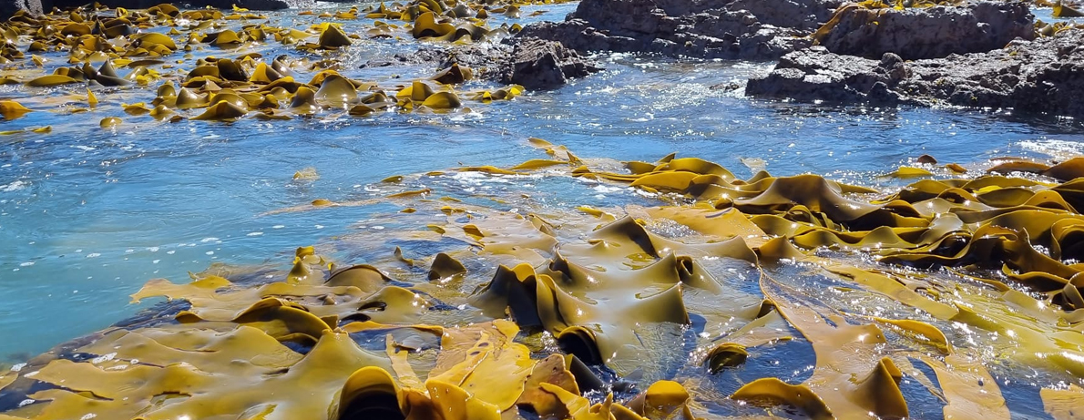
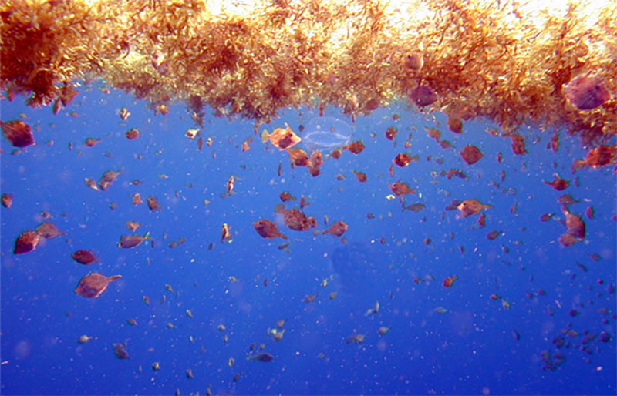
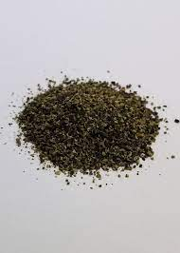
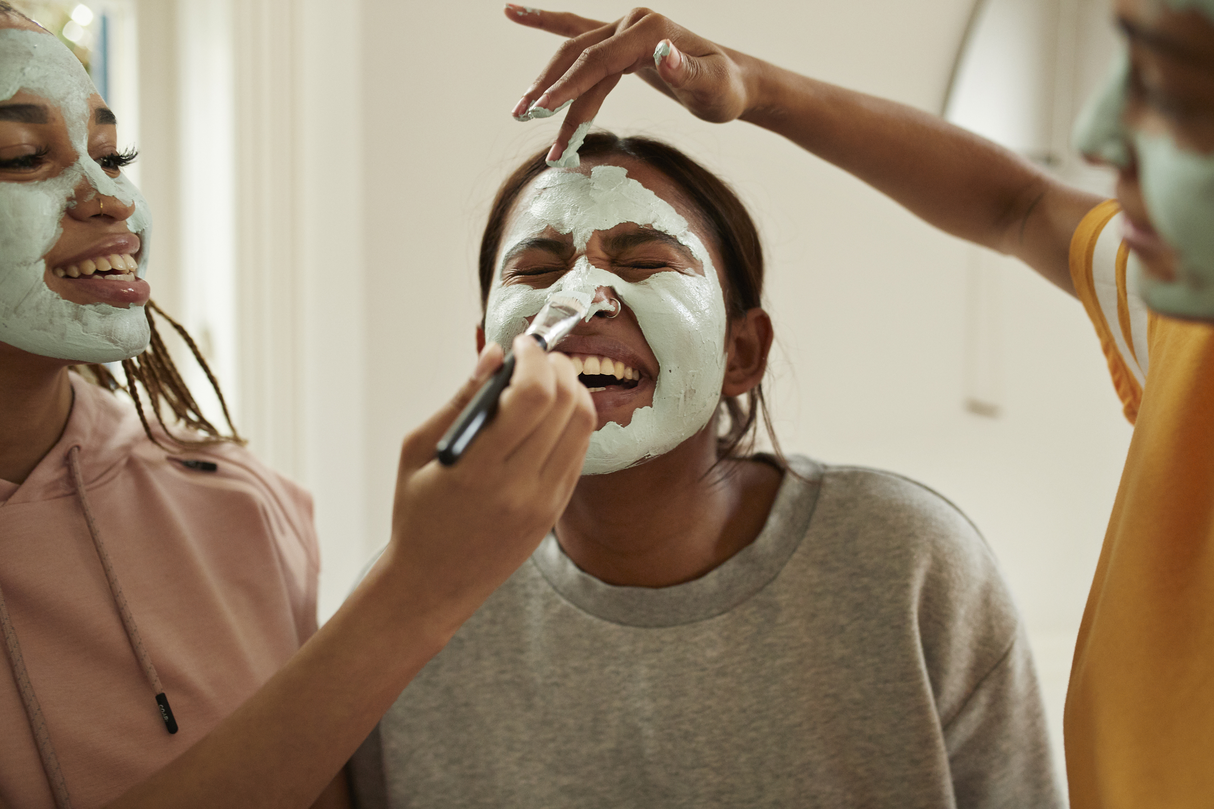
New vocabulary
Kelp – large brown seaweed
Sargassum – large brown seaweed that floats as
island like masses
Fertilizer – a natural substance that is added to soil or land
to make it more productive
Cosmetics – something that is applied to the body to
enhance the bodies appearance

Slide 4
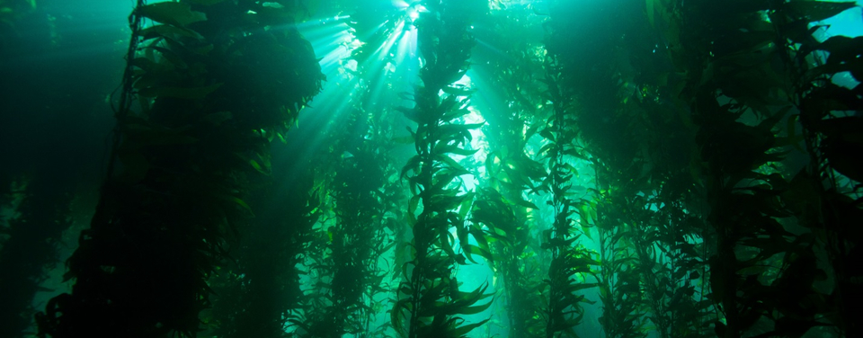
Some facts about kelp
It can grow 45 cm in a day
It provides food and shelter for ocean organisms
Produces oxygen
Helps to keep the ocean calm during storms
Doesn’t have roots
Has many uses

Slide 5
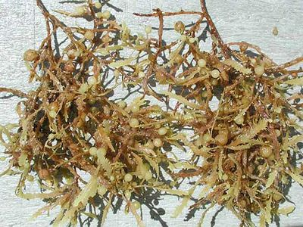
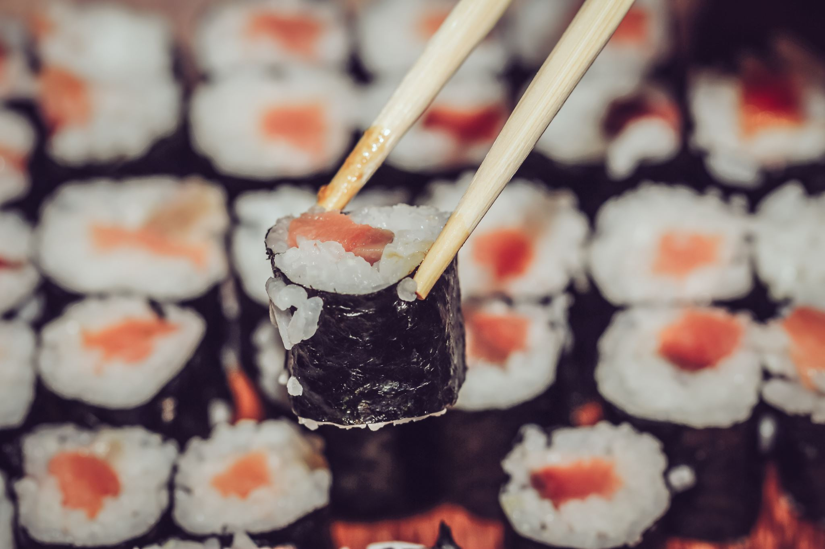
Sargassum in Maldives
Has a strong smell when it is decomposing
BUT
It is used in cosmetics like shampoo and
toothpaste
It is used by farmers as fertiliser
It is a source of food – delicious when cooked in coconut milk or vinegar or lemon juice
It is very nutritious
https://www.facebook.com/mvplusmedia/videos/seaweed-season-in-the-maldives-can-use-them-for-fertilizers/462994325477799/

Slide 6
https://www.youtube.com/watch?v=vVdKTGK0W2Y

Slide 7
Acrostic poem
Oceans
Create
Energy
And
Nourish
Kelp
Exists Like Plants
Sea Energy Abounds

Slide 8
Acrostic poem – You are going to create an acrostic poem using the letters in the word sargassum. Your acrostic poem will tell us about The Hidden Forest in your ocean. You will work with a partner to do this task. Firstly - with a partner, you will need to make lists of as many words as you can think of that begin with the letters in the word sargassum Secondly – you will need to create a sentence, using one word for each letter, that makes sense, in the order of the letters in the word sargassum
S
A
R
G
A
S
S
U
M
A
Animal
Algae
Among
Almost
Anywhere
S
Sea
Seaweed
Sun
Slimy
Salty

Slide 9
Worksheet
S.....................................................
A.....................................................
R.....................................................
G.....................................................
A.....................................................
S......................................................
S......................................................
U......................................................
M......................................................

