Slide 2
Learning intentions
Students will:
Literacy
listen to a story
participate in the shared reading of the story
Using the letters of their name write an ingredient relating to compost for each letter
Science
Develop an understanding of what compost is and how it works

Slide 3
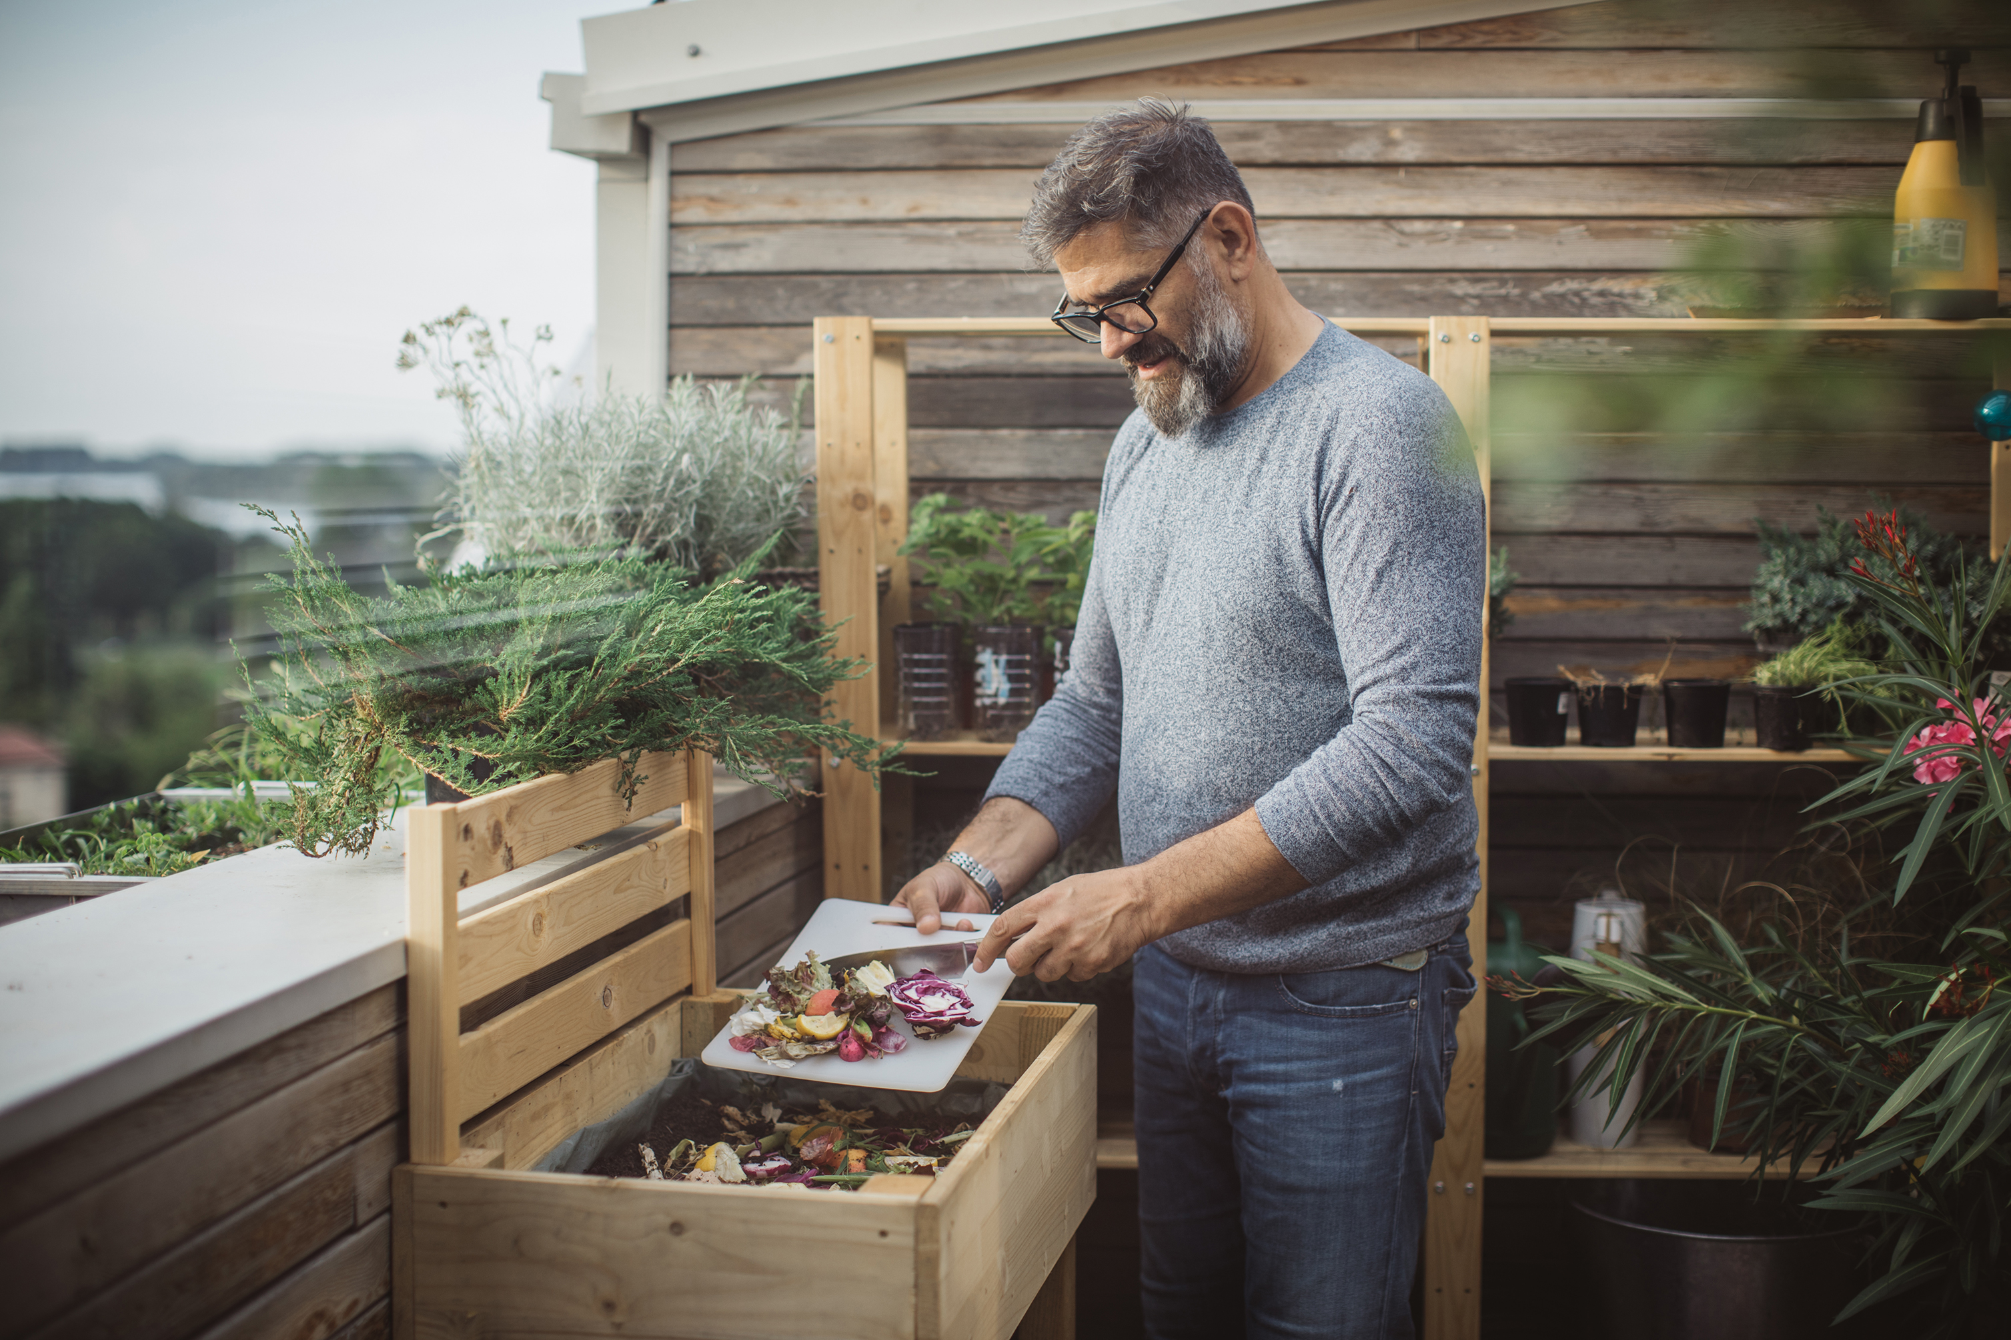
New vocabulary
Compost – decayed organic material

Slide 4
https://www.google.com/search?q=how+to+make+compost+for+kids&sca_esv=583234059&rlz=1C1ONGR_enAU1075AU1075&ei=f-ZWZc_QBdjXseMPgpaH-AQ&ved=0ahUKEwiPjOP0k8qCAxXYa2wGHQLLAU8Q4dUDCBA&uact=5&oq=how+to+make+compost+for+kids&gs_lp=Egxnd3Mtd2l6LXNlcnAiHGhvdyB0byBtYWtlIGNvbXBvc3QgZm9yIGtpZHNIvhFQvwJY1A9wAXgBkAEAmAG1AaAB3wmqAQMwLjm4AQPIAQD4AQHCAgoQABhHGNYEGLADwgINEAAYgAQYigUYsAMYQ8ICChAAGIAEGIoFGEPCAgUQABiABOIDBBgAIEGIBgGQBgo&sclient=gws-wiz-serp#kpvalbx=_iOZWZdPHFO3ZseMP2eqbmA0_42

Slide 5
https://www.kidsdogardening.com/how-to-start-composting-with-children/

Slide 6
Compost Stew - YouTube

Slide 7
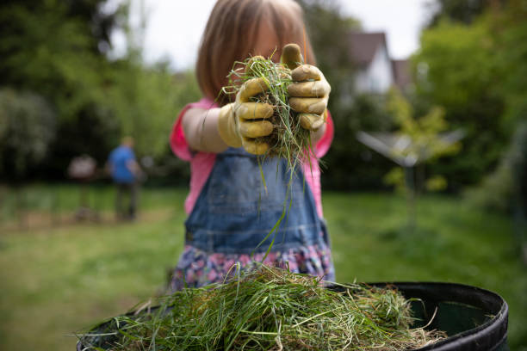
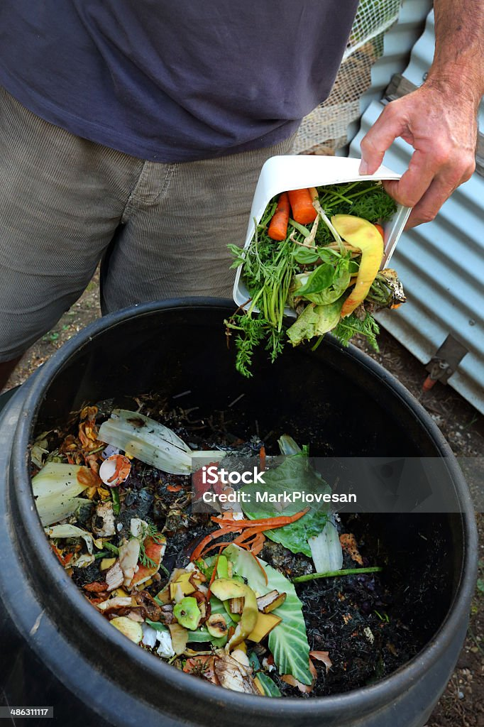
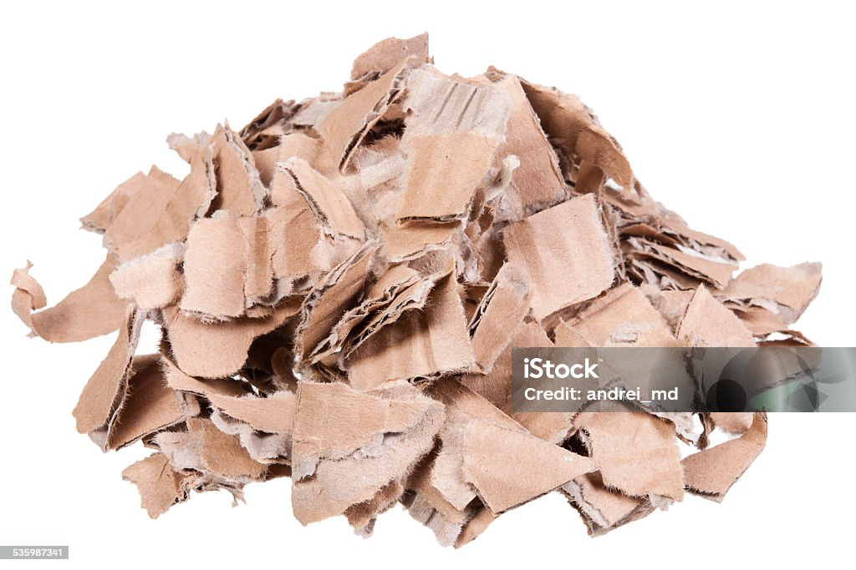
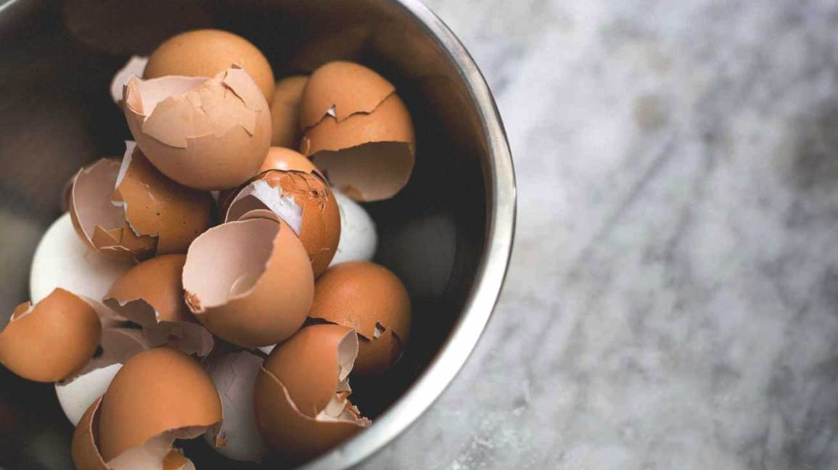
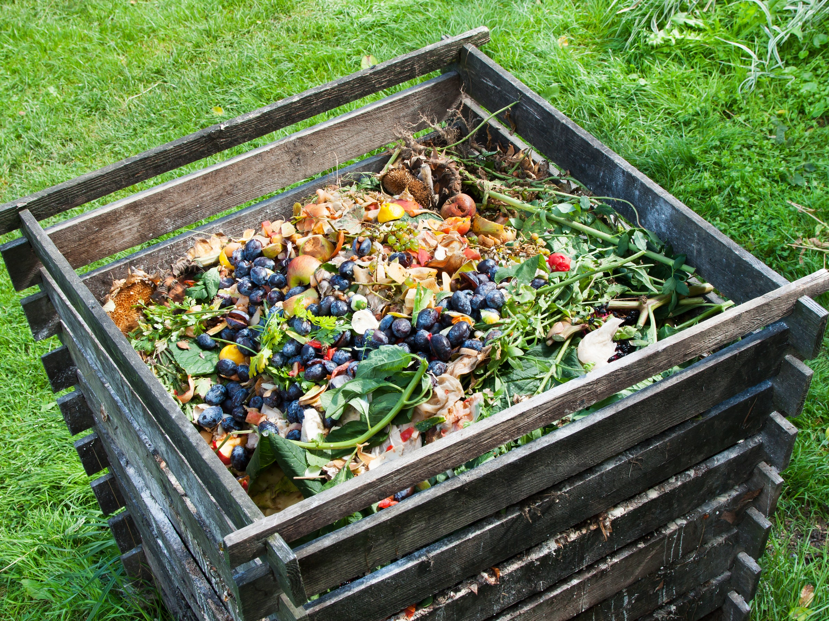
How to make compost 4 key ideas from today's story 1. Moisten 2. Toss lightly 3. Cover 4. Let brew

Slide 8
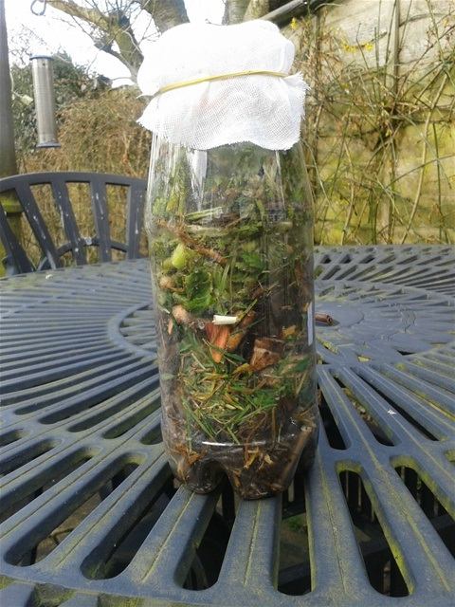
https://growinghealthykids.co.uk/how-to-make-compost-in-a-bottle/

Slide 9
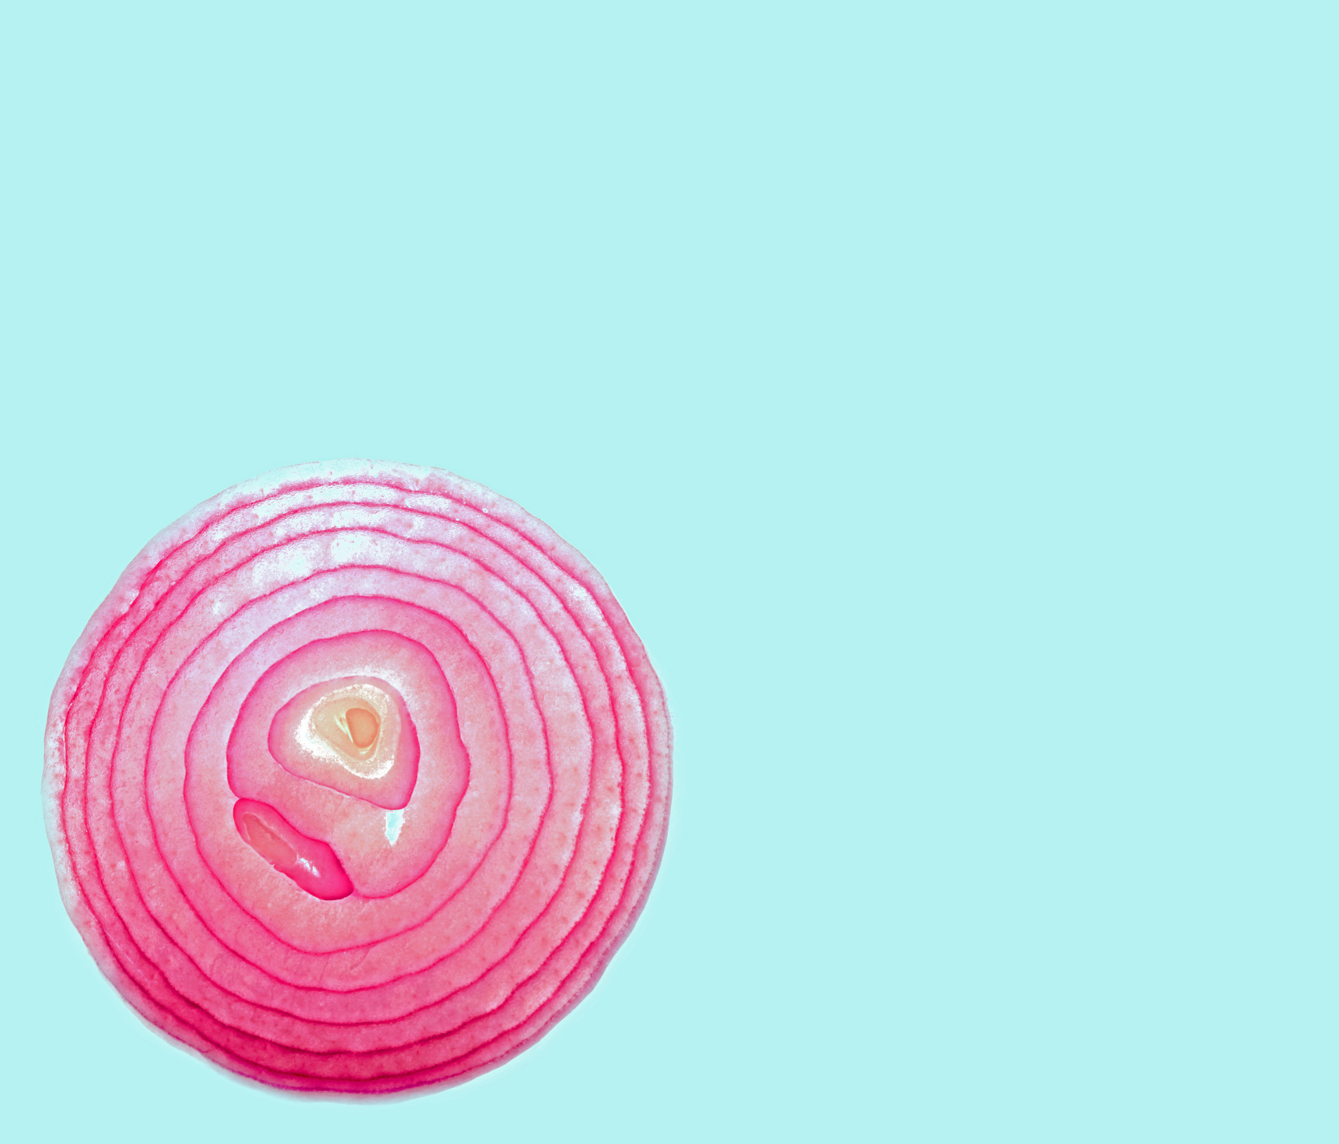
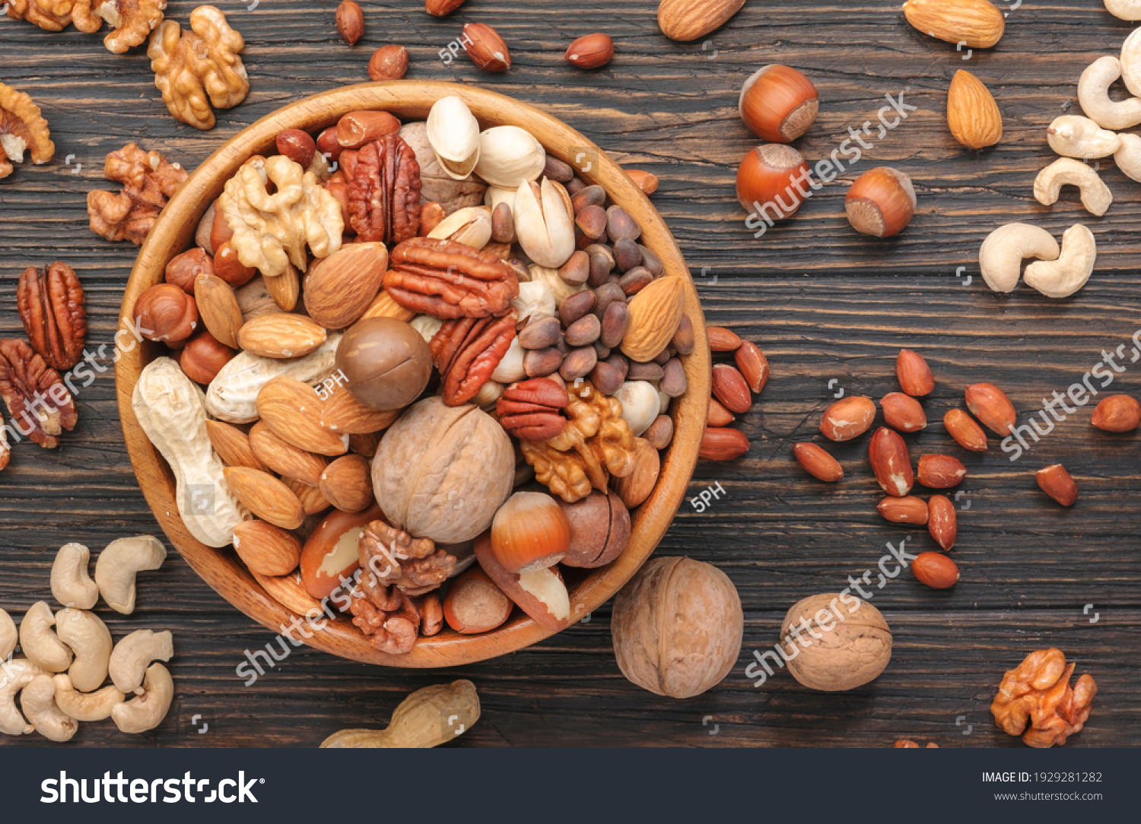
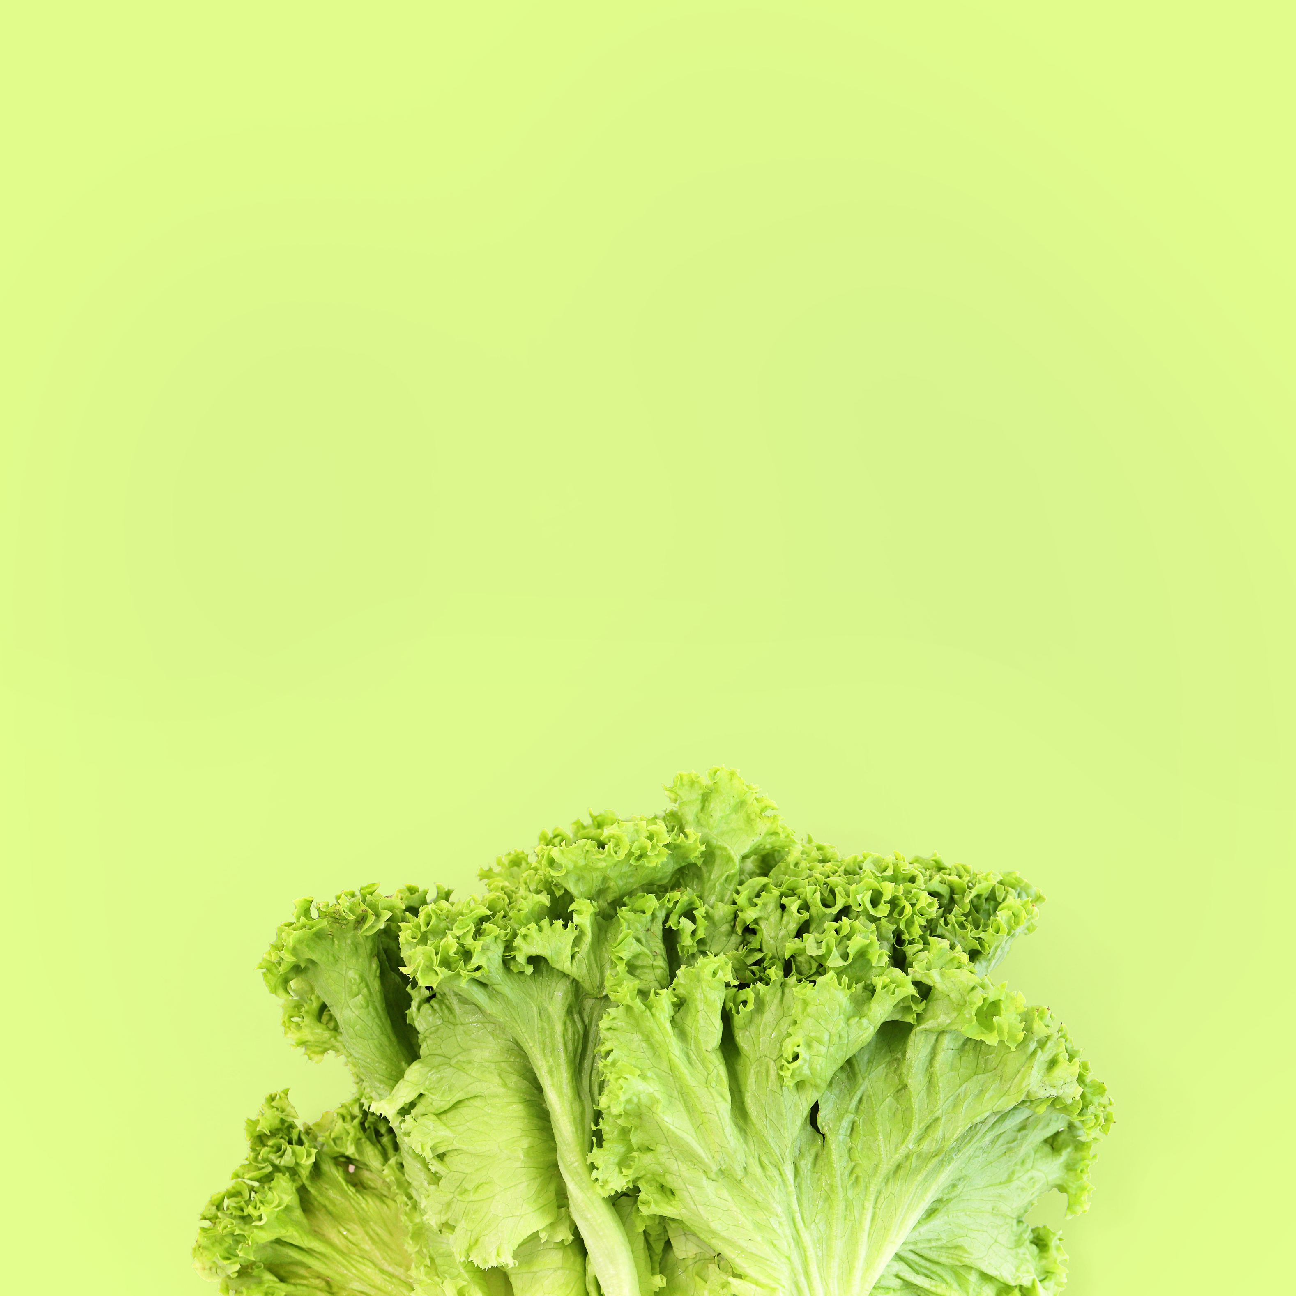
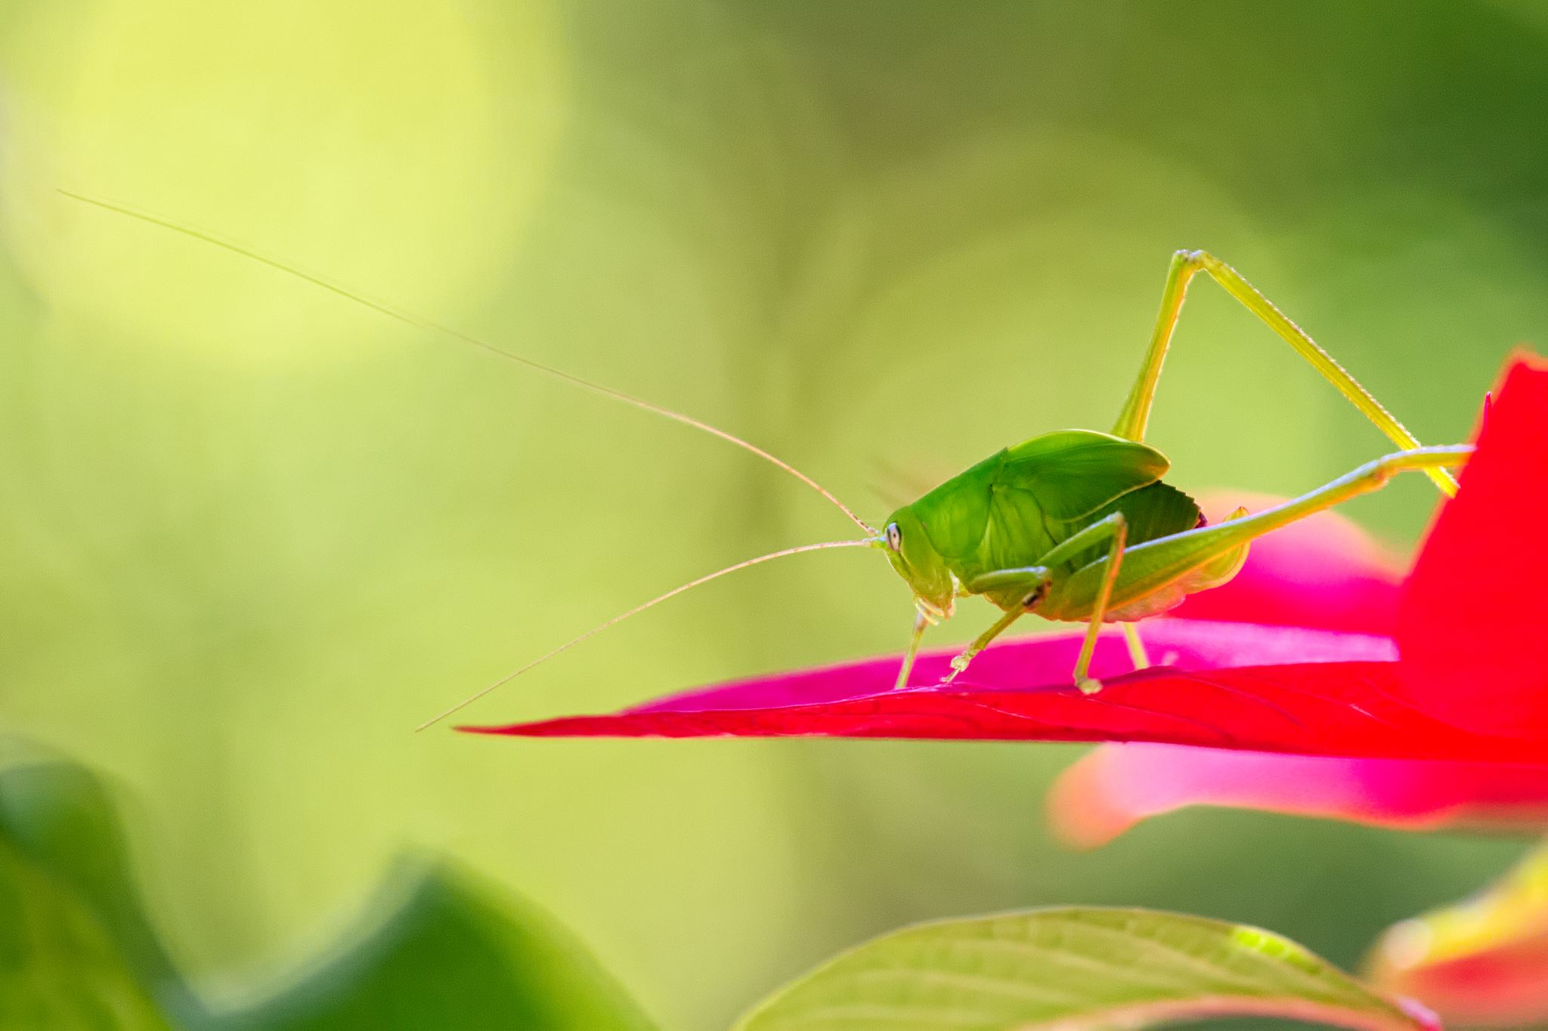
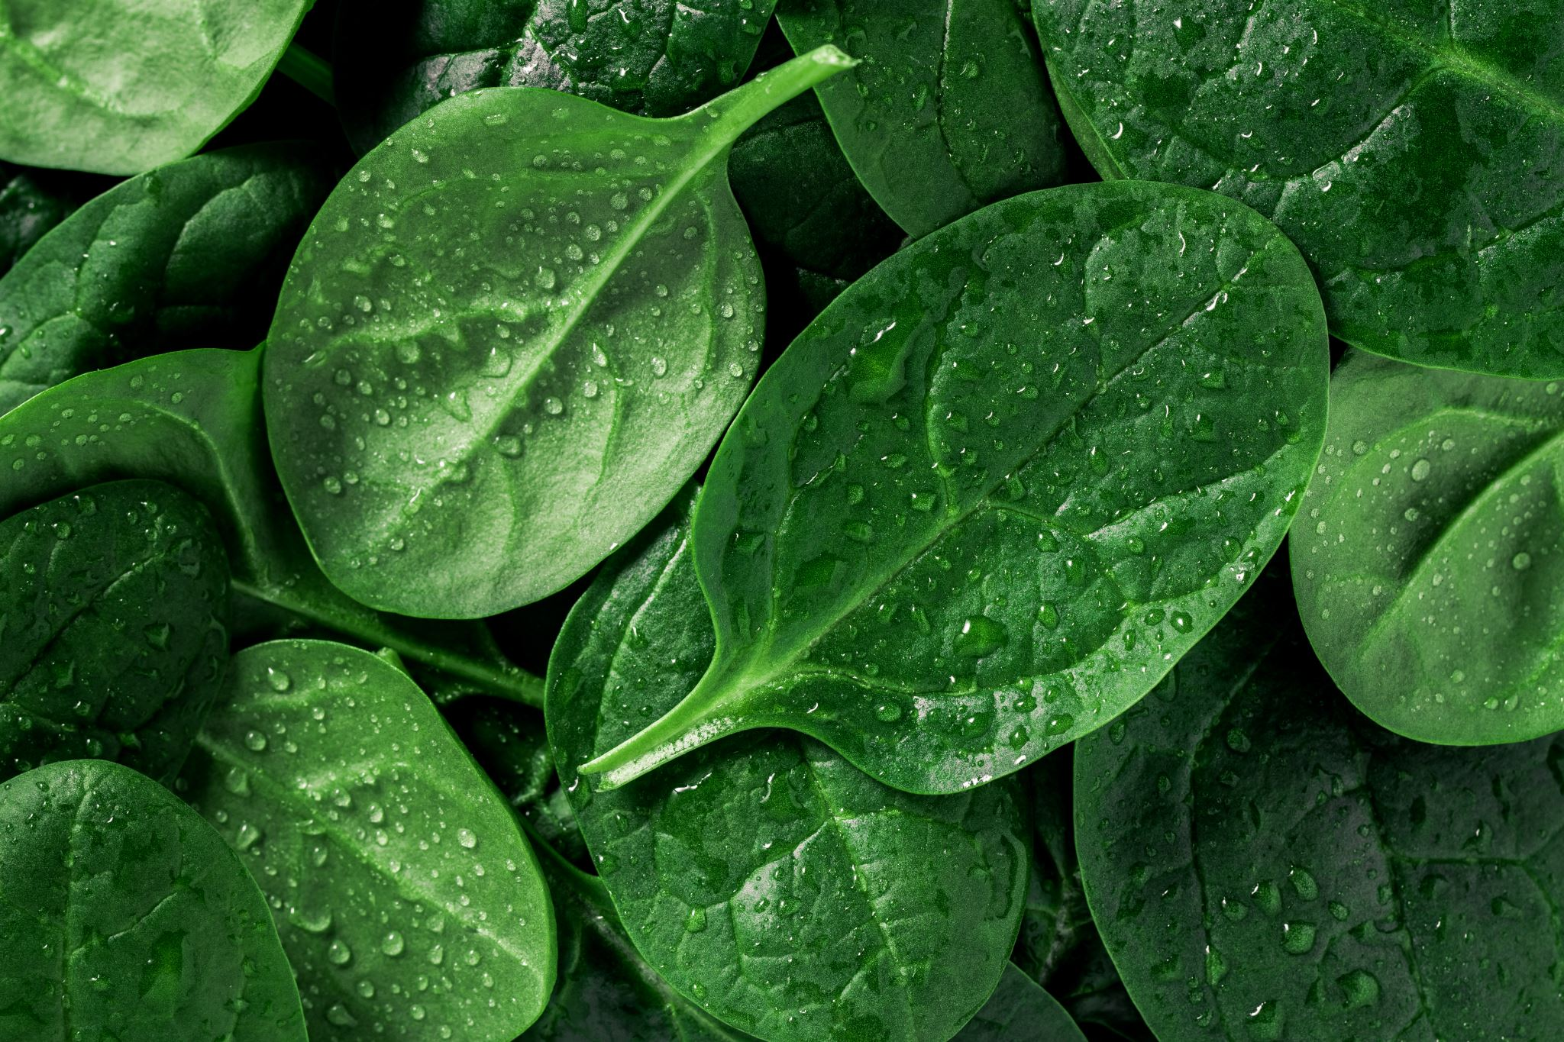
Your task today A recipe for compost stew
My compost stew recipe
Apple cores
Lettuce leaves Insects Spinach leaves Onion skins Nut shells

Slide 10
Worksheet
My compost stew recipe
___________________
____________________
____________________
____________________
____________________
____________________
____________________
____________________

