Slide 1
GREEN GREEN

Slide 2
Learning intentions
Students will:
Literacy
listen to a story
participate in the shared reading of the story
write a response to the story by completing a sentence pattern
Social Studies
Develop an understanding of how communities can work together to create a community garden

Slide 3
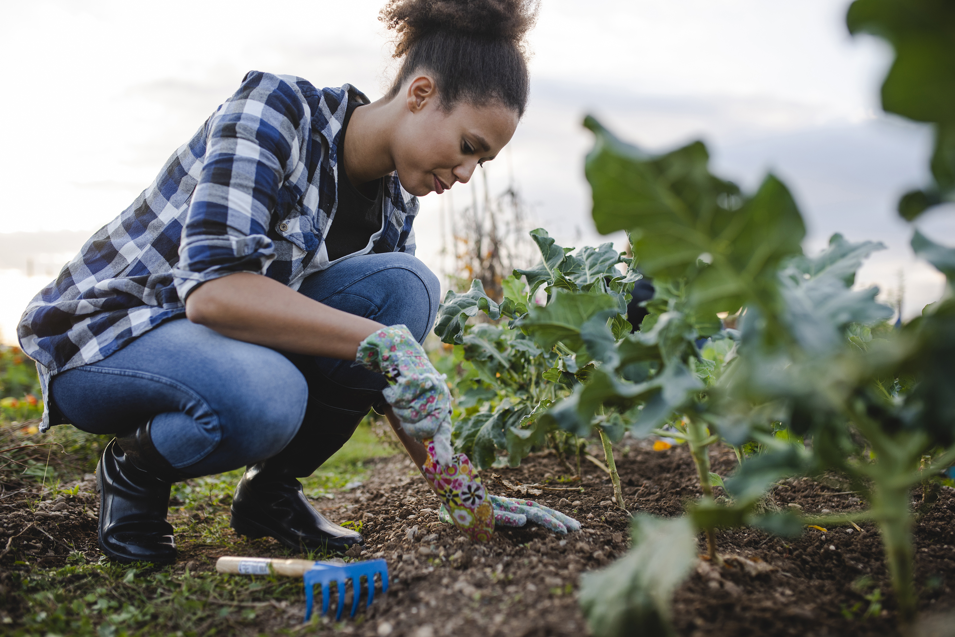
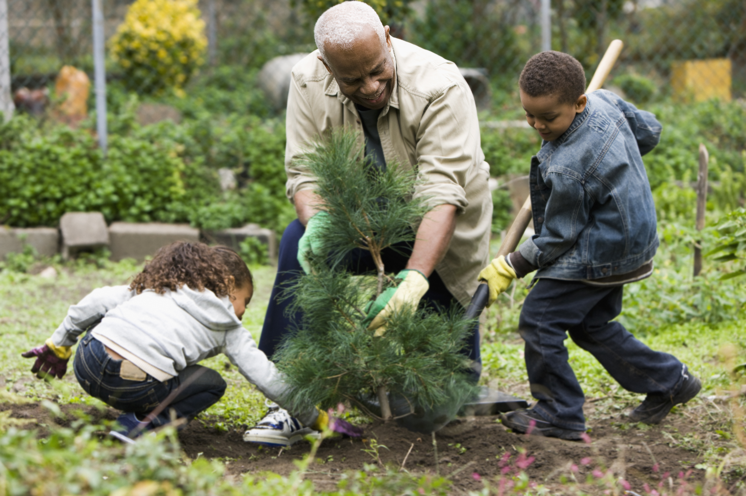
New vocabulary
Community – a group of people living together and sharing the same place
Tamp - pack or ram something down

Slide 4
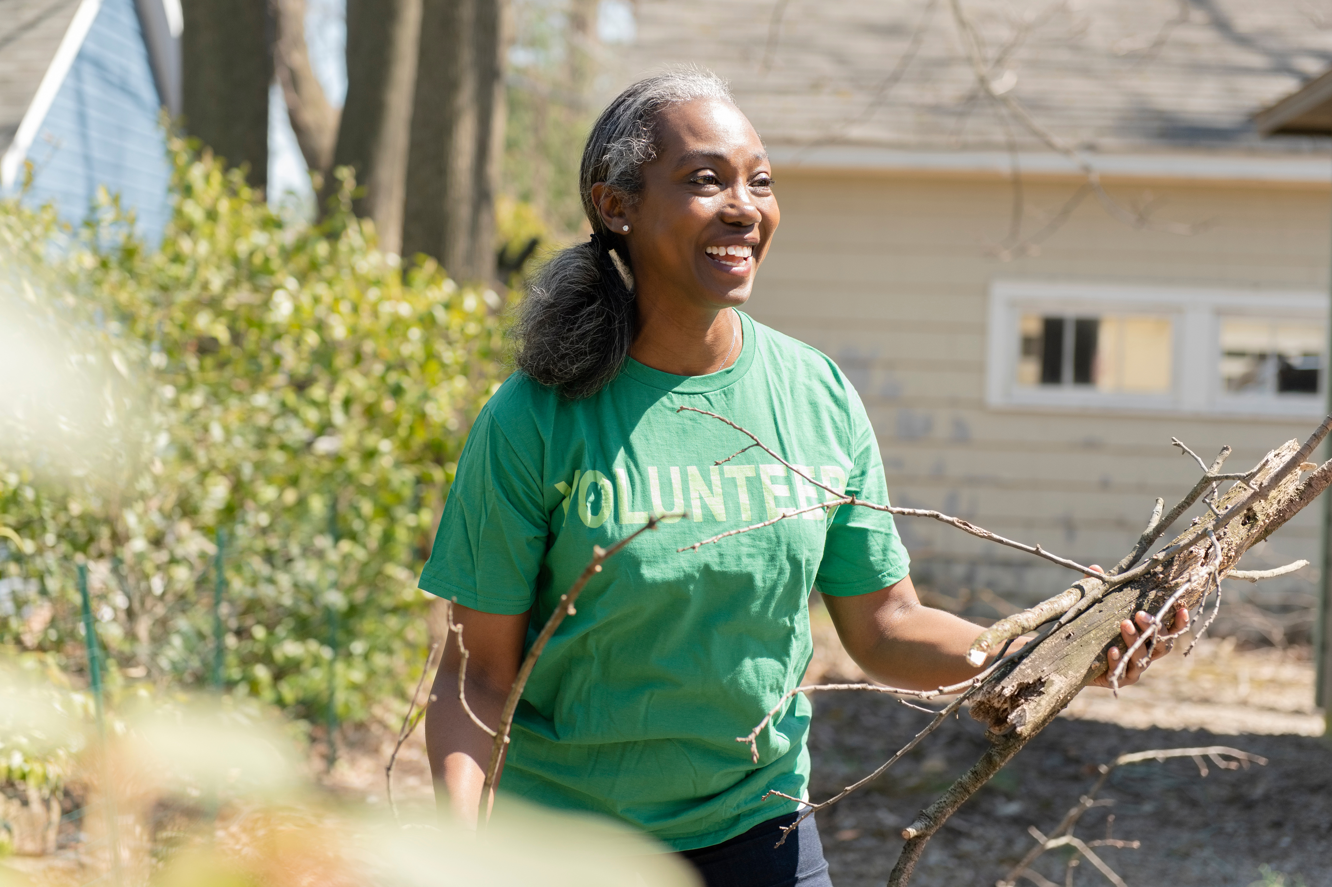
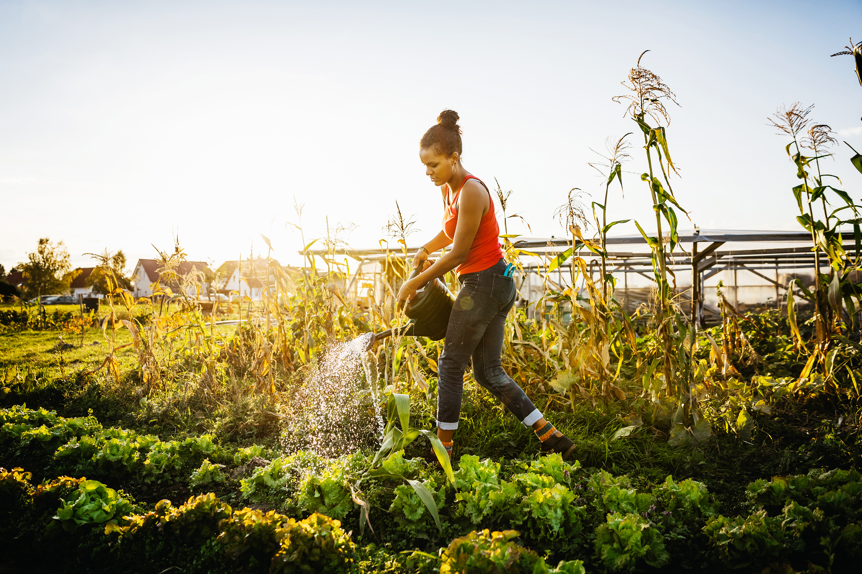
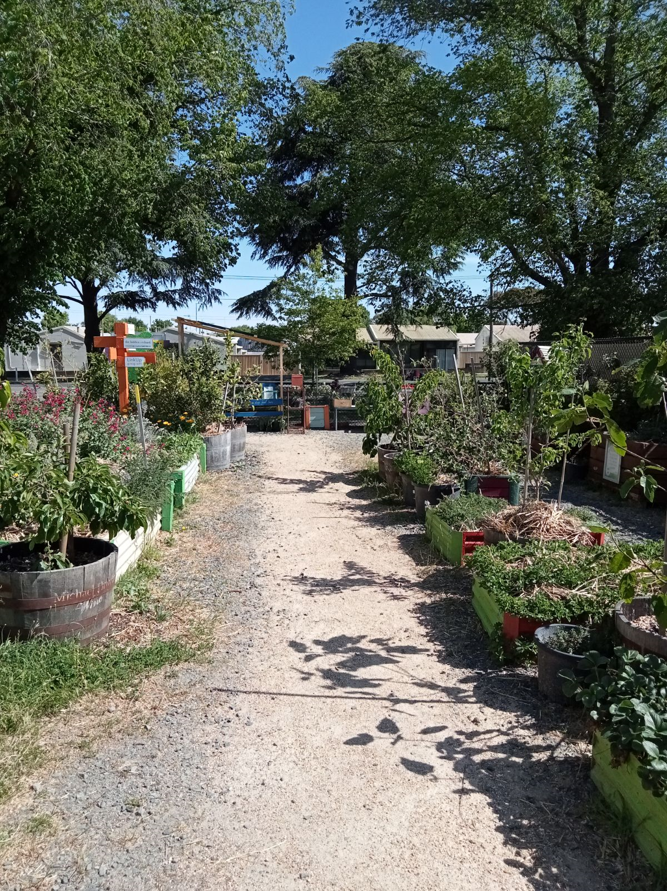
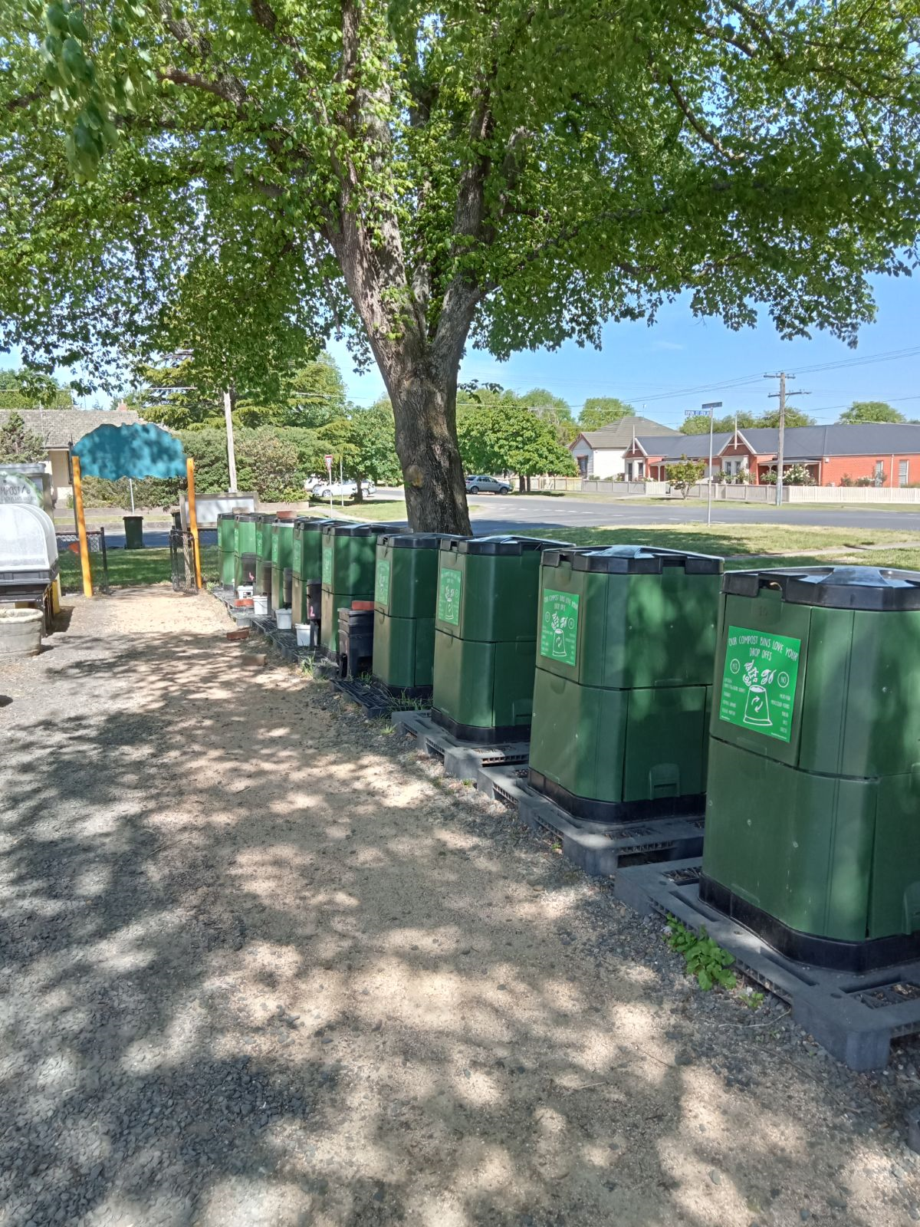
What does a community garden look like?

Slide 5
This is what my community garden looks like.
Community Garden Video (new clip 1-9).mp4

Slide 6
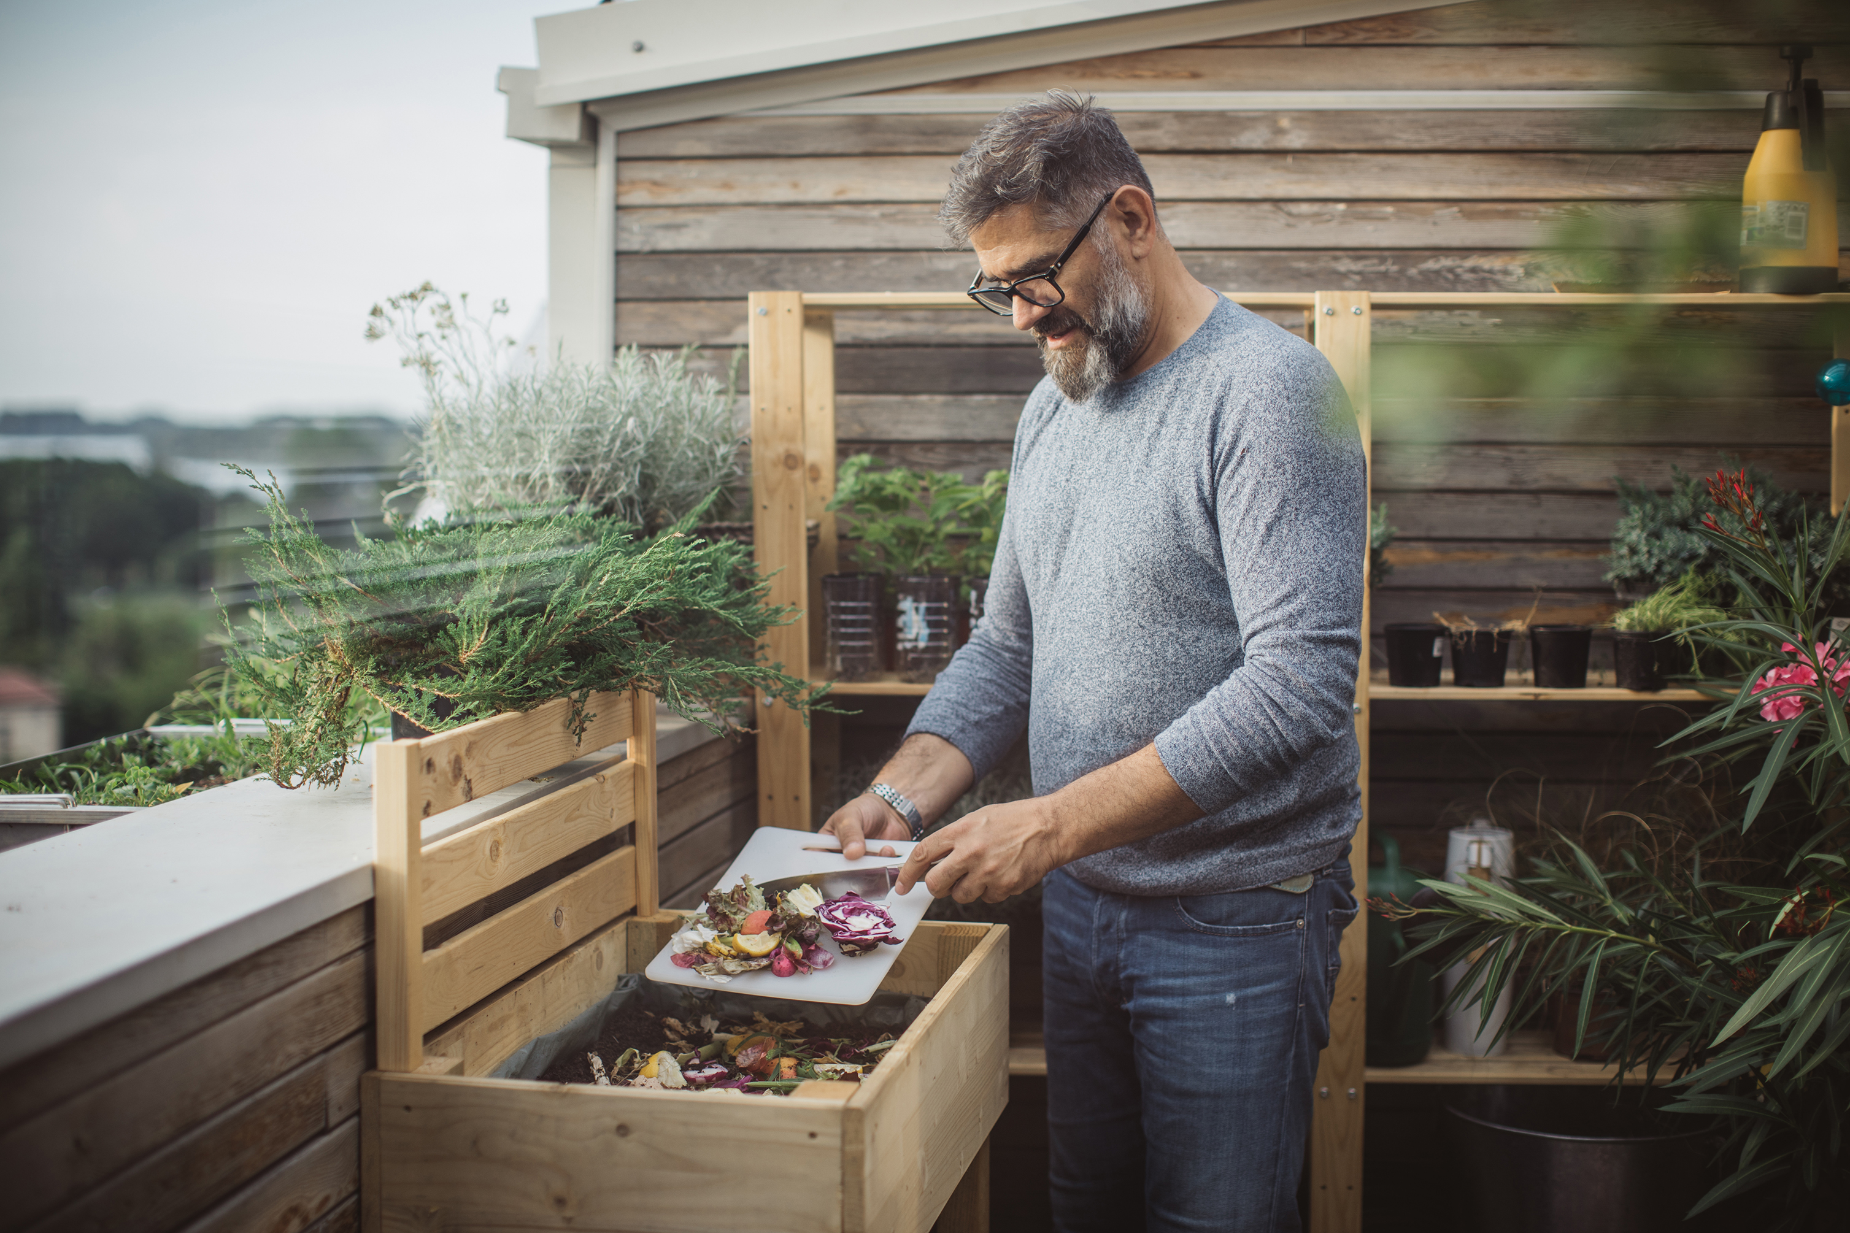
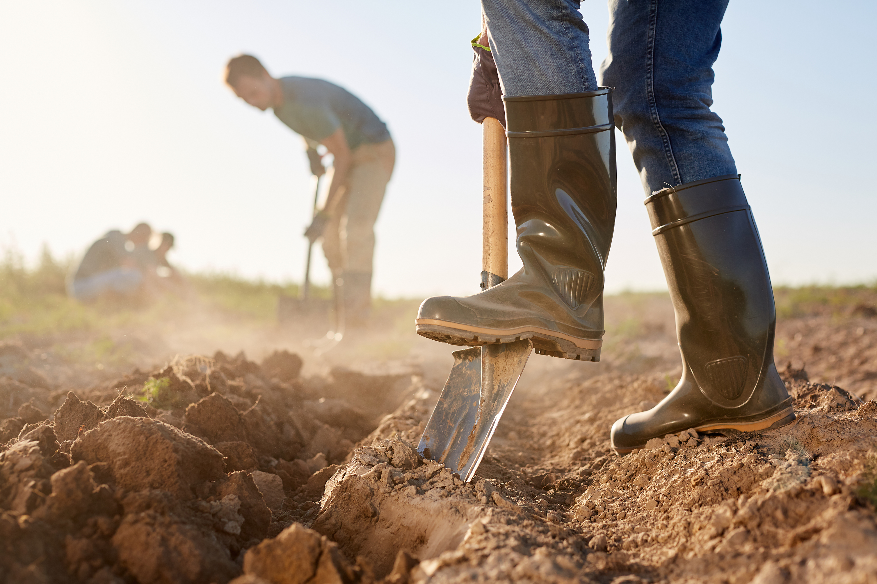
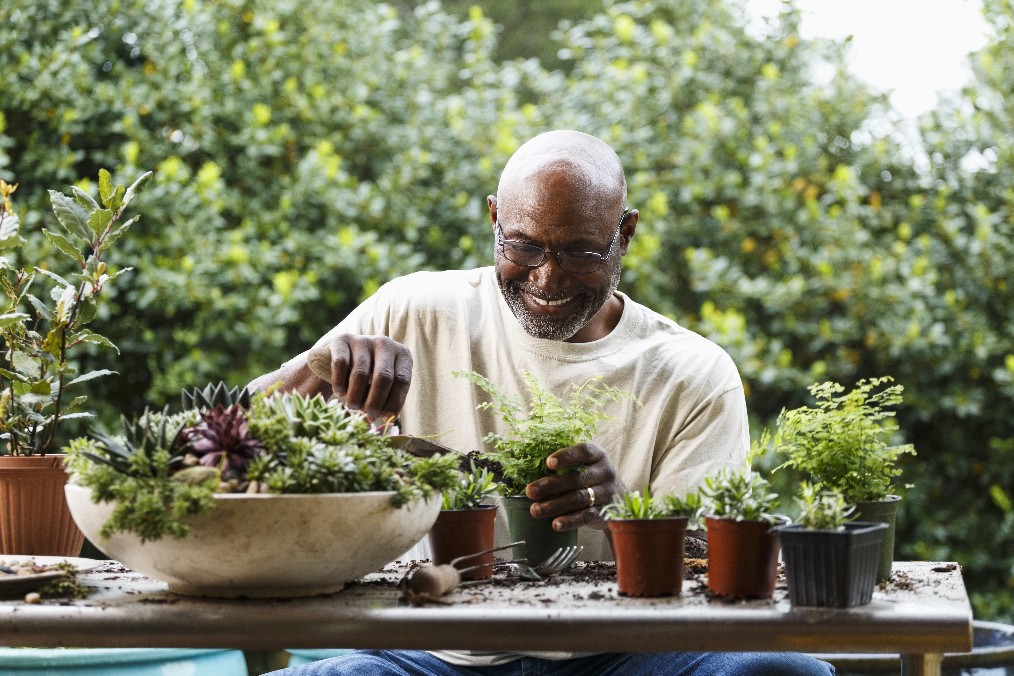
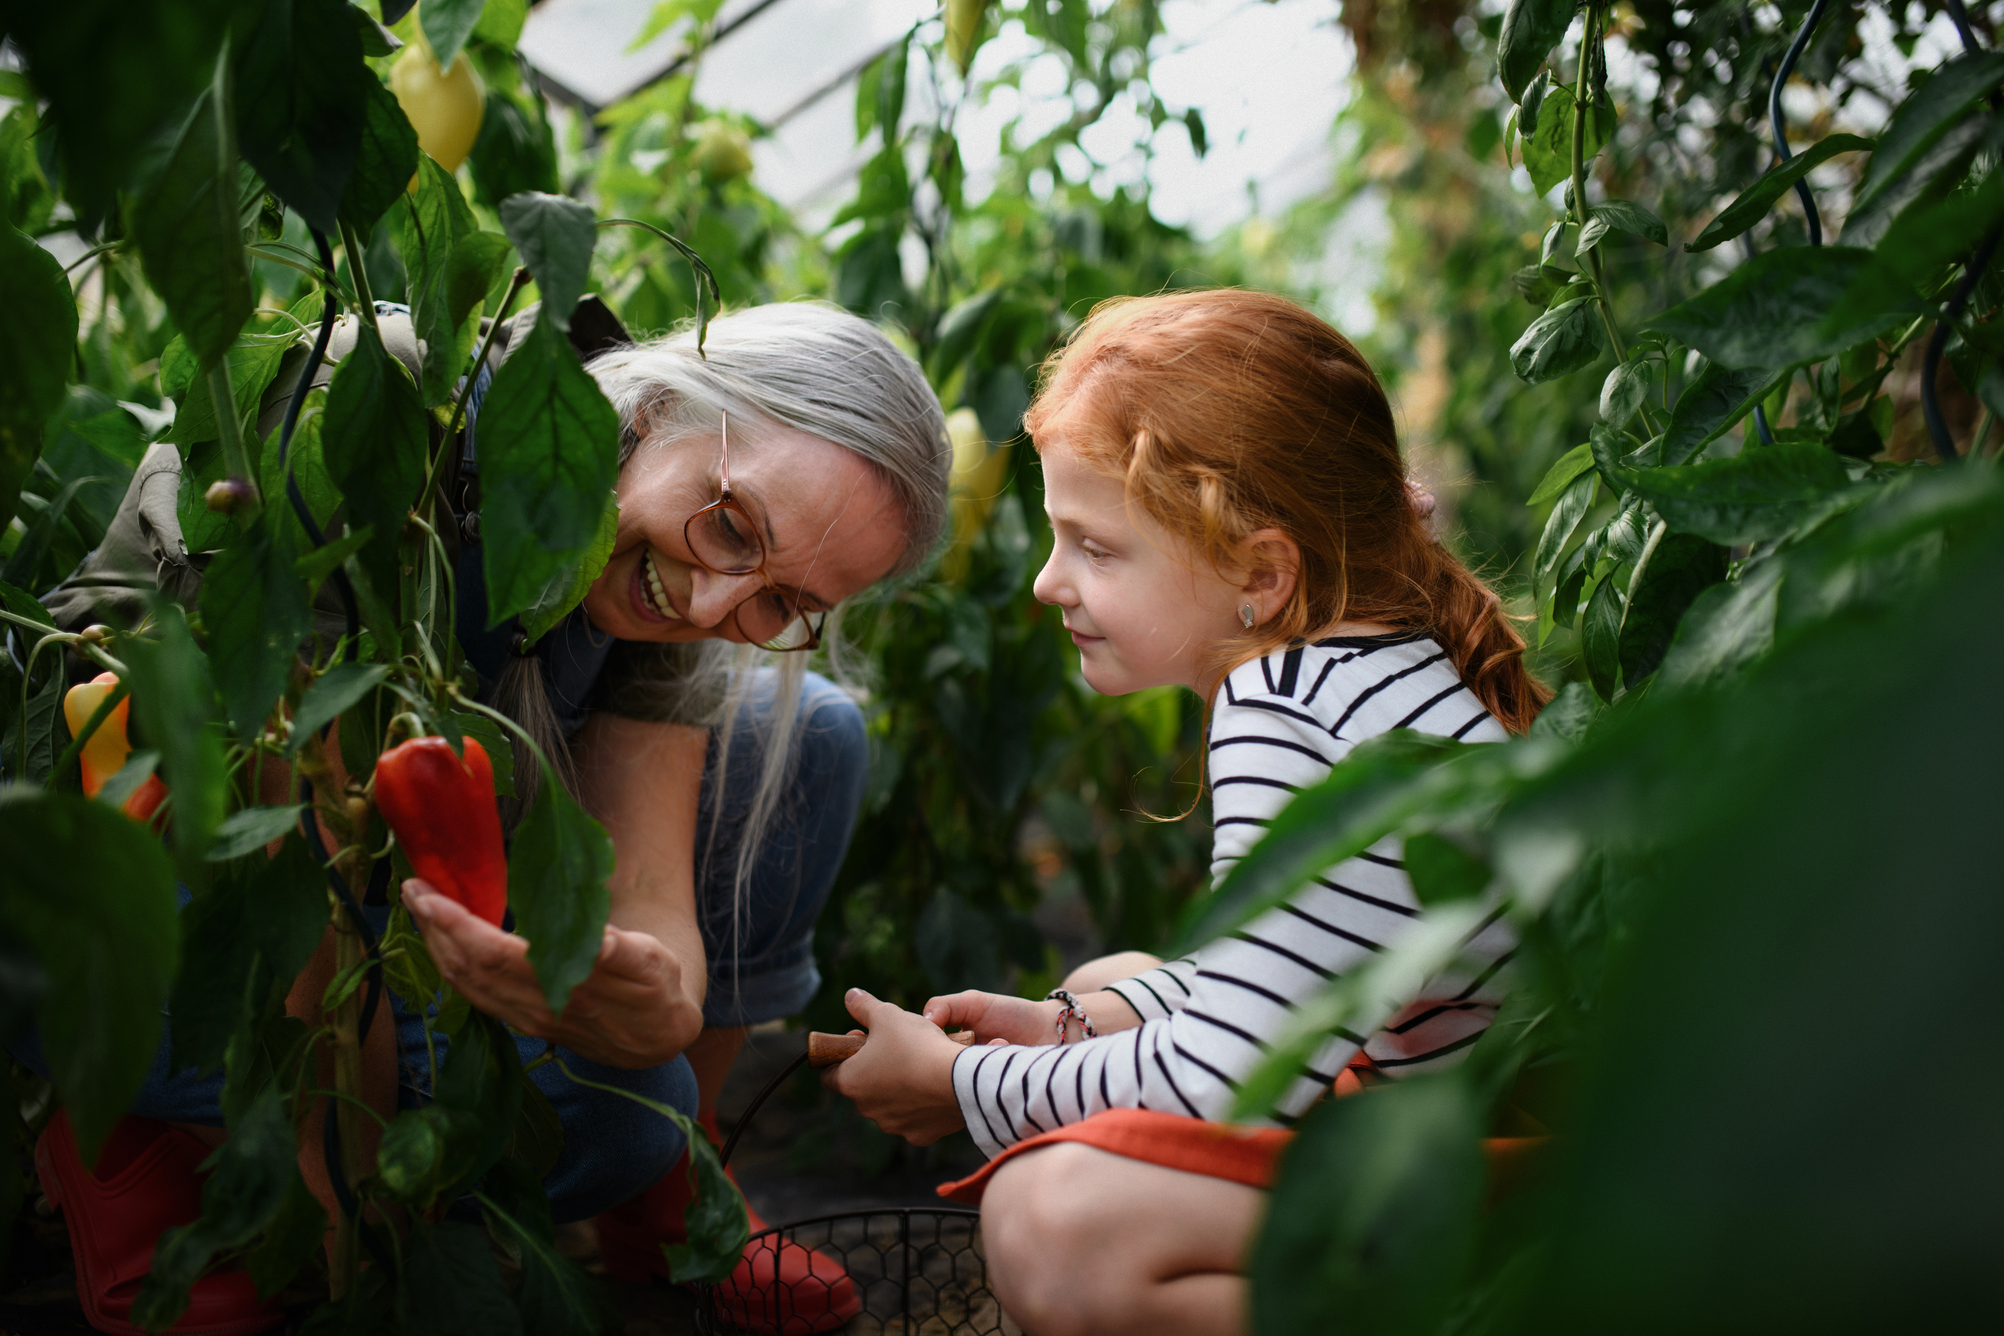
What do people do in a community garden?

Slide 7
GREEN GREEN
https://readwj.files.wordpress.com/2022/08/green-green-a-community-gardening-story-marie-lamba.pdf

Slide 8
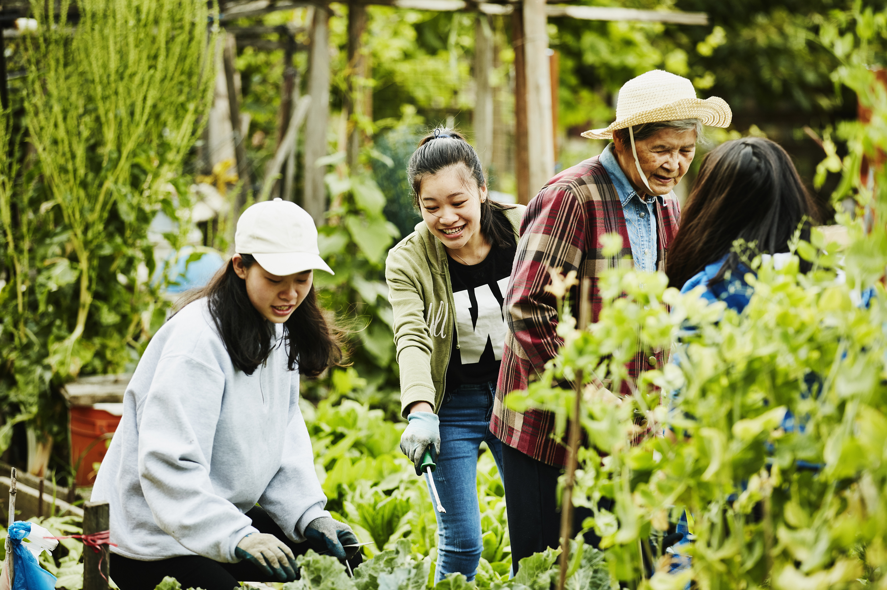
Benefits of community gardens
Improves our environment by making a healthier place
Beautifies the landscape
Provides food for the community
Adds to community green space
Encourages community members to take an interest in where their food comes from
Encourages community members to try different types of foods
Creates a happy environment for people to gather in
The list could go on and on. Can you add to this list

Slide 9
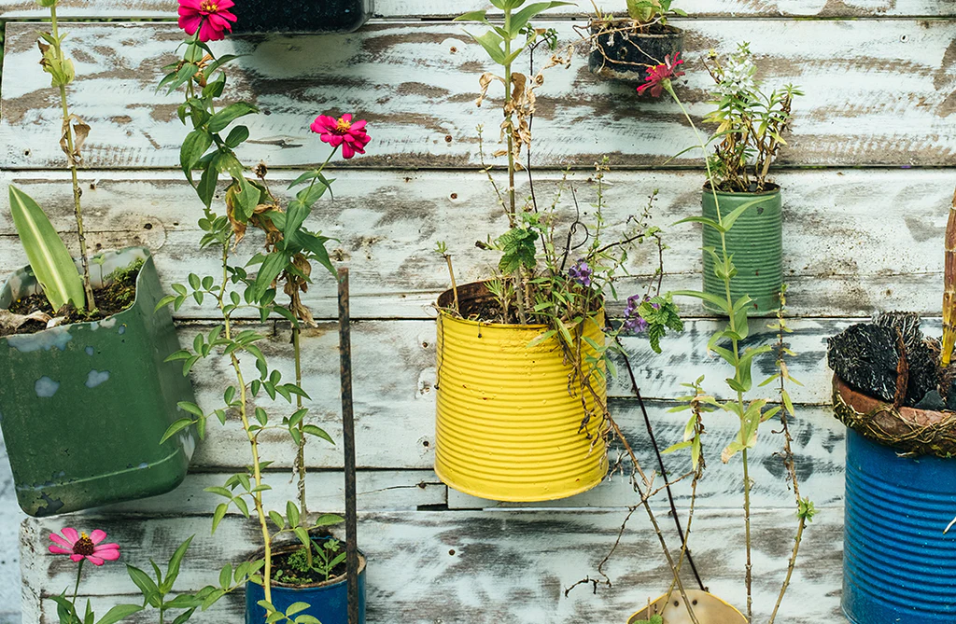
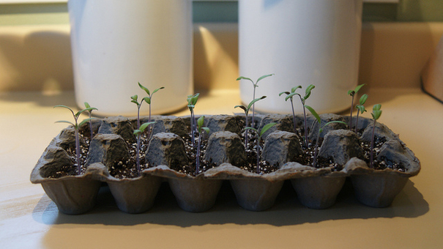
What can you do? What would you need to start a community garden?
Get creative and re-use things whenever you can!

Slide 10
Our Community Garden
Our Community Garden will be important because
………………………………………………………………………………..
In our Community Garden there will be………………………… and
………………………… and…………………………
We will need …………………………. and …………………………… and
……………………………….
This is what our Community Garden will look like (illustrate)

Slide 11
A useful resource – check it out
https://kidsgardening.org/resources/create-sustain-a-program-starting-a-school-garden-program-overview/

Slide 12
Imagine a day in the life of a garden inhabitant. Have students observe and then create their play around the everyday happenings of an animal or a plant in their garden. Follow a butterfly or bee as it visits different flowers. Create commentary or dialogue for a patch of sunflowers turning their heads as the sun moves through the sky. Imitate a group of ants as they search for food.
Recreate a garden-based phenomenon. Nature is full of significant events that keep our world turning. Bring a scientific phenomenon to life through characters and an entertaining story. Act out the life cycle of a plant from seed to seed or the adventures of a pollinator looking for its next meal. Share the story of a drop of water as it moves through the environment.
Create Your Own Garden-Inspired Performance - KidsGardening

