Slide 1
Why Should I Recycle
Written by Jen Green
Illustrated by Mick Gordon

Slide 2
Learning Intentions
Students will:
Literacy
Listening – listen to a story about recycling
Speaking – participate in discussions about recycling
Writing – provide written reasons for why they should recycle and what they could recycle
Social Studies
Develop an understanding of the positive impact of recycling of a variety of items

Slide 3
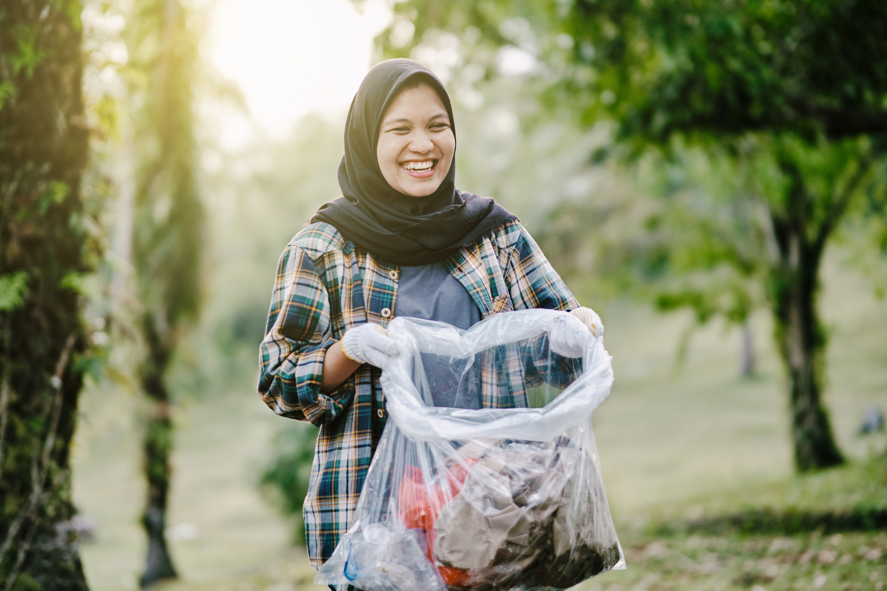
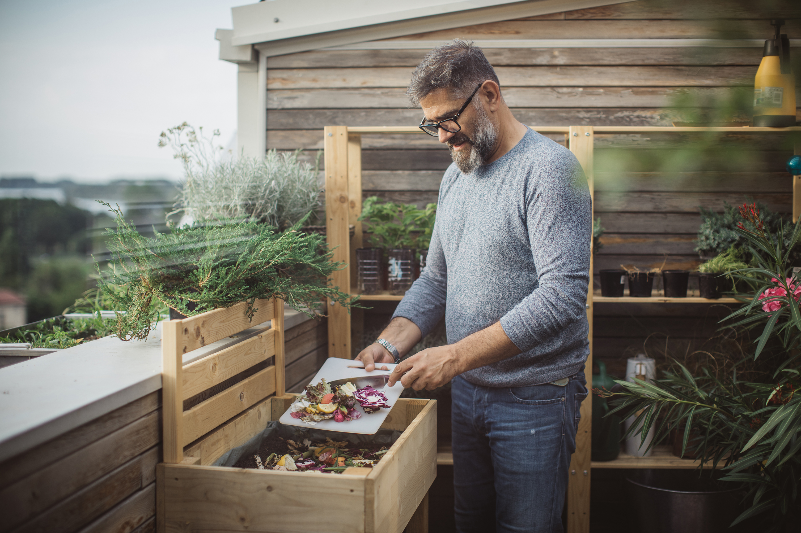
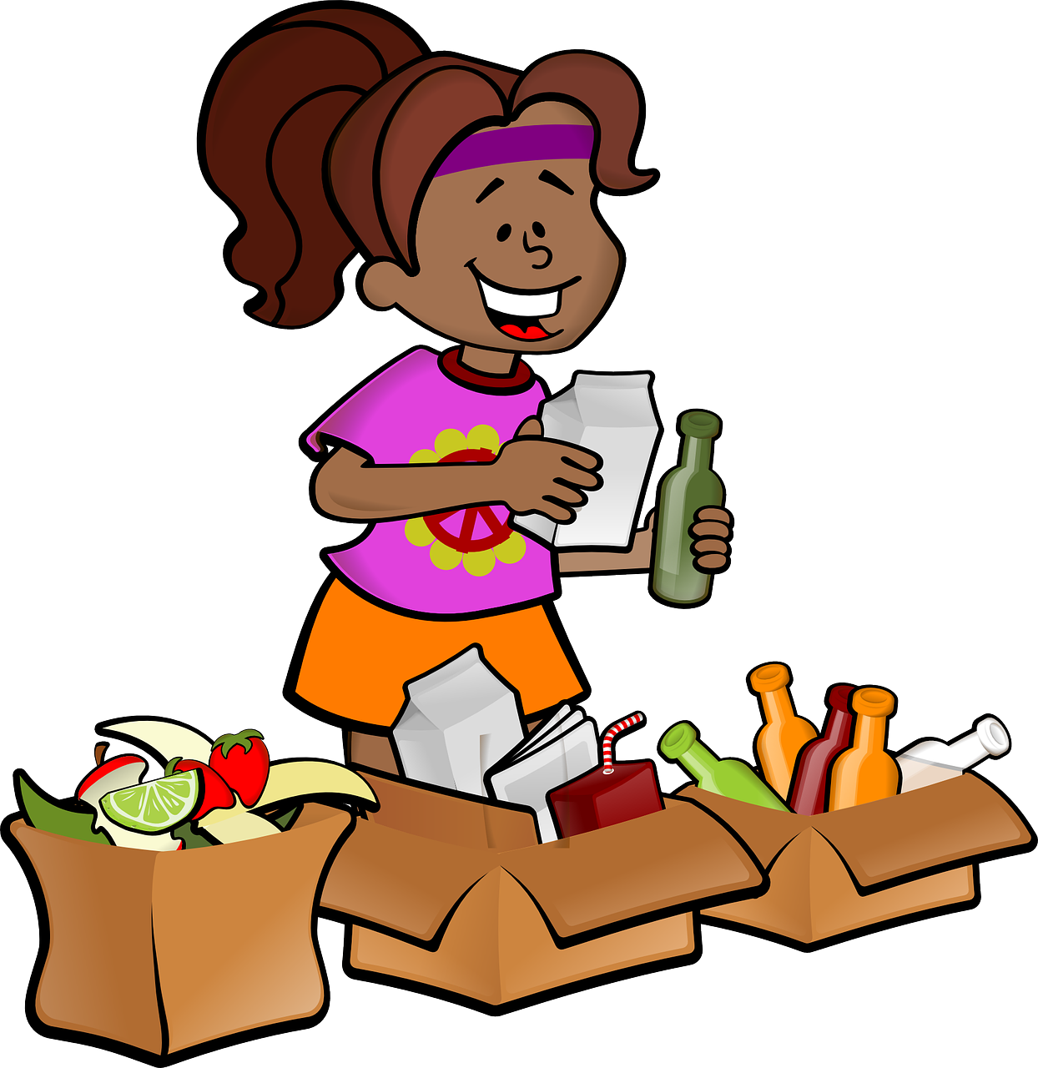
New vocabulary
Recycle – to use something again
Compost – decayed (rotted) organic matter
Landfill – a place where waste is taken to be buried
Second hand - Something that has been used

Slide 7
What things can you see in this landfill? What are they made out of?

Slide 8
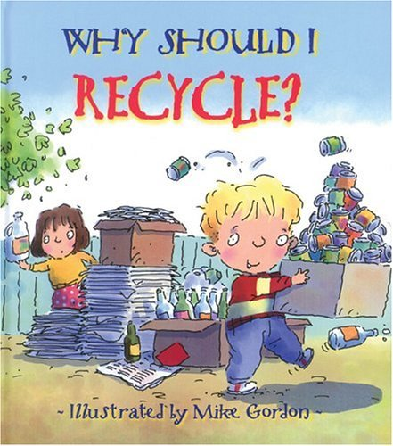
Why Should I Recycle? by Jen Green Illustrated by Mike Gordon - YouTube

Slide 9
Why should we recycle?
1
2
3
4

Slide 10
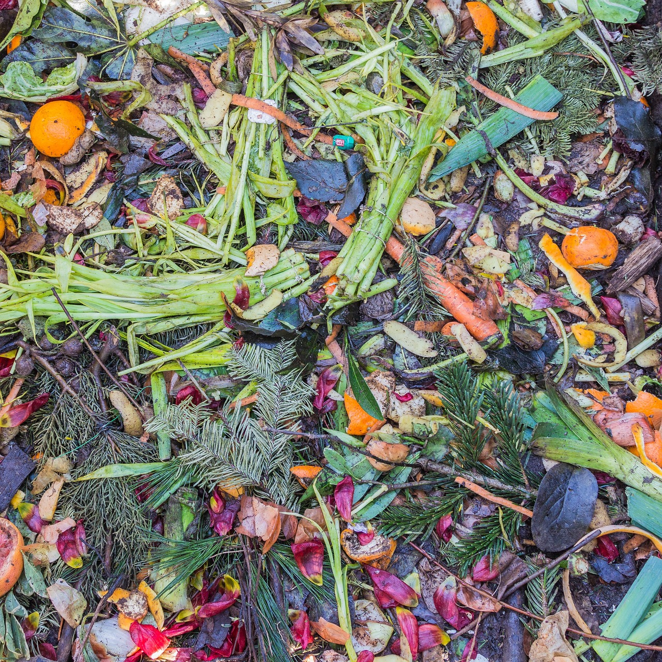
What can we do with your food scraps?
Turn our food scraps into compost
Only use enough food to satisfy our needs
DID YOU KNOW THAT: Roughly one-third of the food produced that is intended for human consumption every year is wasted or lost. This is enough to feed 3 billion people. 25 Shocking Facts About Food Waste | Earth.Org

Slide 11
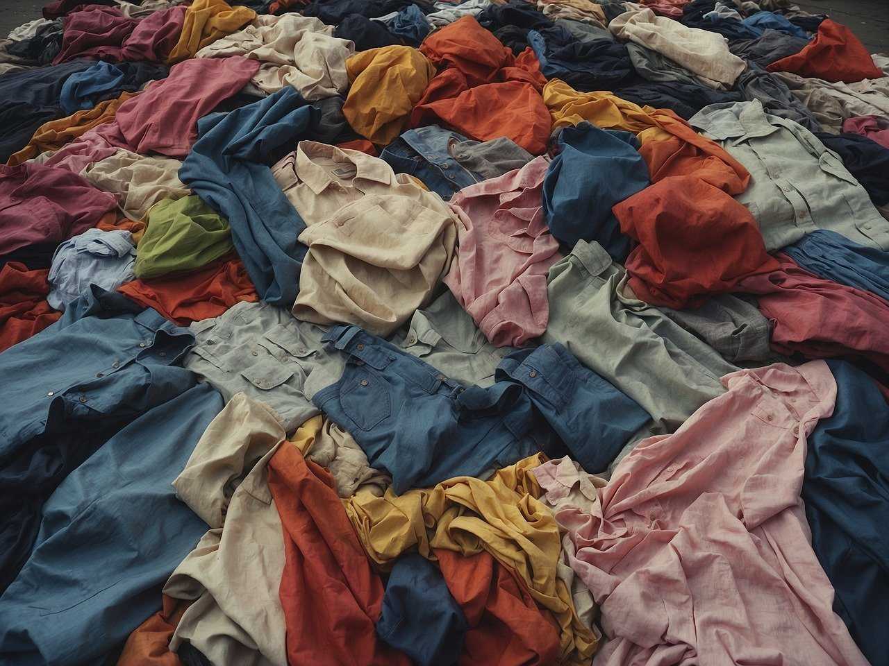
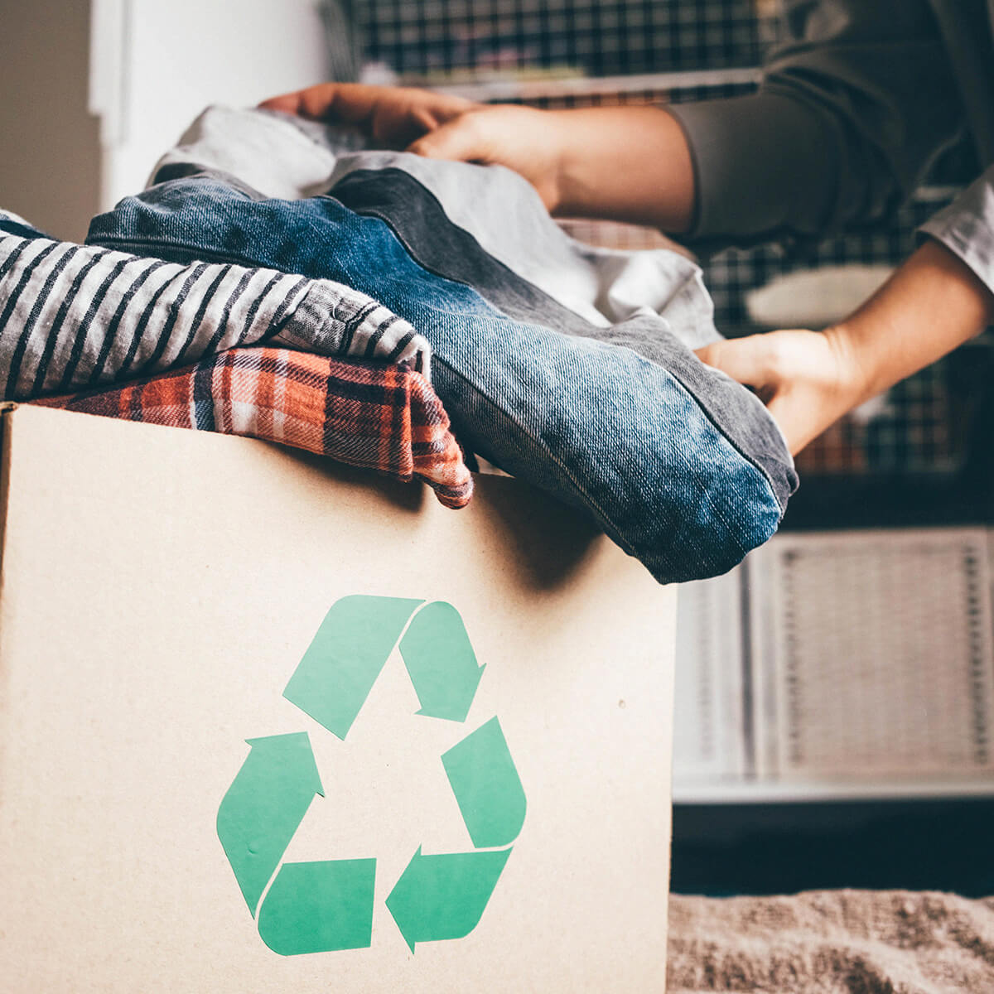
What can we do with old clothing?
Mend it if it is broken or damaged
Donate it to a charity if it is still in good condition and can be worn by someone else
Use the good pieces to make into new clothes
DID YOU KNOW THAT - Every single kilogram of textiles that you save from landfill by passing on for reuse, repurposing or recycling prevents 3-4 kg of greenhouse gas emissions from polluting our atmosphere. How To Recycle Old Clothes And Worn Fabrics In Australia | Urban Revolution - Urban Revolution Australia

Slide 12
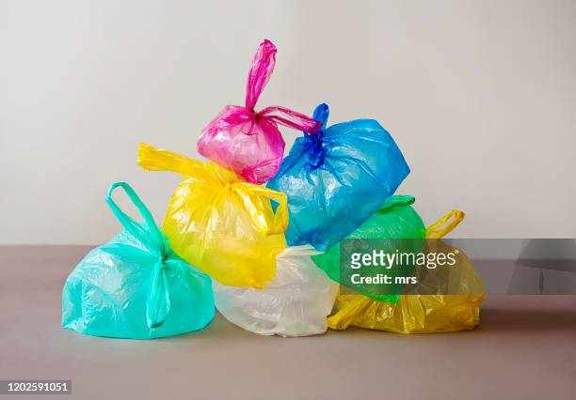
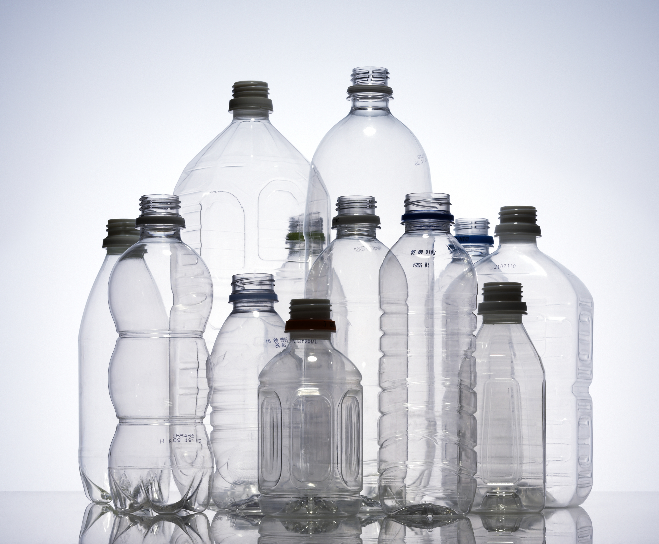
What can we do with plastic?
Repurpose plastic for such things as insulation for buildings
Create ecobricks for buildings
Reuse plastic bottles to make such things as containers for household items
DID YOU KNOW THAT plastic was invented less than a hundred years ago and in that time single use plastic has become one of the biggest made-made threats to our planet. A lot of oil is used in plastic production and plastic releases toxic gases when it is buried.

Slide 13
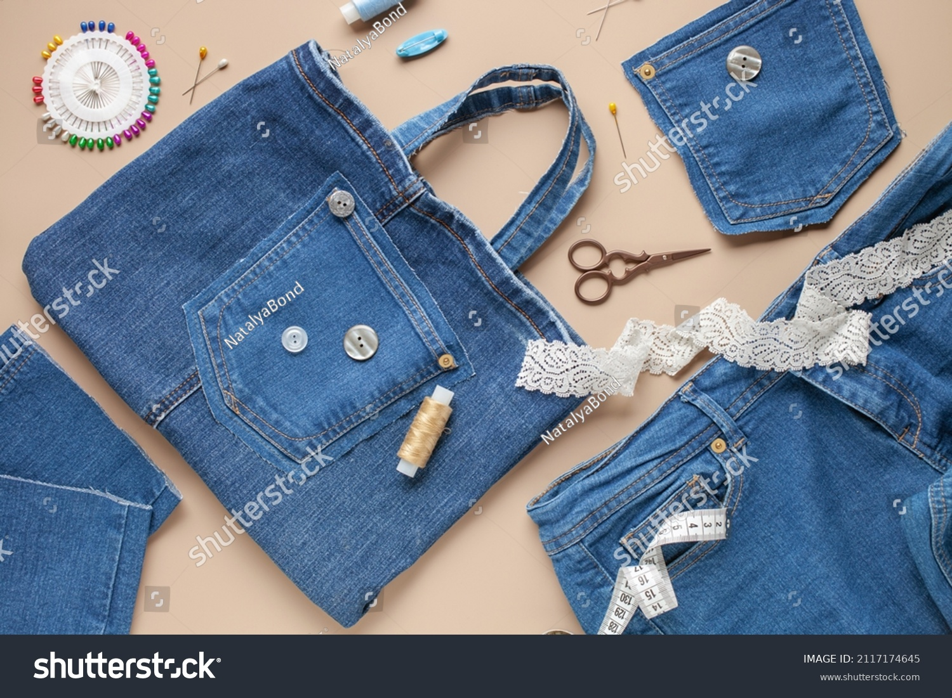
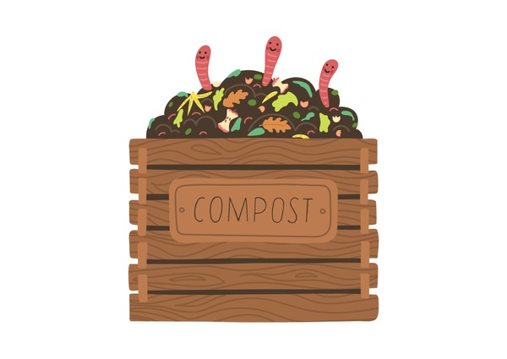
What else can we do to achieve zero waste?

Slide 14
Worksheet practice
Why should I recycle?
I should recycle clothes by donating them to a charity shop
I should recycle food scraps by making a compost bin

Slide 15
Why should I recycle?
I should recycle__________________ by
_______________________________________
I should recycle__________________ by
_______________________________________

