Slide 1
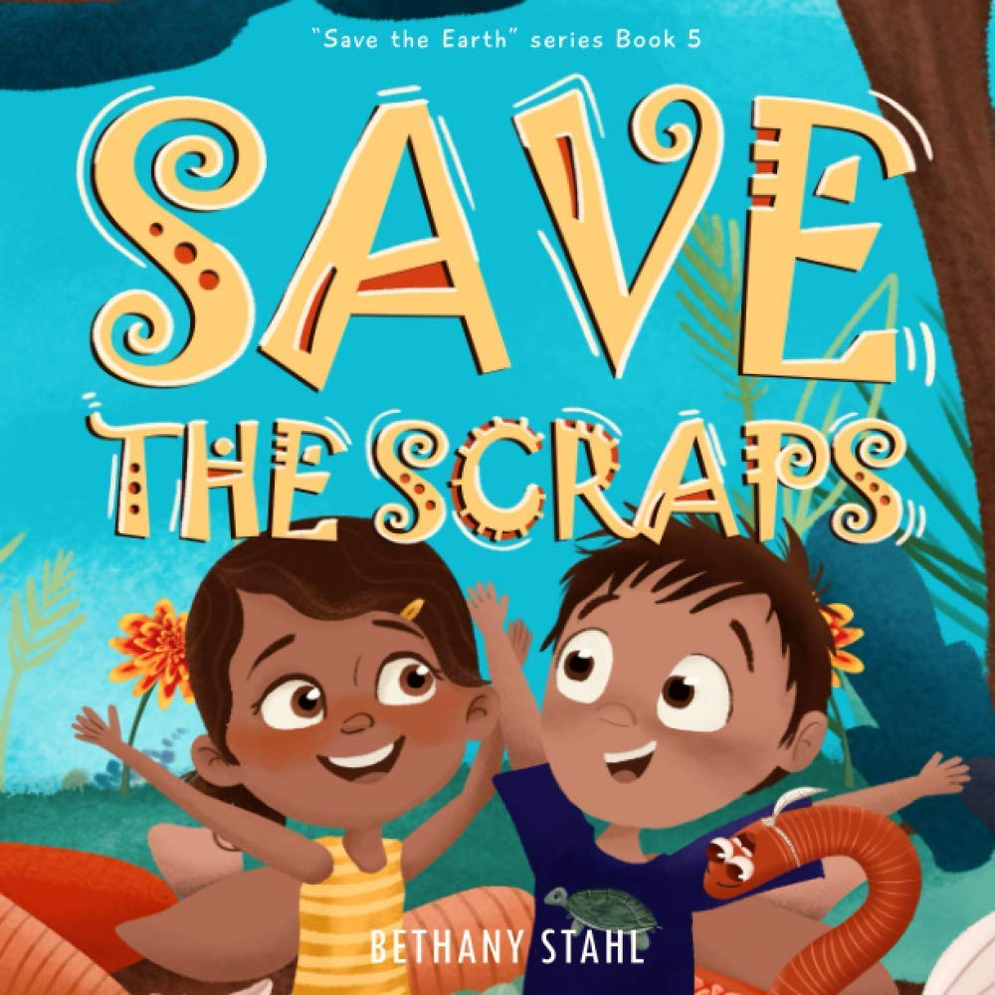

Slide 2
Learning intentions
Literacy
Listening - students will listen to a story
Writing – students will complete sentences to create a story
Speaking – students will share their stories with an audience
Grammar – students will use the past, present and future tenses of the irregular verb 'to eat'
Science – students will understand how food is composted and what happens to food scraps that are composted

Slide 3
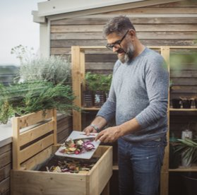
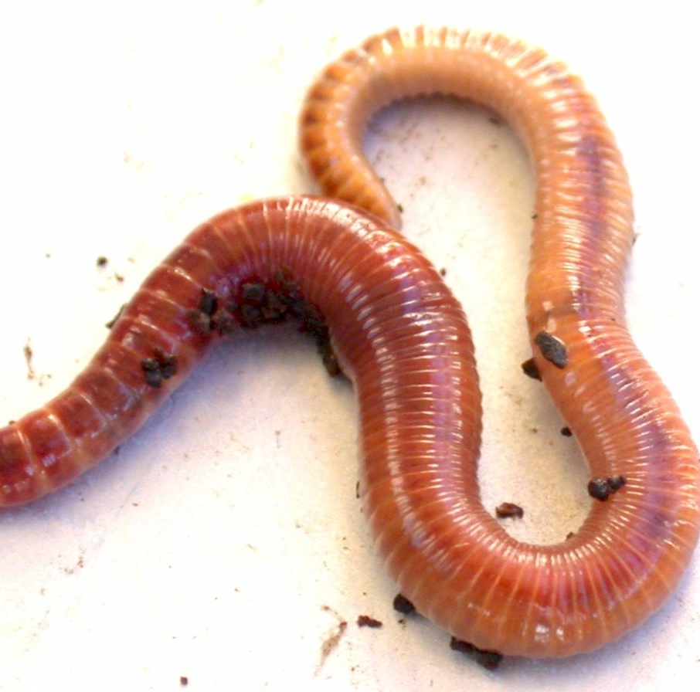
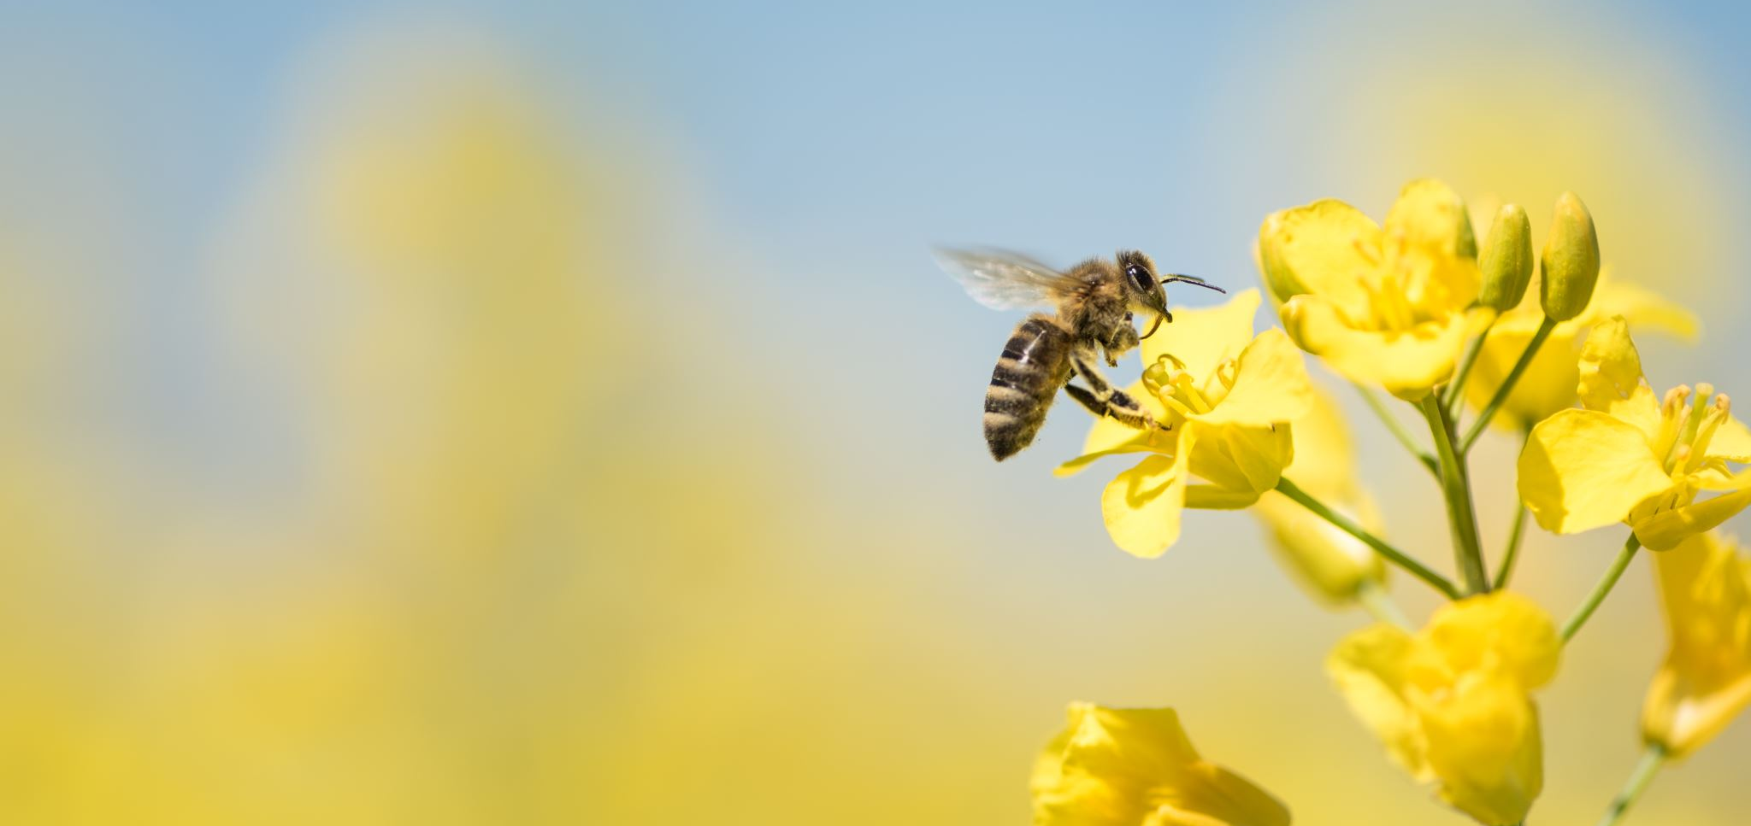
New vocabulary
Composting - is a process by which organic matter, such as leaves and food scraps, decomposes into soil
Pollinators -something, such as an insect, that carries pollen from one plant or part of a plant to another
Worms -A worm is a small, tube-shaped creature with no arms or legs. The worms that hang out in your garden are very helpful, keeping the soil rich and fertile

Slide 4
DID YOU KNOW?
Bees have 5 eyes
Bees have 2 pairs of wings
Bees navigate using the sun
Bees have 6 legs
Bees can see all colours except red
Bees carry pollen on their hind legs
World Bee Day is May 2

Slide 5
DID YOU KNOW?
Worms breath through their skin and have no lung
Worms are made of 90% water
Worms do not have eye but have sensors on their bodies so they can sense light
Worms can consume 100% of their body weight in a single day

Slide 6
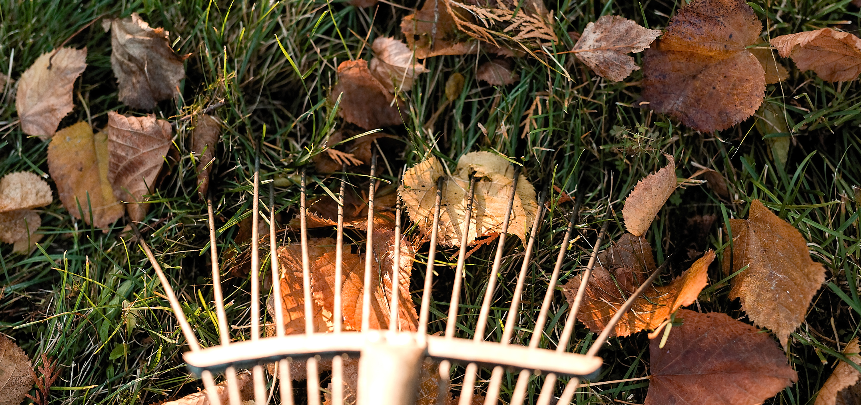
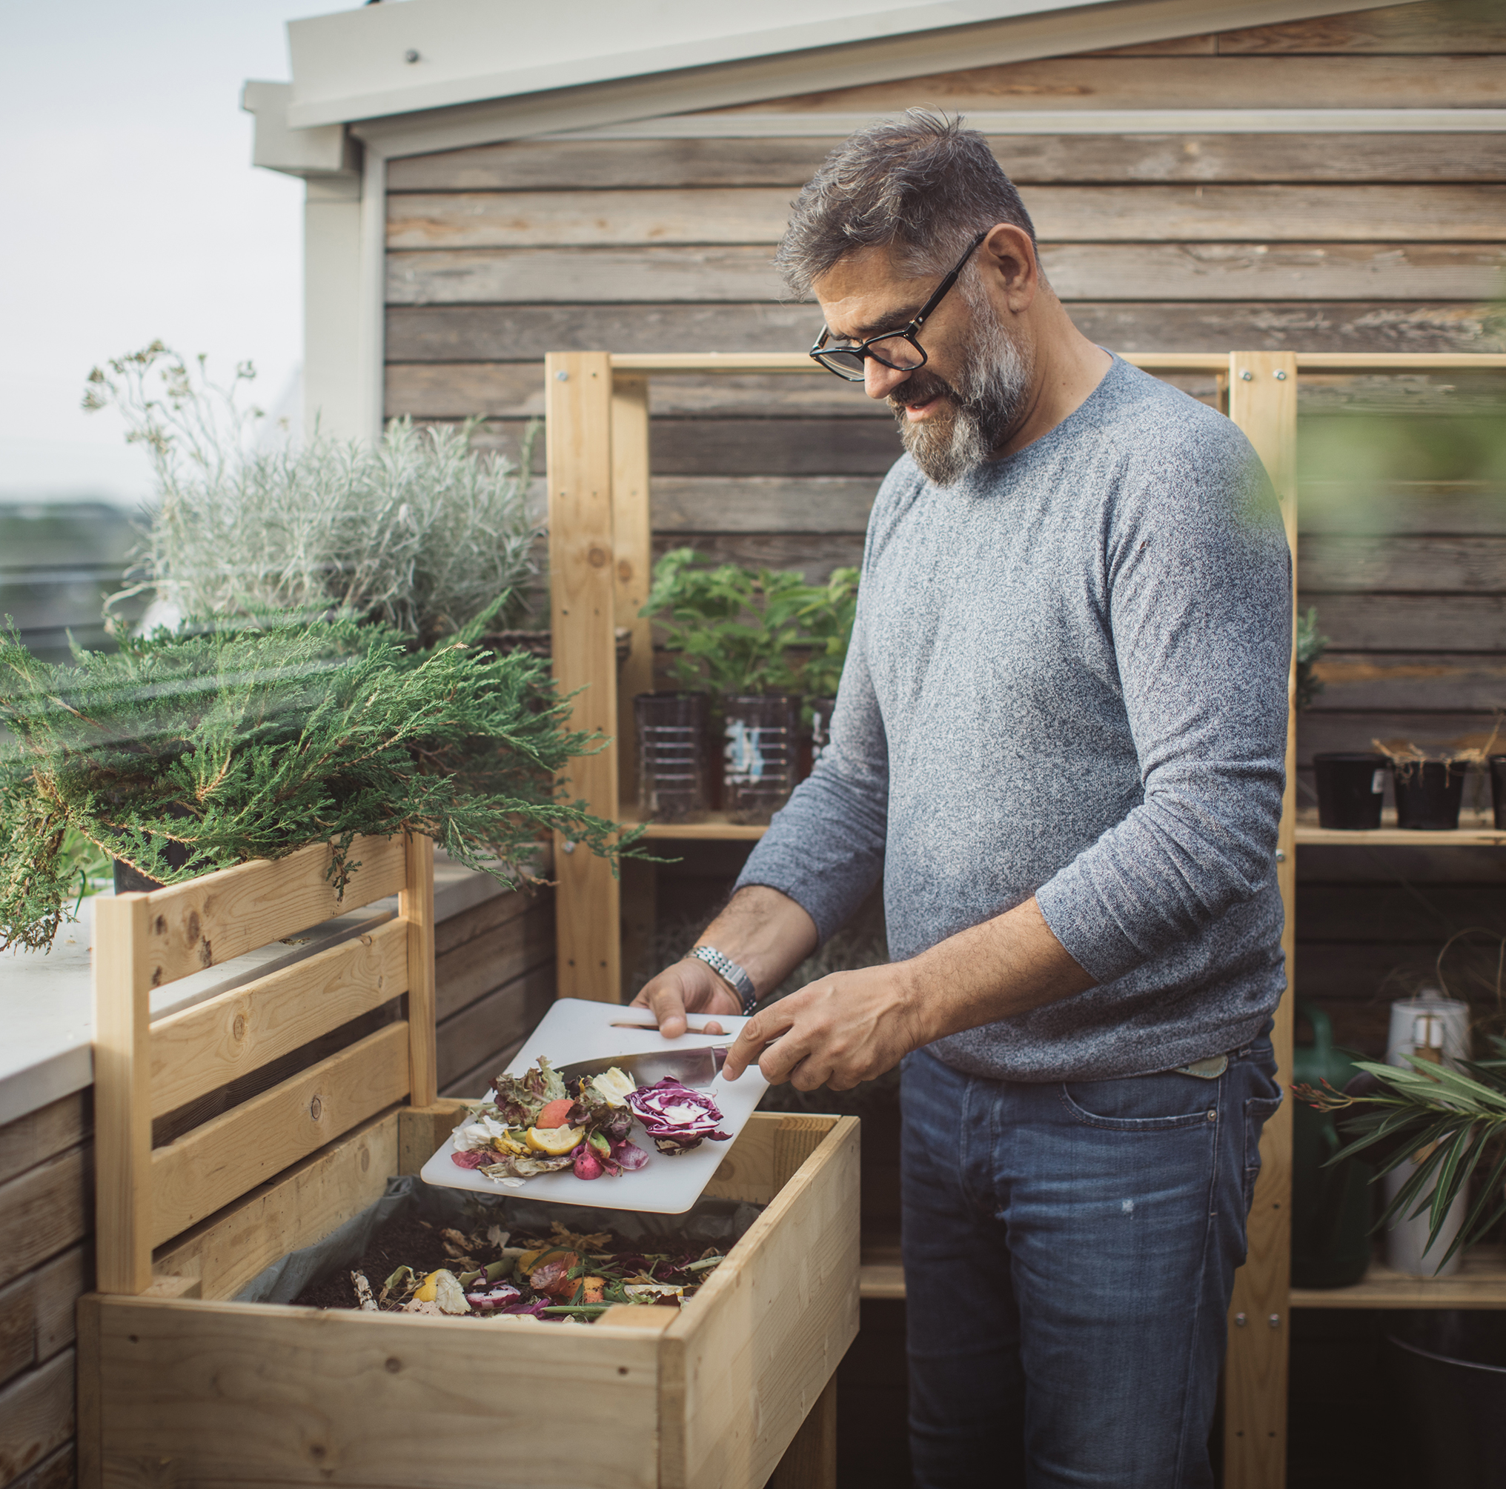
DID YOU KNOW?
By putting organic waste into your garden you help prevent climate change by preventing greenhouse gases from being added to the atmosphere.

Slide 7
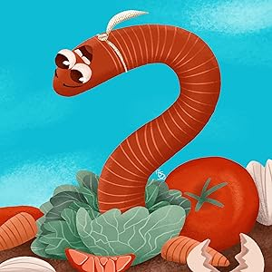
What is happening in these illustrations

Slide 8
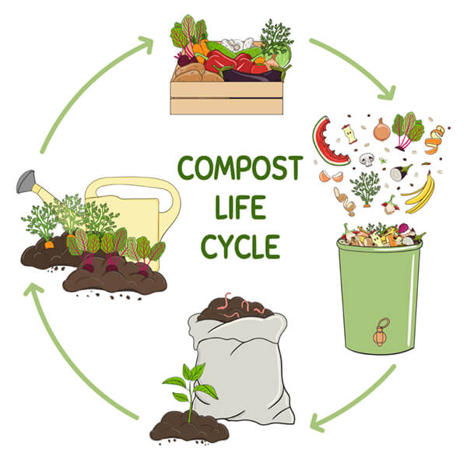

Slide 9
Reading with Kids' Food Basket: Save the Scraps - YouTube

Slide 10
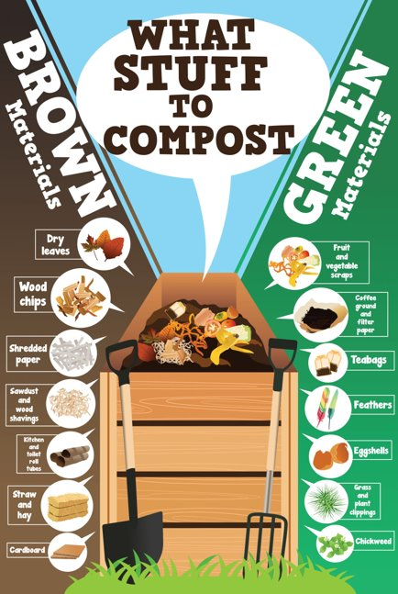

Slide 11
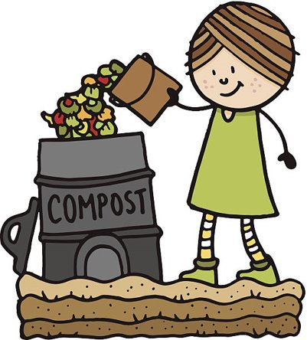
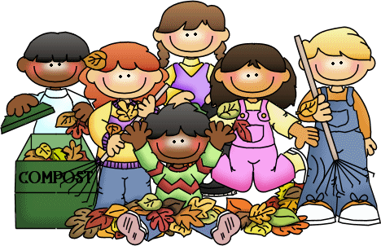
What food scraps could you put into compost today?

Slide 12
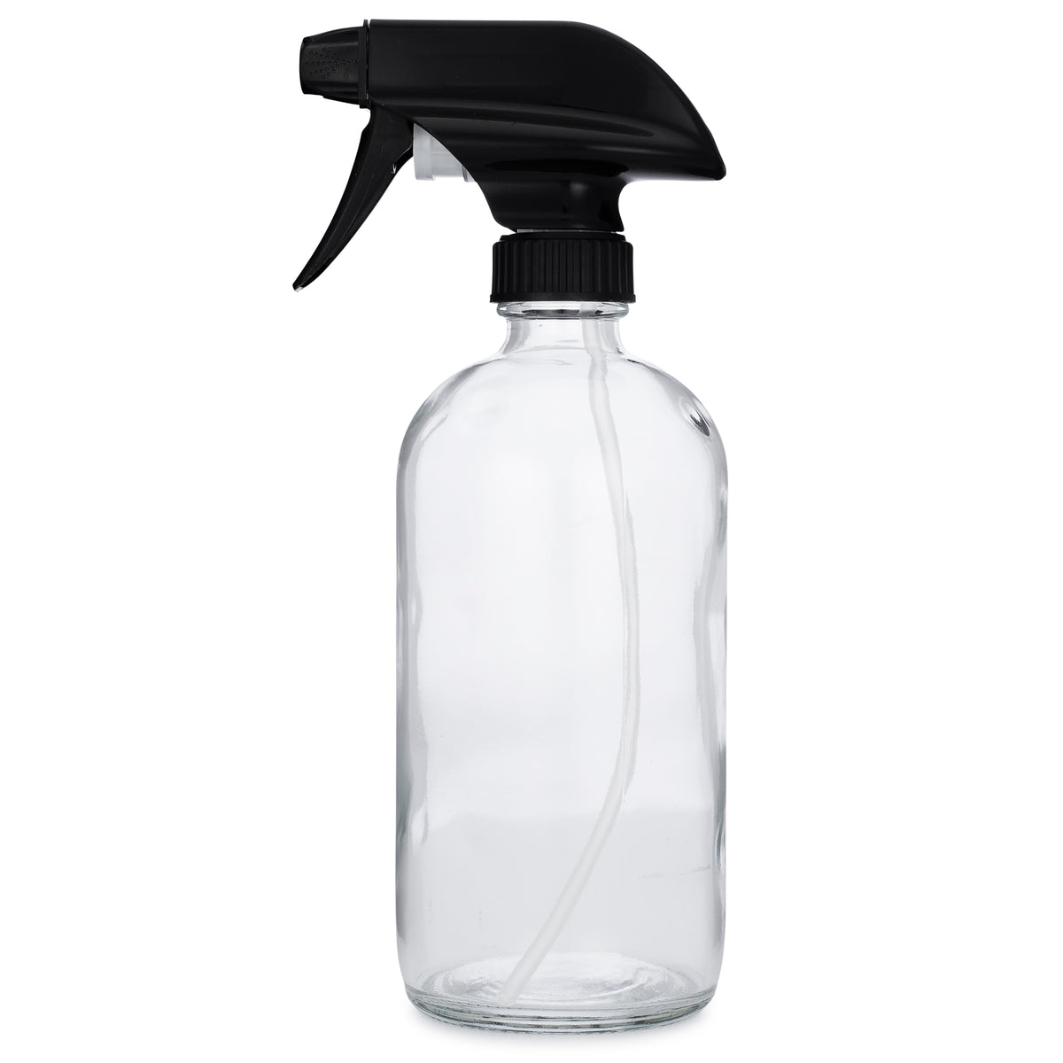
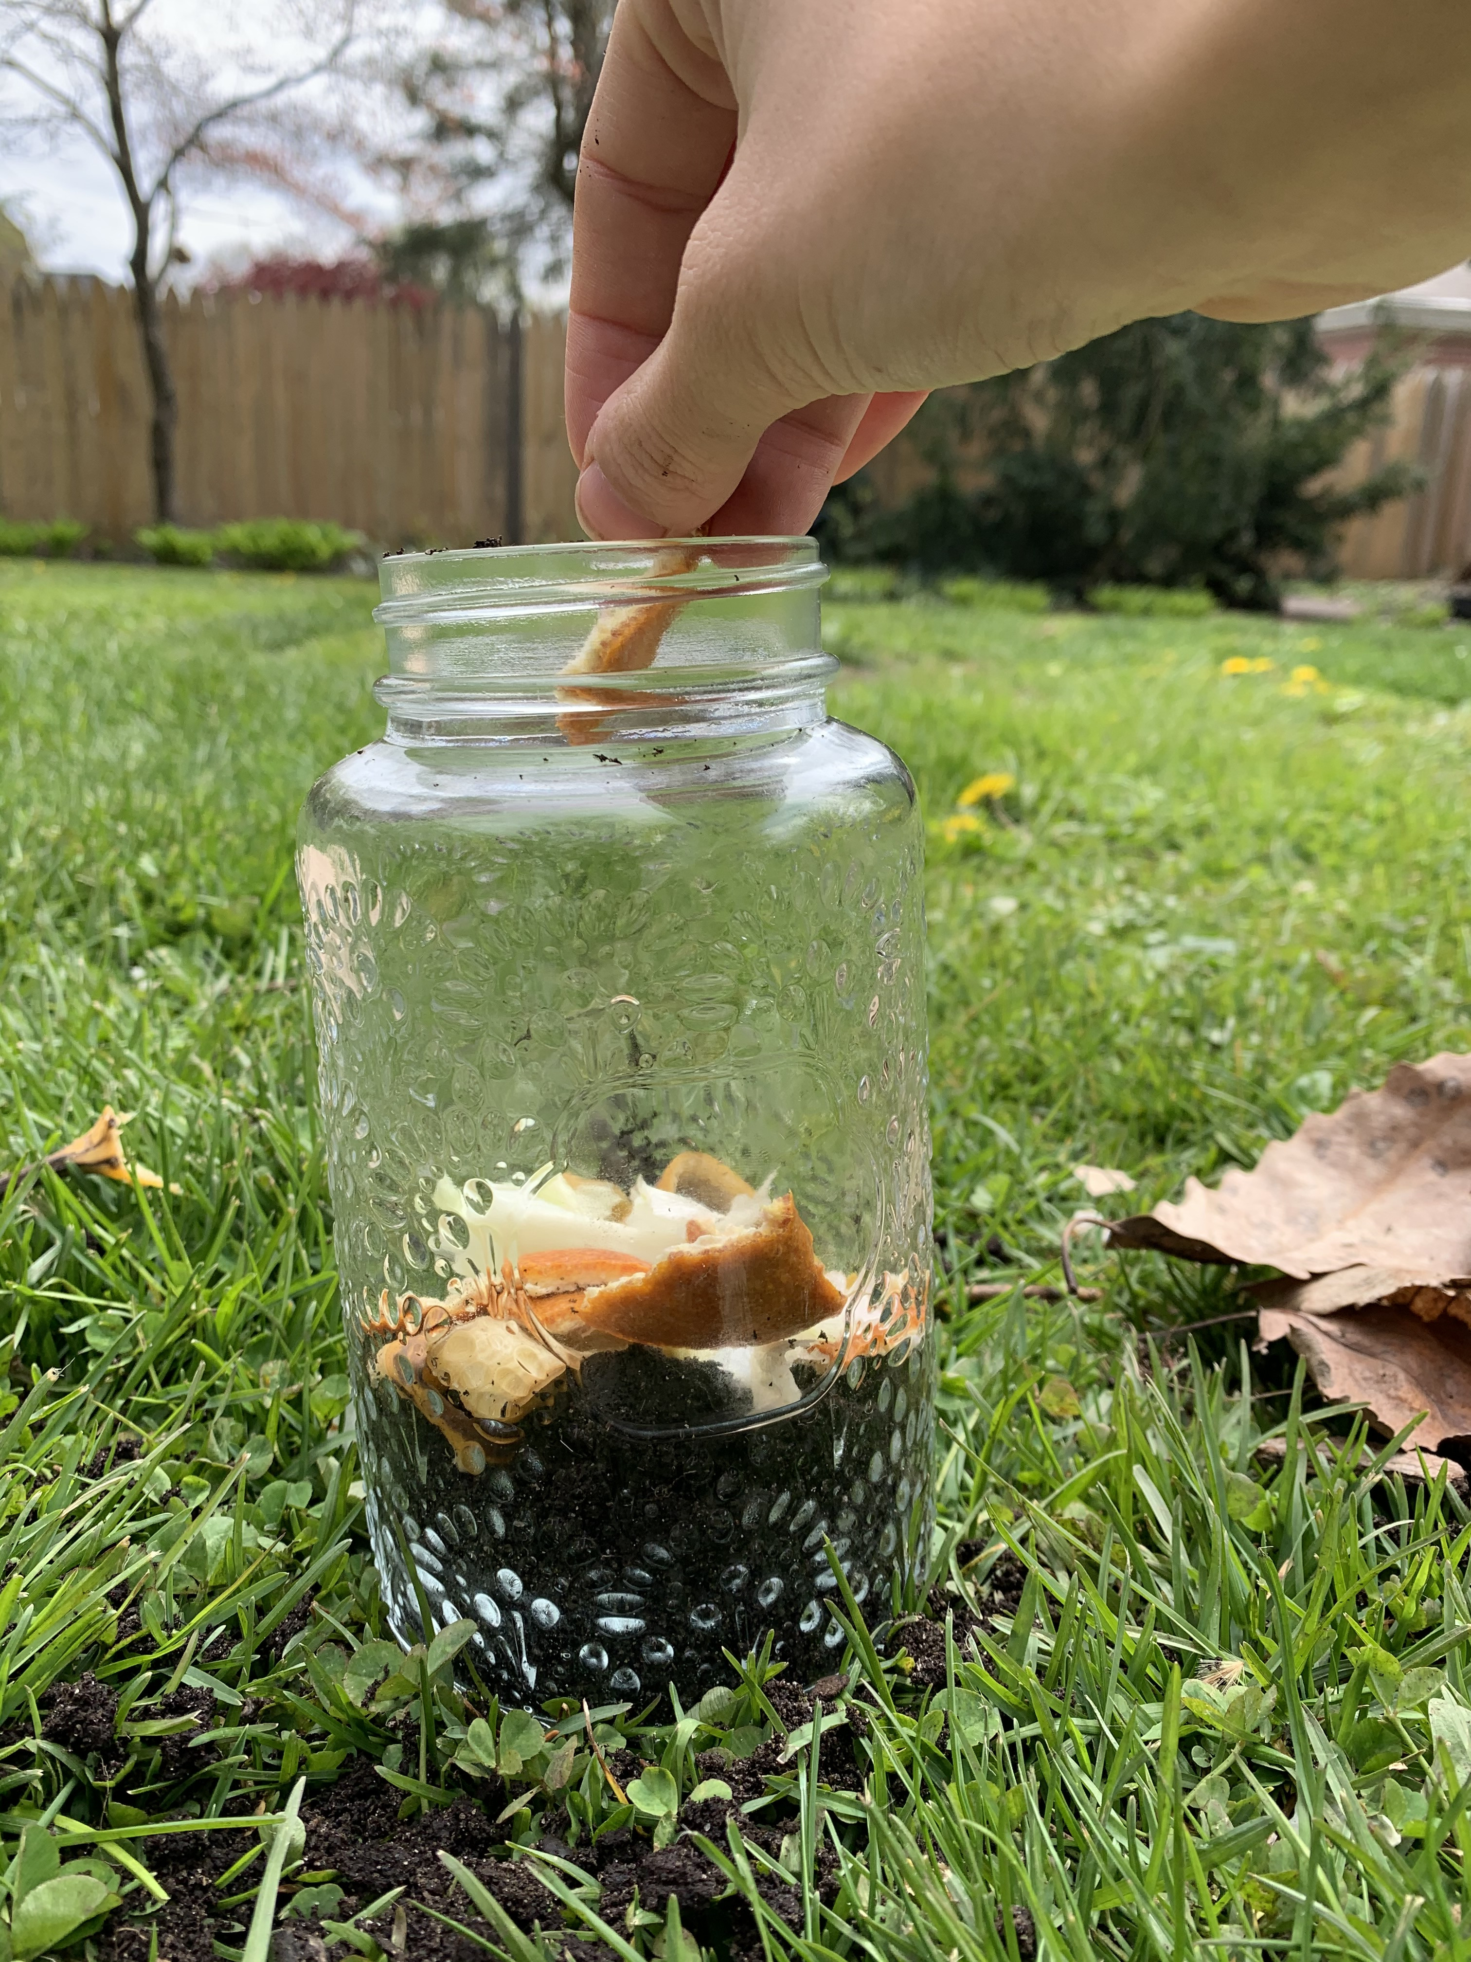
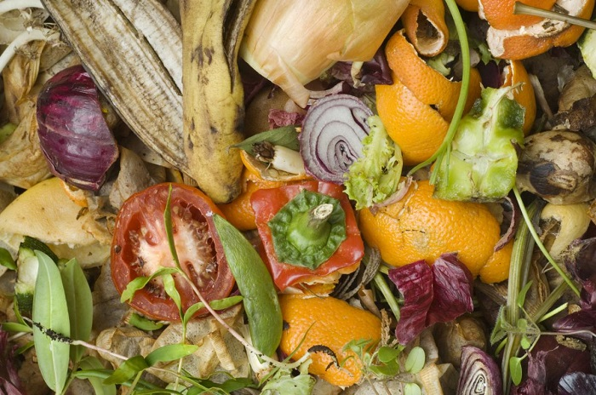
This is something that you might like to try
Making a Homemade Composter! | Full-Time Kid | PBS Parents - YouTube

Slide 13
Save the scraps for Wormy b
Yesterday Wormy ate _______________________
Today Wormy is eating __________________________
Tomorrow Wormy will eat ____________________
And thanks to Wormy we will have beautiful ______________ for our garden.

