Slide 1
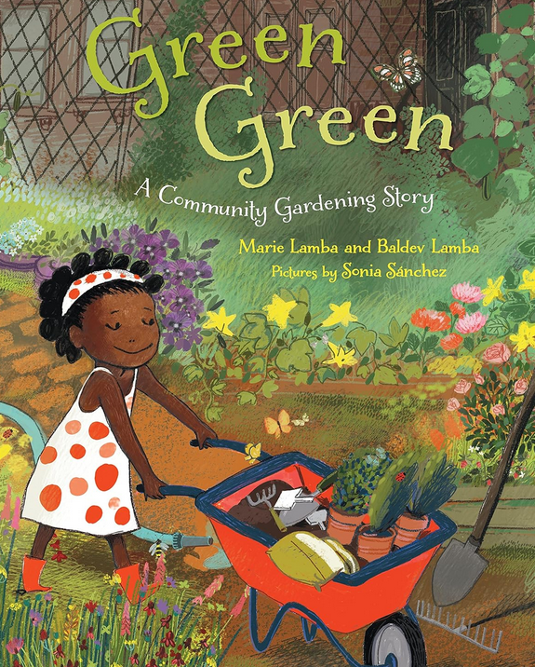

Slide 2
Learning intentions
Students will:
Literacy
listen to a story
participate in the shared reading of the story
write a response to the story by completing a sentence pattern
Social Studies
Develop an understanding of how communities can work together to create a community garden

Slide 3
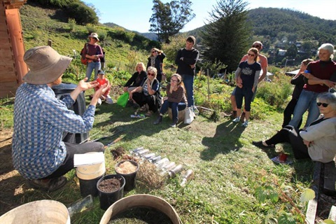
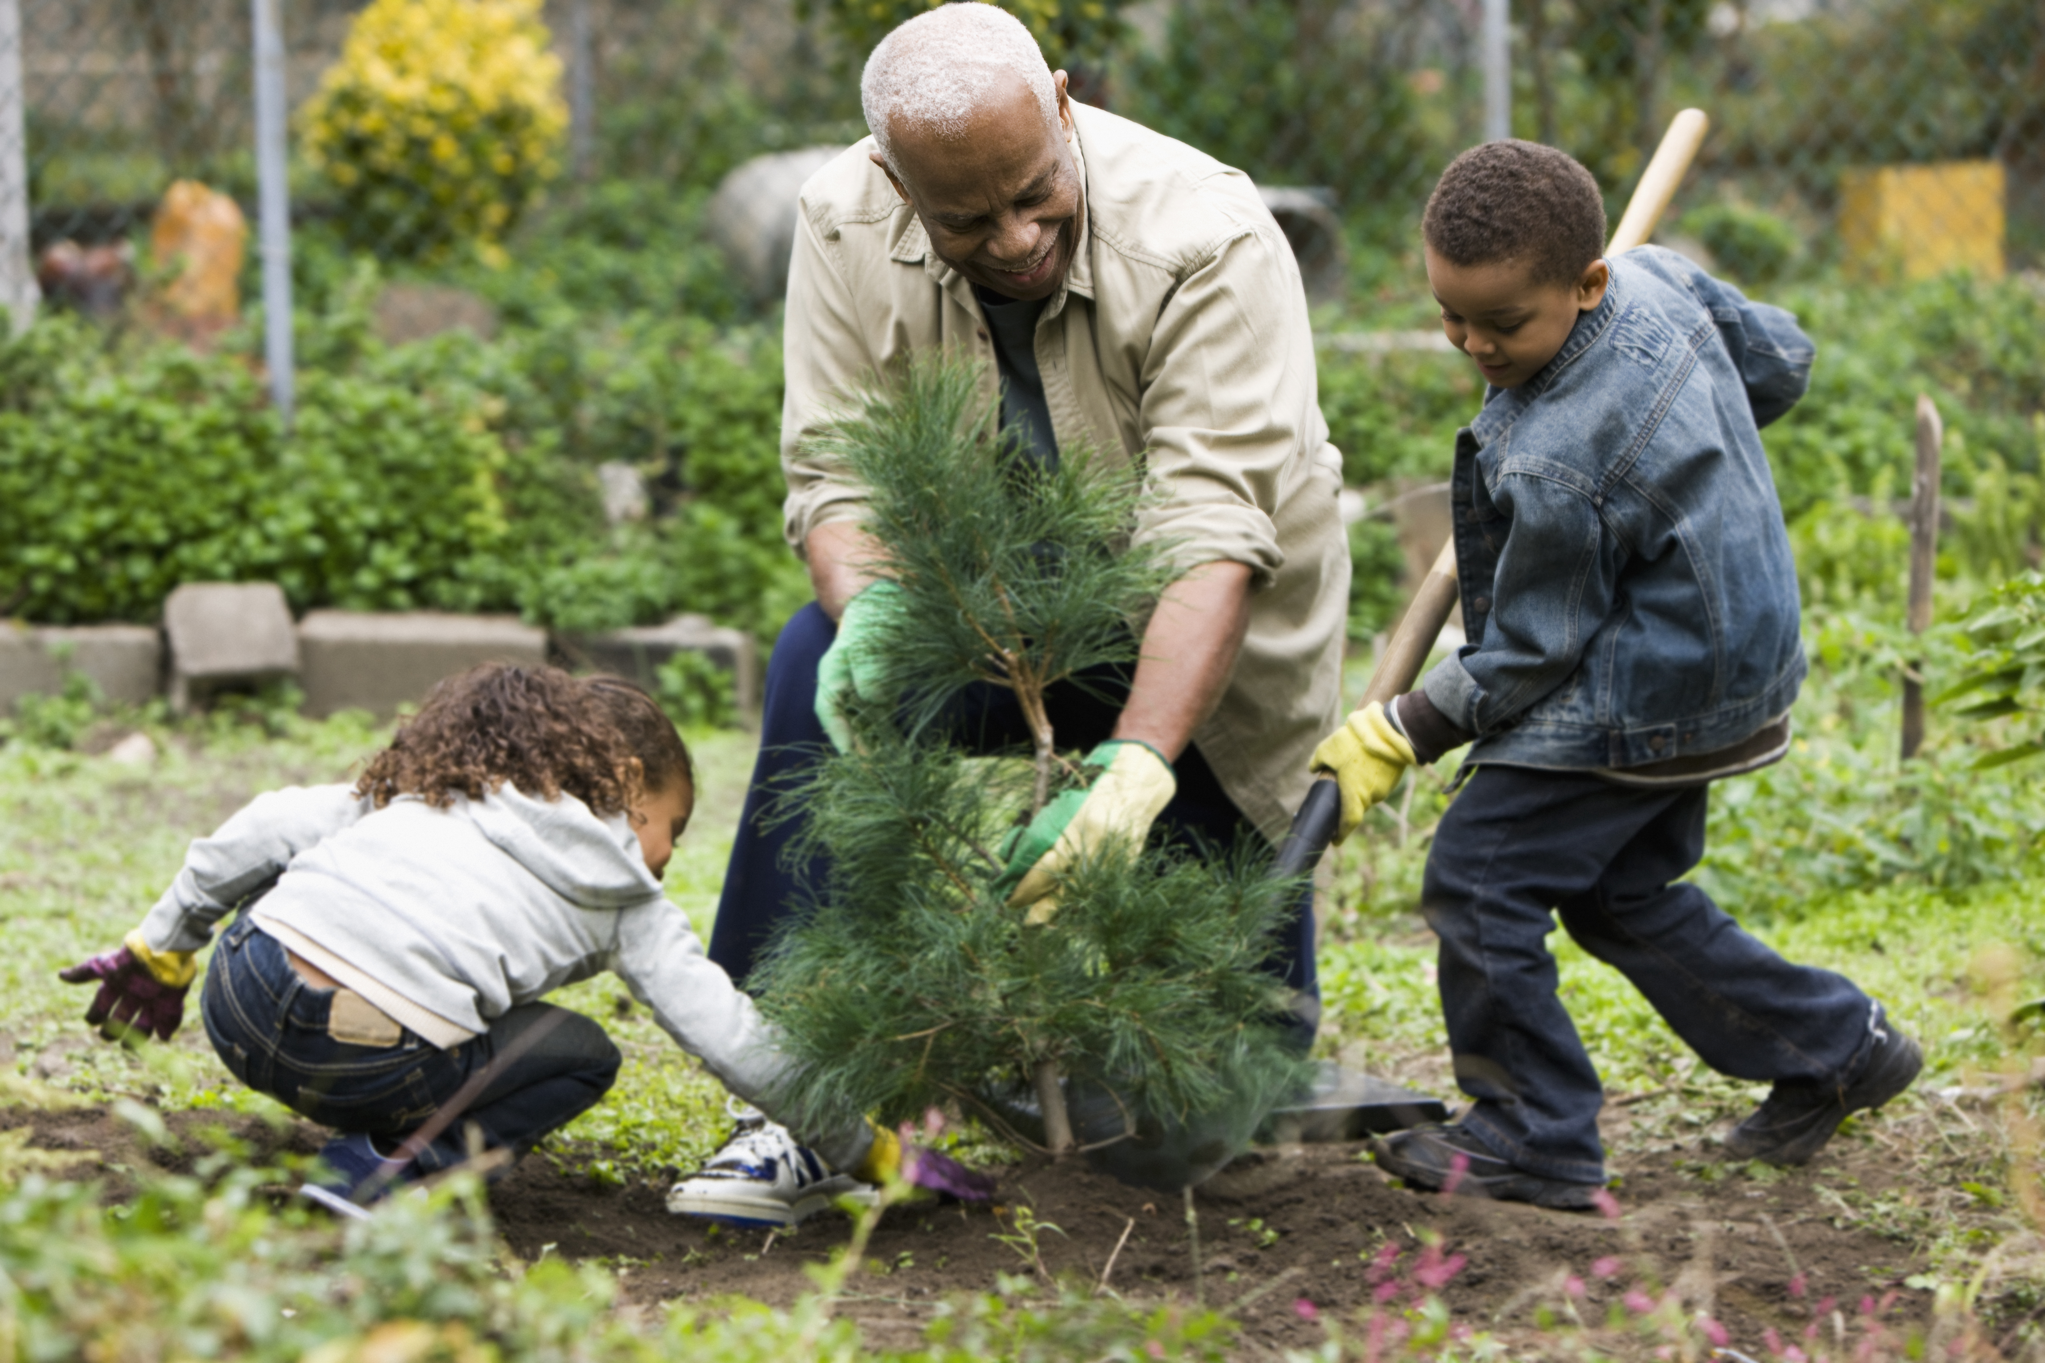
New vocabulary
Community a group of people living together and sharing the same place
Tamp pack or ram something down

Slide 5
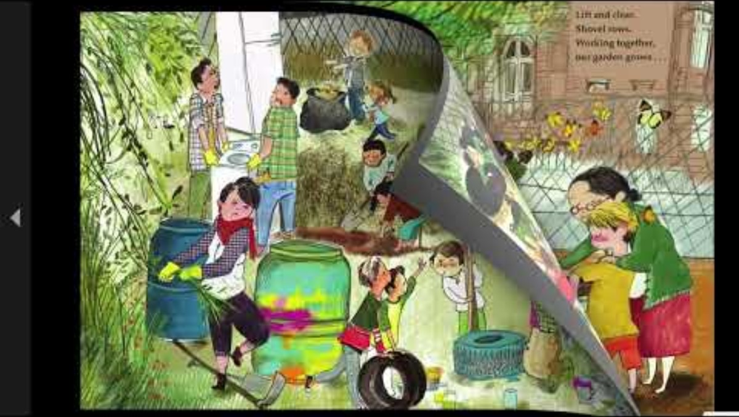
Green, Green: A Community Garden Story

Slide 6
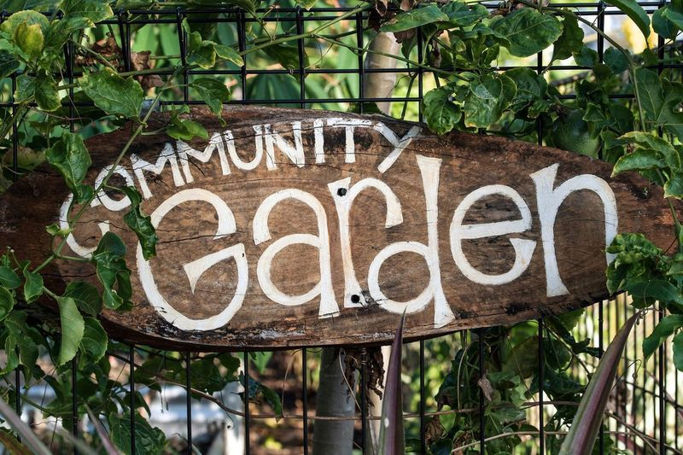
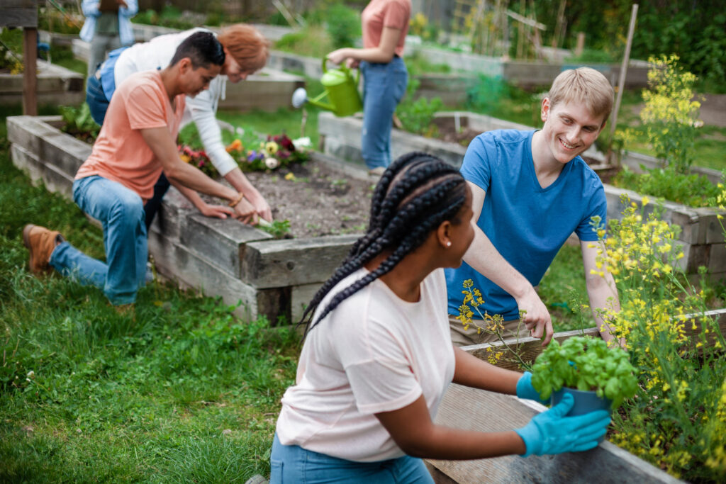
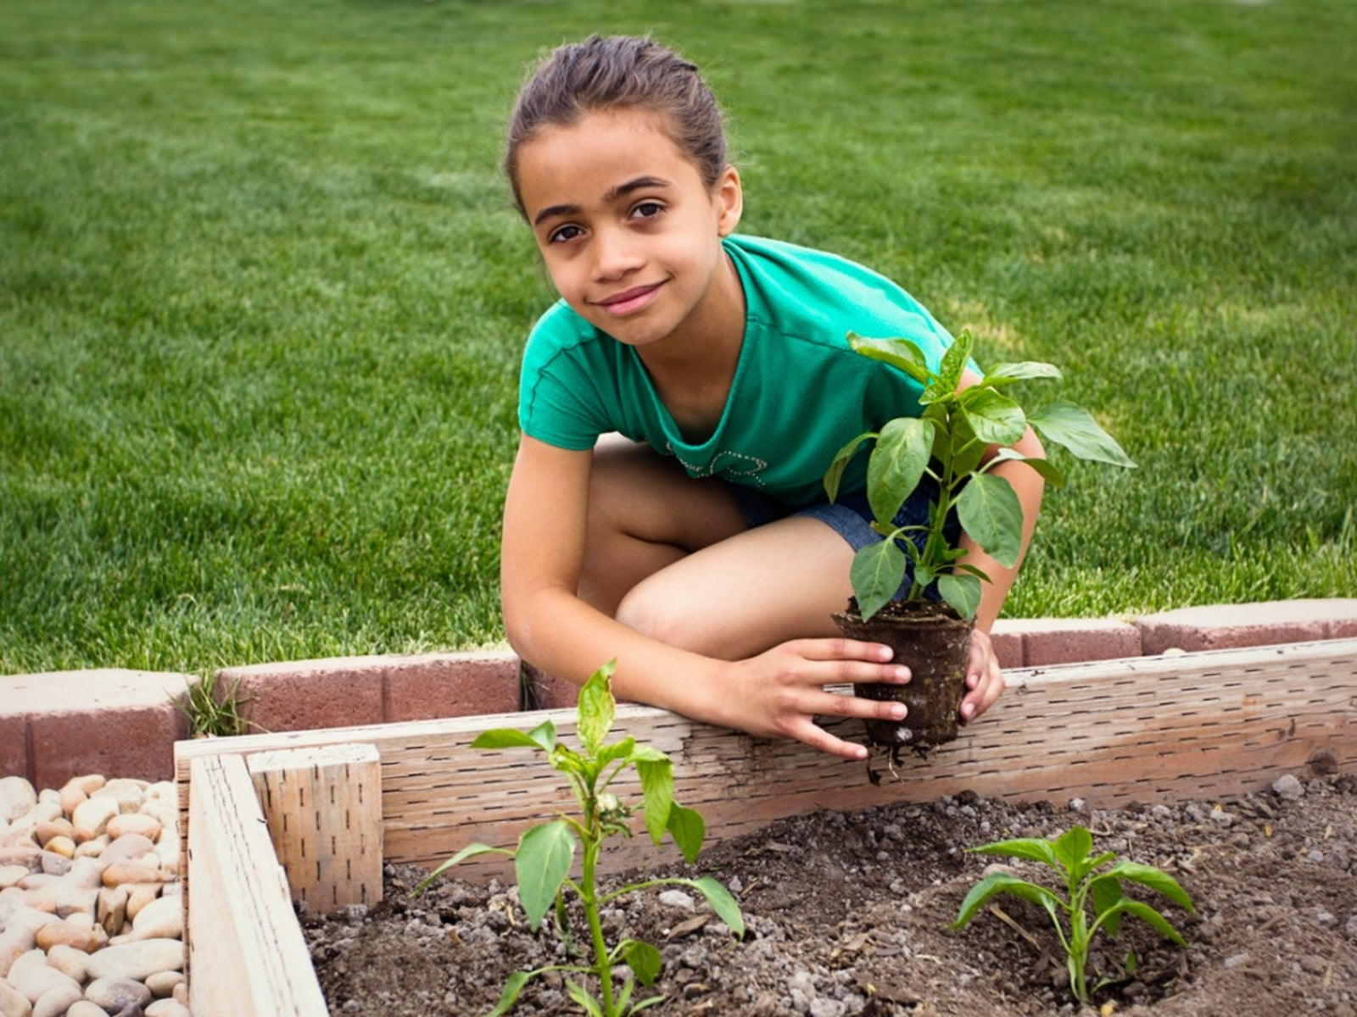
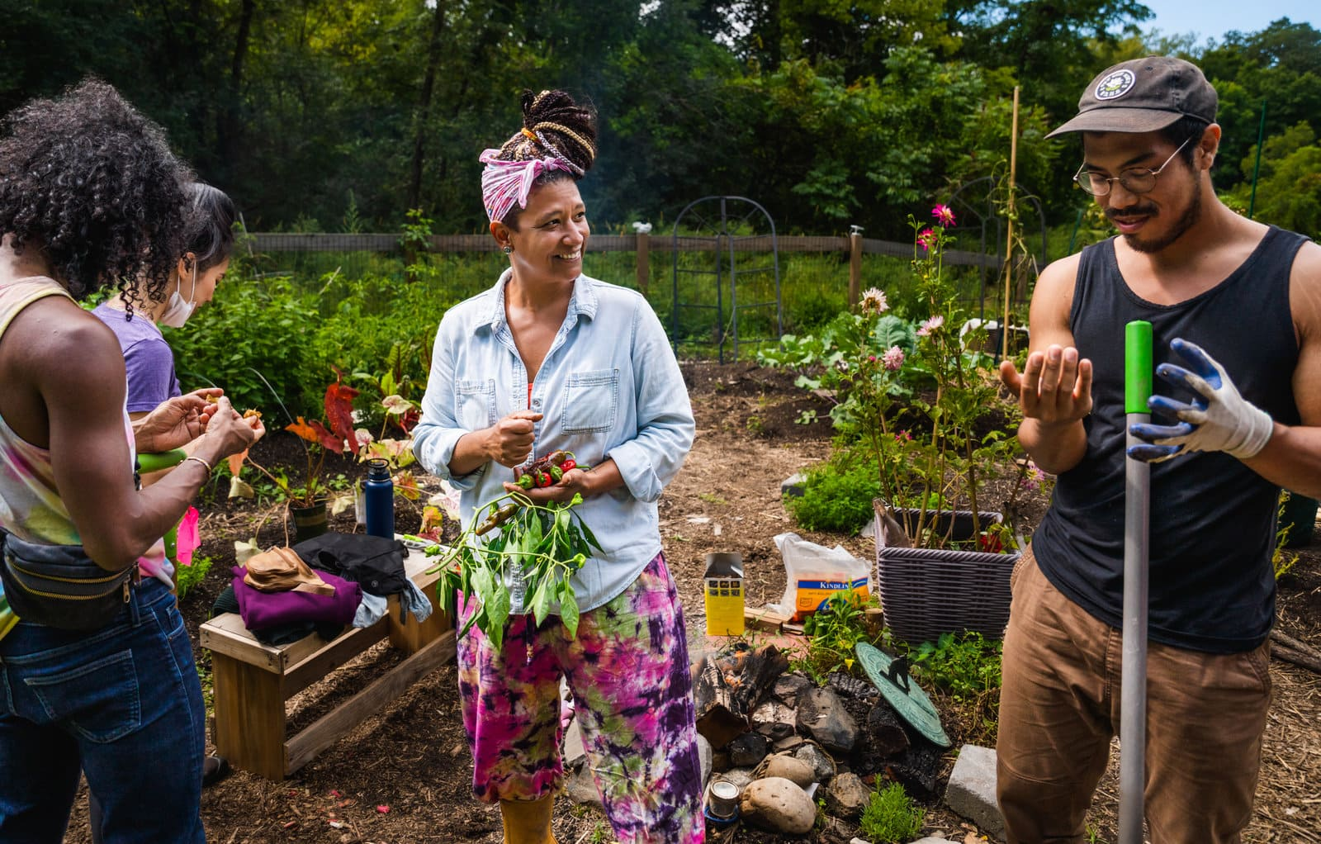
What does a community garden look like?

Slide 7
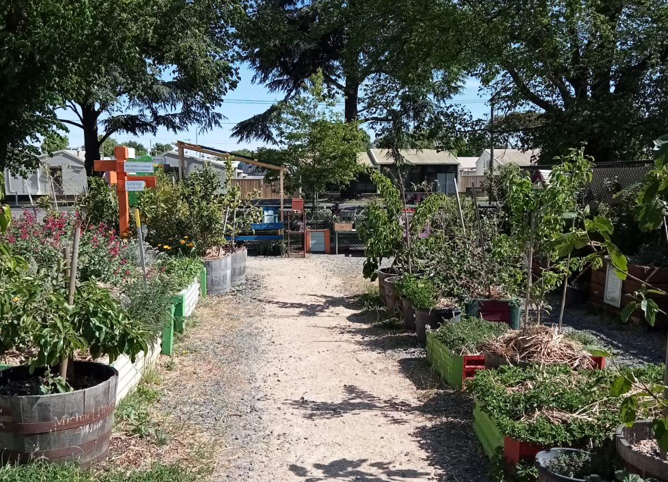
What would you find in a community garden?

Slide 8
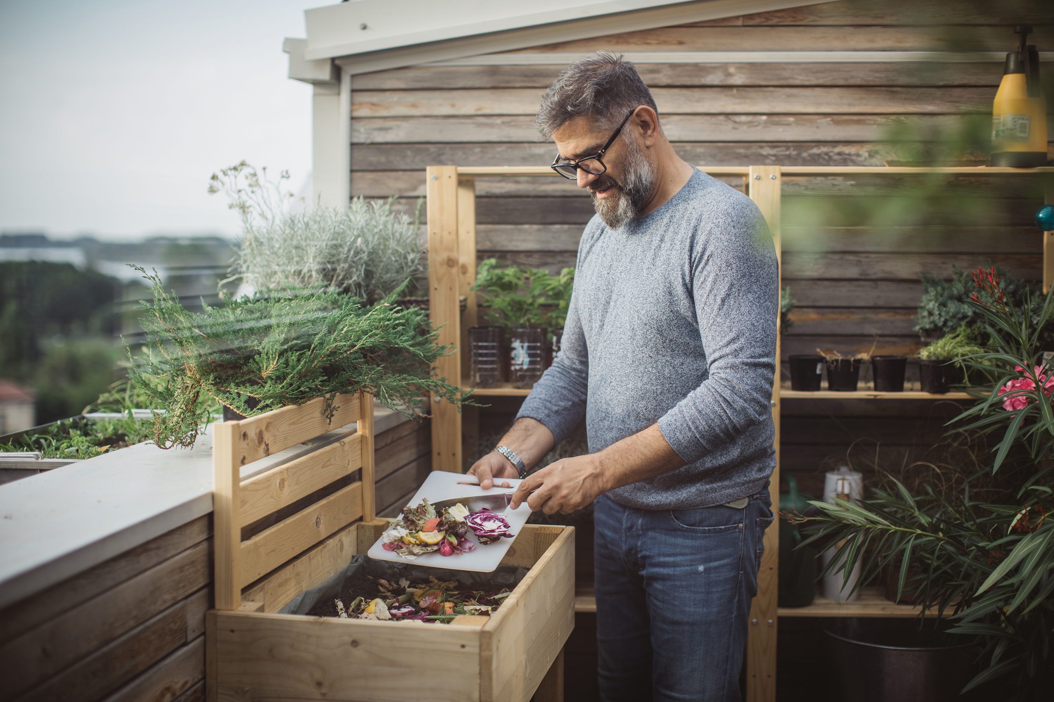
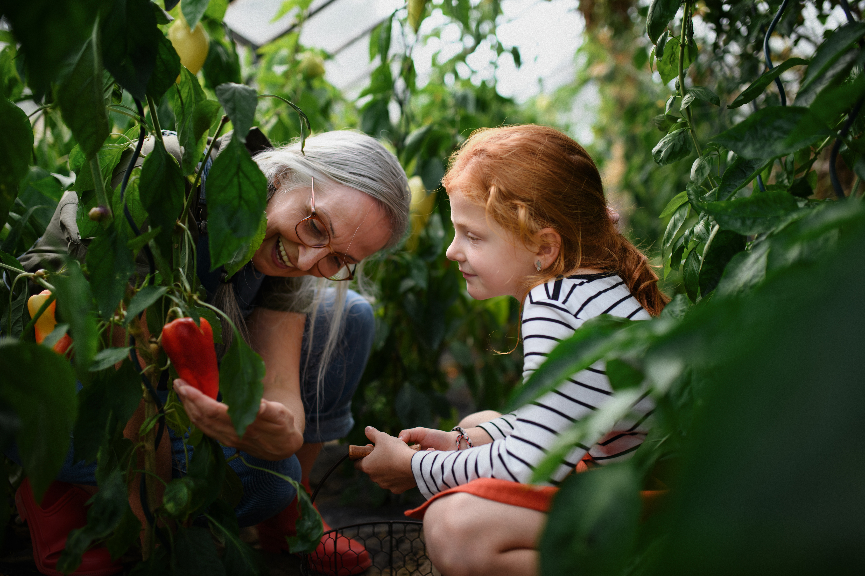
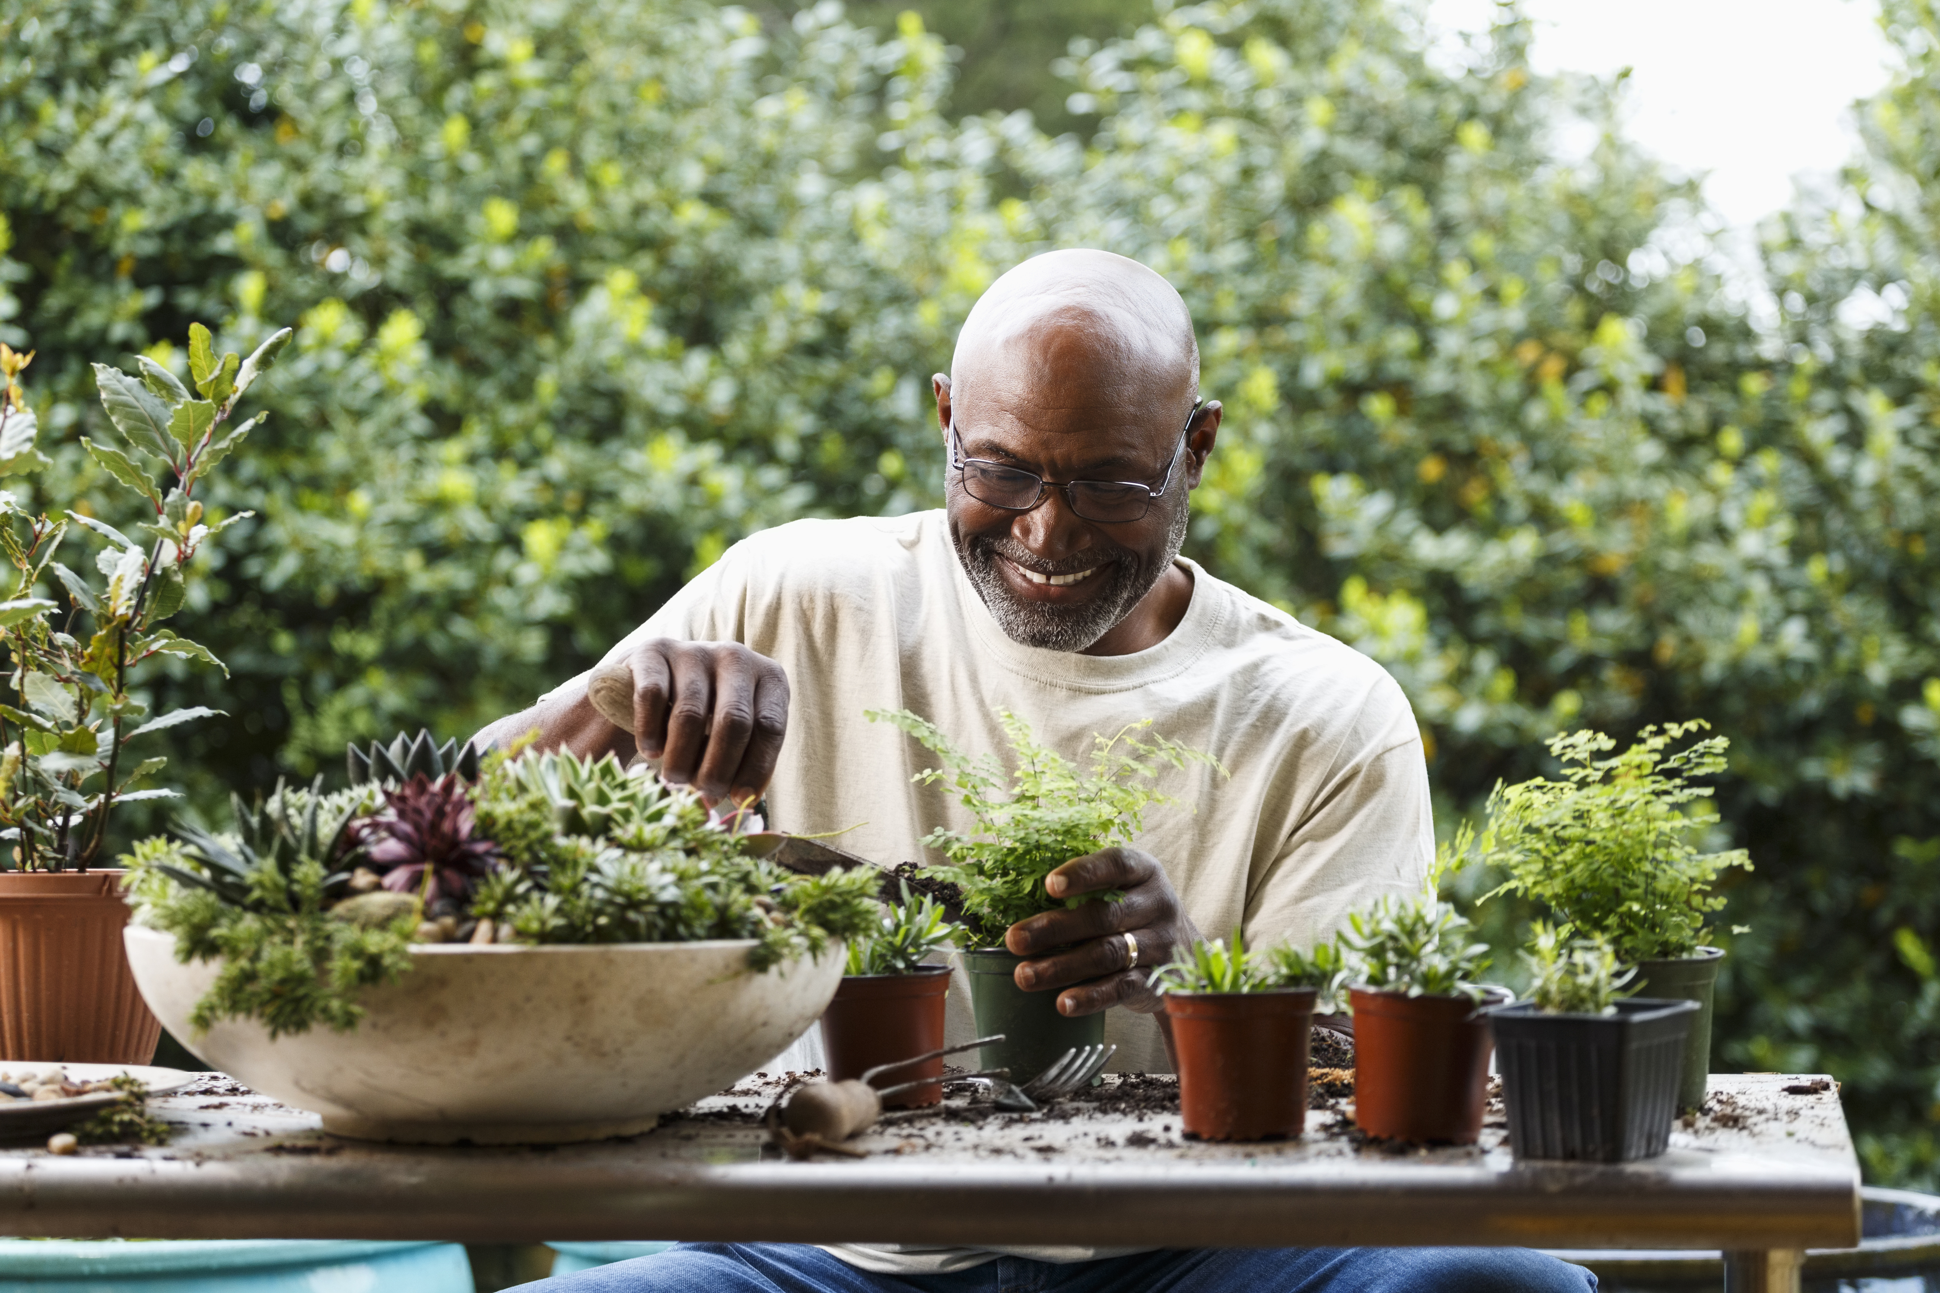
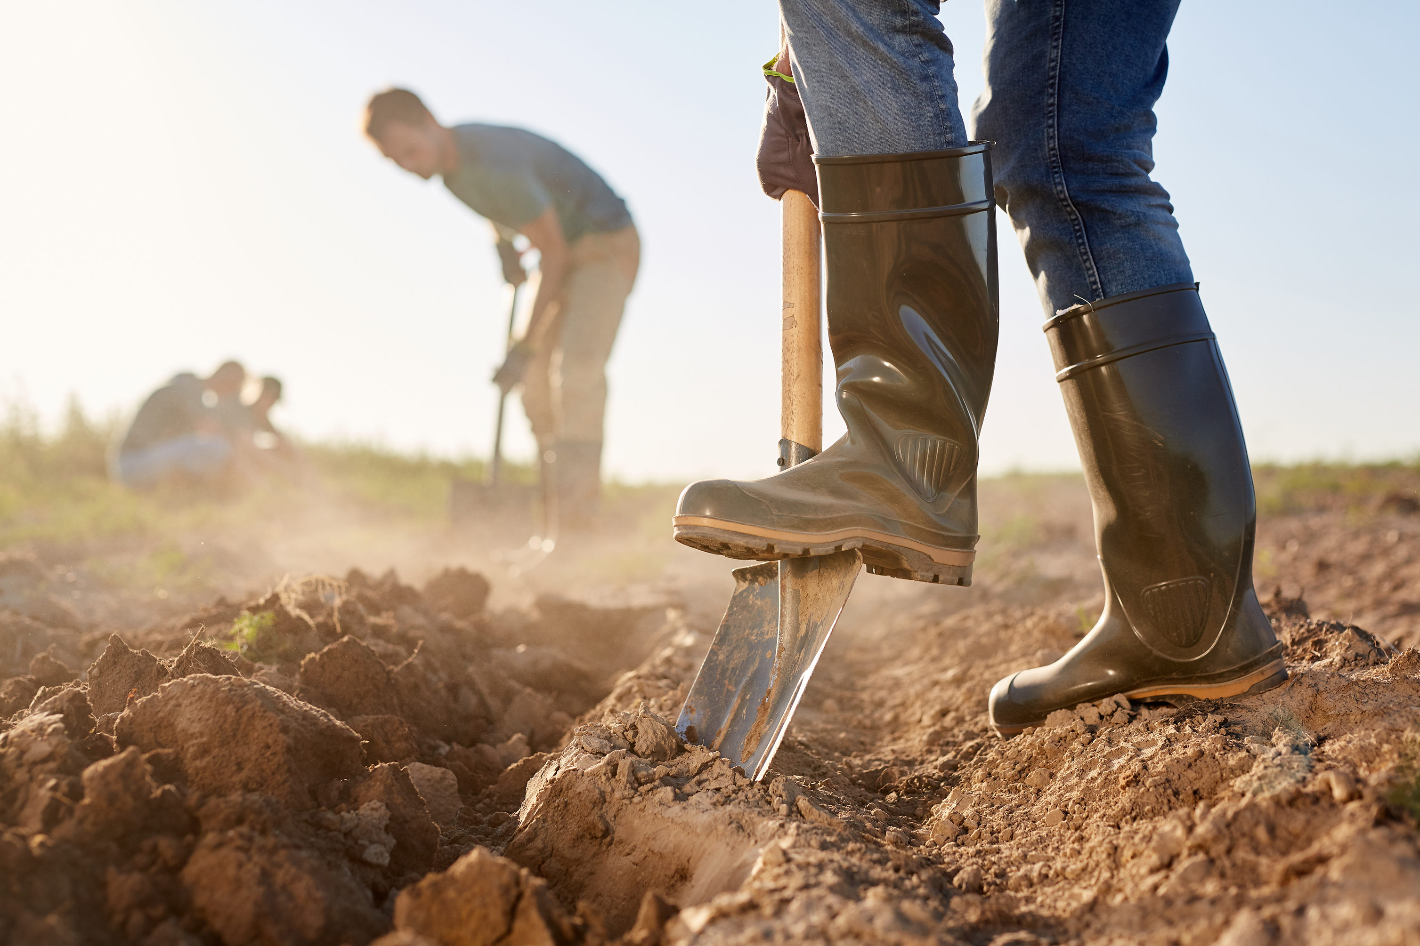
What do people do in a community garden?

Slide 9
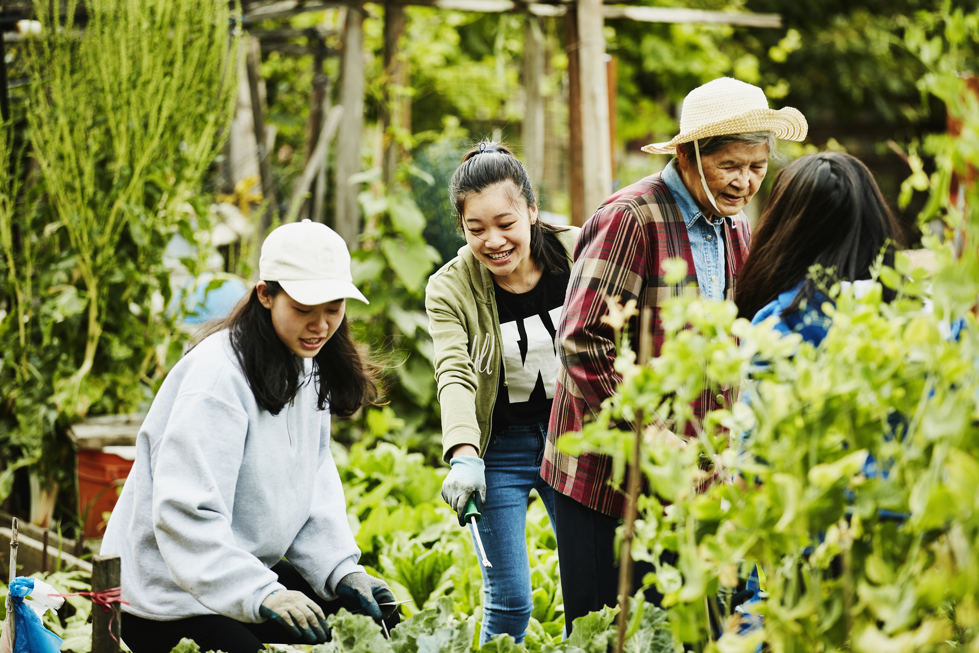
Benefits of community gardens
Improves our environment by making a healthier place
Beautifies the landscape
Provides food for the community
Adds to community green space
Encourages community members to take an interest in where their food comes from
Encourages community members to try different types of foods
Creates a happy environment for people to gather in
What can you add to this list?

Slide 10
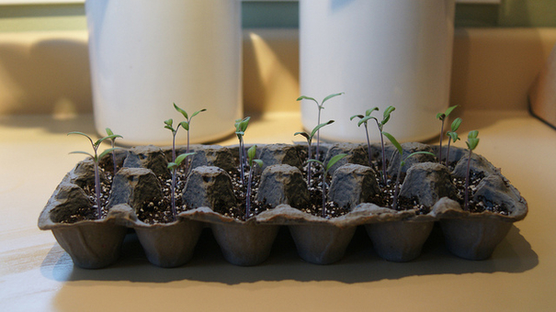
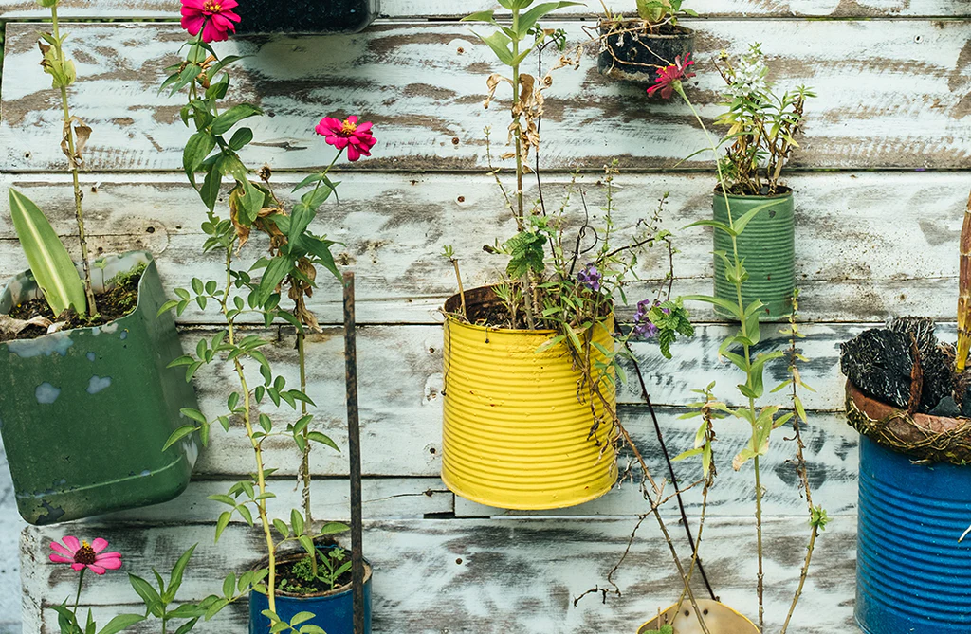
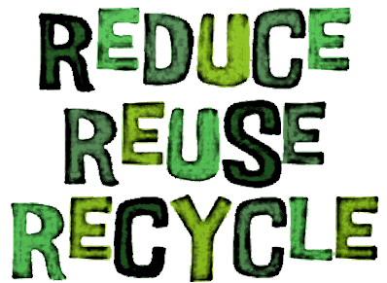
What can you do? What would you need to start a school community garden?
Get creative and re-use things whenever you can!

Slide 11
Our school community garden
Our school community garden will be important because
_________________________________________________.
In our school community garden, there will be _____________
_________________________ and __________________________.
To create our garden, we will need ______________________________ ,
________________________ and __________________________.
Draw a picture of what your school community garden will look like.

Slide 12
Extension tasks
Imagine a day in the life of a garden inhabitant. Have students observe and then create their play around the everyday happenings of an animal or a plant in their garden. Follow a butterfly or bee as it visits different flowers. Create commentary or dialogue for a patch of sunflowers turning their heads as the sun moves through the sky. Imitate a group of ants as they search for food.
Recreate a garden-based phenomenon. Nature is full of significant events that keep our world turning. Bring a scientific phenomenon to life through characters and an entertaining story. Act out the life cycle of a plant from seed to seed or the adventures of a pollinator looking for its next meal. Share the story of a drop of water as it moves through the environment.

Slide 13
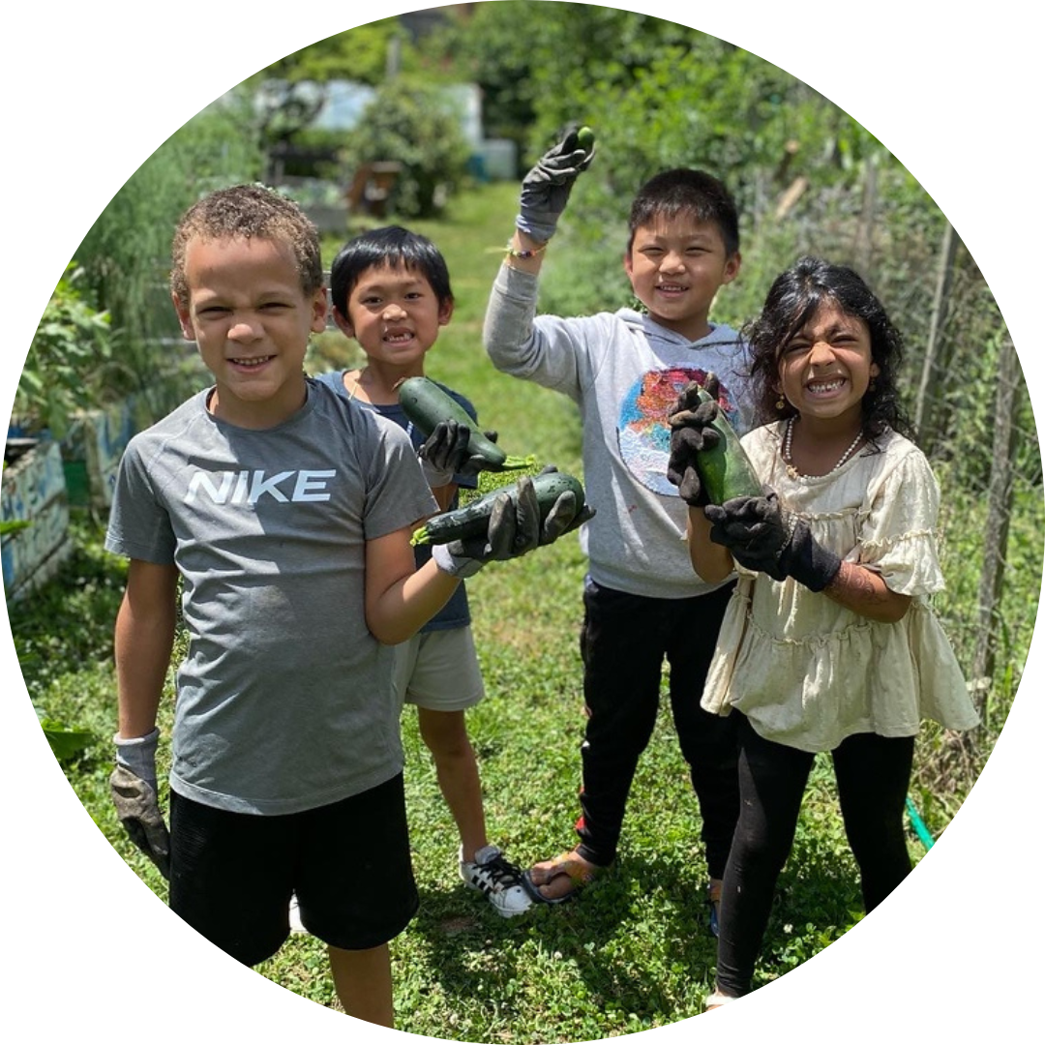

Starting a School Garden Program: Overview
Top Ten Tips for Gardening with Kids

