Slide 1

Growing Plants For Food
In this lesson, we are going to read a story about growing plants for food in a school garden. We are going to learn about how plants grow and what we need to do to help them.
Then you are going to draw and write about what you would like to grow.

Slide 2
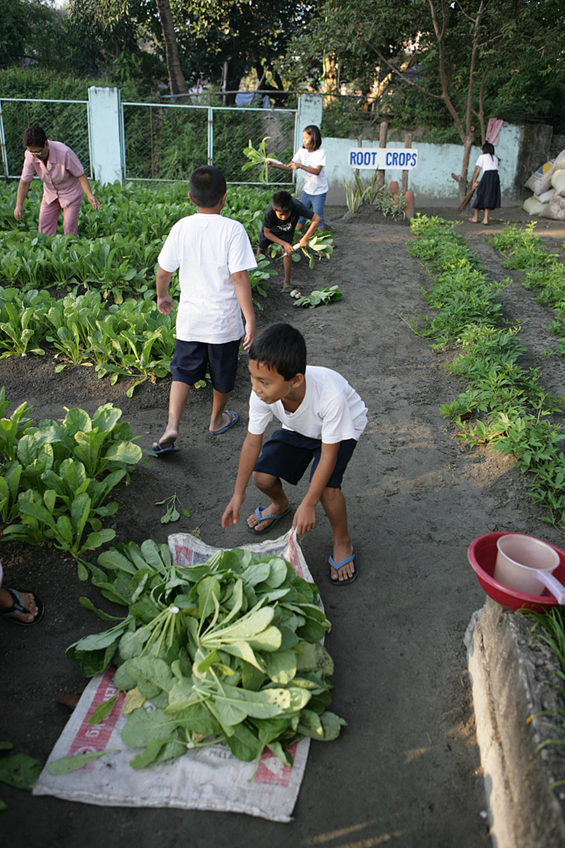
Why gardens are good for us
Gardens give us shade, food and fresh air.
They help the environment by keeping moisture in the soil and giving creatures a place to live.
We can grow food in gardens.
Gardens are a peaceful place to work and think.

Slide 3
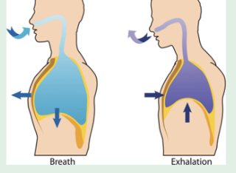
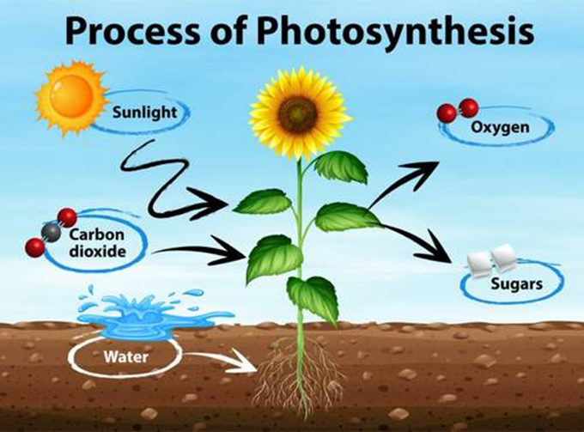
Plants clean the air for us
We breathe in oxygen and we breathe out carbon dioxide
Plants breathe out oxygen and they breathe in carbon dioxide

Slide 4
Learning Intentions
Listening – Students will listen to a story.
Writing – Students will write sentences about what they have learned.
Reading – Students will read their sentences to an audience.
Speaking – Students will present their work to an audience.
Science – Students will develop an understanding of how plants grow.
-- Students will learn about what they can do to help their plants grow.

Slide 5
New Vocabulary
Germination-
Seed- a tiny, baby plant in a protective shell. A seed needs to be in soil to grow into a big plant
Seedling: a tiny, new plant that has just grown from a seed
Sprout- a little shoot growing out of a seed or of a plant
Soil- the special material on the top layer of the earth that seeds and plants grow in
Nutrient-
Root- the part of the plant that is hidden in the soil. It holds the plant firmly in the ground and takes water and food from the soil.
To plant- put a seed or baby plant into soil so it can grow
Weed- unwanted plant in a garden
Harvest- pick or collect food from the plant when it is ready to eat

Slide 6
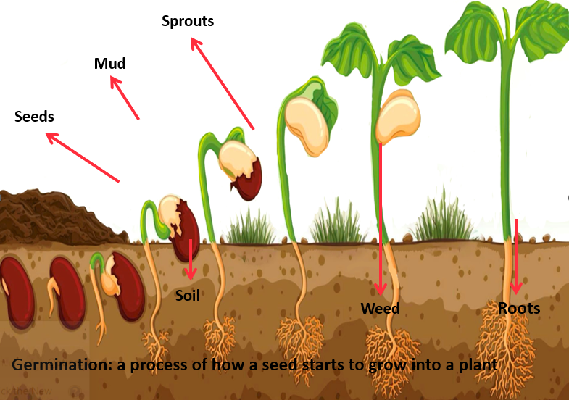
How do plants grow from seeds?

Slide 7
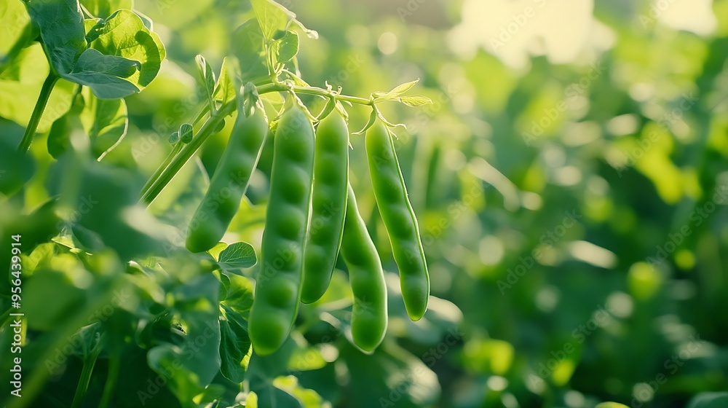
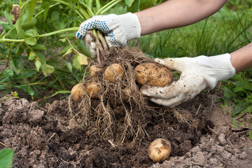
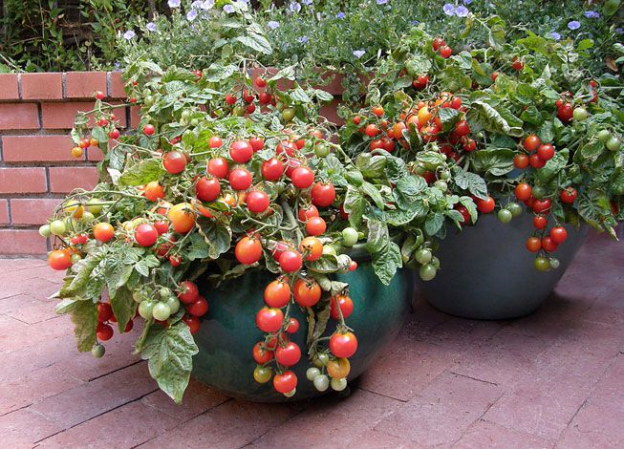
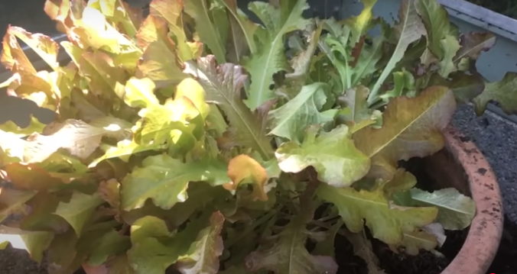
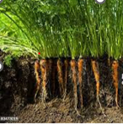
New Vocabulary: Vegetables
Peas
Potato
Spinach
Squash
Radish
Tomato
Lettuce
Carrot

Slide 8
Sylvia's Spinach
We will read a story about a girl called Sylvia and what happened when she grew food in her school garden.
Author: Katherine Prior
Illustrator: Anna Ruff
https://www.youtube.com/watch?v=BwG70NBDGv0

Slide 9
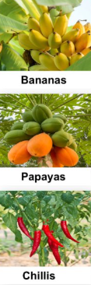
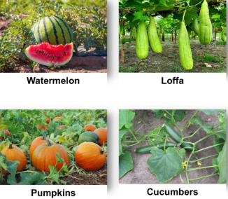
What food can you grow in your garden?
Think about what foods you know grow locally in your area.
They may grow well because they are suited to the weather and soil conditions.

Slide 10
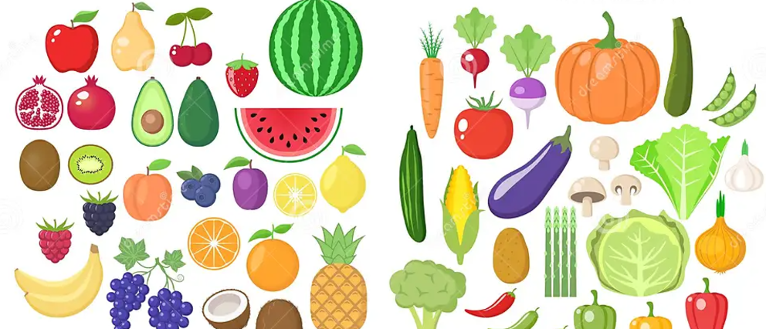
Why do we need to eat fruit and vegetables?
Fruits and vegetables contain important vitamins, minerals, chemicals and fibre. We need these substances for our bodies to grow and stay healthy. They protect our bodies form illness and help our bodies mend after injury.
Fruit and vegetables have many flavours and textures that make our food interesting and fun to eat.
Notes:
https://www.vsgp.org.au/about-2/the-importance-of-school-gardens/

Slide 11
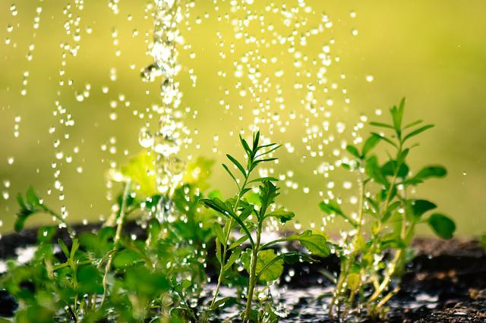
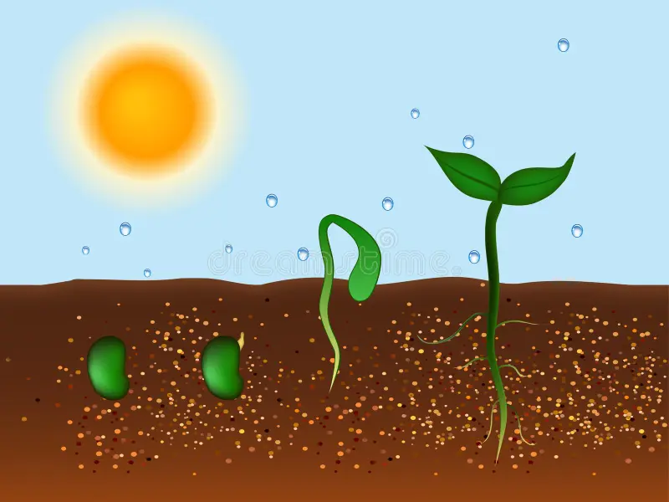
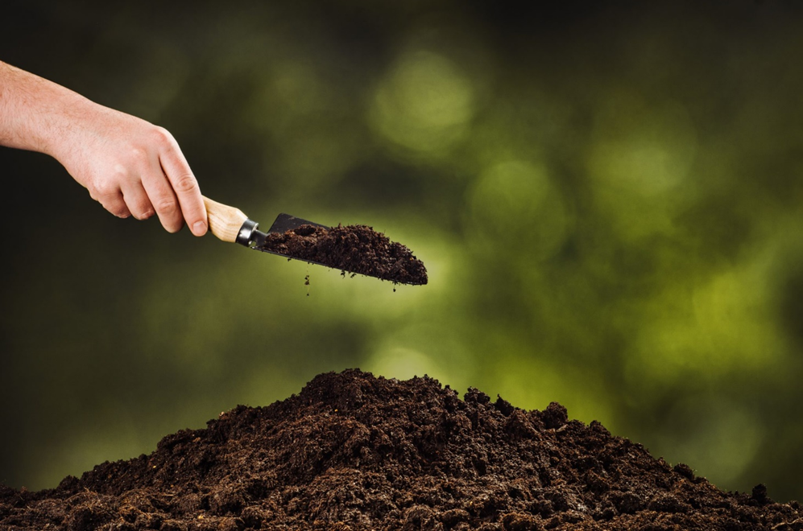
What do plants need to help them grow to be strong and healthy?
Water
Sunshine gives the plant energy to grow its roots, stems, leaves and fruit or vegetable.
Water is necessary for all living things
Sunshine
Soil
Soil contains nutrients and water for the plant to drink and feed.

Slide 12
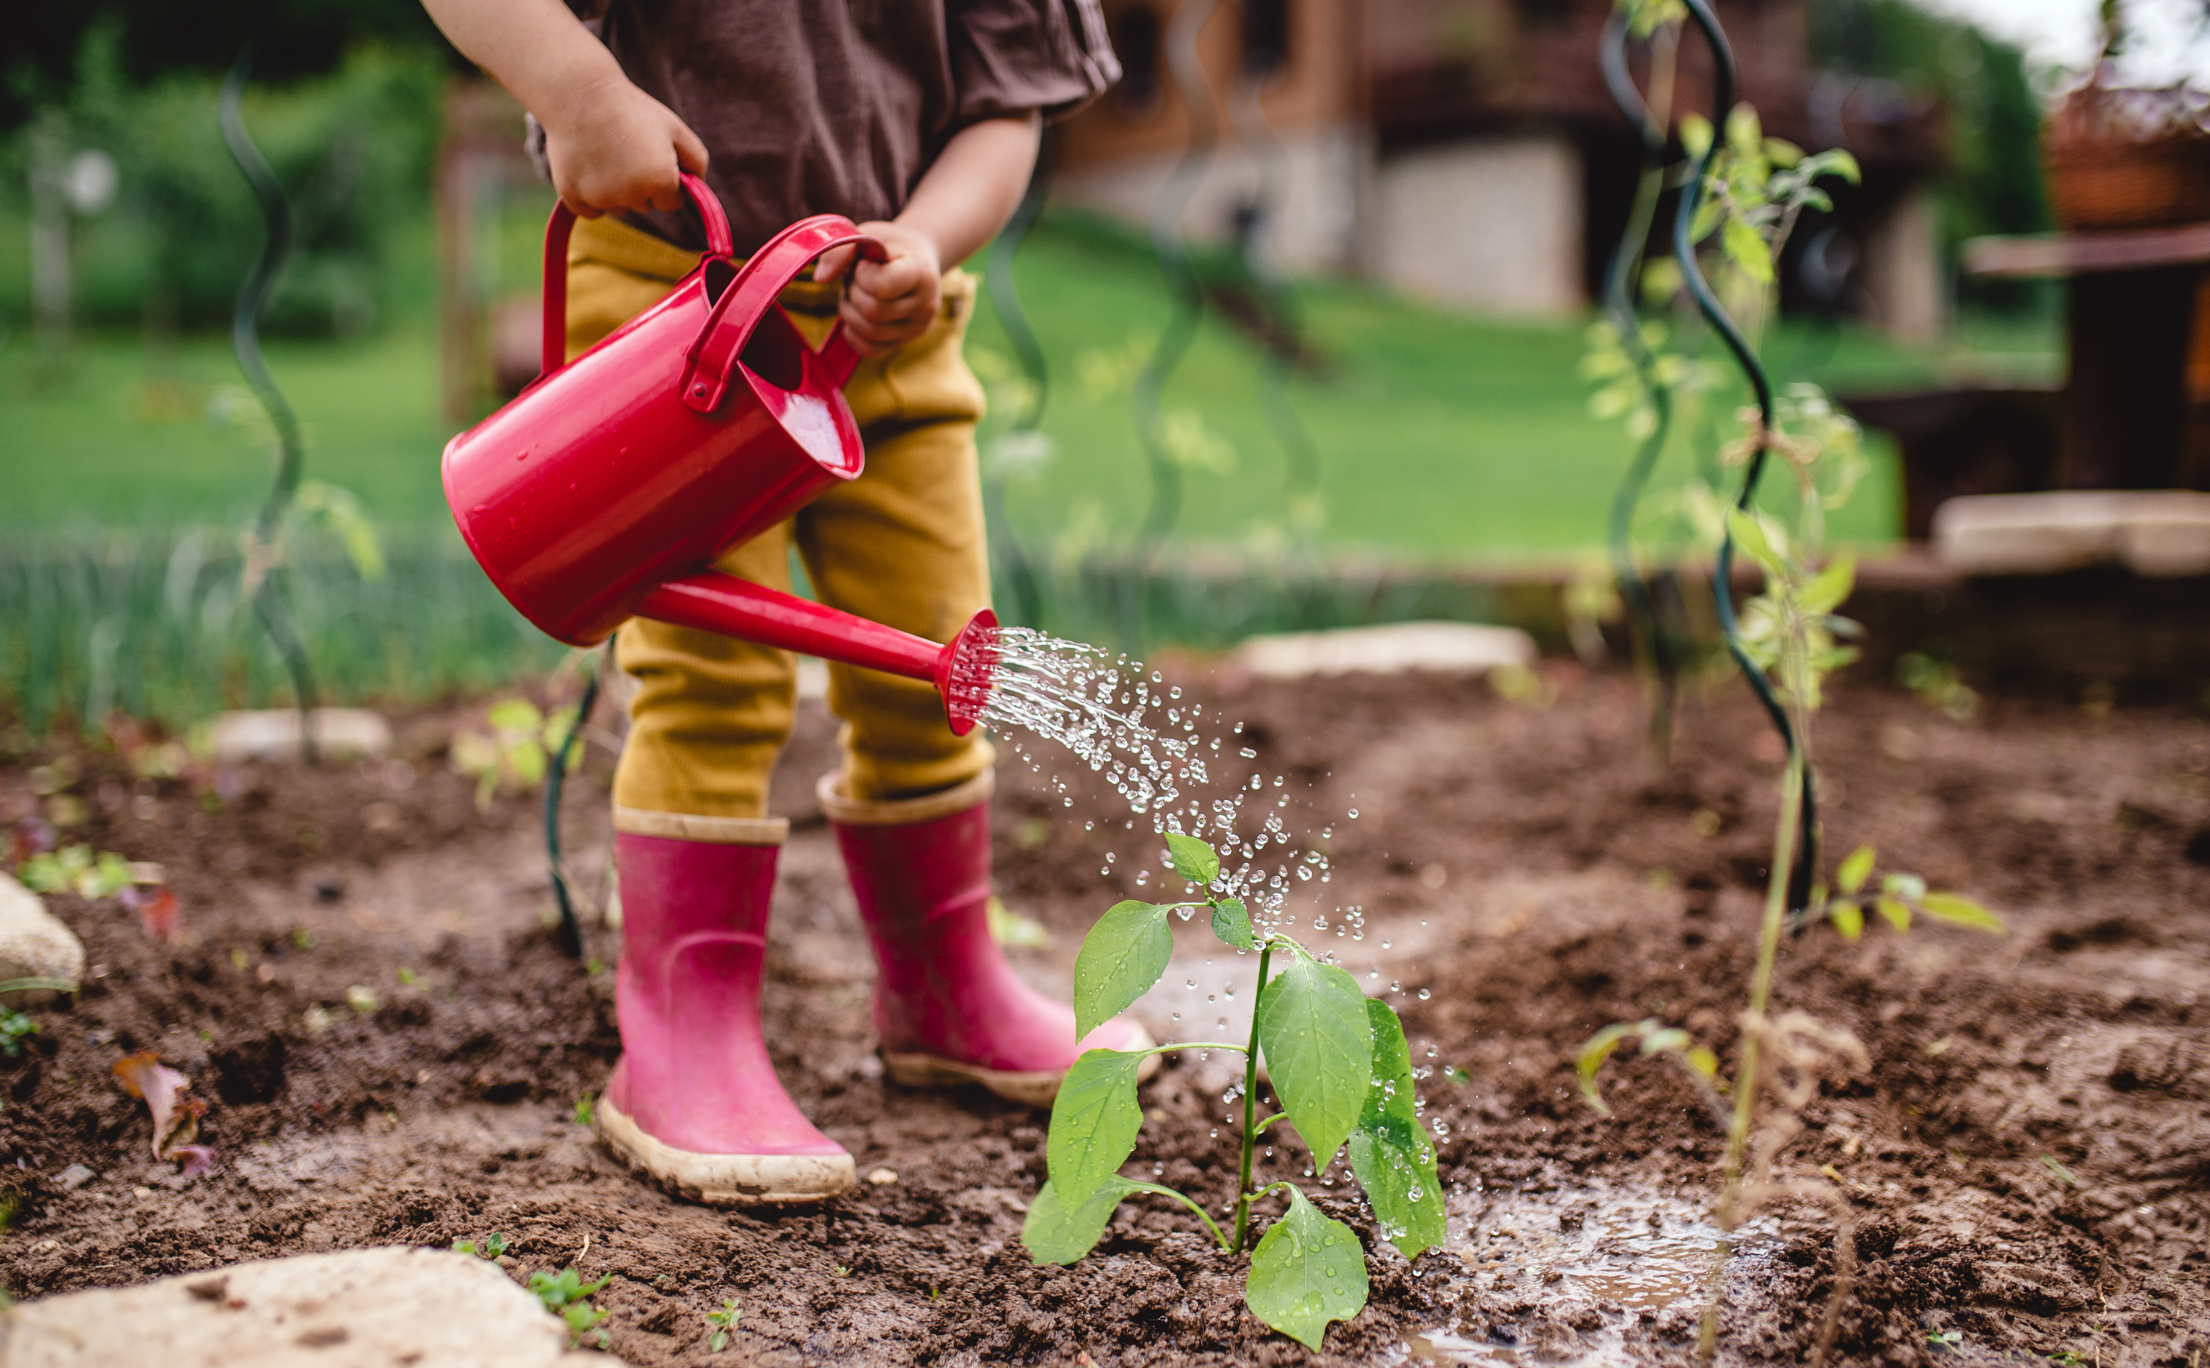
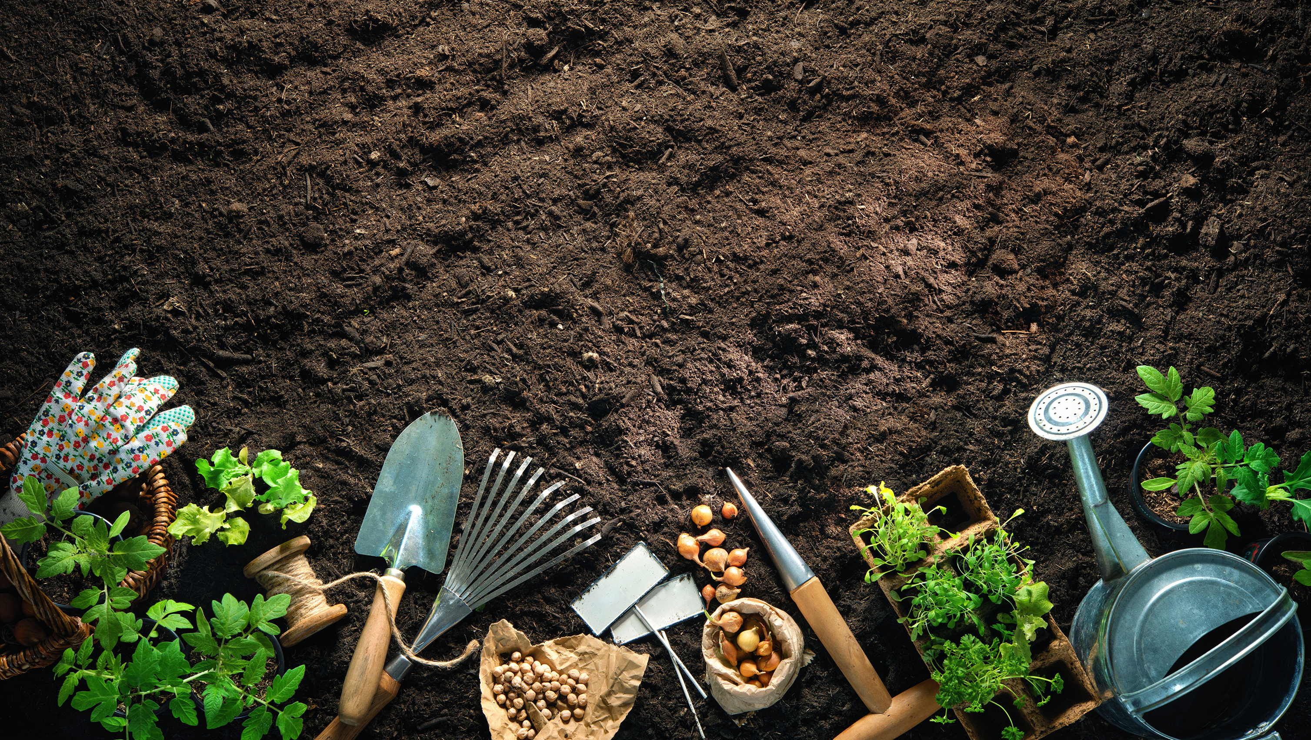
What can you do to help your plants grow?

Slide 13
What do you need to care for your plants?

Slide 14
What food plants will you grow in your school garden?
1.Write your name clearly at the top.
2.Decide what food you would like to grow in your school garden and how you will help your food to grow.
3. Draw a picture showing what food you will grow and how you will help it to grow.
4. Write a few sentences about growing your food and what you will do to help it.
__________________________________________________________________________________________________________________________________________________________________________________________________________________

Slide 15
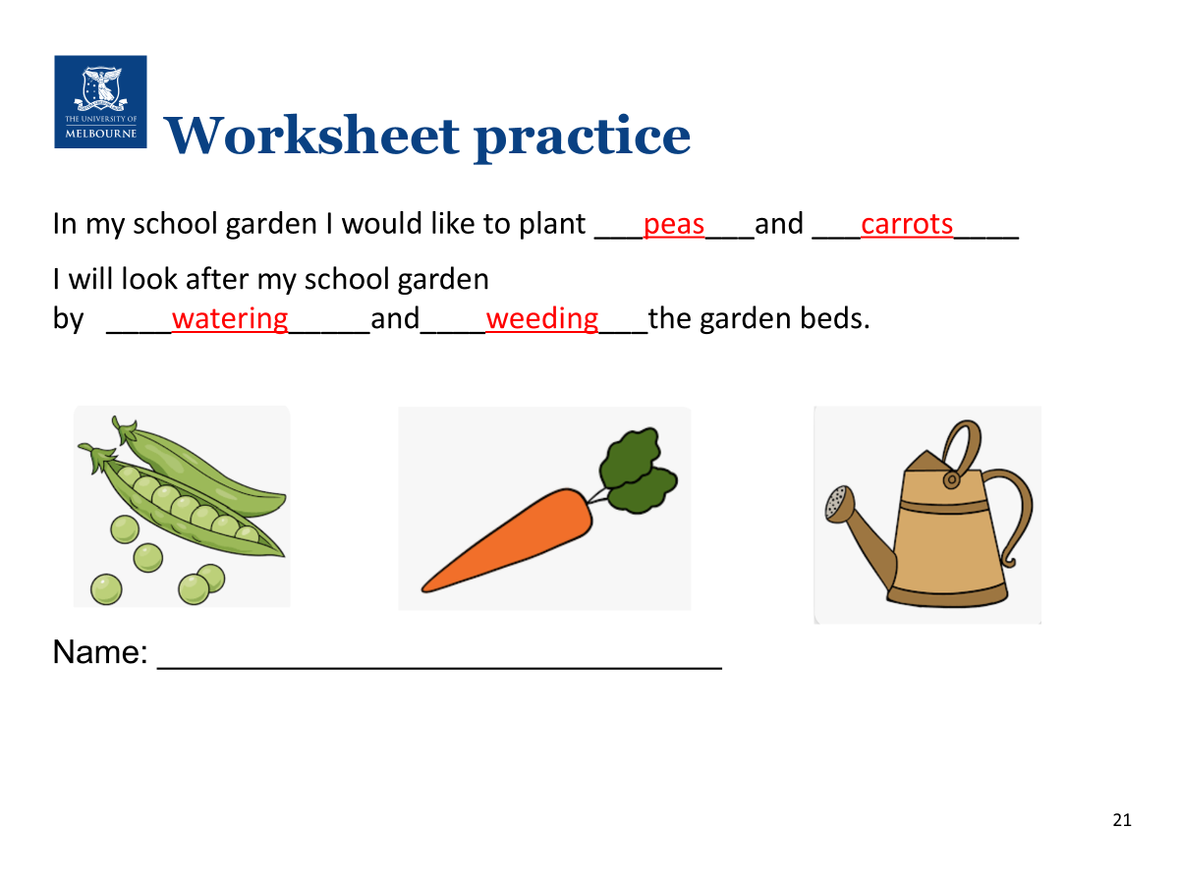

Slide 16
